Slide 1
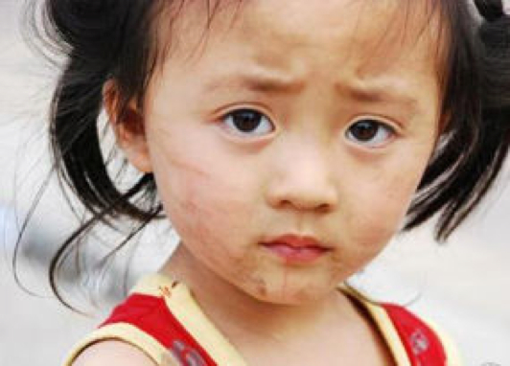
Why is Mai Ling an unhappy little girl?
Notes:
This is a mystery about Mai Ling, a little girl in China.
China is an LEDC (Less economically developed country), although it’s economy is growing at a fast rate.
This mystery investigates China’s strategies for coping with a large and growing population and how it affects the people.
Main themes that come out are that she is an only child, there are laws and incentives for families to have only one child. Boys are preferred to girls because boys do not leave home and will therefore look after the parents into old age. Because of this, the pressures on her to succeed are immense. This is having a profound impact on Mai Ling.
RED/AMBER/GREEN corners. Students to spot where people are in the group and target support.

Slide 2
In your opinion, how fair is China’s One Child Policy?
Very unfair
Positives and negatives
Very fair
Notes:
Students stand on the opinion line
2

