Slide 1
Why do rivers flood?

Slide 2
Starter
http://cgz.e2bn.net/e2bn/leas/c99/schools/cgz/accounts/staff/rchambers/GeoBytes/Content%20Generator%20Quizzes/Penalty%20Shoot%20Out/Year%2010%20Hydrological%20Cycle/Year%2010%20Hydrological%20Cycle/Hydrological%20Cycle_penalty.html

Slide 3
Learning objective
You will learn:
Why flooding occurs – the natural causes and the ways in which people make it worse
Where the floods have occurred in the UK
How the frequency of flooding seems to be increasing

Slide 4
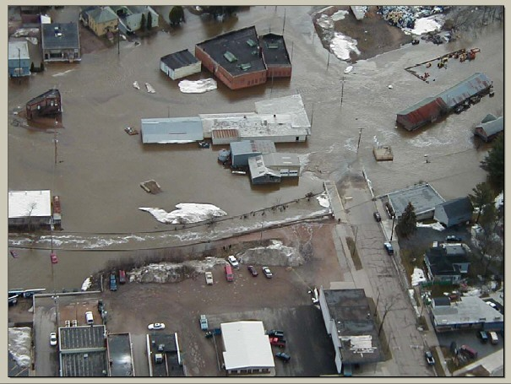
Floods
These occur when a river carries so much water that it cannot be contained by its banks and so it overflows onto-surrounding land – its floodplain.

Slide 5
Look at the following statements about the factors which cause flooding or make flooding worse.
Match a cause with an explanation and then colour code physical factors one colour and human factors another colour.
Prolonged rain | Reduces interception by the trees and rates of transpiration back into the atmosphere; more rainwater reaches the surface quicker, thereby increasing rates of run-off.
Building on flood plains and increasing the size of urban areas | Long, continuous periods of rainfall, leading to saturated ground, as happened in many parts of the UK in 2000 and again in 2007-8.
Heavy Rain | Create impermeable surfaces so that more water runs off the surface. Rainwater falling on hard surfaces (buildings and roads) is led rapidly into underground drains and straight into rivers, with little chance of evaporation into the atmosphere or infiltration into the ground.
Snow melt | A cloudburst in a thunderstorm, which causes large amounts of run-off in a short time, as in Boscastle in 2004.
Deforestation | A sudden increase in temperature that rapidly melts snow and ice. In winter the water cannot seep into the ground because it is still frozen.

Slide 6
Task
Previous history of flooding in UK
1607 – great flood in Devon, Somerset and South Wales
March 1947 – York, Tewkesbury, Shrewsbury, Sheffield, Nottingham and London – rapid melting of snow
January 1953 – Suffolk, Kent and Essex – storm surge and high tides
1968 – great flood affected the counties in south-east England
Complete questions 1 on flooding in Sheffield and 2 on the frequency and location of flood events in the UK.

