Slide 1
Coasts
Lesson 4 – Coastal Management

Slide 2
Starter
You will get your exam question back form last lesson.
Have a look at how you did.
Look at where you and your peers picked up marks to see how you could have improved. (Use the green pens)
If you got full marks then there will still be ways that you can improve your answer. (Mr Pennington is a generous marker)

Slide 3
Lesson Objectives
We are learning to:
To develop an understanding of the different forms of coastal management;
Build an argument which identifies the issues being faced on a named stretch of coastline.
We are learning by:
Collaborating;
Empathising;
Justifying.

Slide 4
Coastal Management
What forms of coastal management can you think of?
Forms of Coastal Management

Slide 5
Task
You will be given a worksheet which states some methods of coastal management.
You need to research the row you have been allocated ready to speed-date.
Extension 1: Research, and add, one form of management which isn't on the sheet
Extension 2: Why are there so many different options?

Slide 6
Task – Speed Dating
In your groups we are going to do a quick speed-dating activity.
You will take turns to sell your form of coastal management to the group.

Slide 7
Lesson Objectives
We are learning to:
To develop an understanding of the different forms of coastal management;
Build an argument which identifies the issues being faced on a named stretch of coastline.
We are learning by:
Collaborating;
Empathising;
Justifying.

Slide 8
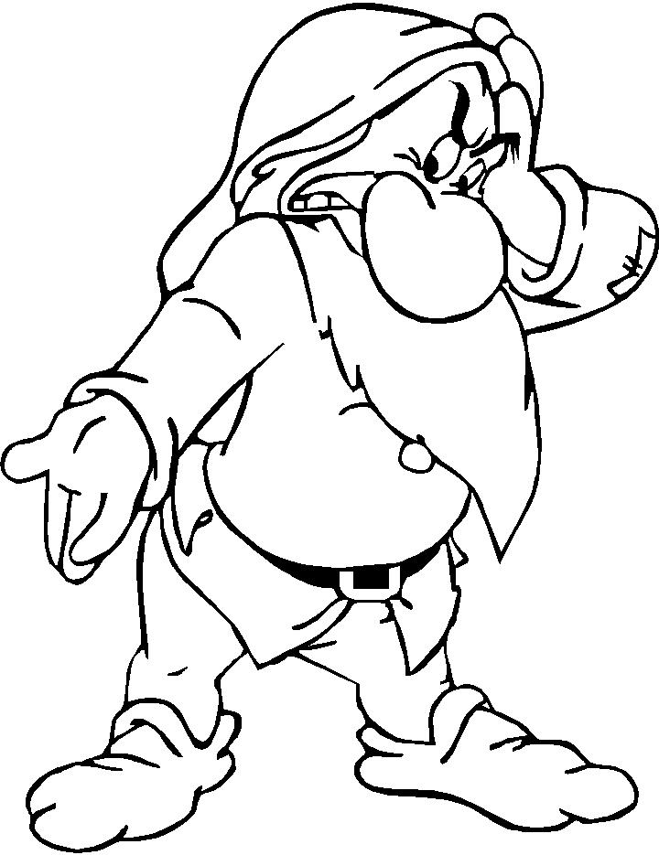
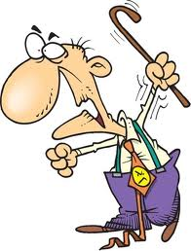
Task- Grumpy Old Men
Barton Vs West African Coast

Slide 9
Task – Grumpy old Men
Your task will be to research a stretch of coastline which you will be given.
You need to construct an argument which you will present to the other group
Explaining why your life is worse living where you are! And how they have got it easy.
You all need to be competent as you will be split up for the argument later.

Slide 10
Task – Grumpy old Men
Your Pack Will Include:
Two documents with information of your coastal area.
One document with the opposing piece of coastal area
A Sheet of connectives so you can use great language to formulate your argument.
You will also have access to the computers (There are loads of great videos on YouTube)

Slide 11
Debate Tennis
You will be paired with somebody of the opposing viewpoint to you.
You will get time to say an opening statement each before the tennis begins.
You now get to take turns in making points arguing why you have it worse!

Slide 12
Lesson Objectives
We are learning to:
To develop an understanding of the different forms of coastal management;
Build an argument which identifies the issues being faced on a named stretch of coastline.
We are learning by:
Collaborating;
Empathising;
Justifying.

Slide 13
Plenary
You need to write a paragraph which evaluates both sides of the argument.
If you do not complete this during the time allocated in class then you need to finish this at home and bring it to Fridays lesson.

Slide 14
Question
With reference to two named pieces of coastline evaluate whether rapid coastal erosion is worse in an LEDC or an MEDC.

Slide 15
Home Study
You will be given an exam question to do.
You may use your notes to answer the question.
Bring this next Wednesday ready to be marked.

