Slide 1
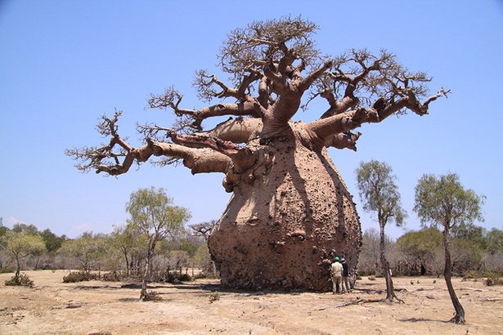
What is the value of the biosphere?
All: Know what the biosphere gives us
Most: Be able to explain why it is so important.
Some: To understand the interdependence between ecosystems and people.

Slide 2
A Baobab Tree
What is the value of this tree to us?

Slide 3
Wood
Fruit
Fuel
Medicine
Habitat
Tourism
Fibres
Water
Dye
Oxygen
Nutrients

Slide 4
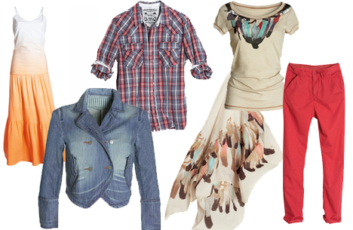
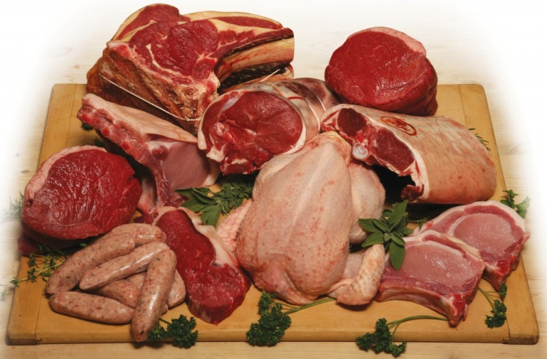
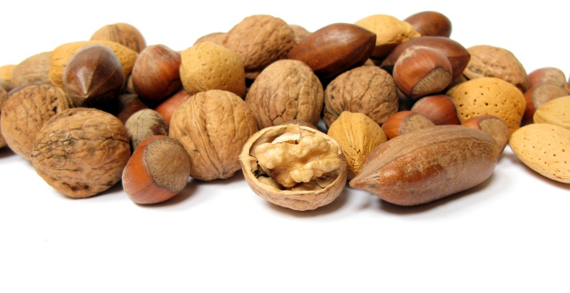
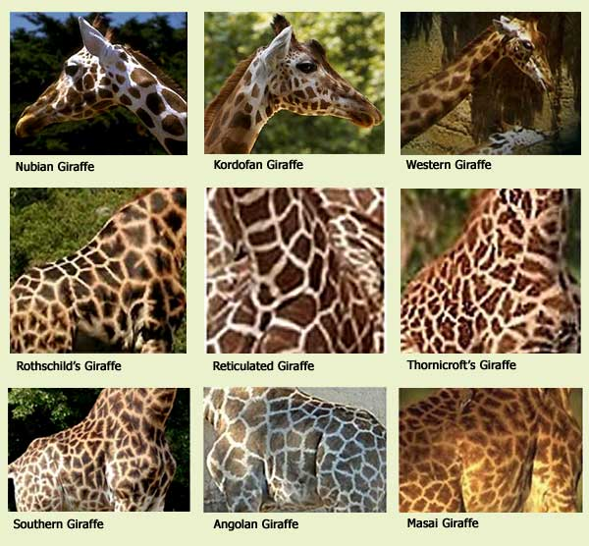
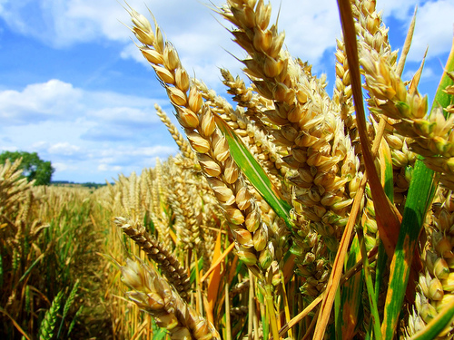
Goods = What does the biosphere give us?

Slide 5
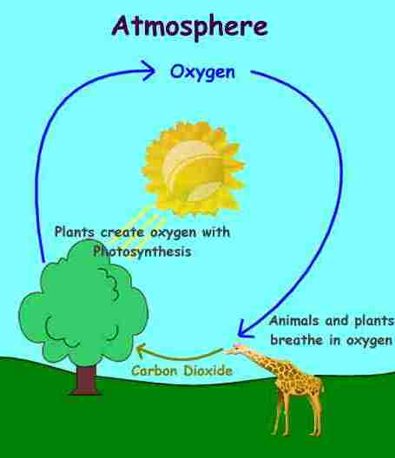
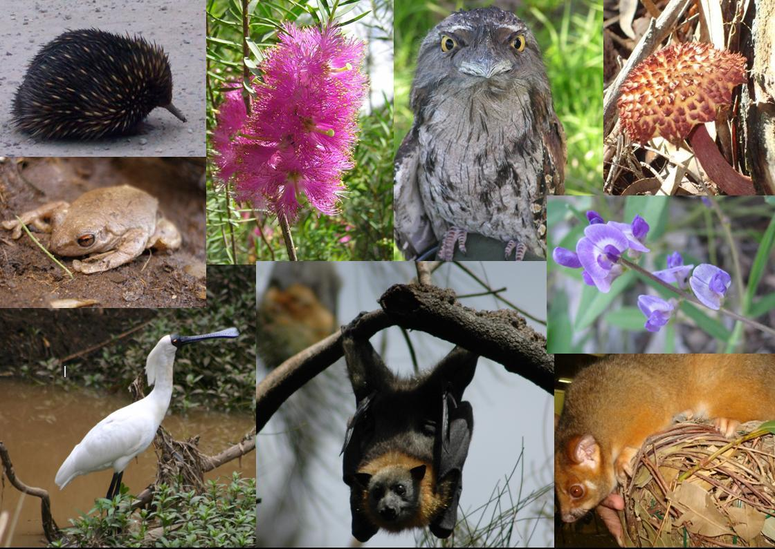
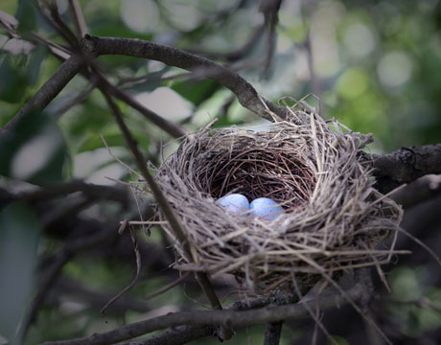
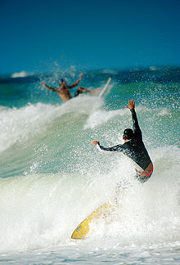
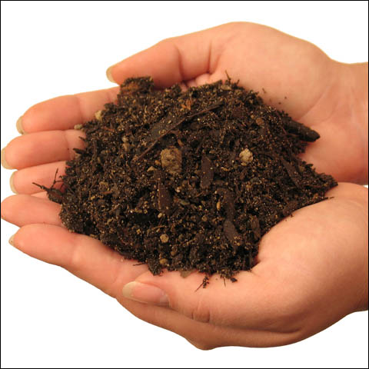
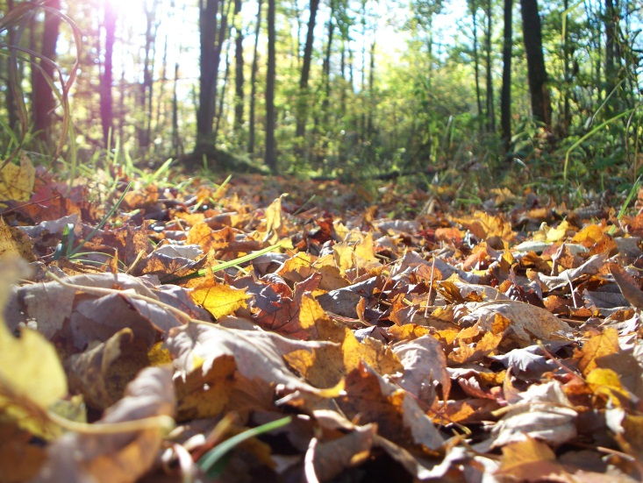
Services = How does the biosphere serve us?

Slide 6
The biosphere
Goods
Services
All: Copy the diagram and add at least 5 examples to each box
Most: explain the difference between good and services with examples

Slide 7
Why

Slide 8
Clean Atmosphere
Biodiversity
Recreation/leisure
Clean Water

Slide 10
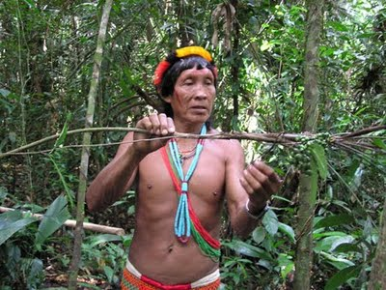
What happens when it disappears?
Indigenous people have lived in rainforest for 1000s of years, however, Transnational companies (TNCs) exploit the forest by logging for wood and paper and to get land for farming/ cattle.
Look at the table on page 45.
How does deforestation affect the services that a rainforest provides?
Extension: What knock-on effects may occur in the longer term on the planet? Is it worth it?
http://www.bbc.co.uk/learningzone/clips/natural-balance-threats-to-the-rainforest/4712.html
http://www.youtube.com/watch?v=VrIcxQ_SUYk

