Slide 1
What is the link between Geography and Sport?
Learning outcome: -
Students will be able to explain the link between geography and sport.
Globalisation and football.

Slide 2
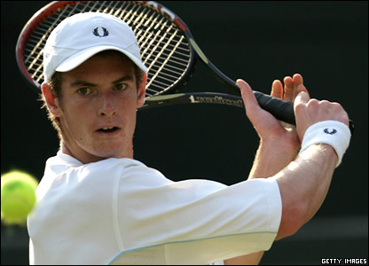
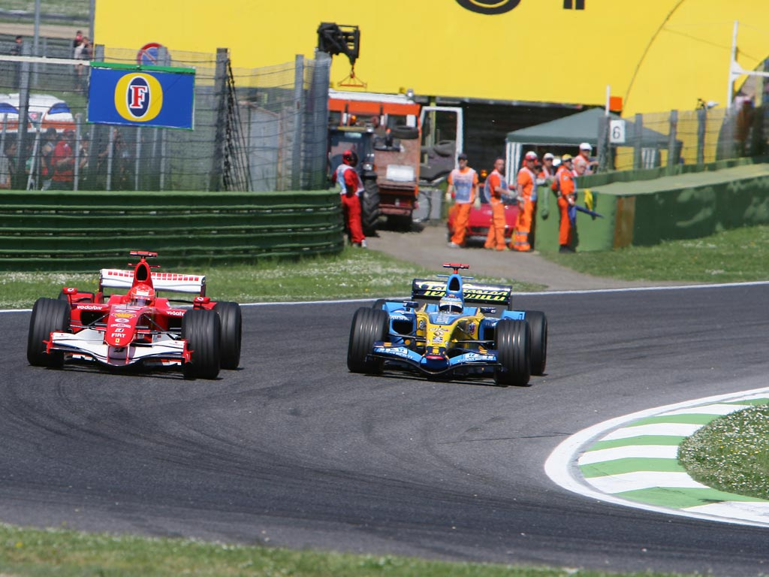
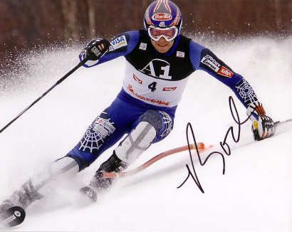
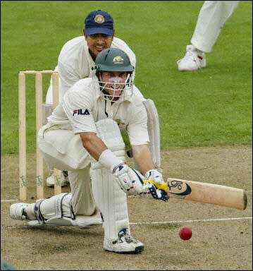
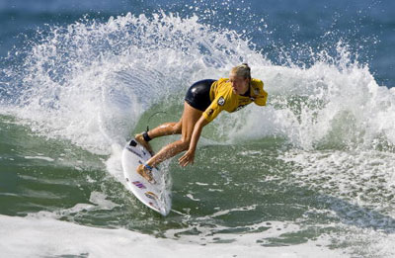
Starter
For each photo, describe how a cold, wet, windy day would affect each sport.

Slide 3
For each sport explain which ones require special facilities (built by humans) and which require the natural environment.
Which sports are mainly Rural activities and which are mainly Urban?

Slide 4
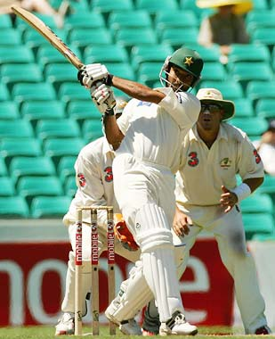
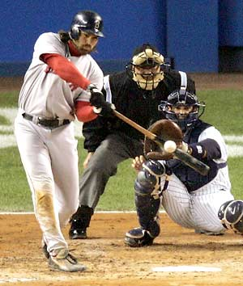
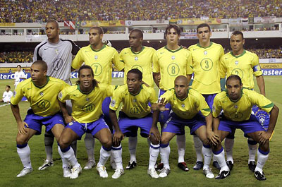
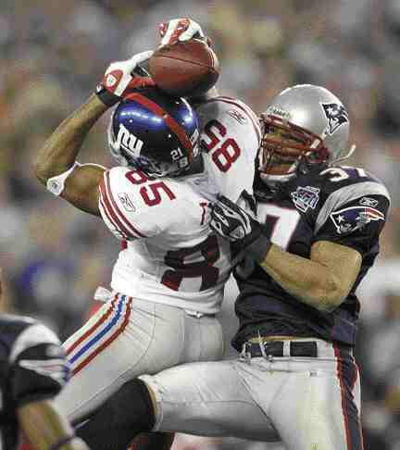
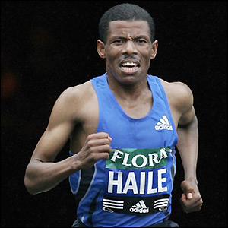
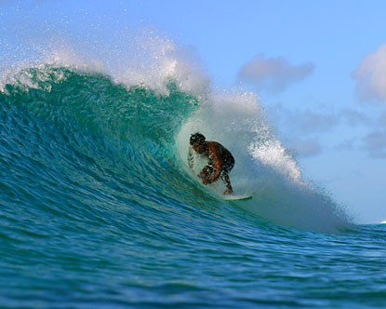
National sports: list countries and their national sports

Slide 5
‘The Beautiful Game’
Why do so many people love football?
Which countries/continents are represented in this film?
What is the link between globalisation and football?
http://www.youtube.com/watch?v=1IxK3-GzFbA
Notes:
GATM video. Scroll down the page about 2/3. The film is red and states ‘why does the world love football?’
Students could be asked to explain why football is the most popular sport in the world. Football is not an elitist, exclusive sport. Poverty does not always get in the way of this sport. All countries in the world play this sport. It has no language barriers. The rules are the same the world over. Most people know about the world cup and champions league.

Slide 6
‘The football shirt
Make a list of the issues surrounding football shirts.
Why is recycling shown in the film?
What is sweatshop labour?
What do the slogans mean to you?
http://www.youtube.com/watch?v=xVuScVCF1Ws&list=PLYPXy8RtvlJ-L1CK17_Pfr2D9kRyqP1LT&index=5
http://www.youtube.com/watch?v=wEKFJWdJ5jg
Notes:
GATM video – scroll down one third of the page. The video is entitled ‘Football:merchandise and trade’. It only lasts for 2 mins so you may want to watch it a couple of times and dwell on the key points the film is making e.g. global trade and transport.

Slide 7
Task
Design your own propaganda message on your football shirt with the intention to end sweatshops.
Write a supporting paragraph for your T-Shirt that explains some links between football and globalisation.
HELP: Football is a global sport because …. For example, the game has become part of the culture in (list some countries). Reasons for this could be …………. Unfortunately there are some negative sides to football such as …………..
Notes:
This map can be used to illustrate the supply chain surrounding common sports goods.

