Slide 1
What do we already know about crime?
Learning objective;
To see what your perceptions are about crime.

Slide 2
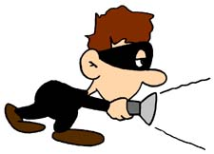
What ‘ingredients’ make a criminal? Highlight them on your worksheet.
Our starter:
Left school at 16 | Likes gardening | Attends church regularly | Wears a suit
Has a pet rabbit | Has a university degree | Takes drugs | Lives with Mum
Lives in the inner city | Owns a car | Looks scruffy | Is overweight
Drinks heavily | Is a pensioner | Lives in a posh house | Is middle aged
Buys stocks and shares | Has a tattoo | Is unemployed | Has a good job
Wears designer gear | Drives a Porsche | Is young | Is married
Has a computer | Collects stamps | Is happily married | Is male
Is female | Truanted from school | Is White | Is Asian

Slide 3
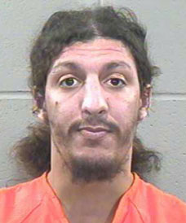
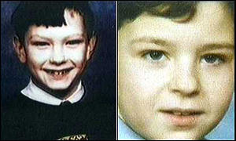
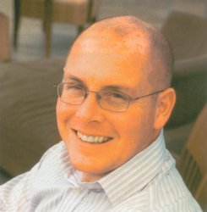
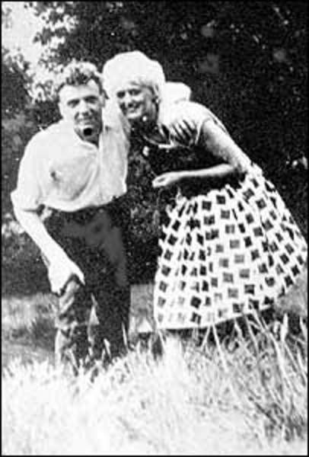
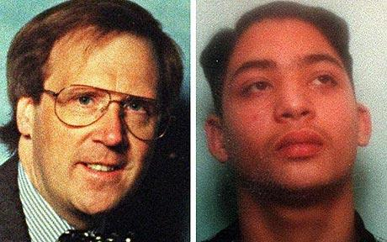
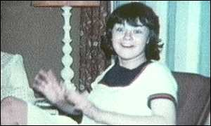
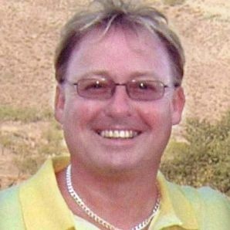
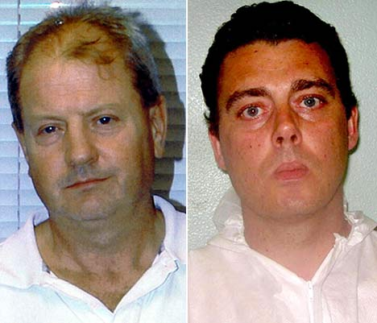
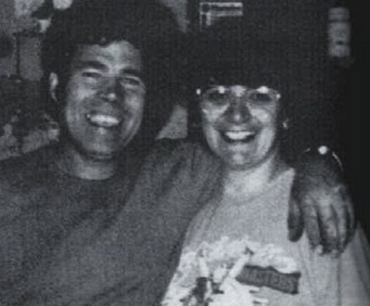
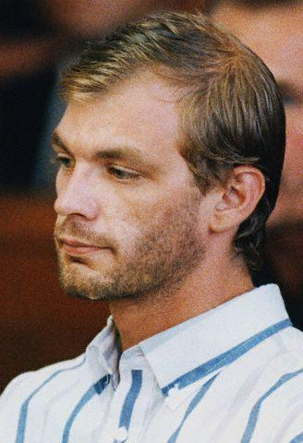
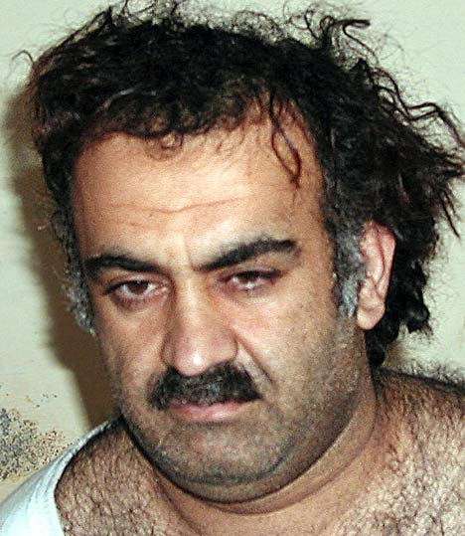
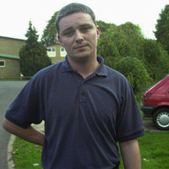
John
Robert
Richard
Nick
Myra and Ian
Phillip
Learco
Mary
Gary
Gary
David
Fred and Rosemary
Jeffrey
Khalid
Ian

Slide 4
Criminal or not??
Write the names where you think they belong
Criminals
Not criminals
Small time criminals

Slide 5
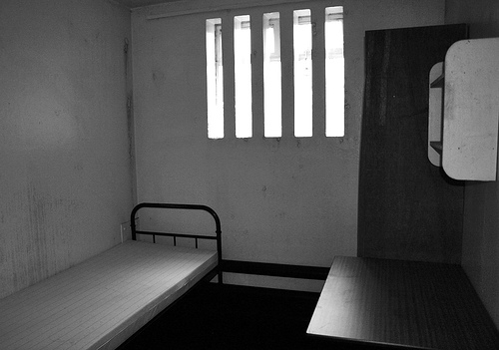
I am Richard Reid and belong to Al Qaeda.
I packed my shoes with explosive and planned to blow up a plane between France and America.
I am the reason why you need to remove your shoes when you go through airport security.
Criminal or not??

Slide 6
We are Robert Thompson and John Venables.
When we were 10 we abducted, tortured and murdered a boy who was only 2 years old.
Criminal or not??

Slide 7
We are Myra Hindley and Ian Brady.
Between us we sexually assaulted and murdered 5 children. We hid their bodies in the moors.
Criminal or not??

Slide 8
My name is Phillip Lawrence. I was a Headteacher who was murdered outside my school when I tried to break up a fight and protect one of my students. I am not a criminal I am a victim
My name is Learco Chindamo. I stabbed and murdered Phillip Lawrence because he tried to stop me attacking someone who wasn’t in my gang. I didn’t even go to his school.
Criminal or not??

Slide 9
I am Mary Bell. When I was 10 years old I was convicted of the manslaughter of 2 boys aged 4 and 5.
Criminal or not??

Slide 10
We are Gary Dobson, 35, and David Norris, 34. We are accused of killing black teenager Stephen Lawrence over 18 years ago. We have not been convicted.
Criminal or not??

Slide 11
We are Fred and Rosemary West. Together we raped, tortured and murdered 11 young girls including our daughter.
Criminal or not??

Slide 12
I am cannibal Jeffrey Dahmer. I raped and murdered 17 men and boys.
Criminal or not??

Slide 13
I am Khalid Sheikh Mohammed. I am believed to be the mastermind behind the 9/11 terrorist attacks on the USA
Criminal or not??

Slide 14
I am Ian Huntley. I murdered two 10 year old school girls.
Criminal or not??

Slide 15
I am Nick Leeson. I was a top banker who defrauded so much money from my bank it collapsed.
Criminal or not??

Slide 16
I am Gary Newlove. I was beaten to death in front of my family by 3 drunken teenagers.
Criminal or not??

Slide 17
Now can we say what ‘ingredients’ make a criminal?
Any surprises?
Is it that easy??:
Left school at 16 | Likes gardening | Attends church regularly | Wears a suit
Has a pet rabbit | Has a university degree | Takes drugs | Lives with Mum
Lives in the inner city | Owns a car | Looks scruffy | Is overweight
Drinks heavily | Is a pensioner | Lives in a posh house | Is middle aged
Buys stocks and shares | Has a tattoo | Is unemployed | Has a good job
Wears designer gear | Drives a Porsche | Is young | Is married
Has a computer | Collects stamps | Is happily married | Is male
Is female | Truanted from school | Is White | Is Asian

Slide 18
Activity: Crime and Demographics
Look at the groups of people below.
What crimes are each groups of people likely to be affected by?
Which crimes are most likely to be committed by each group of people?
Which group do you think is most likely to be the victim of violent crime?
Old people over the age of 65.
Children aged 8 to 16
Young men aged 16 – 24
Women aged 30-59
Questions:
Which group is most likely to be as victim of crime and why?
Is your choice the same as everyone else's – class survey.
Why do you think the class has come to this decision?

Slide 19
Complete the class survey

Slide 20
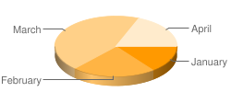
You can still display your word data in a numerical way.
For Example:
A bar graph could be used to demonstrate the main reason thought for why young people commit crimes.
Produce a pie chart to answer this question.
This will help us to easily see how many people are of working age.

