Slide 1
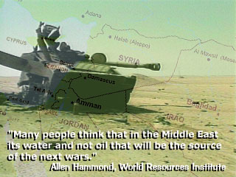

Slide 2
‘New Geography of Conflict’
“Possible flashpoint for resource conflict”
Water systems & aquifers
Jordan
Nile
Tigris – Euphrates
Amu Darya
Indus
Mountain Aquifer (West Bank/Israel)”
Notes:
Flight back from NY 2 days ago, free copy of Foreign Affairs, article on geography of conflict
Much writing about resource scarcity - and Nile almost always surfaces as a flashpoint

Slide 3
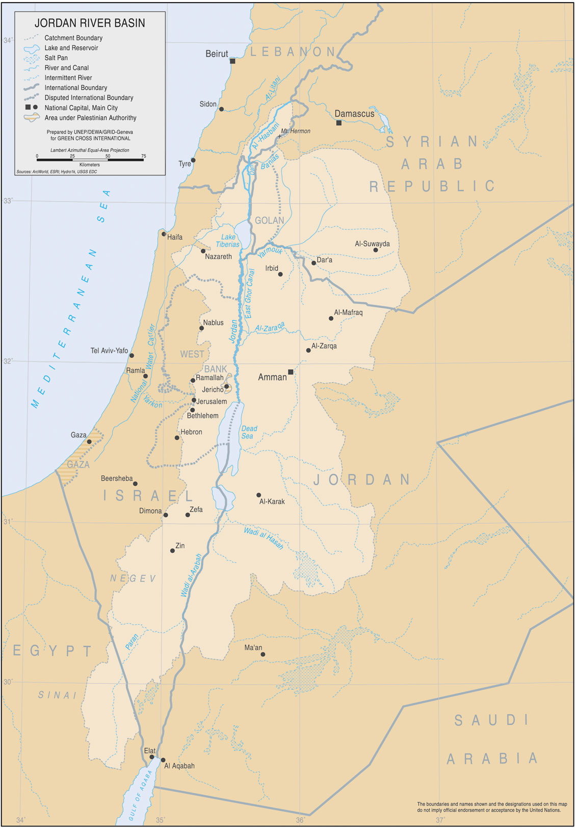
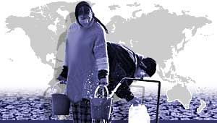
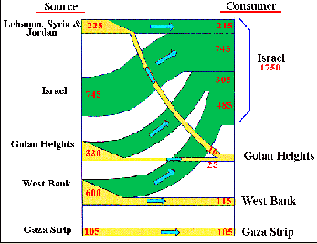
Middle East
Water Conflicts

Slide 4
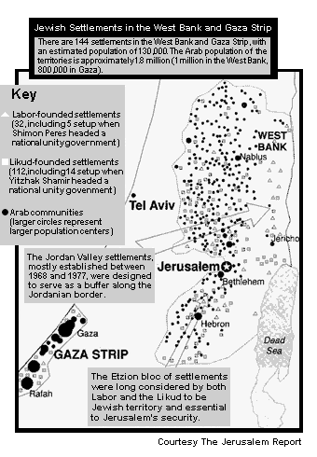
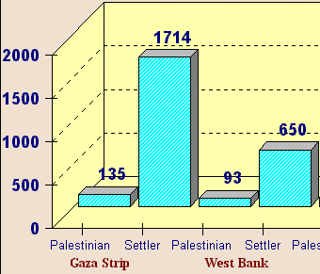
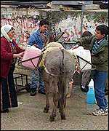
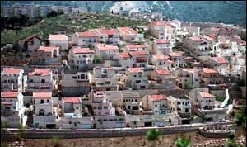
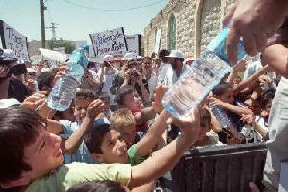
Israeli-
Palestinian
Water
Conflict
Israel uses 82%
Of West Bank
groundwater;
charges Arabs 3x

Slide 5
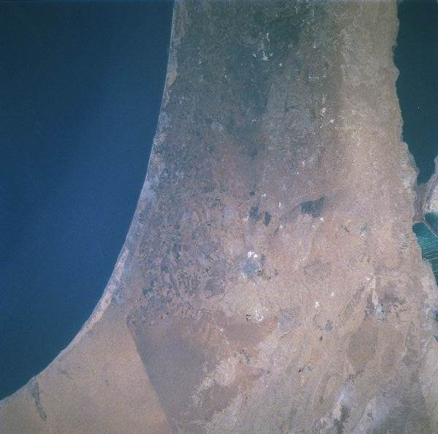
Israel’s
boundary
with Egypt
and Gaza
(Palestine)

Slide 6
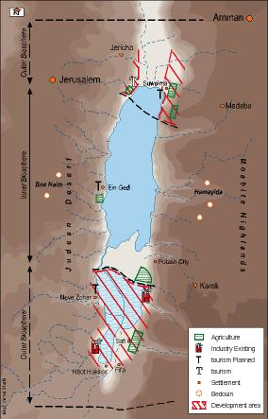
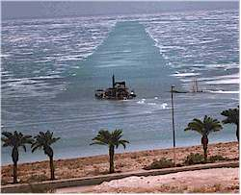
Dead Sea
Shrinkage

Slide 7
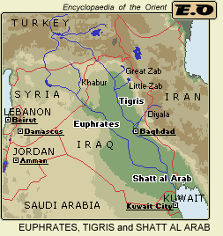
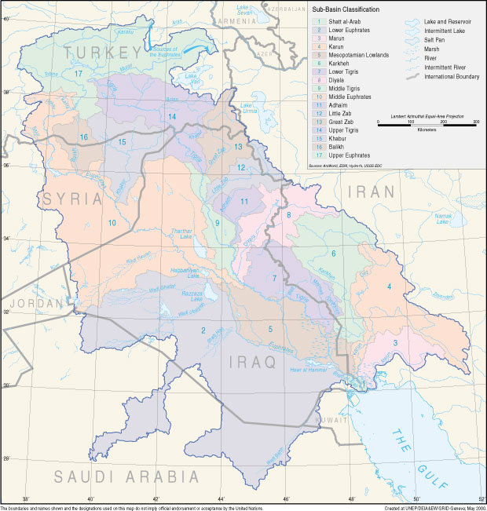
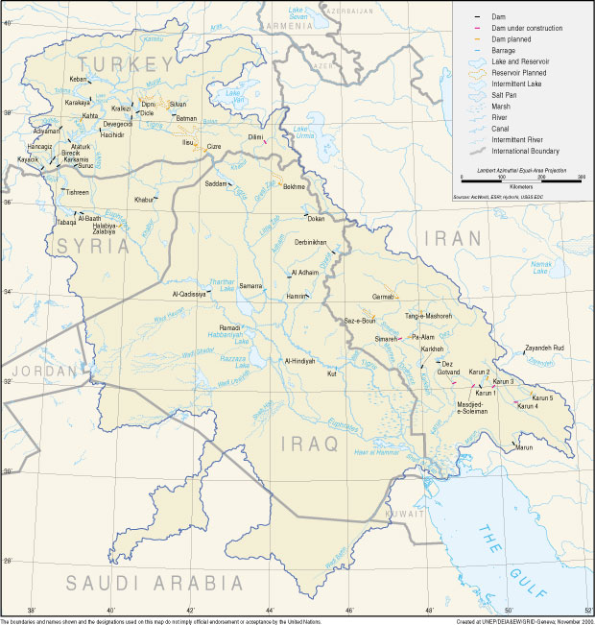
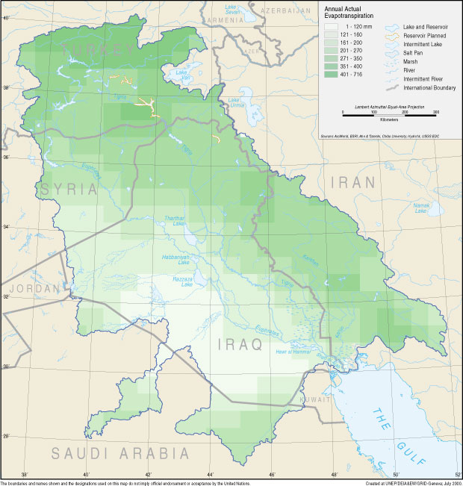
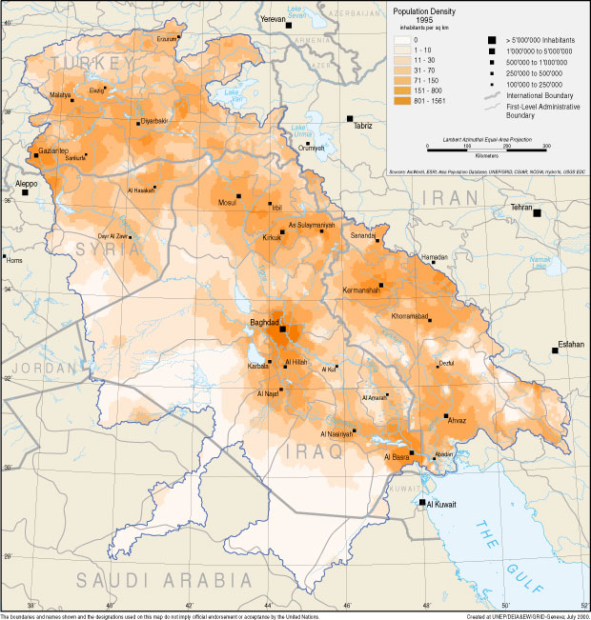
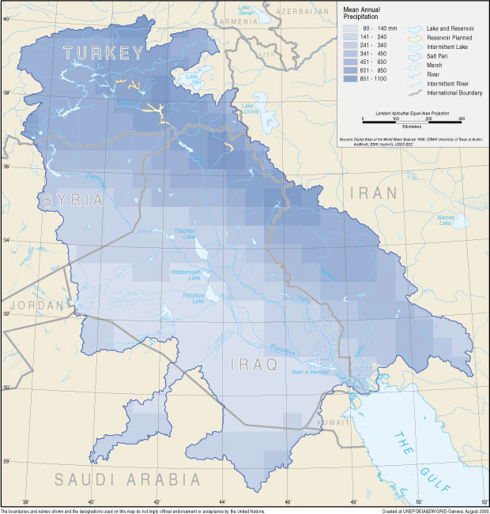
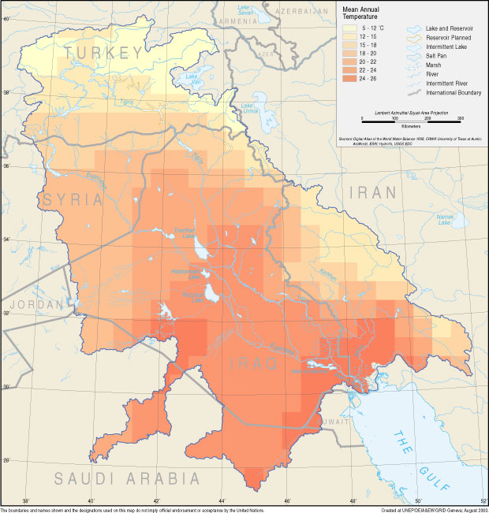
Tigris and Euphrates rivers
Turkey
Iraq

Slide 8
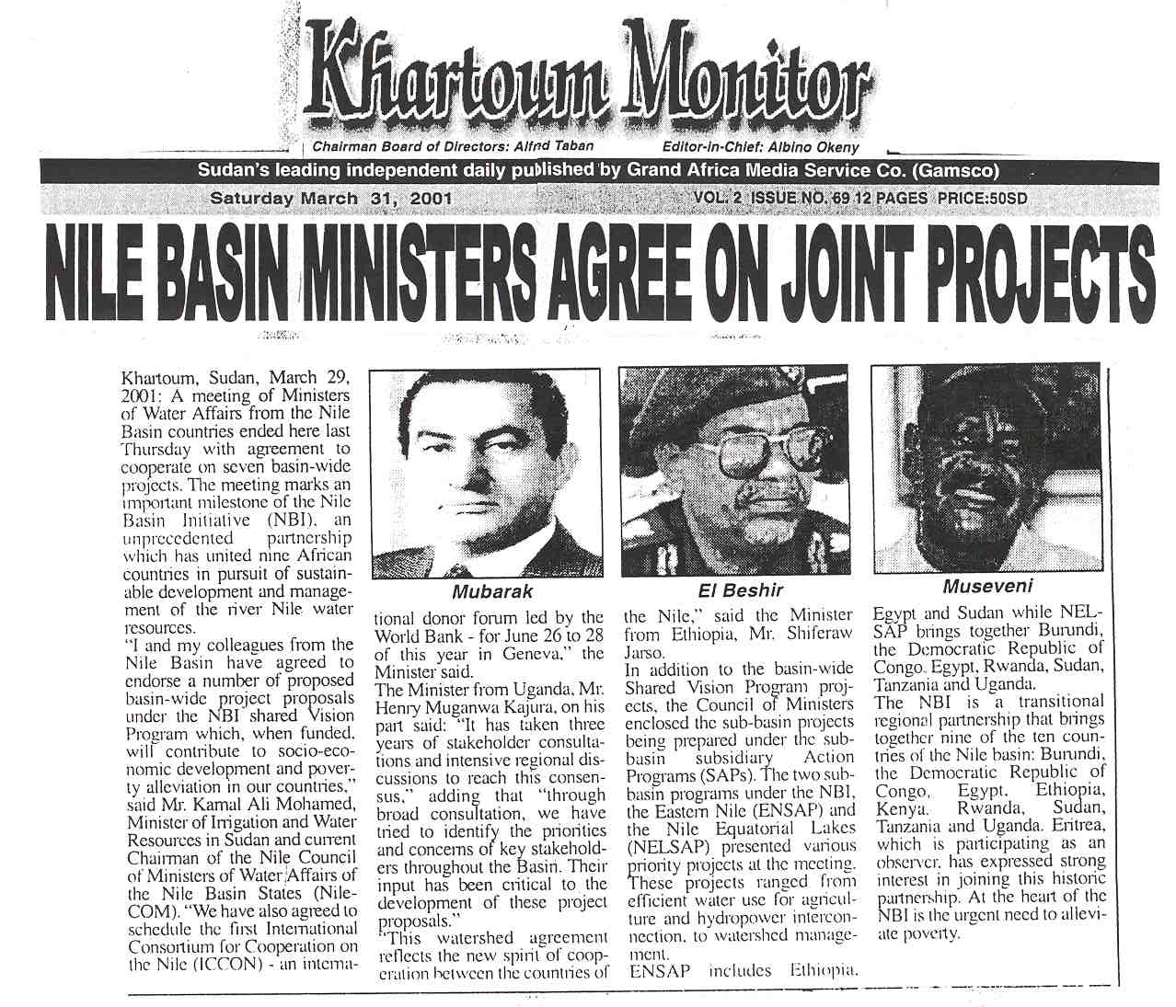
International cooperation on water use

