Slide 1
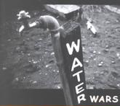
Lesson Objectives:
◊ To be able to explain the terms conflict and co-operation and give examples
◊ To be able to debate a point of view using evidence in source
◊ To be able to make an informed decision about the future of the Ilisu Dam

Slide 2
Copy the mindmap into your books
Add all the types of conflicts and co-operation you can think of
Conflict
Co-Operation
Okay, you have been able to give examples of conflict and co-operation but what do the words actually mean? Discuss with your partner what you think they mean – You will be asked to feedback your ideas to create a class definition
Conflict
To fight, battle or war – A clash of interests, opinion, statements or feelings usually resulting in violence
Co-Operation
An act of working together towards the same end, purpose, effect or goal
To be able to explain the terms conflict an co-operation and give examples

Slide 3
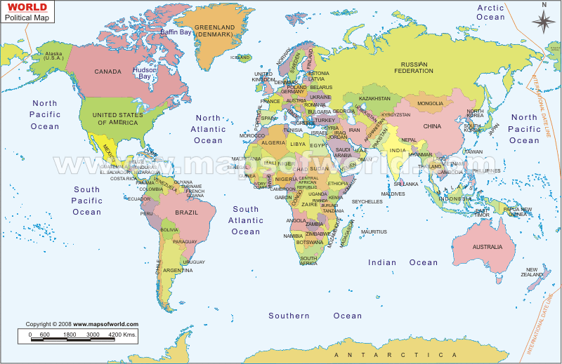
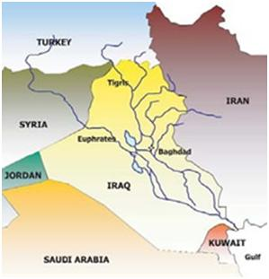
Where In The World Are We Looking At Today?
Tigris
Euphrates
Turkey, Iraq and Syria

Slide 4
The Euphrates And Tigris River System
In your groups you have some information showing the Euphrates and Tigris river system region
Why do you think conflict over water supply is likely?
The dam control the water flow and so has impacts at its site and further down stream.
What could be the positive and negative effects on the landscape, water supply, power supply and river flow?

Slide 5
Turkey, Iraq or Syria?
Each of your groups is going to represent a country affected by the dam.
Using the information on your sheet, you need to write a short speech, to be given at a meeting of the government ministers if Turkey, Iraq and Syria.
You need to decide which points are the most powerful and pose some awkward questions for your neighbours...

Slide 6
Planning For The Future
In your new groups you will have a representative from each country. Together you need to make a decision about the future of the Ilisu Dam scheme
You need to consider:
◊ the impacts of each country
◊ other major water supplies in the area
◊ ways of altering the scheme to resolve any conflict

Slide 7
Who ‘owns’ the water in a major world river?
If people have a right to the water that lies within their territory, what responsibilities do they have towards others using it further downstream?

