Slide 1
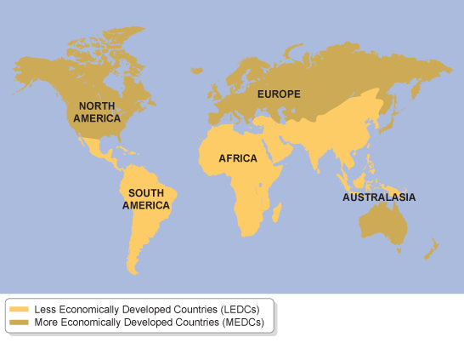
What is the development gap?
How can we measure it?
Take a map and show the north-south divide line (Brandt line).

Slide 2
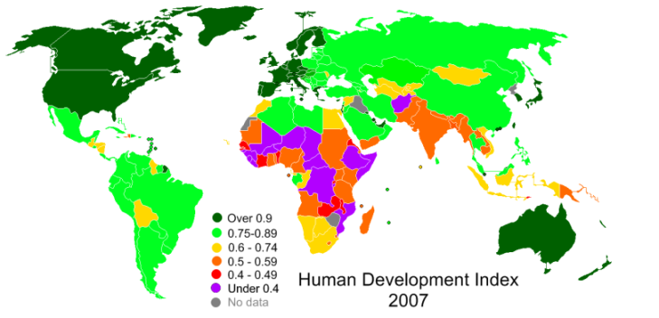
The development gap
The geography of the development gap is more complex than a simple ‘North-South divide’
Latin America has HDI levels similar to eastern Europe; China’s HDI and some others in SE Asia are relatively high
South Asia has a concentration of levels below 0.6
Level in the Middle East are relatively high, although not in Yemen, Syria and Iraq
The picture for Africa is very complex, with the extreme north and south having decent HDI levels, but some regions with shockingly low numbers

Slide 3
Development Indicators?
How can we accurately measure development between countries?

Slide 4
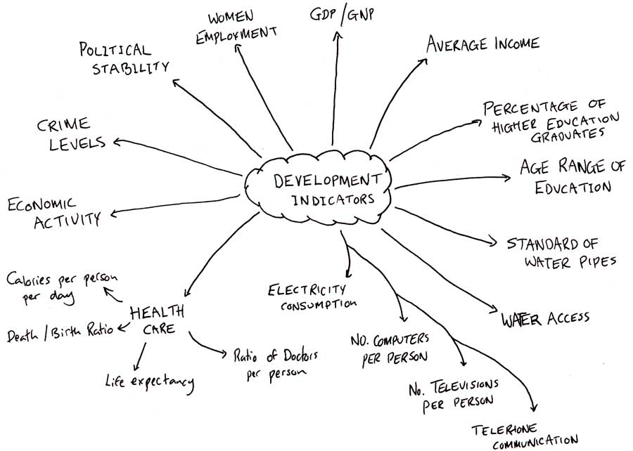
Development Indicators?

Slide 5
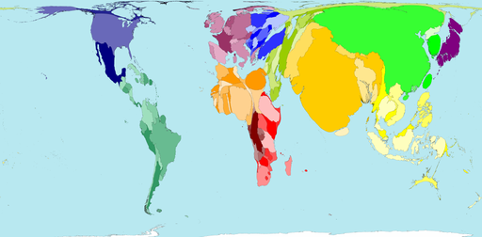
What is this map showing?

Slide 6
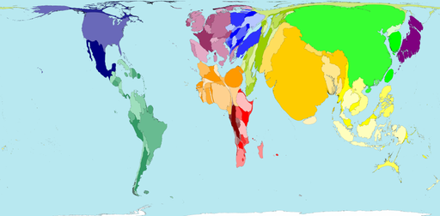
Life expectancy

Slide 7
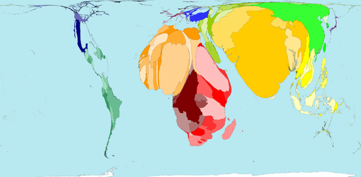
Infant mortality

Slide 8
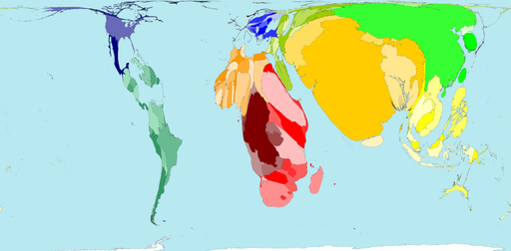
Under-nourishment

Slide 9
Burgernomics
THE ECONOMIST's Big Mac index is based on the theory of purchasing-power parity: in the long run, exchange rates should adjust to equal the price of a basket of goods and services in different countries. This particular basket holds a McDonald's Big Mac, whose price around the world we compared with its American average of $4.20.

Slide 10
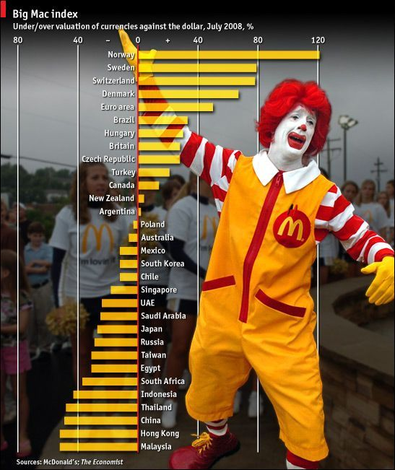

Slide 11
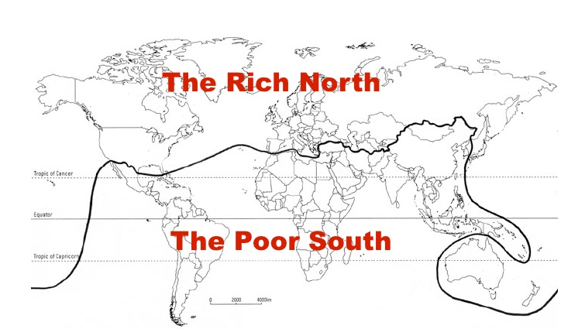
Understanding indicators…
Take an atlas ands find 10 contrasting countries. Analyse them using 5 development indicators.
Rank them according to each indicators and add up the totals. The least scores shows the most developed

