Slide 1
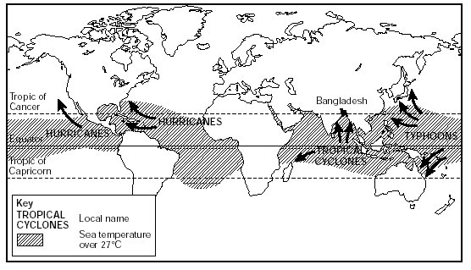
‍Tropical Storms
Tropical storms take different names in different parts of the world. In The Caribbean, US and Central America they are known as hurricanes, in the Indian Ocean they are known as cyclones and in the Pacific around the Philippines and Indonesia they are known as Typhoons. Tropical storms are normally found between the tropics near the Equator. The formation of tropical storms is not fully known, but scientists do know that they draw their energy from warm seas. Therefore tropical storms tends to happen in late summer when temperatures are warmest (over 27 degrees Celsius). Because tropical storms get their energy from the sea, when they do hit land they lose their energy quickly. Most tropical storms last between one and two weeks. The main hazards caused by tropical storms are:
•Winds: Very strong winds up to 250km/hr accompany tropical storms. Strong winds can damage buildings, knock over trees and disrupt transport and communications
•Flooding: Heavy rainfall is associated with tropical storms. Heavy rainfall actually causes much more damage and deaths than high winds.
•Storms urges: Tropical storms moving in land can create storm surges and big waves. If tropical storms coincide with spring tides the impacts can be severe.
•Landslides: Landslides are a secondary hazard. Landslides can be triggered when large amounts of rainfall saturate the ground increasing the stress on the slope.

Slide 2
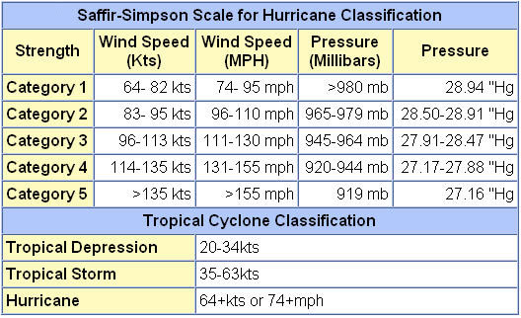
Saffir-Simpson Scale

Slide 3
Tropical storms are measured on the Saffir-Simpson Scale. The Saffir-Simpson currently has five categories, although some meteorologists believe a sixth category should be introduced to describe super hurricanes. Storms below 74mph (119kph) are described as only tropical storms. Anything above this speed is officially a hurricane/cyclone/typhoon.
Landfall: This term simply describes when tropical storm hits land.
Formation: The time when an area of low pressure turns into a tropical storm.
Dissipation: The time when a tropical storm breaks up and loses all its strength.
The eye: The centre of a tropical storm.

Slide 4
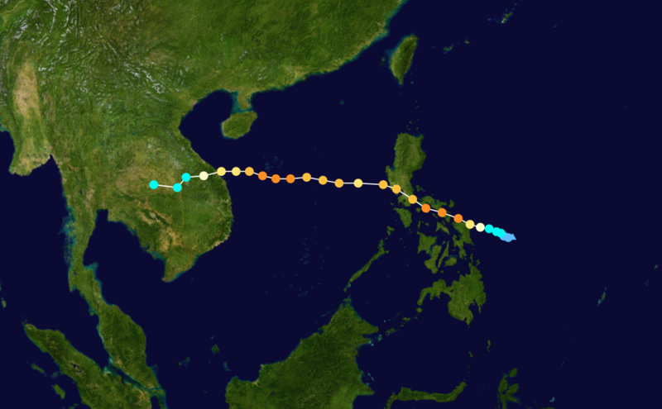
Typhoon Xangsane
Typhoon Xangsane was a category 4 typhoon that hits the Philippines, Vietnam (Southern Laos) and Thailand (SE Asia). The typhoon formed on the 25th September 2006 in the South China Sea off the east coast of the Philippines. It dissipated on October 1st 2006 over Vietnam, but the remnants off the storm went onto hit Thailand. The typhoon was very destructive causing a total of 279 deaths and $747 million in damages. Like with any destructive tropical storm the name Xangsane was retired and will never be used again to name a tropical storm.
In preparation for the arrival of Xangsane the Philippines closed all schools in its path, cancelled many flights in and out of Manilla and suspended over forms of public transport. In Vietnam 300,000 were evacuated from low lying areas and 2,400 boats ordered to return to port. Vietnam Airlines also cancelled or diverted flights. In Thailand residents were warned about possible flooding and landslides.
After the typhoon the Filipino Red Cross asked for $4.6 million. In addition 3,000 workers and 3 rescue teams were dispatched to the impacted area. The Red Cross also provided food and essential supplies to 6300 families. In Vietnam the Red Cross also released emergency funds. The Vietnamese government released $6.2 million in aid money and donated 1500 tonnes of rice. In Thailand the Red Cross gave emergency kits to 16,000 flood affected families.

