Slide 1
To understand what world trade is and how it works.

Slide 2
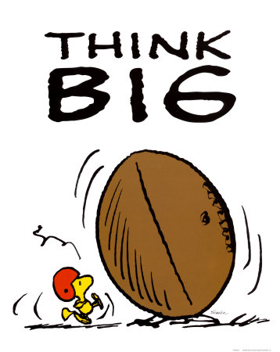
How many different brands of trainers can you think of?
How much do they cost on average?

Slide 3
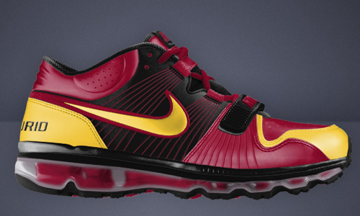
Nike Air Max Trainers

Slide 4
Materials?
Labour cost of the worker?
Production Cost?
Profit
subcontractor?
Transport
And tax?
Publicity for
retailer?
Rent of
retailer?
Research?
Labour cost of the retailer
(paying person who sells shoe)?
VAT?
Nike
profit?
Publicity for Nike?

Slide 5
Materials – €8.50
Labour cost of the worker –
€0.50
Production Cost –
€1.50
Profit
Subcontractor –
€3
Transport
And tax –
€5
Publicity for
Retailer –
€2.50
Rent of
Retailer-
€12
Research –
€11
Labour cost of the retailer
- €18
VAT - €17
Nike
Profit - €13
Publicity for Nike - €8

Slide 6
World Trade is the movement of goods and services between different countries in the world. Most countries rely on trade to bring in a source of income.
E.g. Nike – designs trainers in North America, makes them in south-east Asia and sells them in Europe. Many countries are involved in the process.

Slide 7
World Trade is not just about goods; it’s also about services!

Slide 9
Couple of Questions...
How many people have a land-line phone in their house?
How many people know they are connected with BT for phone or internet?
How many people want to do a college course / degree at some point in the future?
How many people would like to work in a call centre?

Slide 10
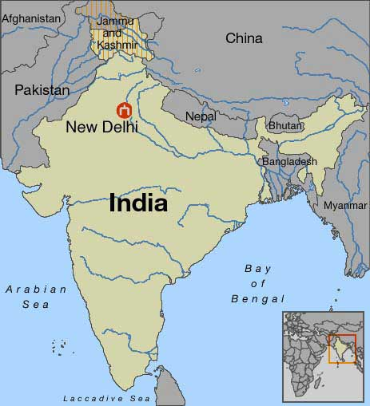
2003 - BT set up call centres in India to reduce costs and increase efficiency – India has more than 3 times unemployment of Britain.

Slide 11
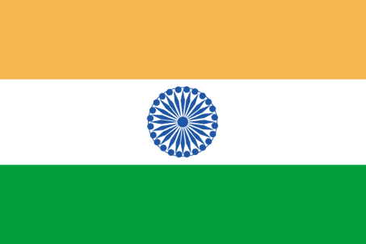
Salaries and Training?
£12,500 £1200
Most Indian workers have undergraduate degrees and are trained to speak English, taught about pubs, soap operas and English culture.
They are told not to tell people they are calling from India.

Slide 13
Is BT exploiting Indians or is their business good for India? Reasons for and against.

