Slide 1
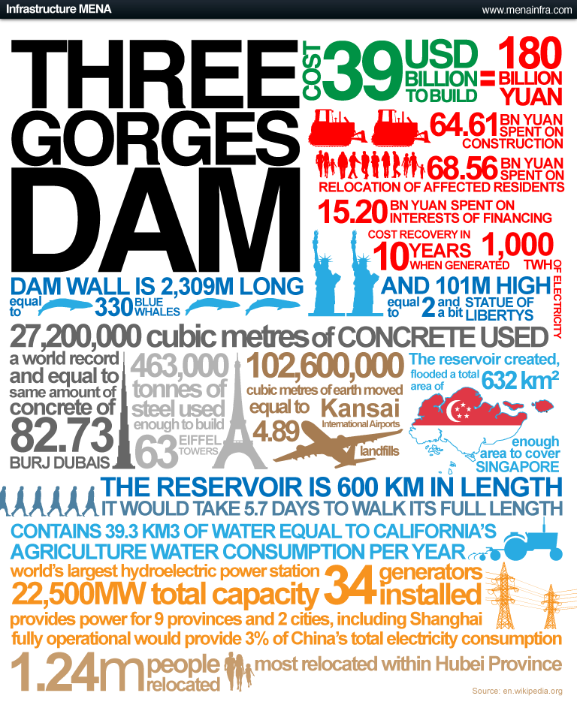
1.Write down 2 facts
about the size of the dam
2. Write down 1
fact about
energy
3. Write down either one social or economic impact
Facts are great to use in your introductionand make good supporting sentences for your points.
L/O - To evaluate whether China is developing sustainably with the use of HEP.

Slide 2
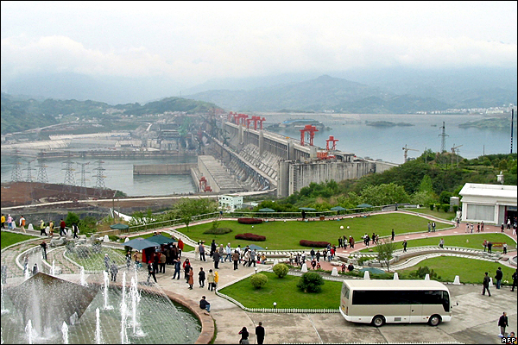
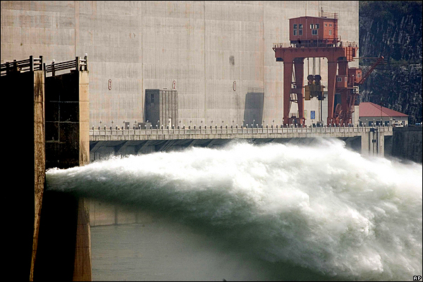
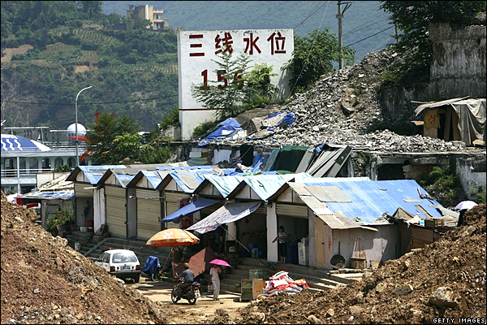
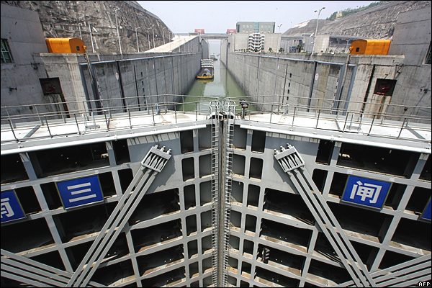
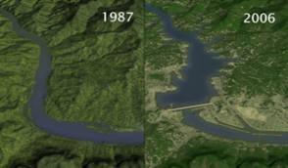
The primary aims of the dam are to alleviate flooding on the Yangtze River and generate power. Fourteen turbine generator units are already in operation.
The project was begun in 1993 at an official cost of 200bn yuan ($25bn), though unofficial estimates are far higher.
China's controversial Three Gorges Dam project hits a significant milestone on Saturday, when it is expected to reach its final height of 185m (607 feet). But it will not be fully operational until 2009
A billboard in the port of Wushan shows the height that the water will reach, ultimately submerging all of its wharf facilities.
When the dam's reservoir reaches its final height of 175m, scheduled for 2009, the five-chamber shiplock will raise boats by as much as 113m.
At least 1 million people are being relocated to make way for the project.

Slide 3
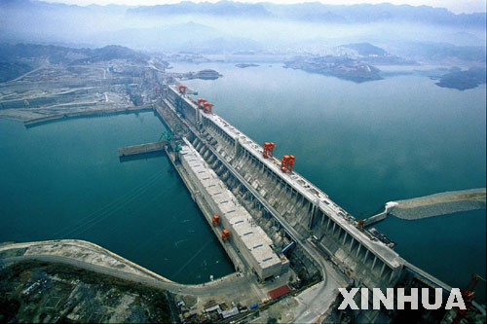
Whilst watching…..
Note down why the Dam was built
Advantages about the Dam
Disadvantages about the Dam
http://www.youtube.com/watch?v=T2JMVxnMqxU
L/O - To evaluate whether China is developing sustainably with the use of HEP.

Slide 4
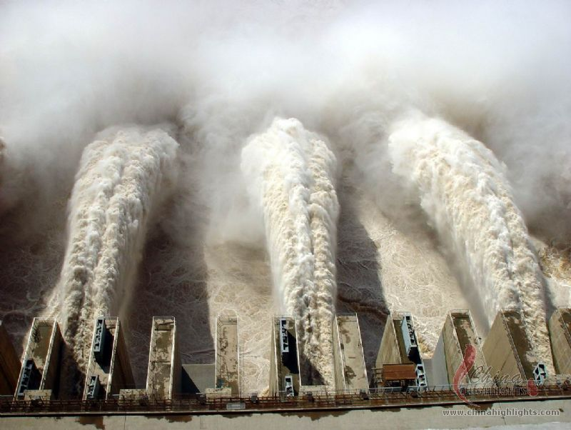
Has the Three Gorges
Dam benefitted the
Chinese people?
Lets investigate whether the Dam is sustainable.
Use the information sheets around the classroom to add full detail on the Dam.
Everyone in your group should have a role
e.g info collector, intro, why it was built, positives of the project, negatives of the dam.
L/O - To evaluate whether China is developing sustainably with the use of HEP.

Slide 5
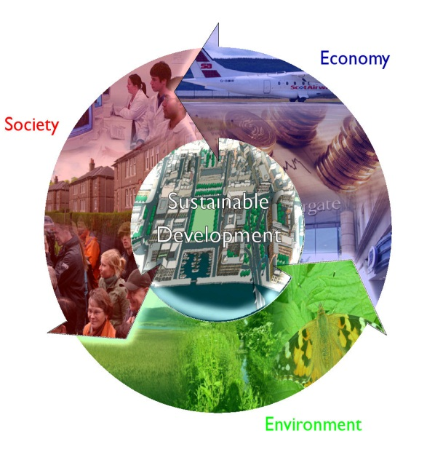
Referring to examples analyse the importance of HEP as a renewable source of energy.....
Use the paragraph grid to evaluate the sustainability of the dam
Point: The Three Gorges Dam has many advantages….
Evidence: The positives of the dam are…
1)
2)
Explain: This means that…
Evaluation and Analysis:
The Chinese government were thinking economically because …….
Link: Provide concluding sentence and link to the next point
L/O - To evaluate whether China is developing sustainably with the use of HEP.

Slide 6
Referring to examples analyse the importance of HEP as a renewable source of energy.....
Use the paragraph grid to evaluate the sustainability of the dam
Point: However, The Three Gorges Dam sparked controversy because….
Evidence: The negatives of the dam are…
1)
2)
Explain: This means that…
Evaluation and Analysis:
The Chinese government could have done ………. to make it more sustainable. Because …….
Link: Provide concluding sentence
L/O - To evaluate whether China is developing sustainably with the use of HEP.

