Slide 1
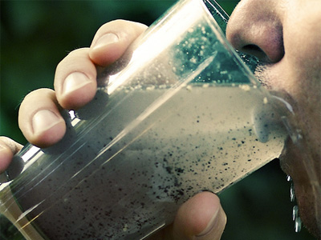
Threats to water quality and water availability
To know how people interfere with water quality and water stress
To be able to explain
the process of eutrophication
To understand how climate change may impact on water supplies

Slide 2
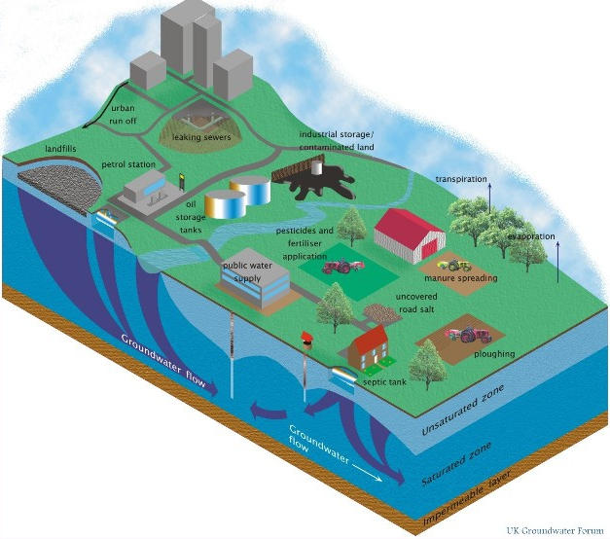

Slide 3
Pollution in emerging countries…
Levels of water pollution can be related to economic development. The highest levels of water pollution are usually linked with rapid growth – in countries such as China and India. These countries are industrialising and developing their energy sources rapidly. They tend to put economic growth before environmental concern. Countries like this are also experiencing rapid urban growth, infrastructure can not cope. As a result, streams that run through slums and shanty towns are badly affected by pollution.

Slide 4
Pollution in emerging countries…
Many countries with rapidly developing economies are also developing commercial agriculture which relies on pesticides and fertilisers to increase yields. Runoff of those chemicals increases water pollution.
Developing countries tend to lack concentrations of larger countries, as a result streams and rivers are polluted.
Why do countries such as India and China not have standards for water quality?

Slide 5
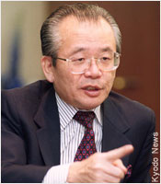
Minamata Mystery
Mr. Susaki is a 45yr old businessman with a wife and 3 children.
He has been living in the Japanese city of Minamata all of his life.
However, last year something started making Mr. Susaki ill. He has lost his balance, is unable to write and has no coordination. Dr’s struggled to diagnose him…
We are going to explore what is making Mr. Susaki ill.

Slide 6
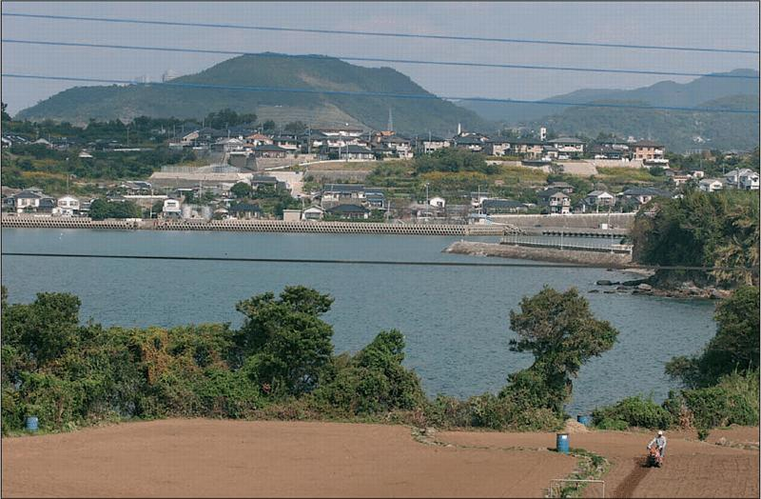
What do you think is making Mr. Susaki ill?
What is making Mr. Susaki ill?

Slide 7
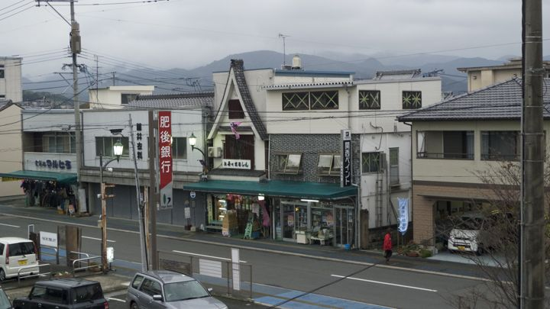
What do you think is making Mr. Susaki ill?
What is making Mr. Susaki ill?

Slide 8
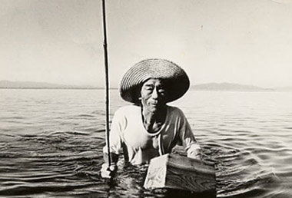
Over to you!
TASK
Read the boxes on the sheet in front of you. They tell the story of what happened in Minamata.
Using 3 coloured pencils piece together the story. Shade in boxes into the following categories…
Symptoms
Causes
Consequences

Slide 9
Now that you know what has happened…
TASK
Is there a health problem present? If so describe what it is and some of the symptoms. (1 paragraph)
What is causing the problem? (1 paragraph)
What is the source of the problem? (1 paragraph)
Describe and explain the consequences that have arisen from this industrial mistake. (2 paragraphs)

Slide 10
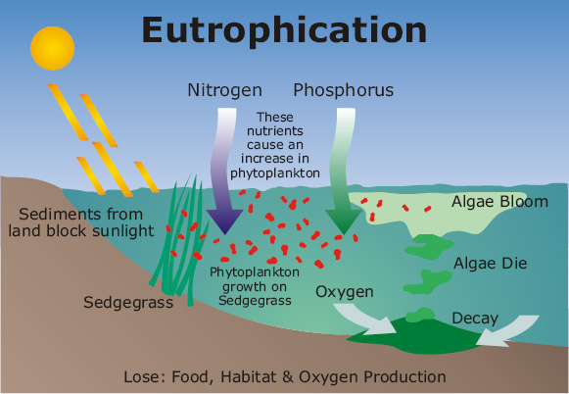

Slide 11
TASK
You are going to research the answer to the following question… “Climate change will have a negative impact on water quality and availability, how far do you agree?”.
Each of you has a pack of resources – use this and your own research at home to complete the essay question. Today we will write success criteria and begin to plan…

Slide 12
Success Criteria
A*/A
B
C

