Slide 1
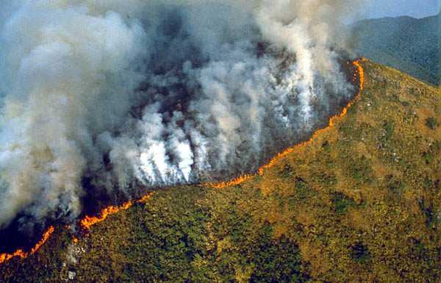
What threats are there to the biosphere?

Slide 2
What threats are there to the biosphere?
Biosphere= the part of the Earth inhabited by living things

Slide 3
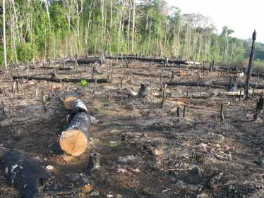
What threats are there to the biosphere?
D – All – Know some threats the biosphere faces B/C – Most – Be able to explain why a number of factors threaten the biosphere A/A* - Evaluate the importance of each threat at different scale

Slide 4
What threats are there to the biosphere?
Biosphere= the part of the Earth inhabited by living things
In what ways can your everyday lifestyles threaten the biosphere?

Slide 5
What threats are there to the biosphere?
Page 49:
Amazon
Logging removes trees affecting flooding, soil and humus
Deforestation
Threats to Biosphere
D- Write down 5 threats
B/C - …and explain each of them in a single sentence.
A*/A- …and write down an example and consider if we classify any of these threats?

Slide 6
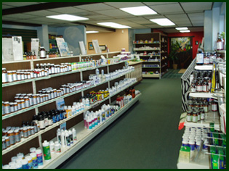
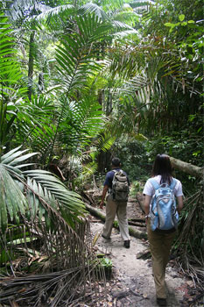
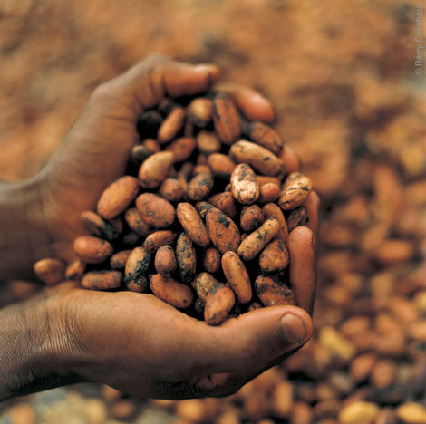
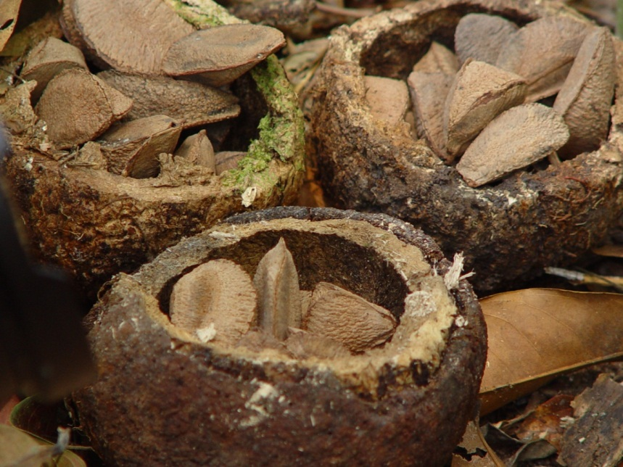
What are the uses of the Rainforest?

Slide 7
Rainforest
How does the rainforest system work?

Slide 8
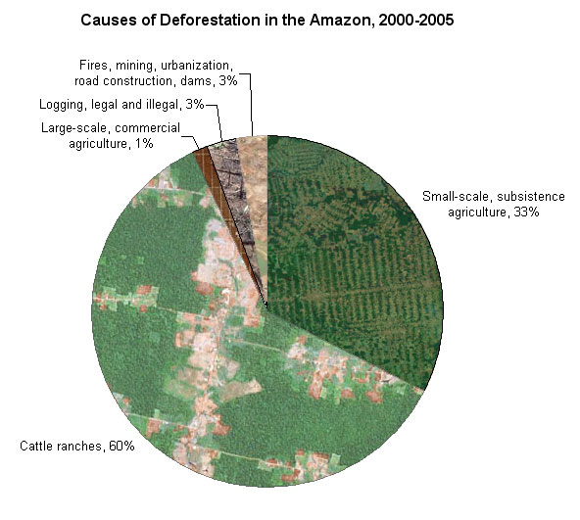

Slide 9
Rainforests
Over-exploited = used too much
Video: Make notes in each section to show how the rainforest is over - exploited by people
Homework: Due Monday 25th Feb
Explain how the global biosphere is being threatened (4)
Explain in what ways rainforests are being threatened (4)

Slide 10
Rate the degree of impact that each of the uses have on the TRF environment
10= High impact
0 = Low impact
Atmosphere
10
Vegetation and wildlife
10
0
10
Soil
Uses of the TRF
Ranching
Logging
Rubber tapping
Farming
Mining
Hydroelectricity
10
Water
On your diagram write where each of the uses of the TFR would go on the 4 way scale

Slide 11
What threats are there to the biosphere?
D – All – Know some threats the biosphere faces B/C – Most – Be able to explain why a number of factors threaten the biosphere A/A* - Evaluate the importance of each threat at different scale

Slide 12
What are the effects of deforestation? Task: Colour code the cards to show - the causes of deforestation - The resources of the amazon - the local effects - The global effects Extension: how else can we categorise the effects?

Slide 13
Using the sheet provided complete the boxes with the correct options from the list.
Extension: Question 1c

