Slide 1
The Upper Course of a river
Processes of erosion
Hydraulic power
This is the force of the water on the bed and banks of the river, powerful when in flood, the force of the water removes material from the bed and banks of the river.
Corrasion
When the river is particularly full, pebbles and boulders are carried along by the water. These rub against the bed and banks of the river and wear them away. The process is called abrasion.

Slide 2
Processes of Erosion
Corrosion
River water sometimes causes some rock to slowly dissolve. (e.g. limestone dissolves in slightly acid water and is carried away in solution (as a liquid) as calcium hydrogen carbonate).
Attrition
The pebbles and small rocks being carried by the river- the load- collide and rub against each other, breaking up into smaller and smaller pieces. The rough edges become smooth, forming smaller rounded material. Eventually the particles are reduced to sand and silt-sized particles

Slide 3
Upper Course of a River : Features and how they are formed
Learning objectives:
Recognise upper course features from maps and photographs
To be able to explain how features such as V-shaped valleys and waterfalls are formed.
To understand how the processes of erosion and weathering form these features.

Slide 4
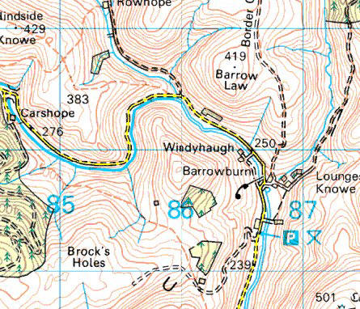
On your map can you label? (tributary, V-shape valley, confluence, source)

Slide 5
Source
Confluence
V-shape
Valleys
Tributary

Slide 6
Upper-course river features include:
steep-sided V-shaped valleys,
interlocking spurs,
rapids,
Waterfalls
gorges.
These are all features formed by EROSION!

Slide 7
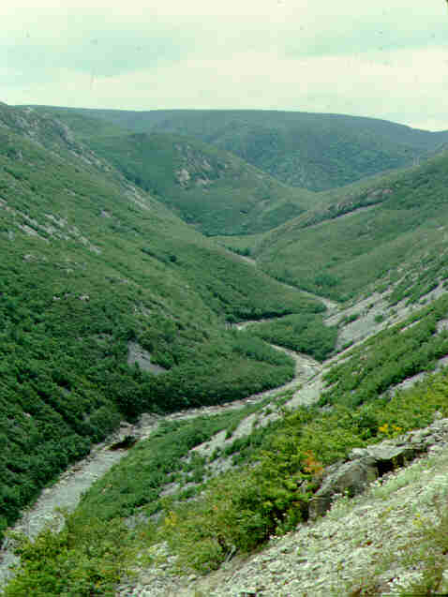
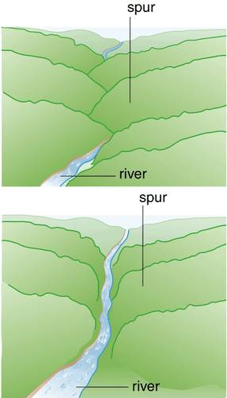
Spurs…..

Slide 8
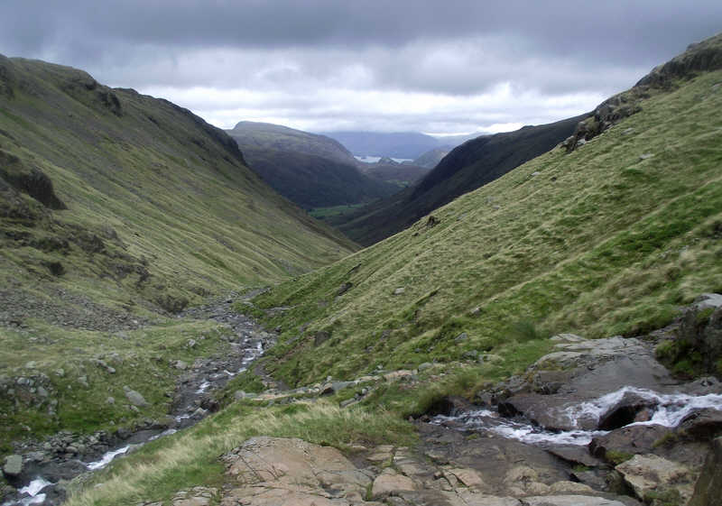
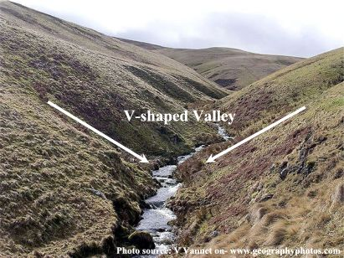
V-shaped valley

Slide 9
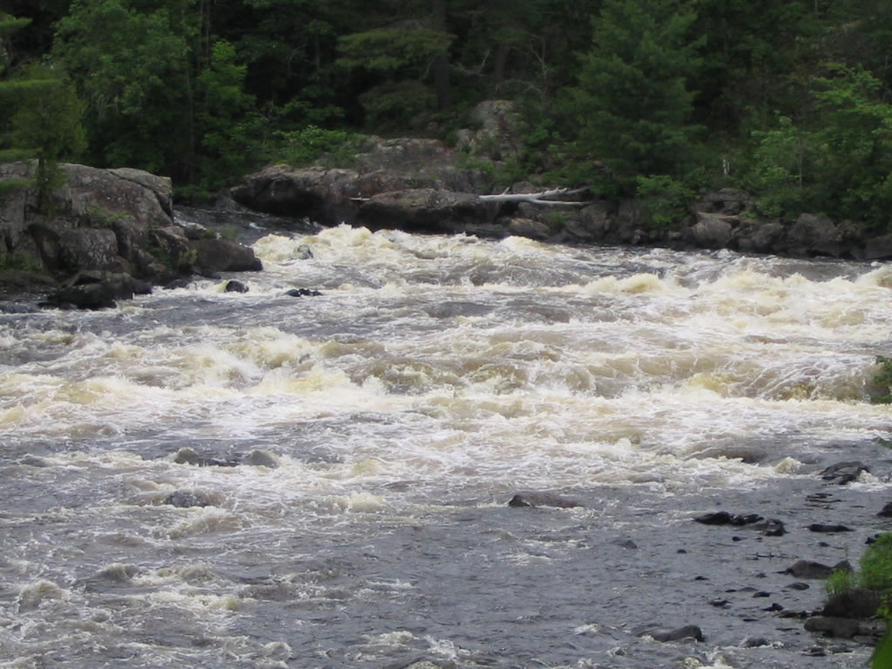
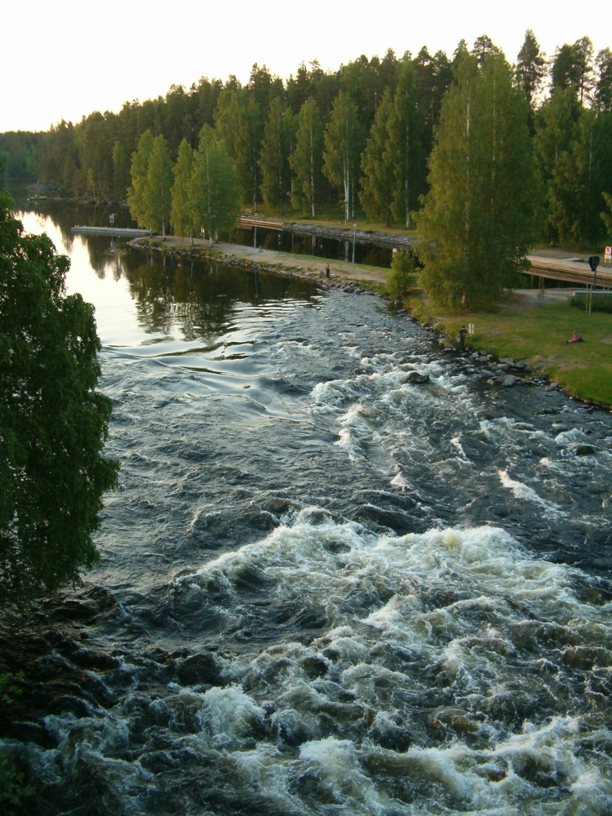
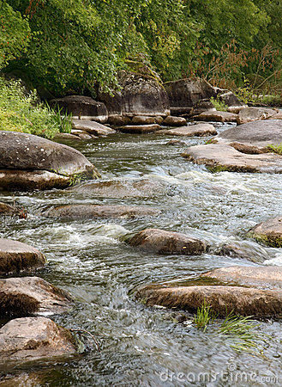
Rapids…….

Slide 10
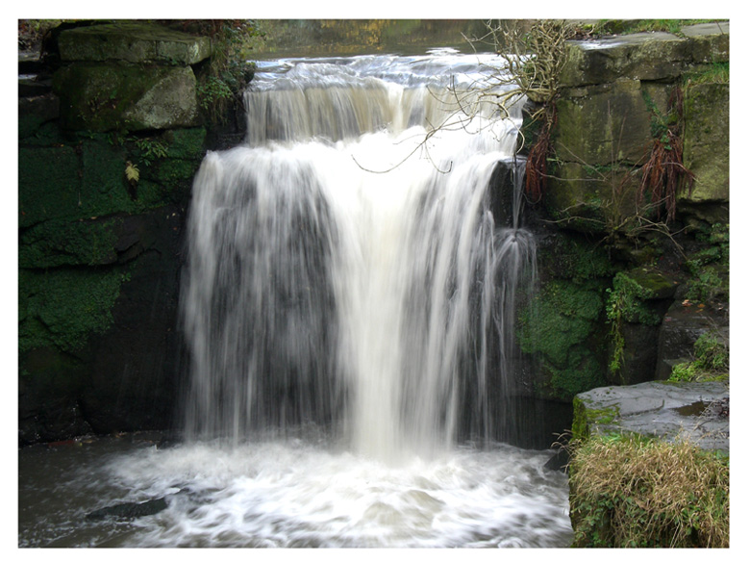
Waterfalls….

Slide 11
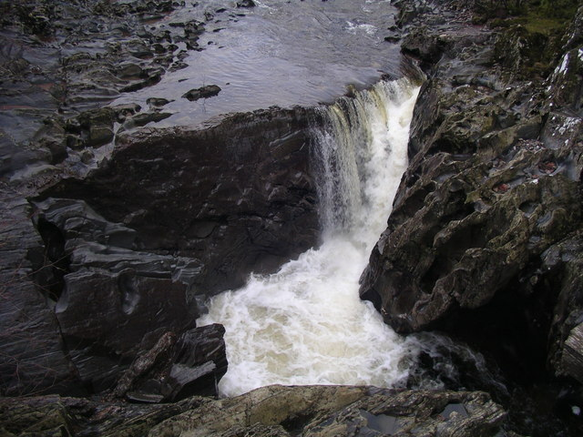
Gorges….

Slide 12
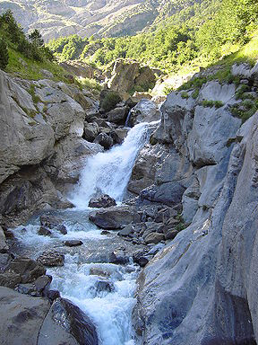
In your table groups write down answers to these questions on an upper course photograph
How steep are the slopes?
How wide is the channel?
What is the bed load like?
What are these?
Where has most of the erosion happened here?
How fast is the water moving?

Slide 13
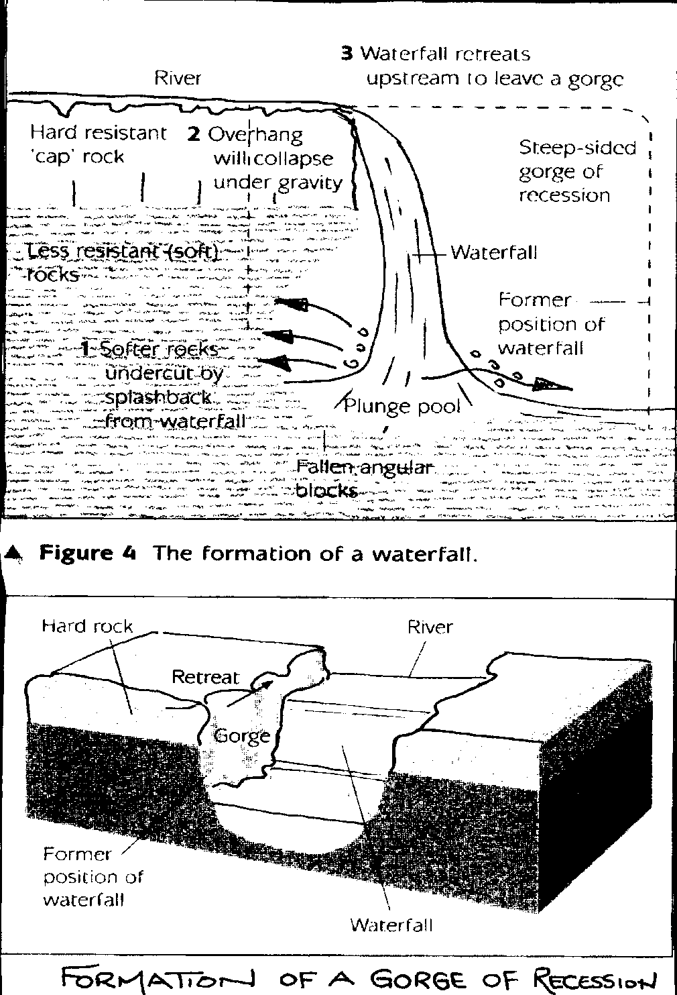
Features of the upper course of a river
The main features of a Waterfall are:
A steep drop in the river ~ called a high head of water
A plunge pool at the base
Hard, resistant rock at the top~ the cap rock
Softer rock below that are undercut.
Waterfalls and gorges are formed over a long period of time they are characterised by the following: -
Bands of hard and soft rock being eroded at different rates. (softer rock the quickest)
The river moves back as the erosion takes place, this is known as recession.
A gorge and waterfall have steep sides

Slide 14
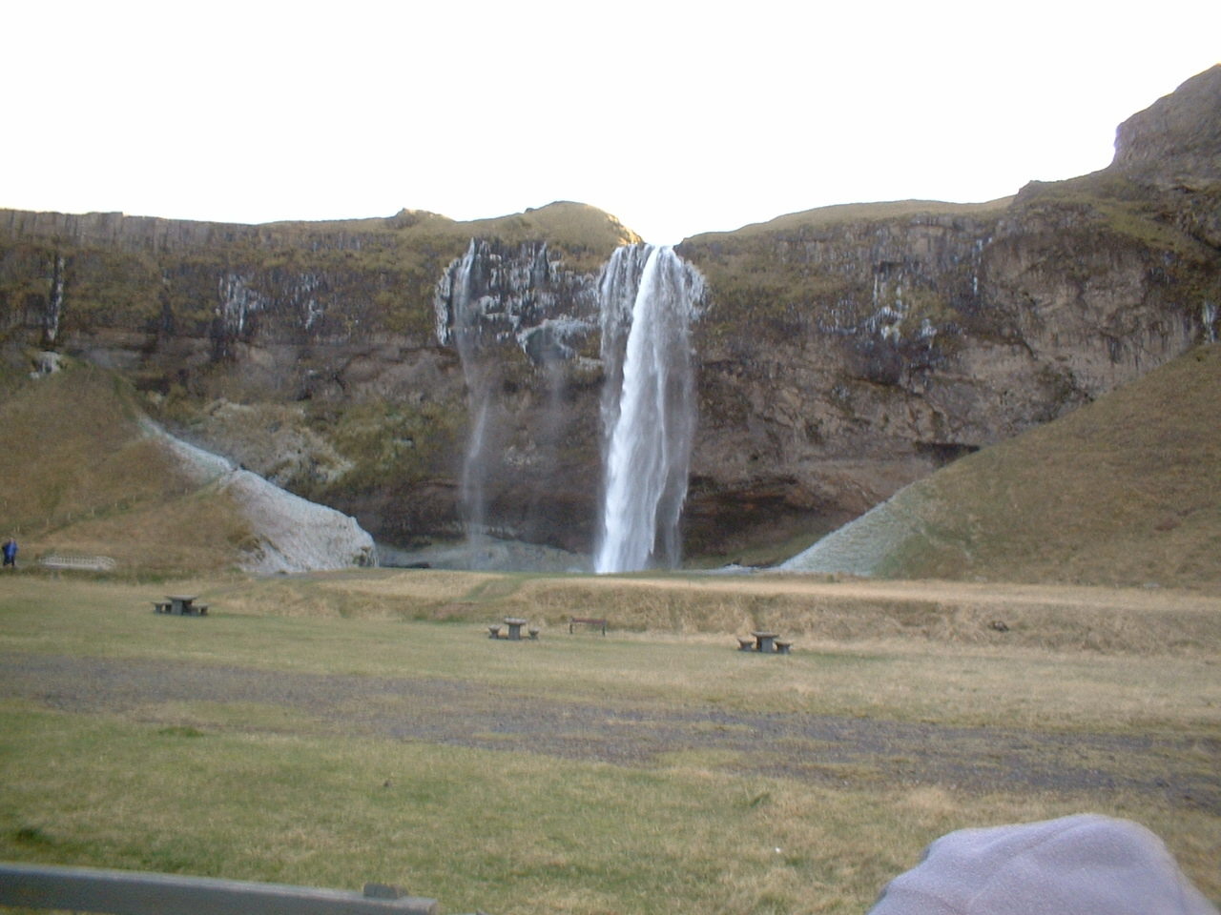
Softer less resistant rock is easily eroded by fast flowing water.
Hard cap rock
(resistant)
Softer rock is undercut by backwash from falling water

Slide 15
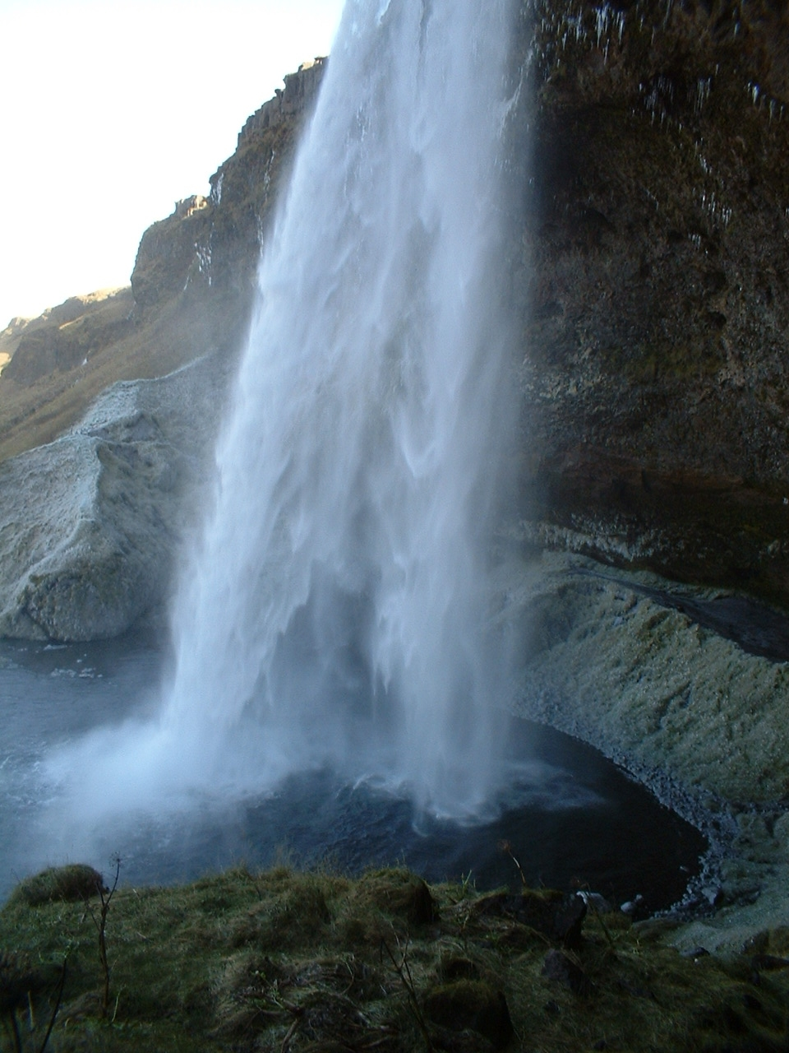
Deep plunge pool at base of waterfall
Undercutting has taken place where softer rock is found

Slide 16
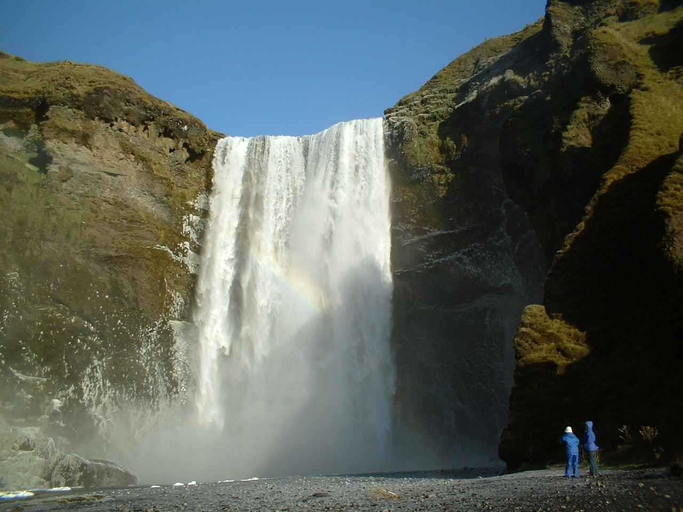
Waterfall over 150 metres high
Deep plunge pool at base of waterfall

Slide 17
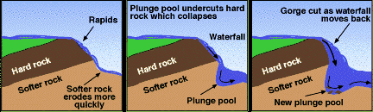
Formation of Waterfalls and Gorges
Using the above sequence to help you, write a short paragraph to explain how waterfalls form.
Use the following words somewhere in your answer:
Hard Rock
Soft Rock
Undercutting
Plunge pool
Erosion

Slide 18
V-shape valley formation – write these out in the correct order in which a V-shape valley is formed
This vertical erosion deepens the valley, making the sides steeper and exposed.
As the small stream flows downhill steeply, the bedload will erode downwards and scrape away the bottom of the chanel (vertical erosion)
Over time, weathering and gravity wear away the steep valley sides, forcing material into the stream, which it uses to cut the valley deeper.
A small stream will naturally follow small depressions in the landscape.

Slide 19
V-shape valley formation –
CORRECT ORDER
A small stream will naturally follow small depressions in the landscape.
As the small stream flows downhill steeply, the bedload will erode downwards and scrape away the bottom of the chanel (vertical erosion)
This vertical erosion deepens the valley, making the sides steeper and exposed.
Over time, weathering and gravity wear away the steep valley sides, forcing material into the stream, which it uses to cut the valley deeper.

Slide 20
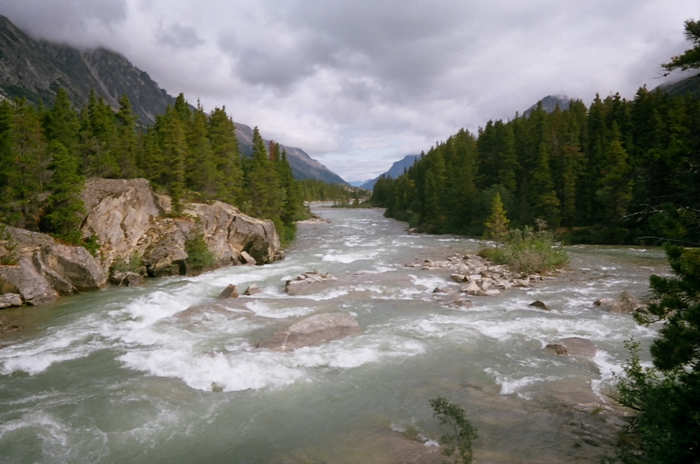
Annotate a sketch of river rapids to show how it forms (use text book to help).

Slide 21
5,4,3,2,1, upper course
Name 5 river upper course features
Give the names of 4 types of river erosion
Name the 3 courses of a river long profile
Give 2 names of river features you can identify on a map
Name 1 upper-course feature that you are confident in explaining to someone else.

Slide 22
Question - Why would Palouse waterfall not be in exactly the same place in 1000 years time?
map
Task 1 - Study the Google Map to the right. Copy the learning question into your book and click on more info to write down some locational information for Palouse Falls. (country, state, closest big city). Then find out how high the falls are in metres.

Slide 23
crazy fellow
Task 2 - Watch the YouTube video to the right. He's a bit of a crazy fellow.
So, he went over the edge and survived. If someone else were to try and equal his record in 1000 years time, why would they have to go to a slightly different location?

Slide 24
Task 3 - Click on the link for a visual illustration.
Task 4 - Produce a three sequence cartoon strip to show the formation of waterfalls using Palouse as your example. Each cartoon strip must be fully annotated and include a scale (height in metres).
waterfalls formation

Slide 26
Task 5
i. What are the key ingredients for a waterfall to form?
ii. Is a waterfall an erosional or depositional feature?
iii. Why is the plunge pool such a dangerous area?

Slide 27
End Task - Wikipedia 3012
You have to write the entry for the Pelouse Falls in the year 3012. You can use this Wikipedia template.
In less than 300 words, write about where and why Tyler Bradt broke the world record in a place that no longer exists. You must use all the annotations from your cartoon section in task 4.

