Slide 1
The Three Gorges Dam
Monday 2nd July
Learning Objective- To investigate whether China is developing sustainably.
hydro power
reservior
Yangtze
- I can locate the Three Gorges dam with place names – Level 4
- I can explain why the government built the Three Gorges Dam – Level 5
- I can evaluate whether the Dam is sustainable in developing China and its people – Level 6/7

Slide 2
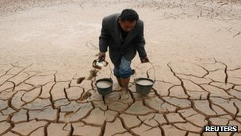
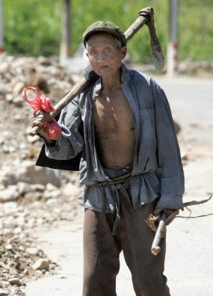
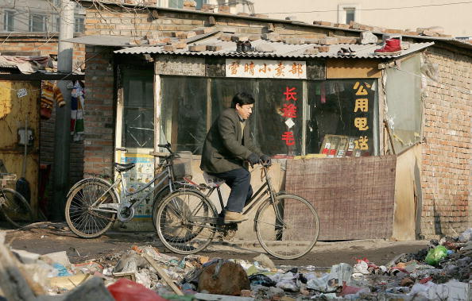
Is there poverty in China?
The gap between rich and poor is already too large.
The government have said by 2020 no-one in China would need to worry about food and clothing.
Some 27 million people were classified as rural poor last year by the government, earning less than 55 cents a day (30p)
Girls are also more at risk than boys of becoming poor.
90% of those
in poverty are
in rural areas
China now has more billionaires than any other country except the USA.
There are over 18
million rural people
living on less than $1 a day (70p)
Those classified as poor are entitled to government help such as subsidies, job training, discounted loans and employment opportunities
The poverty rate
has fallen from 85%
in 1981 to 16% in 2005
L/O - To investigate whether China is developing sustainably.

Slide 3

Is there poverty in China?
90% of those
in poverty are
in rural areas

Slide 4
Is there poverty in China?
1. Read your answer to the person sat next to you
2. Mark your partners answer.
Did they answer the question?
Did they include facts that backed up their point?
Did it make sense, any spelling mistakes?
L/O - To investigate whether China is developing sustainably.

Slide 5




Development
http://www.youtube.com/watch?v=B7U0qaKRnbE
What does development mean?
Development is the process of change for the better.
L/O - To investigate whether China is developing sustainably.

Slide 6
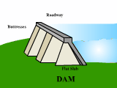
What is a Dam?
A dam is any barrier that holds back water; dams are primarily used to save, manage, and/or prevent the flow of excess water into specific regions. In addition, some dams are used to generate hydropower.
L/O - To investigate whether China is developing sustainably.

Slide 7
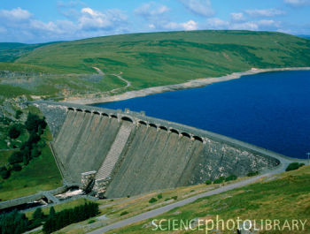
What is a Dam?
Another term often used when discussing dams is reservoir. A reservoir is a man-made lake that is primarily used for storing water.
L/O - To investigate whether China is developing sustainably.

Slide 8
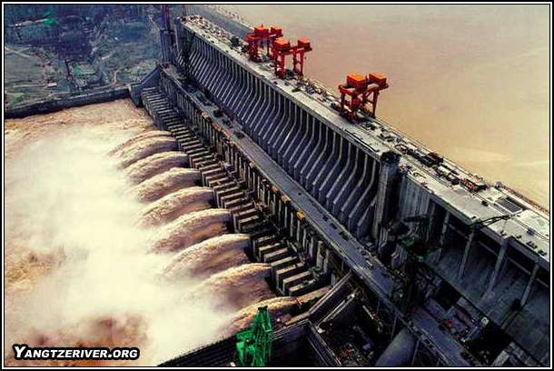
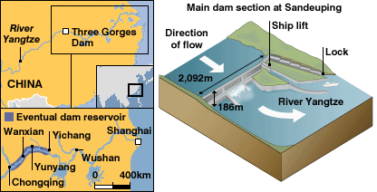
L/O - To investigate whether China is developing sustainably.

Slide 9
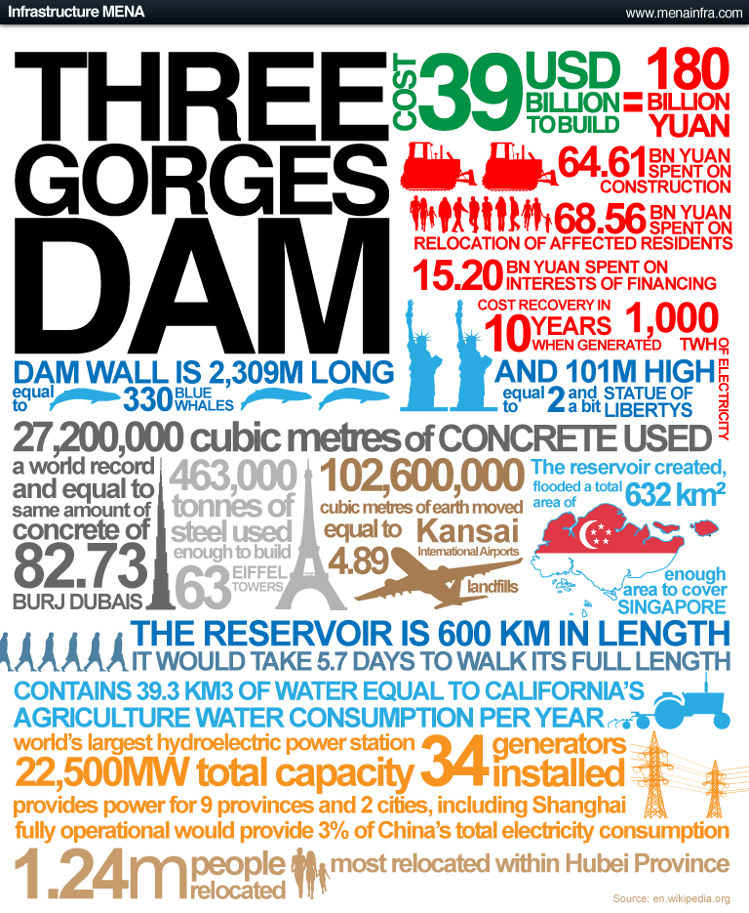
1.Write down 2 facts
about the size of the dam
2. Write down 1
fact about
energy
3. Write down either one social or economic impact

Slide 10
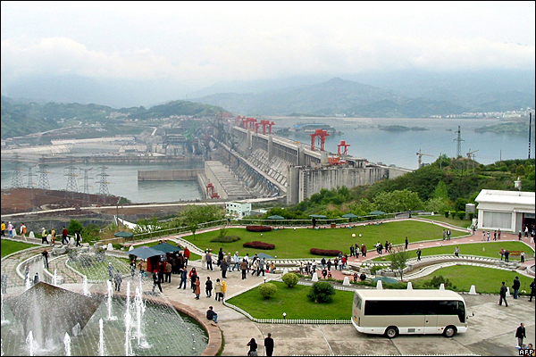
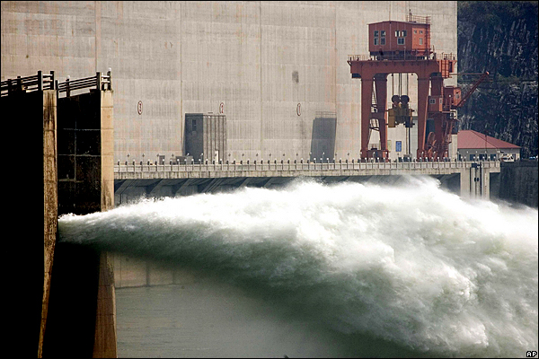
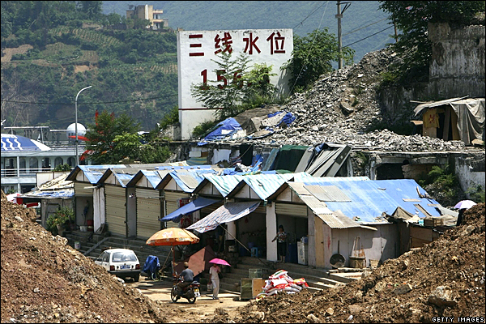
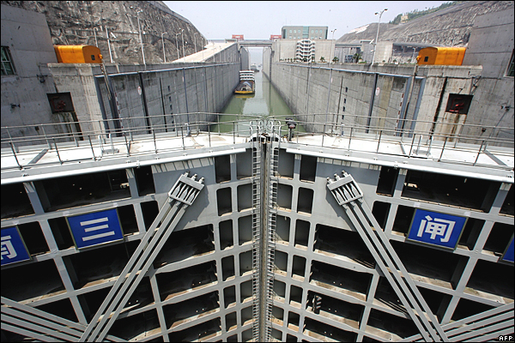
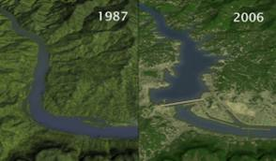
The primary aims of the dam are to alleviate flooding on the Yangtze River and generate power. Fourteen turbine generator units are already in operation.
The project was begun in 1993 at an official cost of 200bn yuan ($25bn), though unofficial estimates are far higher.
China's controversial Three Gorges Dam project hits a significant milestone on Saturday, when it is expected to reach its final height of 185m (607 feet). But it will not be fully operational until 2009
A billboard in the port of Wushan shows the height that the water will reach, ultimately submerging all of its wharf facilities.
When the dam's reservoir reaches its final height of 175m, scheduled for 2009, the five-chamber shiplock will raise boats by as much as 113m.
At least 1 million people are being relocated to make way for the project.

Slide 11
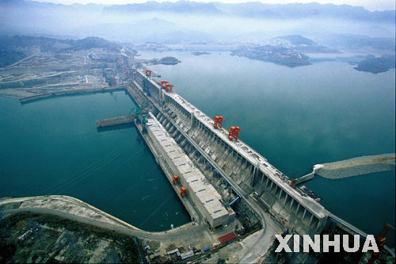
Whilst watching…..
Note down why the Dam was built
Advantages about the Dam
Disadvantages about the Dam
http://www.youtube.com/watch?v=T2JMVxnMqxU
L/O - To investigate whether China is developing sustainably.

Slide 12

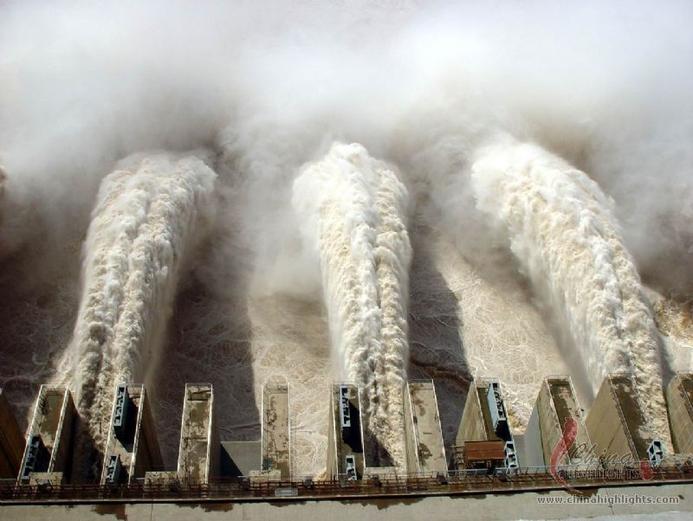
Has the Three Gorges
Dam benefitted the
Chinese people?
Create a Newsround special on the question above, investigating whether the Dam is sustainable.
Use the information sheets around the classroom to add full detail on the Dam.
Everyone in your group should have a role
e.g info collector, intro, why it was built, positives of the project, negatives of the dam.
L/O - To investigate whether China is developing sustainably.

Slide 13
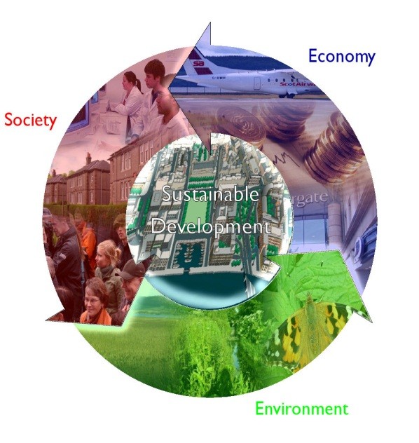
Finally.....
Use the paragraph grid to evaluate the sustainability of the dam
The Three Gorges Dam was built because….
The positives of the dam are…
1)
2)
The negatives of the dam are
1)
2)
In conclusion, I think the dam is sustainable/not sustainable because
The Chinese government could have done ……….
To make it more sustainable. Because …….
L/O - To investigate whether China is developing sustainably.

Slide 14


Flooding controlled
Change landscape
Tourism introduced
Damage wildlife & ecosystems
Hydroelectric power
Recreation opportunities
Can flood downstream
Very expensive
L/O - To investigate whether China is developing sustainably.

Slide 15
Flooding controlled
Very expensive
Tourism introduced
Change landscape
Damage wildlife & ecosystems
Hydroelectric power
Can flood downstream
Recreation opportunities
L/O - To investigate whether China is developing sustainably.

Slide 16
The Three Gorges Dam
Learning Objective- To investigate whether China is developing sustainably.
hydro power
reservior
Yangtze
- I can locate the Three Gorges dam with place names – Level 4
- I can explain why the government built the Three Gorges Dam – Level 5
- I can evaluate whether the Dam is sustainable in developing China and its people – Level 6/7

