Slide 1
The Impacts of Tourism in Cambodia
The Good, The Bad, and The Ugly!

Slide 2
Ecotourism in Cambodia
The Good!

Slide 3
Sun and Moon Bear Sanctuary
http://www.youtube.com/watch?v=KuPNFXBsHFo

Slide 4
Our bears have been:
Rescued from restaurants where they would have been butchered and served as bear paw soup to diners.
Confiscated from hotels and restaurants where they were caged for the amusement of guests and tourists.
Seized from the black market and rescued from bear bile farms where their gallbladders and other parts may have been used for traditional medicines or souvenirs.
Saved from poachers selling orphaned cubs as exotic pets or as status symbol.
Freed from snare traps set in the forests to capture animals.

Slide 5
Child Sex Tourism (CST)
The Ugly!

Slide 6
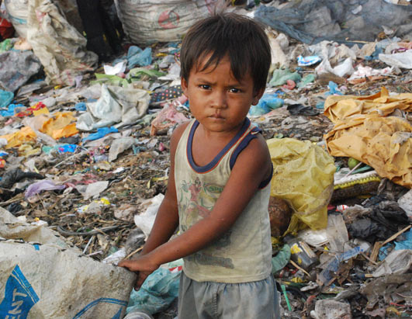
Children in Cambodia
More than 50% of people in Cambodia are under 21 years old.
Over one third of the population lives below the poverty line.
Cambodia is ranked as 154th out of 178 countries in terms of corruption, whereby the powerful are able to further exploit those with less influence. Children inevitably fall victim to these power plays. Corruption acts as a major obstacle in the effective prosecution and punishment of child abusers.
The number of street children (estimated at 10,000 to 20,000) is increasing at a rate of 20 per cent per year. Factors as to why children are on the streets include poverty, domestic violence, rapid population growth, and rural-urban migration. Weaknesses in the education system encourage the supply of child labour and incidence of street children. Additionally, in 2009 there were 27 forced evictions of slums (involving 23,000 people) in Cambodia, inevitably contributing to the population of street families, and children without adequate shelter.
According to the National AIDS Authority (NAA), there are 80,000 orphans and vulnerable children living in Cambodia as a result of the AIDS epidemic.
UNESCO estimates that there are 700,000 economically active children between the ages of 5 and 17 in the country. Nearly three quarters of these children have dropped out of school.

Slide 7
Child Sex Tourism
The commercial sexual exploitation of children affects millions each year.
One form of this exploitation is the growing phenomenon of Child Sex Tourism (CST).
People who travel from their own country to a foreign country to engage in a commercial sex act with a child commit CST.
The crime is fueled by weak law enforcement, the Internet, ease of travel, and poverty.

Slide 8
Global Efforts Made to Address the CST Phenomenon
In response to the growing phenomenon of CST, intergovernmental organizations, the tourism industry, and governments have begun to address the issue. World Congresses Against Commercial Sexual Exploitation convened in Stockholm and Yokohama in 1996 and 2001, drawing significant international attention to the issue.
The World Tourism Organization established a task force to combat CST and promulgated a Global Code of Conduct for Tourism in 1999.
Over the last five years, there has been a worldwide increase in the prosecution of child sex tourism offenses. Today, 32 countries have extraterritorial laws that allow the prosecution of their nationals for crimes committed abroad, regardless of whether the offense is punishable in the country where it occurred.

Slide 9
Combating Child Sex Tourism
Several countries have taken commendable steps to combat child sex tourism:
Brazil implemented a national and international awareness campaign on sex tourism.
Italy requires tour operators to provide information regarding its extraterritorial law on child sex offenses.
Swedish tour operators have signed a code of conduct agreeing to educate its staff about CST.
Japan prosecutes its citizens caught having sex with children in other countries.

Slide 10
AND Cambodia …
Cambodia established police units focused on combating child sex tourism and has arrested and extradited foreign pedophiles.

Slide 12
Srey’s Story
“I was tricked and sold to a brothel when I was only 14. Everyday, I would have to provide services to 10 men against my will."
Srey, a Cambodian child sex tourism survivor, spoke these words as she shared her story with an audience of high-level government representatives
Recently, the group convened in Hanoi, Vietnam, to address the crisis of southeast Asia's sexually exploited children.

Slide 13
“On the weekend, it can be as many as 20 customers; most of them are foreigners. I was sick and disgusted," the teenager added.
Srey implored: "I would like all of you to understand that child sex tourism is a real problem, and I would like all of you to do everything you can to prevent other children from facing the same problem I did."

Slide 14
Tragically, the teenager's experience is not uncommon in Cambodia.
In 2001, research conducted by World Vision and the Cambodian Ministry of Tourism, revealed: 45% of Cambodian travel agents interviewed said they had witnessed tour guides "supplying" children to foreign visitors.
More than 70 percent of children surveyed in the vicinity of Angkor Watt, a popular tourist destination, said tourists had approached them for sex.

Slide 15
