Slide 1
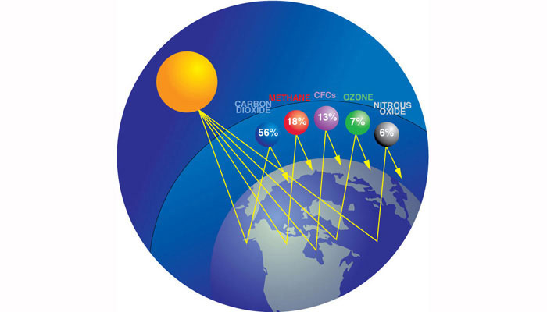
The GHGs

Slide 2
Exam Question
Draw a labelled diagram to show the radiation inputs and outputs in the atmosphere which result in global warming (the enhanced greenhouse effect)
(6 marks)
Mark scheme
Show incoming short-wave (1 mark)
Show outgoing long-wave radiation returning to space (1 mark)
Show some of the radiation being reflected and absorbed (1 mark)
Show a layer of greenhouse gases (1 mark)
Further detail and accuracy (2 marks).

Slide 3
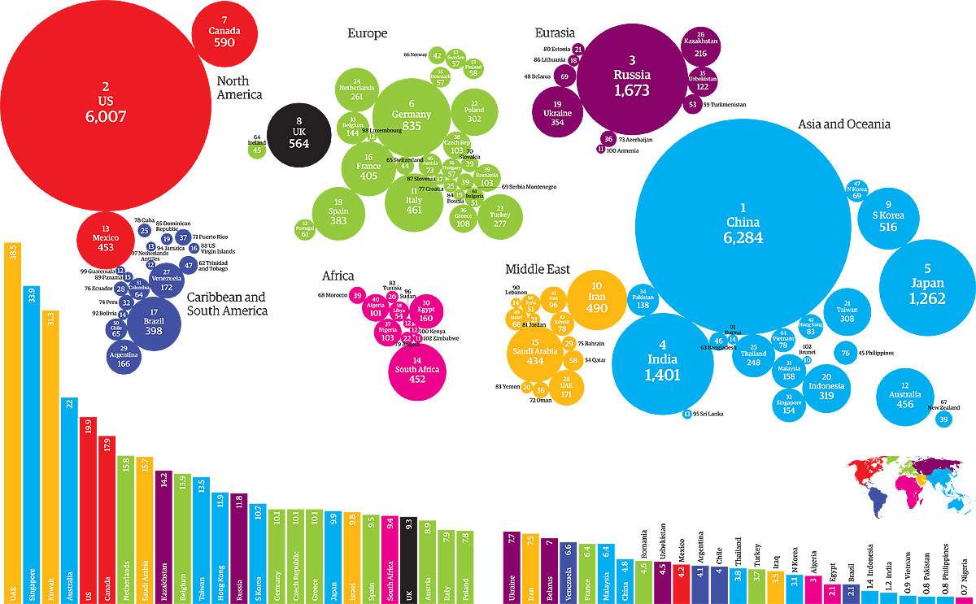
Carbon Emissions Atlas

Slide 4
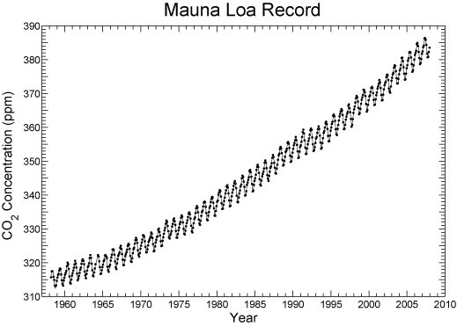
What Is the Keeling Curve?
The Keeling Curve shows that atmospheric carbon dioxide levels are increasing, and at a faster rate each year.

Slide 5
Charles David Keeling’s discovery
In 1953 Keeling observed that there were higher concentrations of CO2 at night due to localized respiration of plants
He further discovered that CO2 levels peaked in May and dropped in October.
"We were witnessing for the first time nature's withdrawing CO2 from the air for plant growth during summer and returning it each succeeding winter."
(Keeling, Scripps Institution of Oceanography)

Slide 6
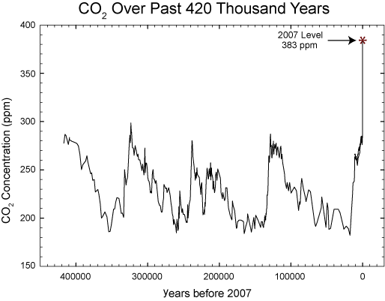
Unprecedented CO2 Levels
But Keeling also discovered something more profound: Year after year, the amount of CO2 in the atmosphere was gradually increasing due to the combustion of fossil fuels.
Of even greater concern to Keeling was his discovery that the rate of increase was sharper each successive year, giving Keeling's CO2 chart a distinctive upward curve, now called the "Keeling Curve."
Keeling's record of data from Mauna Loa is considered one of the best and most consistent climate records anywhere, though scientists also use other sources for atmospheric data, including samples of air trapped in polar ice, to analyze CO2 levels in past millennia.
The rate at which atmospheric carbon dioxide levels are increasing is unprecedented.
Source: Scripps Institution of Oceanography

Slide 7
Methane (CH4)
Natural wetlands and paddy fields are a source of Methane emitting 150 million tonnes annually
As global warming increases, bogs trapped in permafrost will melt and release vast quantities of methane.

Slide 8
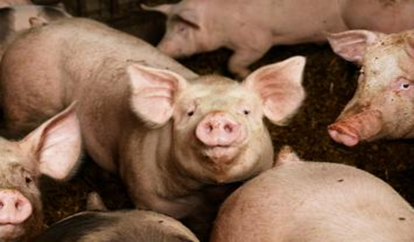
Methane is the second largest contributor to global warming
It is estimated that cattle convert up to 10% of the food they eat into methane
They emit 100 tonnes of methane into the atmosphere each year.
Factory farms and the demand for meat is increasing
Methane emissions are increasing at a rate of 1% per year

Slide 9
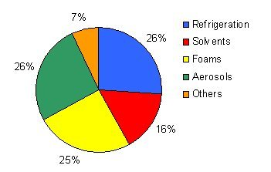
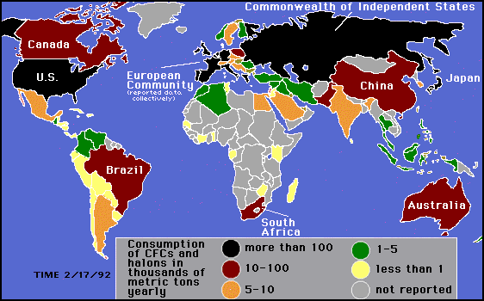
Chlorofluorocarbons (CFCs)
CFCs are synthetic chemicals that destroy the Ozone as well as absorb long-wave radiation.
CFCs are increasing at a rate of 6% per annum and are up to 10,000 times more efficient at trapping heat than CO2

Slide 10
Ozone
Ozone (O3) is a molecule made up of three oxygen atoms. It is formed from dioxygen (O2) molecules by the action of ultraviolet light and atmospheric electrical discharges.
Ozone is always present in the Earth's atmosphere in low concentrations.
It makes up 0.6 parts per million of the atmosphere. This presence of ozone in the Earth’s atmosphere is referred to as the ozone layer.
It is a pale blue gas with a distinctively pungent smell like chlorine.
Ozone is a potent respiratory hazard and pollutant near ground level. However, the ozone layer (a portion of the stratosphere with a higher concentration of ozone, from two to eight ppm) is beneficial, preventing damaging ultraviolet light from reaching the Earth's surface, to the benefit of both plants and animals.

Slide 11
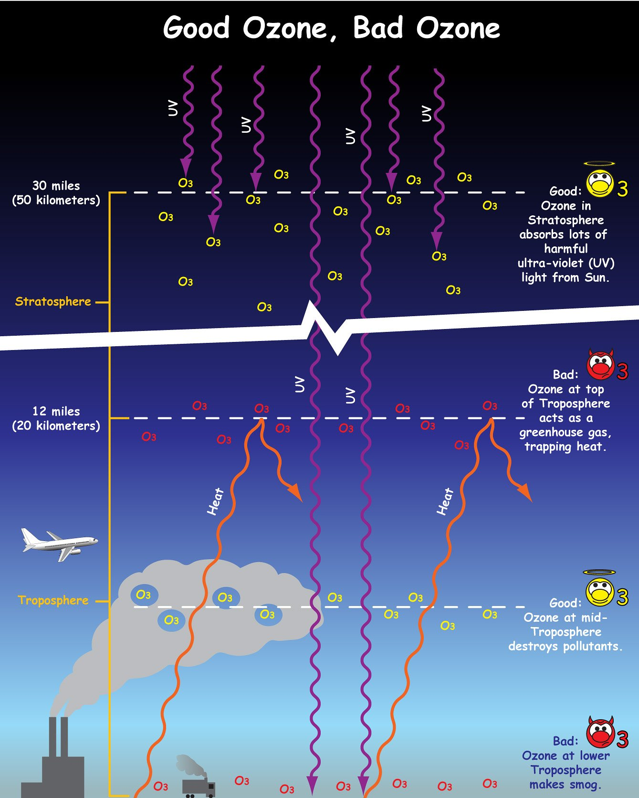

Slide 12
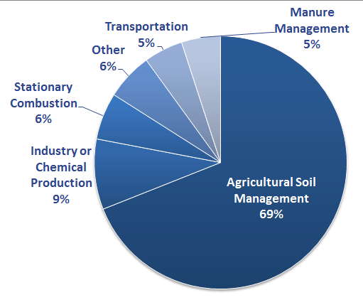
Nitrous Oxide (N₂O)
Nitrous oxide is naturally present in the atmosphere as part of the Earth's nitrogen cycle, and has a variety of natural sources. However, human activities such as agriculture, fossil fuel combustion, wastewater management, and industrial processes are increasing the amount of N₂O in the atmosphere. Nitrous oxide molecules stay in the atmosphere for an average of 120 years before being removed by a sink or destroyed through chemical reactions. The impact of 1 pound of N₂O on warming the atmosphere is over 300 times that of 1 pound of carbon dioxide.
Globally, about 40% of total N₂O emissions come from human activities. Nitrous oxide is emitted from agriculture, transportation, and industry activities

Slide 13
