Slide 1
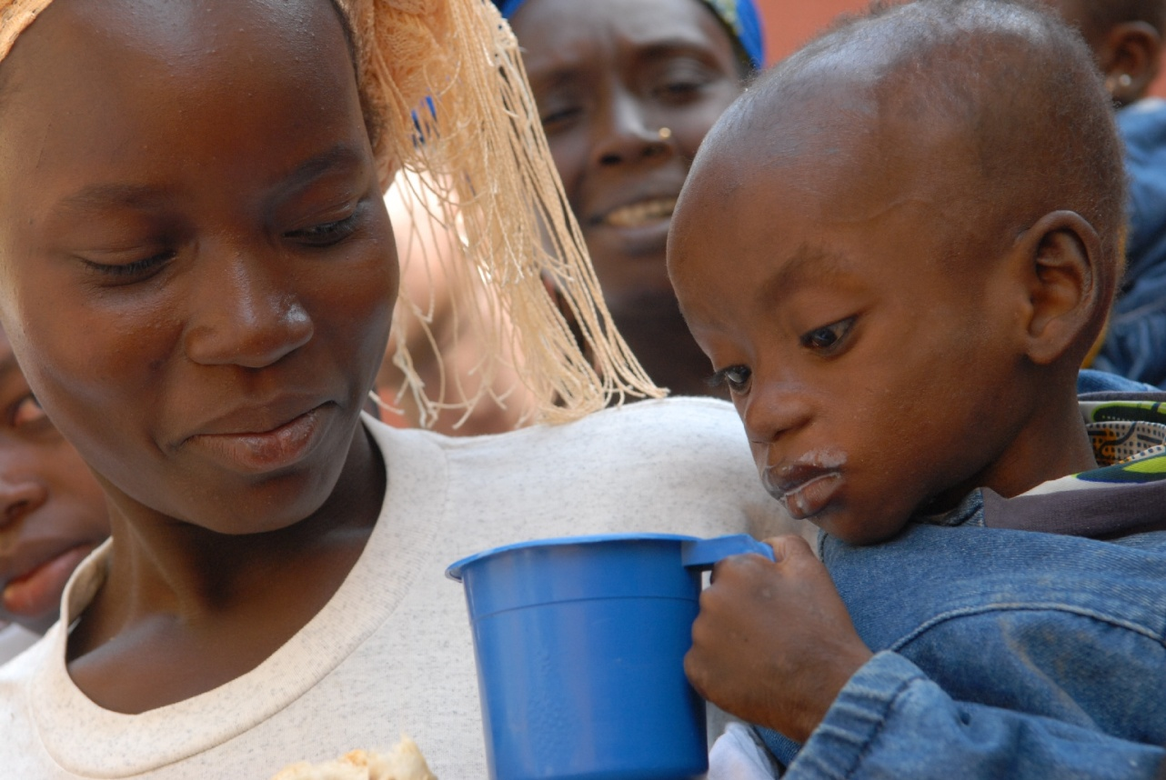
The Food Crisis

Slide 2
Food crisis? What food crisis?
Food is a human right that is essential to live a safe and healthy life. In order for people to grow and develop, food must be available, food must be affordable and food must be prepared safely.
For most people in Australia and other high income countries, there is plenty of food in homes and on supermarket shelves. However, people living in poverty have limited access to food. Those who live in poverty may not have enough money to buy food or have access to land on which to produce their own food.

Slide 3
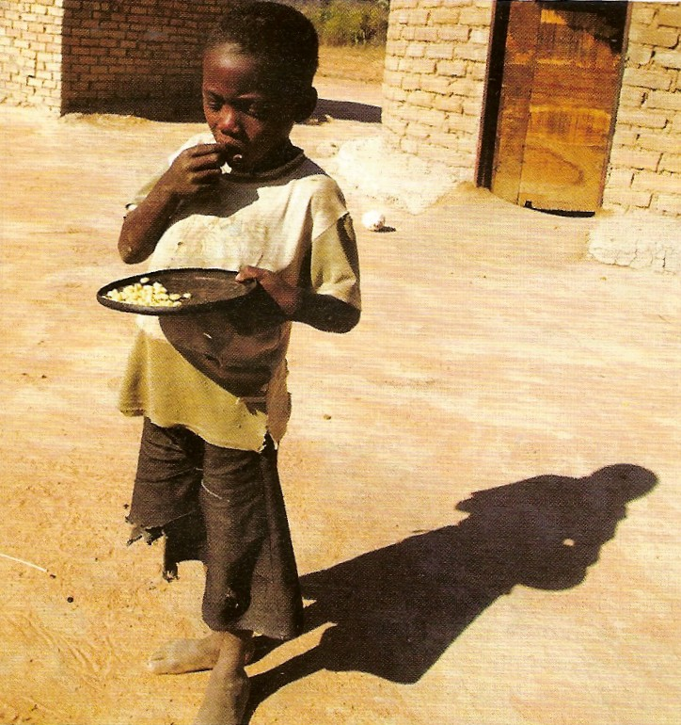
Food crisis in Zimbabwe
Food crisis in Australia

Slide 4
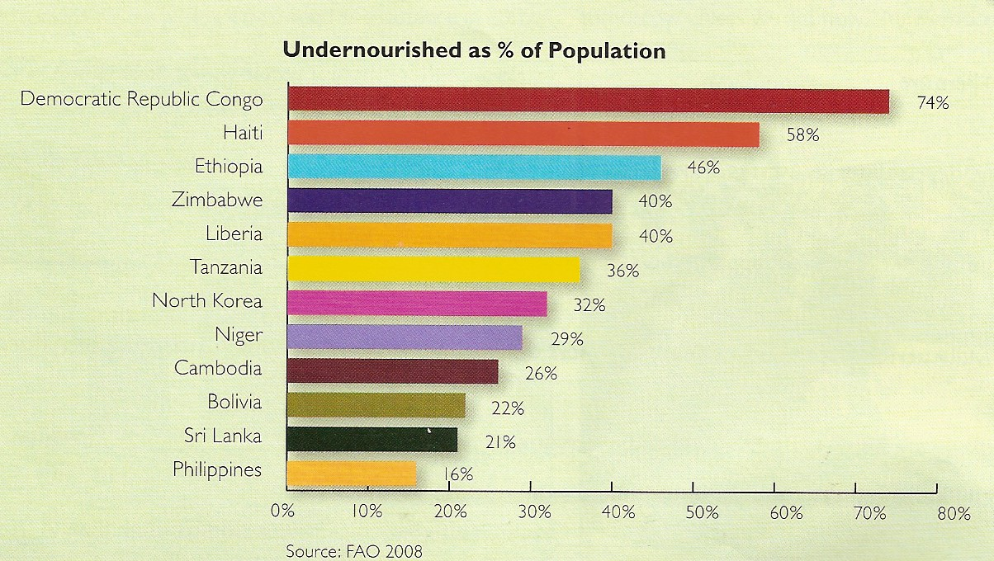
Where is the food crisis?

Slide 5
Activity 1
Using an atlas, find the countries suffering from the food crisis mentioned in the graph.
Label and record the percentage of the population undernourished on your blank World map.

Slide 6
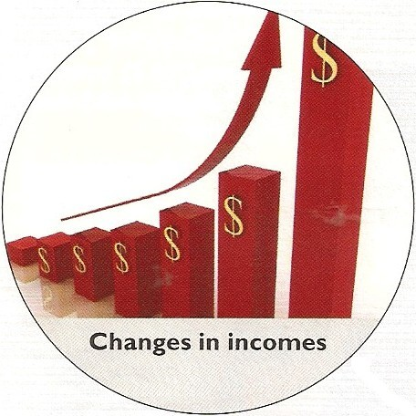
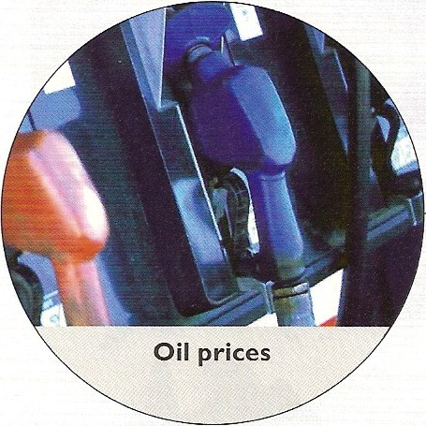
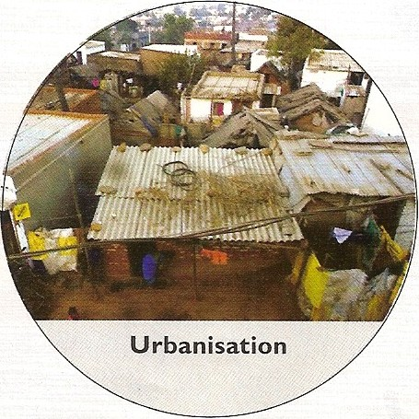
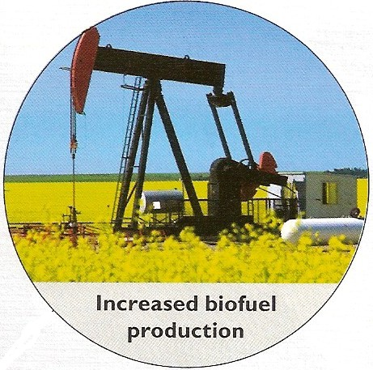
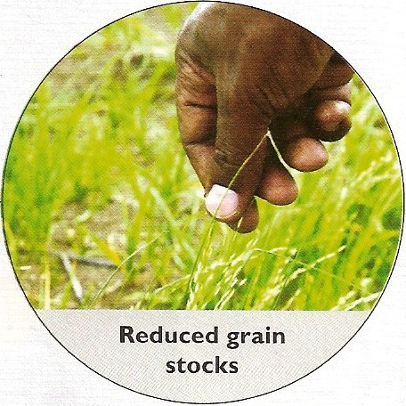
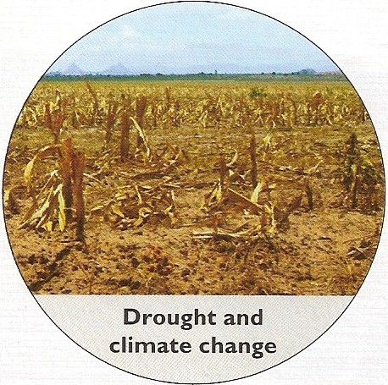
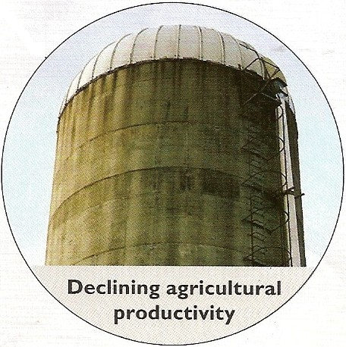
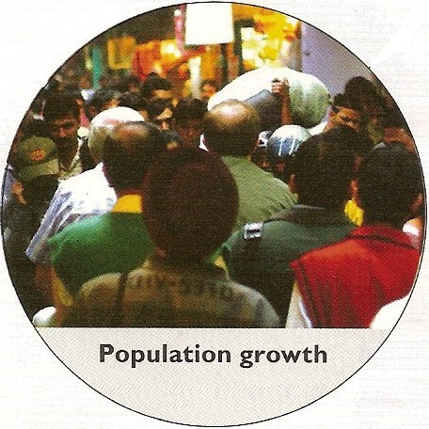
What are the causes of the food crisis?

Slide 7
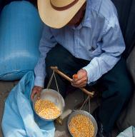
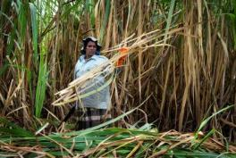
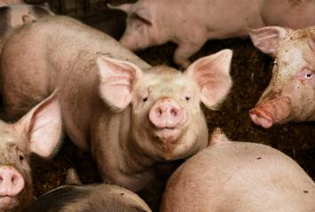
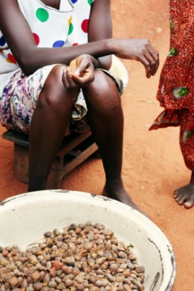
Which of these are a biofuel?
Bioethanol from corn in the USA
Bioethanol from sugar cane in Brazil
Biodiesel from palm oil in Malaysia
Biogas from pig poo in the UK

Slide 8
Activity 2
As a class, match up the passages to the correct heading and picture and insert the missing word in each passage from the word bank.
Do the same with your individual copies and glue them into your books.

Slide 9
Country In focus – Sudan
Use the information from your books page 117 to complete your fact file
The main effects:
Information about location and characteristics of country:
The main Causes:
Suggest solutions to improve the situation:

Slide 10
Country In focus – Zimbabwe
Use the information from your books page 118 to complete your fact file
The main effects:
Information about location and characteristics of country:
The main Causes:
Suggest solutions to improve the situation:

