Slide 1
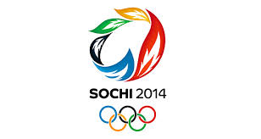
The 2014 Winter Olympics

Slide 2
The 2014 Winter Olympics are being held in Sochi, in Russia

Slide 3
Sochi is in Russia, the largest country in the world. It is situated on the coast of the Black Sea.
Can you find it on the map?
How would you travel there from the UK?

Slide 4
Russia
Nearly double the size of the United States!
Continent: Europe
Capital city: Moscow
Official language: Russian
Weather and climate: mild summers and very cold winters

Slide 5
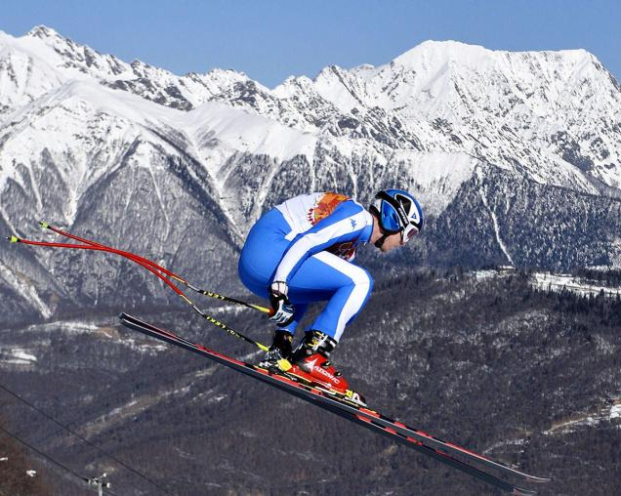
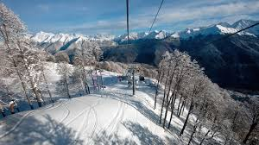
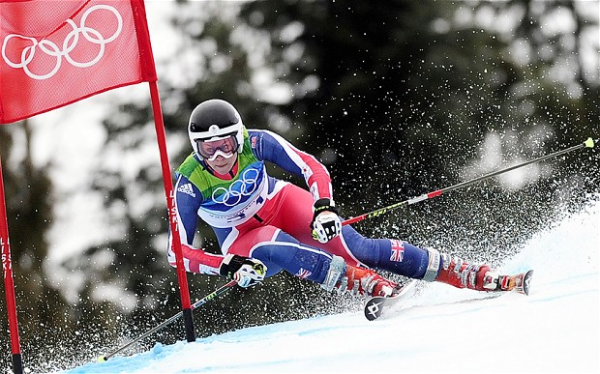
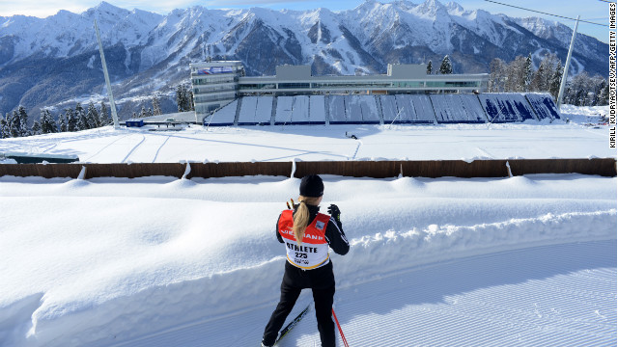
Why do you think Sochi is a great place to hold the Winter Olympics?

Slide 6
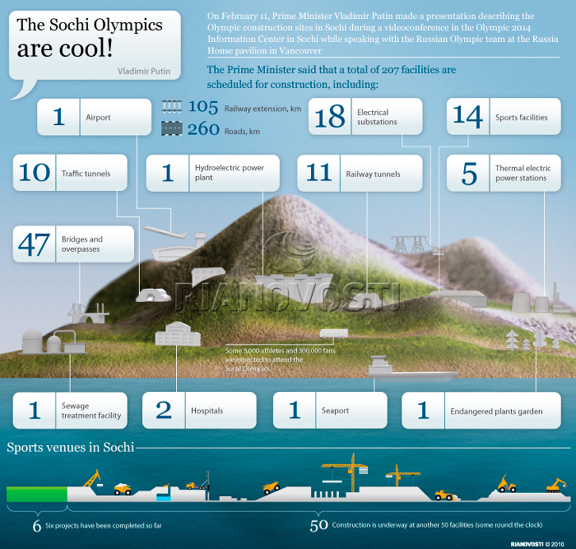

Slide 7
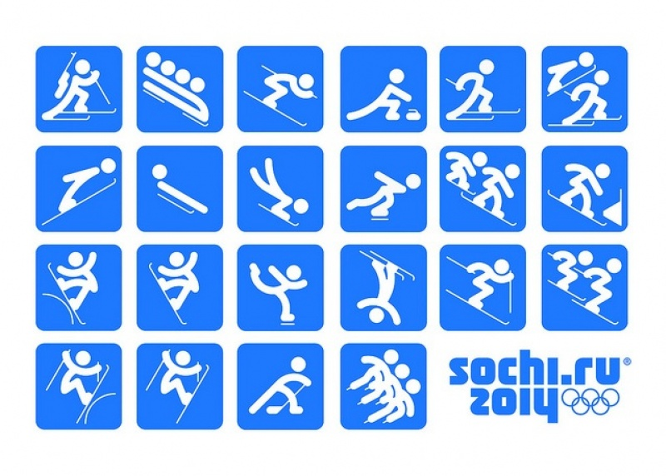
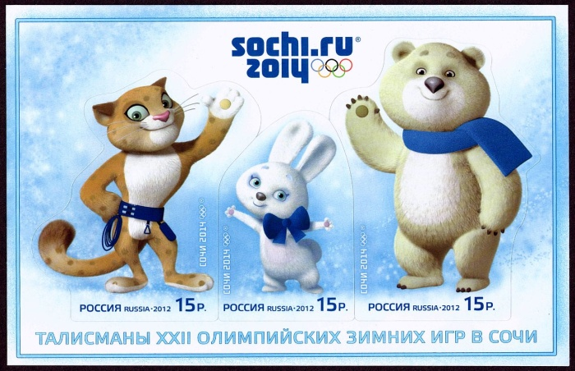
Your task:
Write about the Olympics in Sochi this year…
What have you found out?
Where is Sochi and what is it like?
If you were going to visit the Winter Olympics, what would you need to pack in your suitcase?

