Slide 1
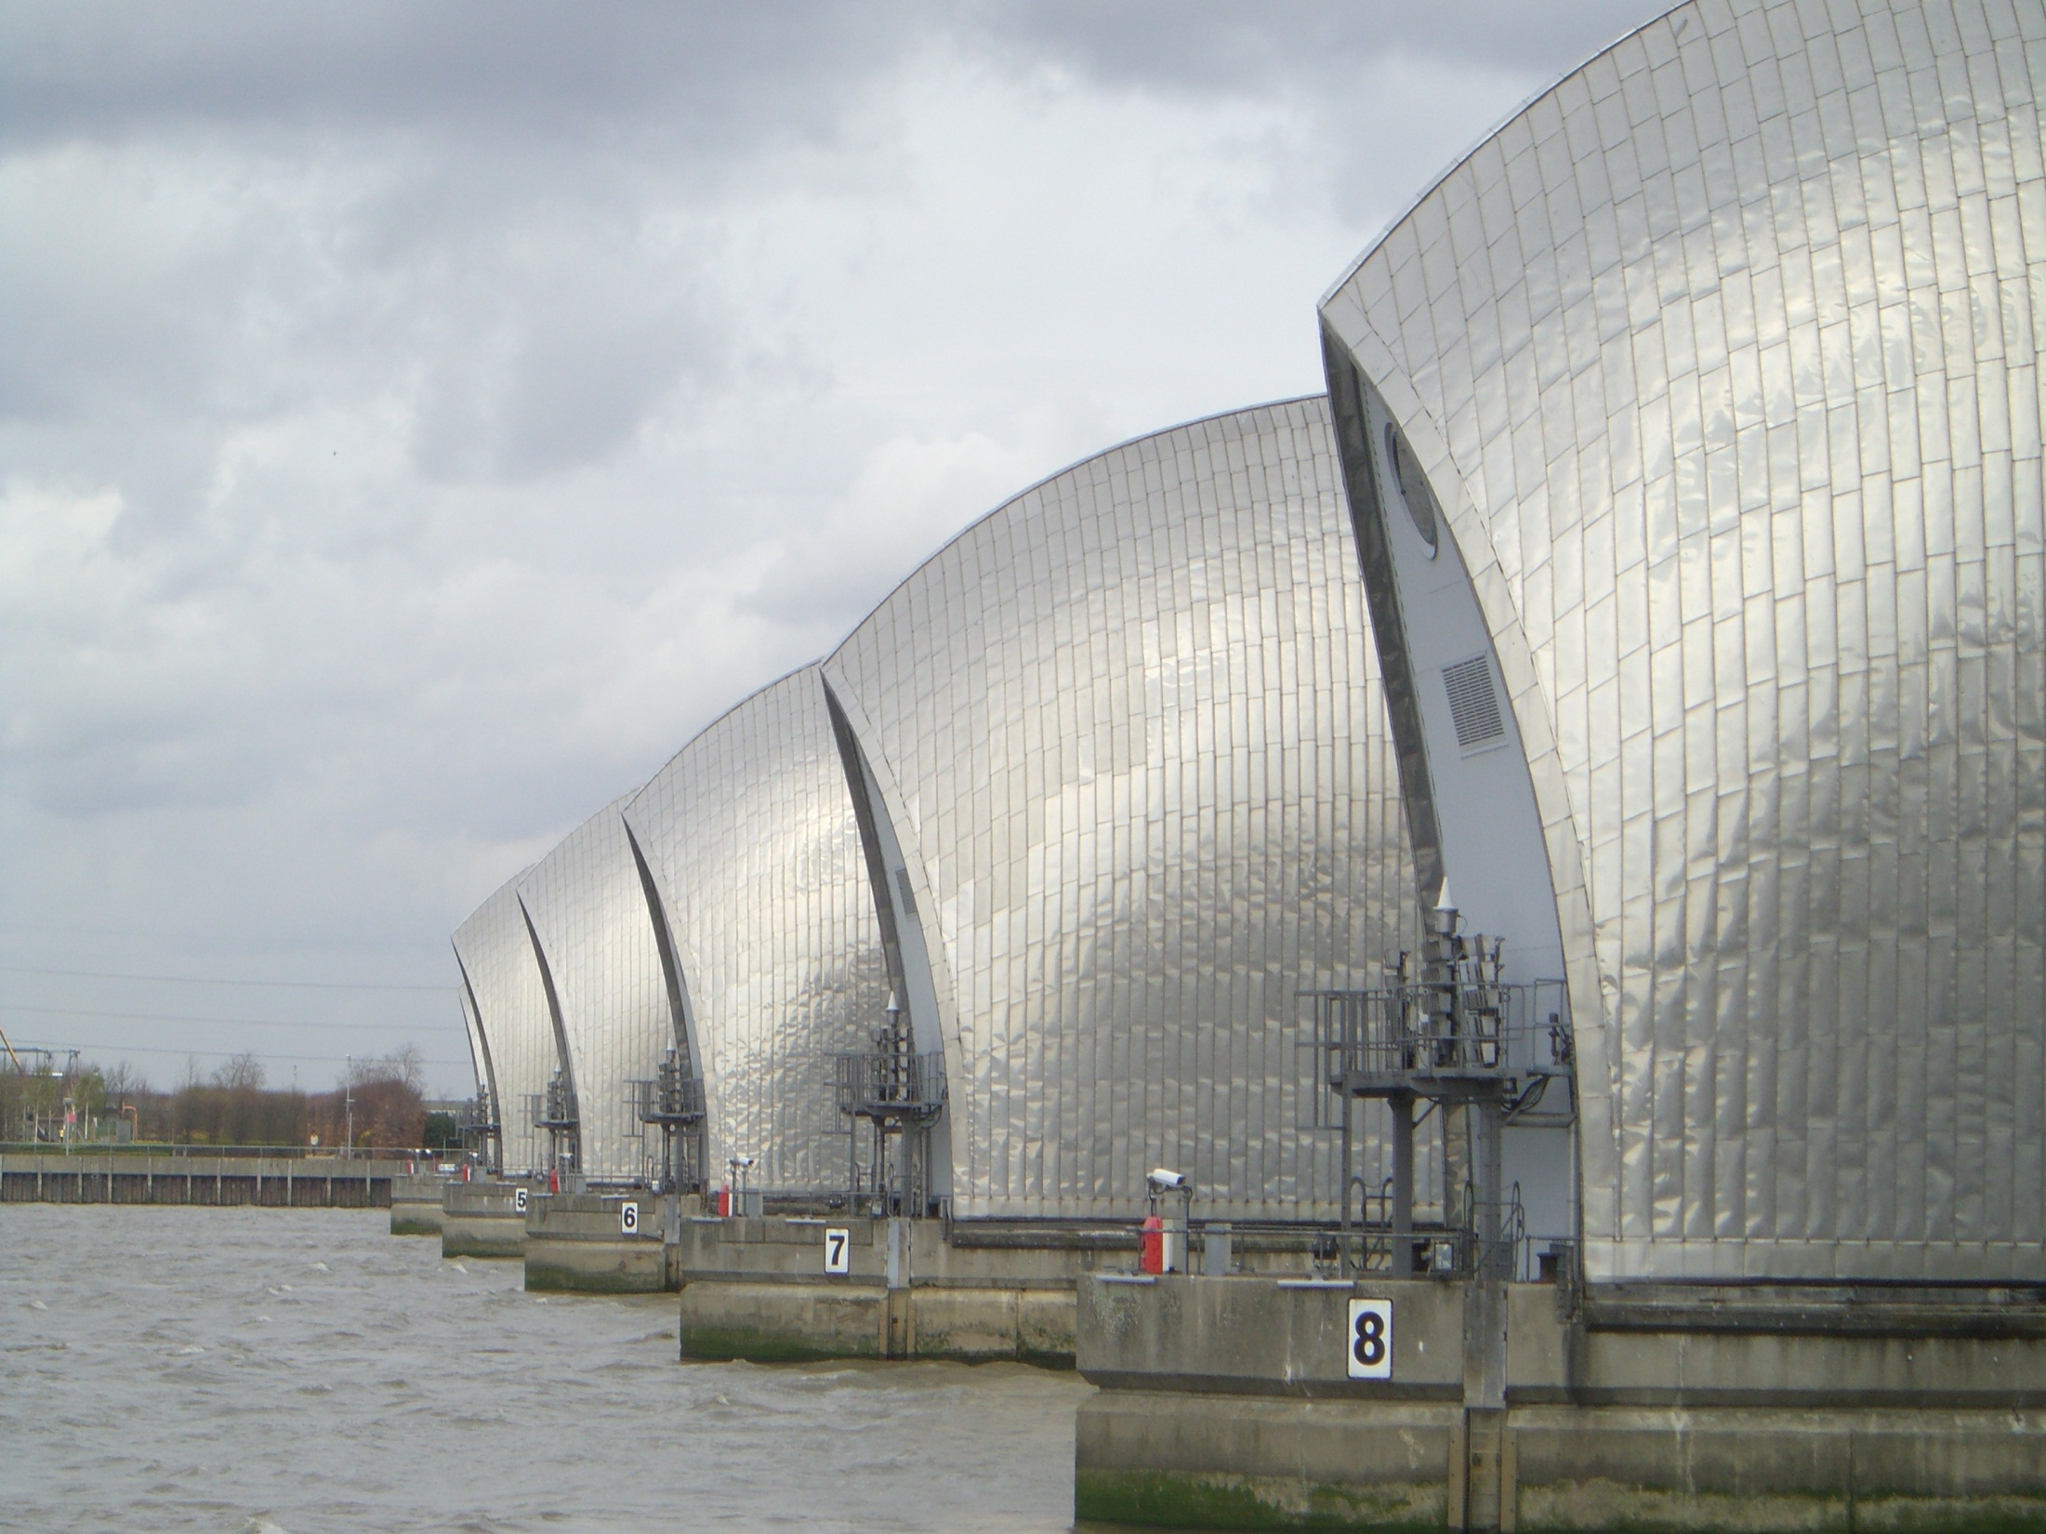
Thames Barrier How does it protect London?

Slide 2
Learning Outcomes
By the end of the lesson you will be able to:
Explain how the Thames Barrier protects London from flooding

Slide 3
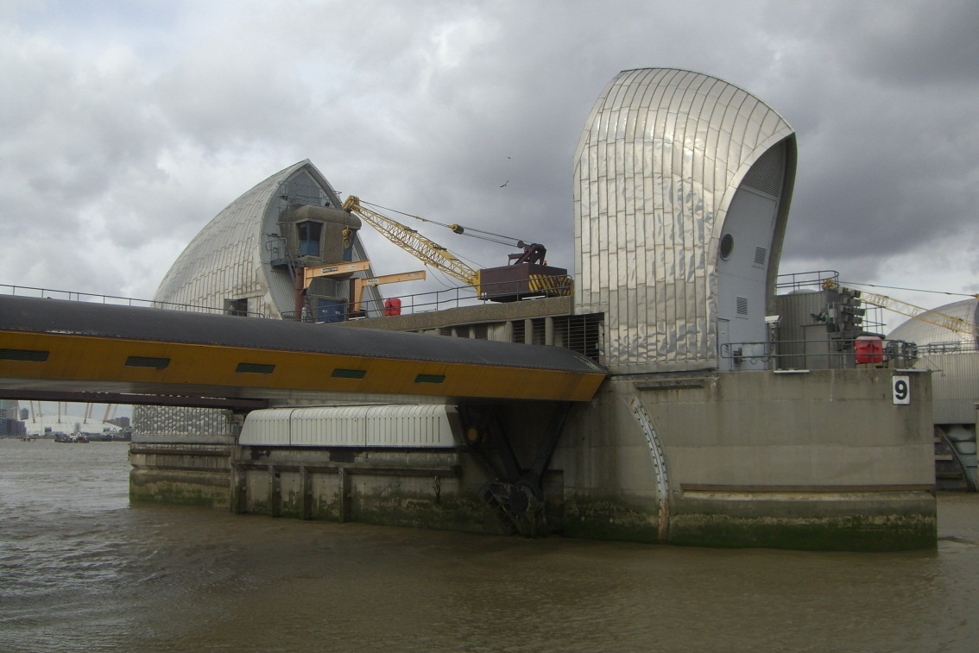
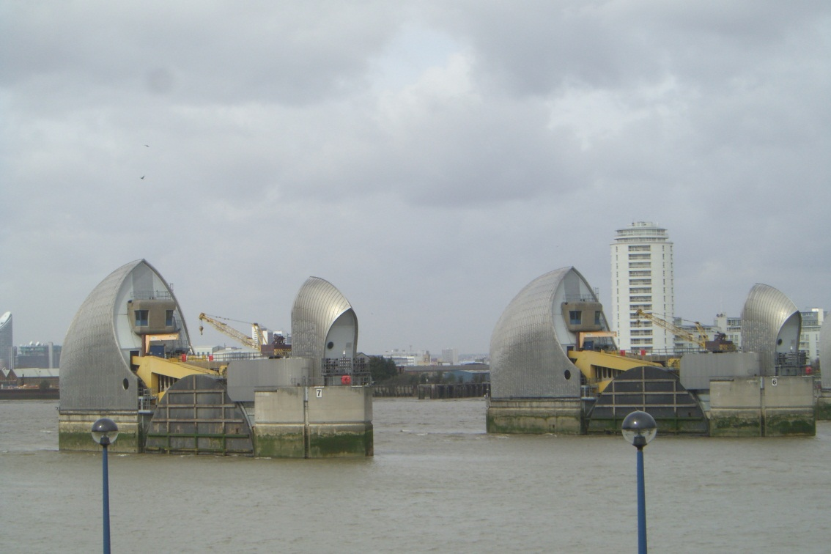
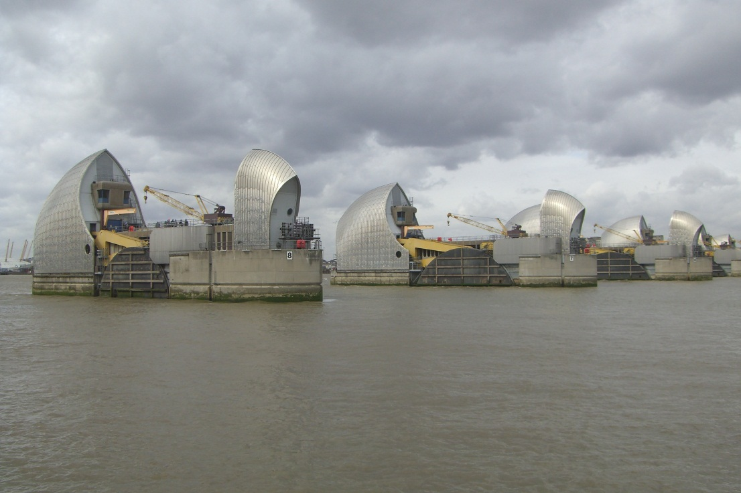
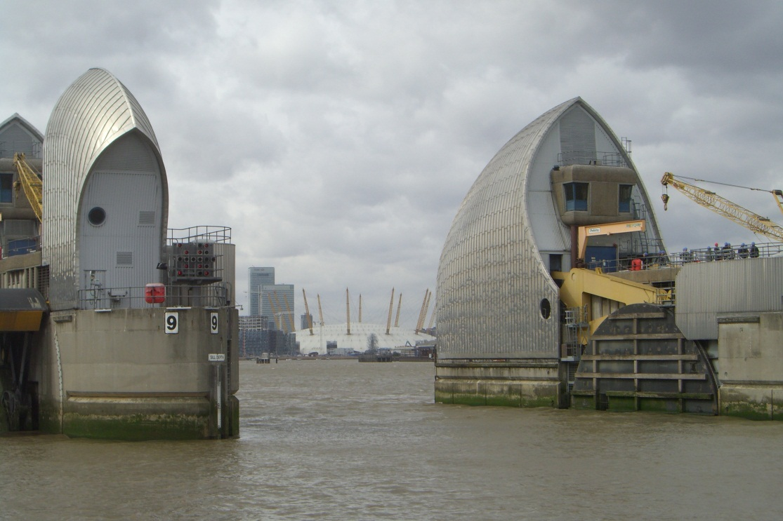

Slide 4
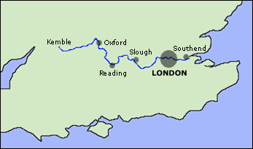
River Thames

Slide 5
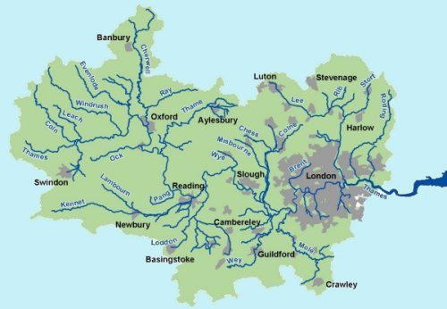
River Thames catchment area

Slide 6
How does flooding in London happen?
Flooding from the river source
When there is precipitation at the source of the River Thames in Gloucestershire, it takes a while to reach London. If there is also heavy precipitation in areas where there are tributaries of the Thames as well as in London, then there is potential for floods (especially when combined with a high tide – as the river is affected by tides in London).
Flooding from the North Sea
When there is a storm in the North Sea, surges can happen which means that sea levels are higher than normal. Additionally, when there are high tides, there is often not much room for much more water in the river in Central London.

Slide 7
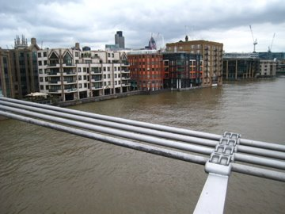
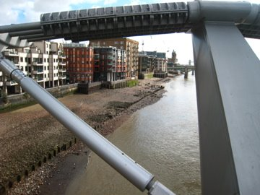
These pictures were taken on the Millennium Bridge connecting St Paul’s Cathedral to the Tate Modern
High tide
The river can change between 5 and 7 metres due to the changing tides!
Low tide

Slide 8
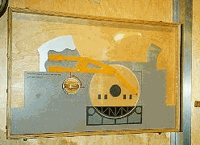
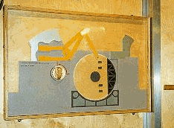
How the barrier works:

Slide 9
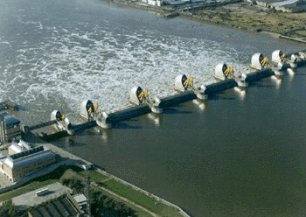
The barrier in operation:

Slide 10
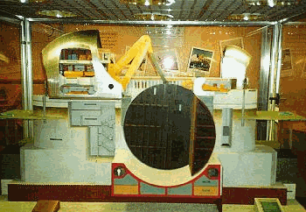

Slide 11
Using a double page in your exercise books, complete a spider diagram like this:
Any other information/statistics
Past
Thames Barrier
Future
Present

Slide 12
Exam questions
Explain one method that can prevent flooding (4)
Using at least one example you have studied, explain how flooding is managed (6)

