Slide 1
Fashion and Globalisation
Today We are learning to:
Develop an understanding of the lives of the people who make our clothes
We will do this by:
Investigating two sweatshop scandals and then comparing them.

Slide 2
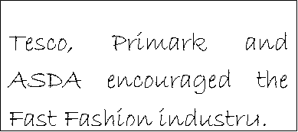
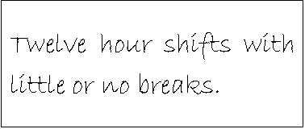
Fast fashion facts
In 2000, people in the UK spent £28 billion on clothing …
Almost £ 470 for every person…

Slide 3
Your group has a sweatshop Scandal to investigate
TASK:
Read through the information your group has been given, fill in the fact file and make a presentation to teach the class about your scandal. Each of you will need to say something.
With the information you will learn from the other groups you will then compare and contrast two different cases. This writing will be marked!

Slide 4
Sweatshop shame In focus – The GAP
Use the information around the room to complete your fact file
Information about Amitosh:
Information about Jivaj and Manik:
What GAP says:
What GAP did:

Slide 5
Sweatshop shame In focus – Nike
Use the information on your sheet to complete your fact file
Information about Nike’s worst mistake:
Breakdown of costs for a pair of shoes:
What Nike says:
Breakdown of cost for a sweatshirt:

Slide 6
Compare and contrast GAP and NIKE

