Slide 1
For or Against ?
Sweatshops

Slide 2
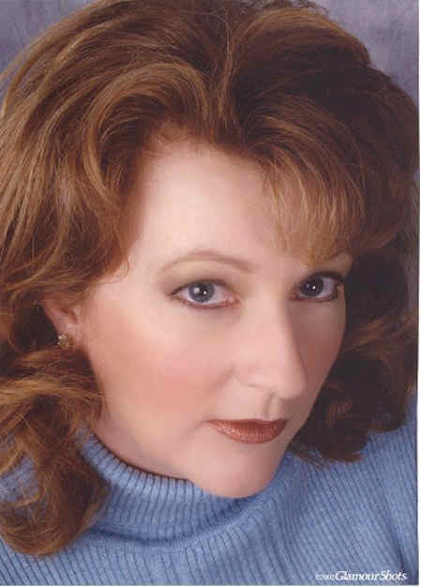
Mum of three, clothes shop manager and fashion lover
This is the ‘utilitarian approach’
My approach to ethical dilemmas: Weigh up the benefits and costs and choose the option that makes most people happy.
Michelle
“I love clothes and I love children but I am a busy mum- I can’t always be running out to special ethical shops. The price of an ethically produced clothes is three times the amount of normal high street fashion. I have a budget and can only spend so much on clothes but I am also concerned about what message I give to my children.”

Slide 3
Factory owner
This is the ‘utilitarian approach’
My approach to ethical dilemmas: Weigh up the benefits and costs and choose the option that makes most people happy.
Factory owner
I don’t think people are worried about the children – yeh they are crammed in factories but that’s how the public get a cheap deal! Clothes are dear enough as it is. You can get a wardrobe out of my factory and I am helping families reduce their shopping bills so they don’t have to live off a budget.

Slide 4
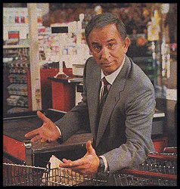
This is self-centred thinking
High street shop owner
My approach to ethical decisions: I simply choose the option that turns out best for my sales
If I don’t sell affordable clothes then I will lose customers.
If people wanted the children to have a better life then they should dig deeper into their pockets

Slide 5
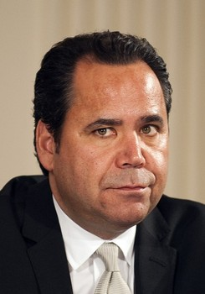
This is self-centred thinking
Owner of the multimillion pound empire – GAP
My approach to ethical decisions: I simply choose the option that turns out best for me
What's all this about the children?
I moved my factory to an LEDC so I can have cheap labour and hard workers. In an MEDC people demand too much money for not enough work. I need to make as much profit as possible for the shareholders!

Slide 6
This is care-based thinking
Psychology student – vegetarian
My approach to ethical decisions: Be caring and compassionate about people, animals and relationships.
Holly
I do not wear clothes made of animals but I don’t know if they are made by children. I think it is about time the government change the legislation on child labour and animal cruelty. I am going on a peaceful demonstration next week to let the public know what happens in these sweatshop factories and then they can make their own mind up on what to do.

Slide 7
This is care-based thinking
Children's rights NGO worker– against abuse
works with the children Welfare Trust.
My approach to ethical decisions: Be caring and compassionate about people, animals and relationships.
Sue Flay
I understand that most factories recognise that conditions are not the kindest method of production. Every single factory owner we deal with is friendly, helpful, courteous and most importantly many are willing to consider change. However, they do cover up the fact that they are using children to cut labour costs as they are faster with nimble hands. We are trying to encourage the businesses to move with changing trends to ethical systems.

Slide 8
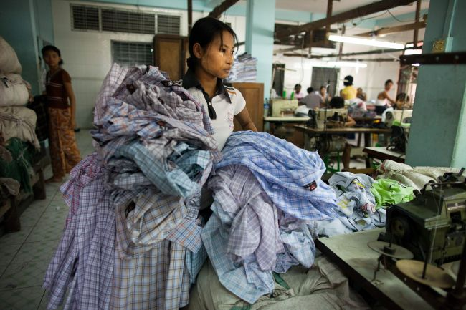
This is rights-based thinking
Chico Saeed – factory worker
My approach to ethical decisions: Before I do anything, I make sure it does not violate other people’s rights.
I just get on with my job. My father has died and my mother is losing her eye sight so I have to go to work. I work very long shifts, sometimes I work all day and night if we have to rush an order through. I don’t get to go to school but at least I can feed my family.

Slide 9
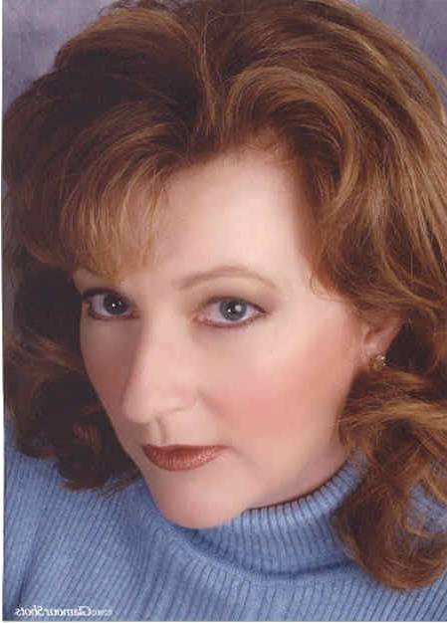
For or against
What must I decide about?
For
Against
What are the benefits (pros) of doing this?
What are the problems (cons) of doing this?
My approach to ethical decisions: Weigh up the benefits and costs and choose the option that makes most people happy.
Utilitarian
Conclusion

Slide 10
For or against
What must I decide about?
For
Against
What are the benefits (pros) of doing this?
What are the problems (cons) of doing this?
My approach to ethical decisions: Weigh up the benefits and costs and choose the option that makes most people happy.
Utilitarian
Conclusion

Slide 11
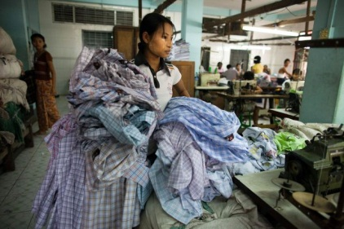
For or against
What must I decide about?
For
Against
What rights do we want to protect? (e.g. choice, freedom, life)
Will the decision violate (go against) any rights? How?
Rights-based
My approach to ethical decisions: Before I do anything, I make sure it does not violate other people’s rights.
Conclusion

Slide 12
For or against
What must I decide about?
For
Against
How will doing this make their life better?
How will doing this make their life worse?
Care-based
My approach to ethical decisions: Be caring and compassionate about people and relationships.
Conclusion

Slide 13
For or against
What must I decide about?
For
Against
How will doing this make their life better?
How will doing this make their life worse?
Care-based
My approach to ethical decisions: Be caring and compassionate about people and relationships.
Conclusion

Slide 14
For or against
What must I decide about?
For
Against
Is this a good thing for me or a bad thing for me?
How important is this to me?
Self-centred
My approach to ethical decisions: Simply choose the option that turns out best for me.
Conclusion

Slide 15
For or against caged hens
What must I decide about?
For
Against
Is this a good thing for me or a bad thing for me?
How important is this to me?
Self-centred
My approach to ethical decisions: Simply choose the option that turns out best for me.
Conclusion

Slide 16
GROUP 1 | GROUP 2 | GROUP 3 | GROUP 4 | GROUP 5 | GROUP 6
WERE A NUMBER OF issues for and against MENTIONED? GOOD/SATISFACTORY/ UNSATISFACTORY | WERE A NUMBER OF issues for and against MENTIONED? GOOD/SATISFACTORY/ UNSATISFACTORY | WERE A NUMBER OF issues for and against MENTIONED? GOOD/SATISFACTORY/ UNSATISFACTORY | WERE A NUMBER OF issues for and against MENTIONED? GOOD/SATISFACTORY/ UNSATISFACTORY | WERE A NUMBER OF issues for and against MENTIONED? GOOD/SATISFACTORY/ UNSATISFACTORY | WERE A NUMBER OF issues for and against MENTIONED? GOOD/SATISFACTORY/ UNSATISFACTORY
All members took part in presentation? YES/NO | All members took part in presentation? YES/NO | All members took part in presentation? YES/NO | All members took part in presentation? YES/NO | All members took part in presentation? YES/NO | All members took part in presentation? YES/NO
WERE THERE ENOUGH GEOGRPHICAL WORDS? YES/NO/ALMOST | WERE THERE ENOUGH GEOGRPHICAL WORDS? YES/NO/ALMOST | WERE THERE ENOUGH GEOGRPHICAL WORDS? YES/NO/ALMOST | WERE THERE ENOUGH GEOGRPHICAL WORDS? YES/NO/ALMOST | WERE THERE ENOUGH GEOGRPHICAL WORDS? YES/NO/ALMOST | WERE THERE ENOUGH GEOGRPHICAL WORDS? YES/NO/ALMOST
WAS THE content EASY TO UNDERSTAND? Y/N | WAS THE content EASY TO UNDERSTAND? Y/N | WAS THE content EASY TO UNDERSTAND? Y/N | WAS THE content EASY TO UNDERSTAND? Y/N Y/N | WAS THE content EASY TO UNDERSTAND? Y/N | WAS THE content EASY TO UNDERSTAND? Y/N
WAS THE content GEOGRAPHICALLY ACCURATE? Y/N | WAS THE content GEOGRAPHICALLY ACCURATE? Y/N | WAS THE Content GEOGRAPHICALLY ACCURATE? Y/N | WAS THE content GEOGRAPHICALLY ACCURATE? Y/N | WAS THE content GEOGRAPHICALLY ACCURATE? Y/N | WAS THE content GEOGRAPHICALLY ACCURATE? Y/N
MARK /10 | MARK /10 | MARK /10 | MARK /10 | MARK /10 | MARK /10
Star pupil? Why? | Star pupil? Why? | Star pupil? Why? | Star pupil? Why? | Star pupil? Why? | Star pupil? Why?

