Slide 1
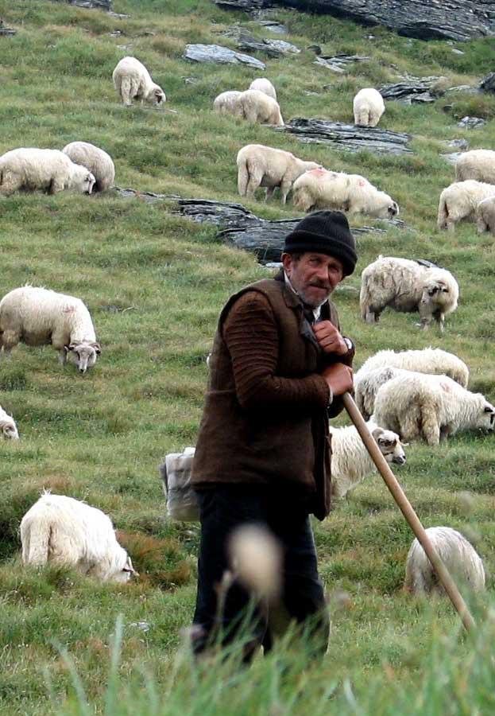
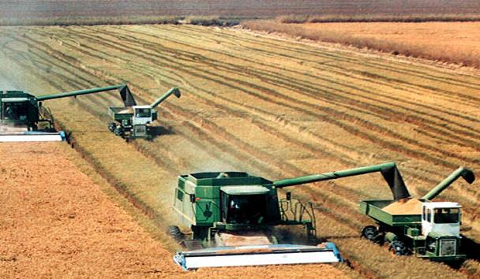
Subsistence Farming vs. Commercial Farming

Slide 2
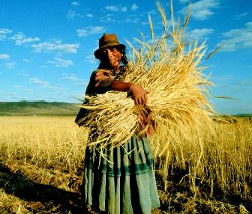
What is Subsistence Farming?
Farmers’ produce is solely for the farmer’s consumption.
Any leftovers are sold on the market.
The farmer makes a low profit, but sustains his/her family who tend to
the farm.
Labour intensive.
Hardly any technological
input into the farming process.

Slide 3
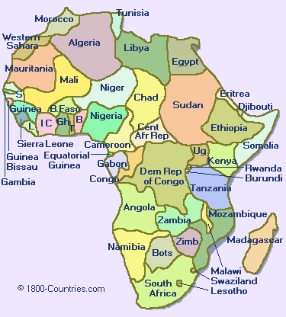
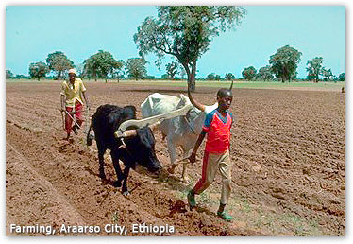
Where do we find Subsistence farming?
Sub-Saharan Africa
Mainly LEDCs

Slide 4
Case Study: Subsistence Farming
Sub-Saharan Africa
In the Sahel, there is not much money put into farming, and the climate does not quite suit farming conditions.
Farmers usually farm what they can to keep themselves relatively full, and what little there is left over, they sell on the market.
There is little available machinery to assist farming processes in Sub-Saharan Africa, so farming is usually labour-intensive and families normally take care of the farm with the help of their sons/daughters.
Largely isolated so subsistence farming best possible solution.

Slide 5
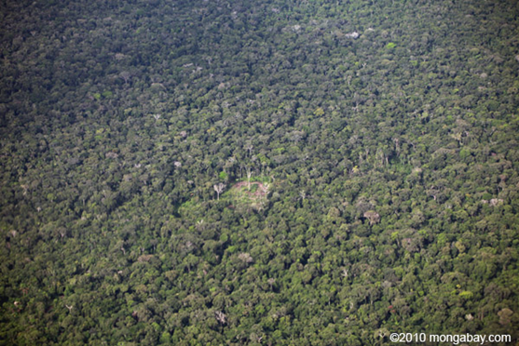
Shifting cultivation in the Amazon rainforest
Shifting cultivation- An area of subsistence farming, practiced usually in the Amazon Rainforest,
where part of the forest is
cut down for farming space.
After this part has been
used up of all resources,
another area Is cut down.
This gives the original area
time to recover so that it
can be cut down and used
again by farmers.

Slide 6
Shifting Cultivation in the Amazon Basin
Look at page 115 of your IGCSE Geography books and read the case study of A traditional rainforest system.
Answer the activities 1-4 in your books.

Slide 7
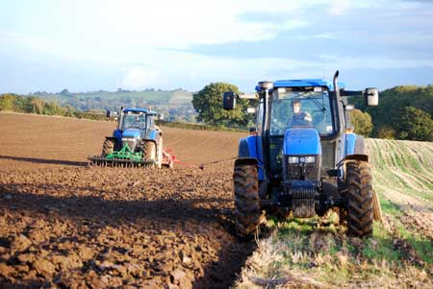
What is Commercial Farming?
Farming and selling crops in order to generate a profit.
Sells everything that the farm produces.
Efficiency is key-maximum yields and high profits are needed to sustain this type of farming.
Involves much more technical input as machinery obtains a greater output.
Normally occupies a larger size of land

Slide 8
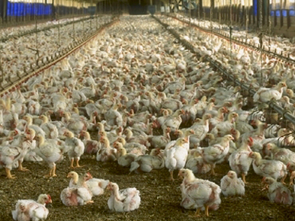
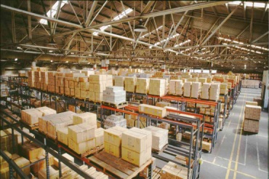
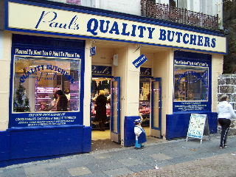
Commercial farm
Wholesaler
Retailer: Butcher’s store
The Customer

Slide 9
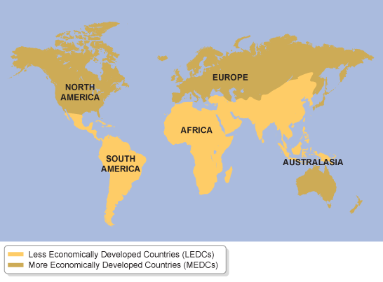
Where do we find Commercial Farming?
North America
MEDCs
Commercial farms are in abundance in countries that consume a lot of goods

Slide 10
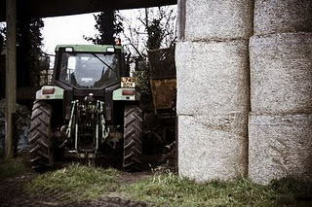
Case Study: Commercial Farming
Cotton Farming in the USA
Flat lands, dry area make for good crop yield per year
Money available to produce fertilisers and machinery to assist in large scale farming
Nearby market for selling crops, high demand for crops in the world
Crops are grown as cash crops (Crops that are grown solely to be sold)
Higher amount of inputs, outputs and processes

Slide 11
Task
Compare India’s subsistence cotton farming to the USA’s commercial cotton farming

