Slide 1
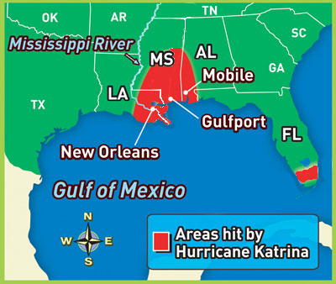
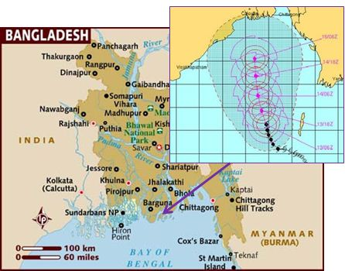
Hurricane Katrina, New Orleans, USA MEDC
VS
Cyclone Sidr, Bangladesh LEDC
Aim: To compare a tropical storm in an LEDC with an MEDC

Slide 2
Hurricane Katrina, New Orleans, USA MEDC
Hurricane Katrina struck in August 2005. It tracked over the Gulf of Mexico and devastated most of the coastline from Louisiana to Alabama (see map below). It arrived as a category 4 storm with winds of over 140 mph and a storm surge of approximately 6 metres. The city of New Orleans was very badly affected because it is mostly below sea-level and is surrounded by water. The city was protected by defence walls called levees. However, the levees were overwhelmed by the extra water from the storm surge and rainfall, and many collapsed allowing water to flood into the city. About 80% of the city was flooded to depths of up to 6 metres.

Slide 3
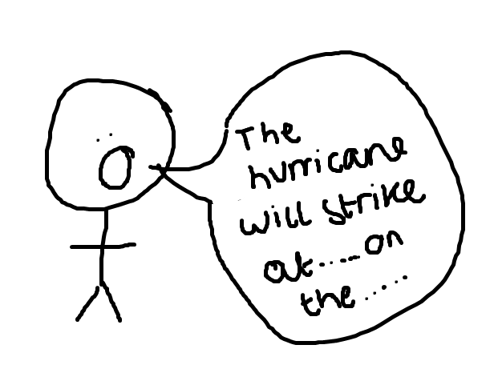
The National Hurricane Centre predicted accurately where Hurricane Katrina would make landfall and how strong it would be....
This gave people the opportunity to prepare for the storm. The mayor of New Orleans ordered people to evacuate the city. About 80% of the city's residents did so, but about 20% remained. The majority of these were in the poorest areas of the city (people had little access to transport so couldn't leave in many cases).
Over 10,000 people sought refuge in the city's Super dome football stadium. Conditions here deteriorated quickly - food and water soon ran out and the toilet facilities were inadequate. The atmosphere in the stadium was described as 'very tense and unsafe'.

Slide 4
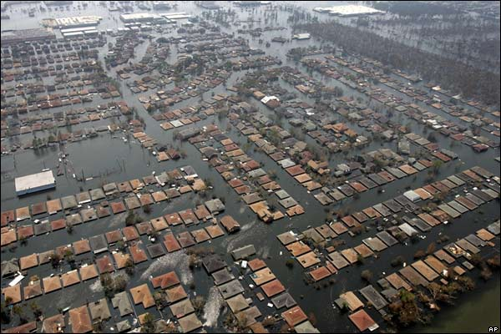
Effects
More than 80% of the city was submerged with floodwater and over 1200 people drowned.
Approximately 1 million people were made homeless and thousands of businesses were destroyed.
Thousands of jobs were lost and millions of dollars lost in tax income.
There was a lot of looting. Criminal gangs roamed the streets, looting homes and businesses and committing other crimes.
Major highways were disrupted and some major road bridges were destroyed.
Agricultural production was badly damaged by the tornadoes and also by flooding.
Cotton and sugar-cane crops were flattened.
Hurricane Katrina didn't just impact people in the USA. Many offshore oil facilities were damaged and supplies of oil were reduced. This caused the price of oil to rise on the global markets and the price of petrol in the UK rose as a result.
Estimates suggest that Hurricane Katrina has cost over $300 billion. This makes it one of the costliest hurricanes ever to hit the USA.
Oooooh dear....

Slide 5
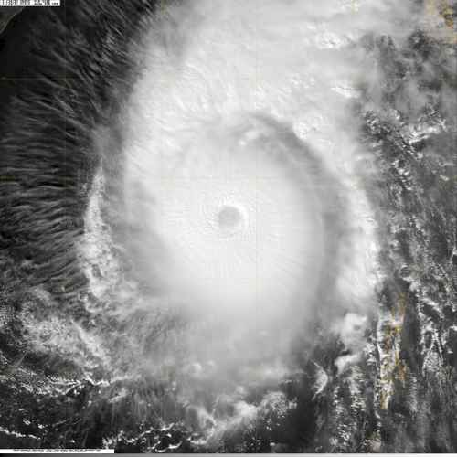
Cyclone Sidr, Bangladesh LEDC
Cyclone Sidr formed in the central Bay of Bengal and quickly strengthened to reach sustained winds of 160 mph, making it a category 5 storm. The storm eventually made landfall in Bangladesh on November 15, 2007. It weakened quickly after landfall.
The Joint Typhoon Warning Centre predicted the scale and location of landfall and so people were forewarned. Government officials were recalled from their weekly leave. Ports were closed. There was mass-scale evacuation of the coastal area, much of which is land below sea-level. The image below shows the storm surge prediction for the area. 2 million people were evacuated to emergency shelters. Over 40,000 Red Crescent volunteers were deployed to order residents in the 15 affected provinces into special cyclone and flood shelters (see image below). Relief organisations distributed seven-day emergency disaster kits of food, blankets and clothing for evacuated families.

Slide 6
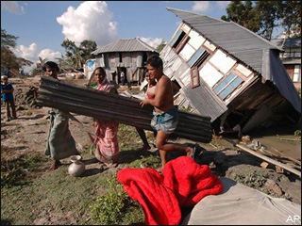
Effects
Coastal districts of Bangladesh faced heavy rainfall as an early impact of the cyclone. The damage in Bangladesh was extensive, including tin shacks flattened, houses and schools blown away and enormous tree damage. The entire cities of Patuakhali, Barguna and Jhalokati District were hit hard by the storm surge of over 5 metres. About a quarter of the world heritage site Sunderbans were damaged. Researchers said mangrove forest Sunderban will take at least 40 years to recover itself from this catastrophe. Much of the capital city of Dhaka was also severely affected, as electricity and water service were cut and significant damage was reported there due to winds and flooding. The local agricultural industry was also devastated, as many rice crops — which have a December harvest — were lost

Slide 7
Similar or not??
Impacts of Cyclone Sidr
LEDC
Impacts of hurricane Katrina
MEDC
Similarities

Slide 8
Exam practise
Exam practise; Using a example you have studied compare and contrast a tropical storm in an LEDC with a tropical storm in an MEDC. (8 marks)

