Slide 1
What are the consequences of people moving?
Objective: -
You can define the term ‘urbanisation’.
You can describe and explain some of the consequences of urbanisation.
Notes:
Consequences are positive and negative.

Slide 2
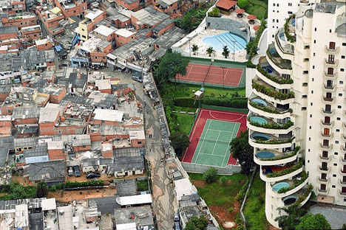
This is a small part of a large photograph of Lagos – use your geographical mind and sketch what you think might surround this area…
Notes:
Inform the students that this is a shanty settlement – common in LEDC cities that are rapidly urbanising.
They complete the task as above in their book.
Show the next slide after 5 mins – 10mins.

Slide 3
Notes:
Link back to the key question.
Rapid urbanisation of people from rural to urban areas cause large, informal settlements to grow as the governments cannot (or do not) keep pace with the movement of people in terms of providing facilities.
It also shows that there are huge inequalities in large cities. This can cause tension and ultimately conflict. It also causes crime rates to increase as poor dwellers see how some people live. Crime results from desperation.

Slide 4
What Is A Shanty Town?

Slide 5
Push or Pull Factors?
Labourers forced off land
Some access to electricity
No investment from the government
Government invests in improving cities
Few doctors
Better health
care
More reliable food and water resources
Better schools
Jobs – official and informal
Lack of basic services
No education
Risk of crop failure and drought
Better housing
Lack of employment
Entertainment

Slide 6
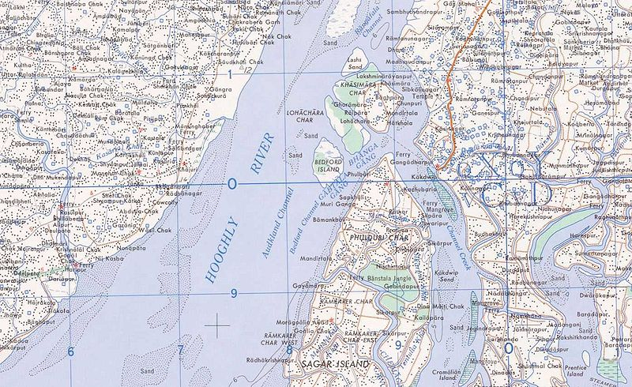
Banks Of A River
Calcutta
ADVANTAGES:
Land available
DISADVANTAGES:
Flooding
Disease

Slide 7
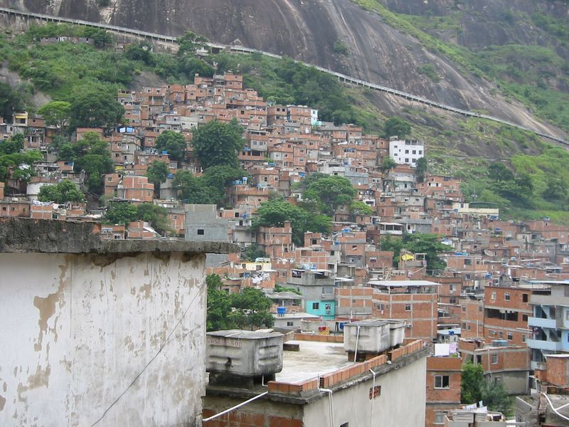
Steep Slopes
Rio De Janiero
ADVANTAGES:
Land available
Close to work
DISADVANTAGES:
Landslides
Difficult to build on

Slide 8
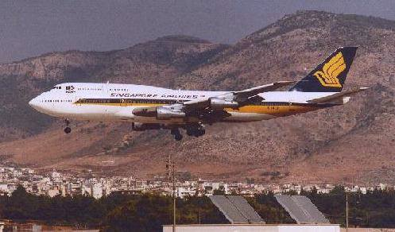
End Of Airport Runway
Mexico City
ADVANTAGES: DISADVANTAGES:
Land available Dangerous
Close to work Noisy
Pollution

Slide 9
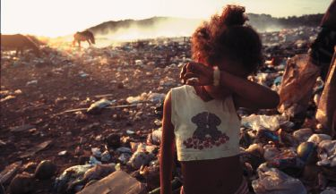
Landfill Sites
Jakarta
ADVANTAGES:
Land available
Jobs
Materials to build with
DISADVANTAGES:
Rats
Dirty
Disease

Slide 10
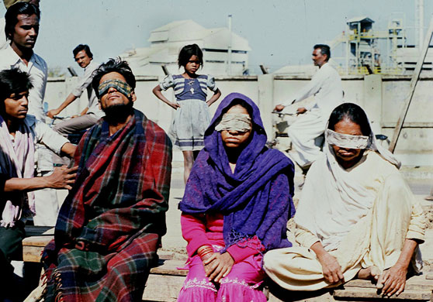
Next To Pesticide Factory
Bhopal, Indian
ADVANTAGES:
Land available
Close to work
DISADVANTAGES:
Near industry so dirty and noisy
Dangerous – 1984, 15000 dead, many blinded or injured

Slide 11
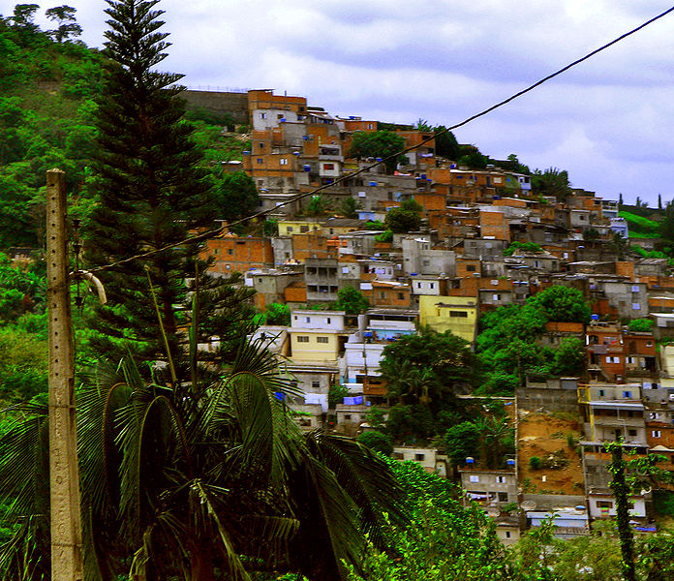
25km From Centre Of Town
Sao Paulo
ADVANTAGES:
Land available
DISADVANTAGES:
Long journeys to work
Long way from services

Slide 12
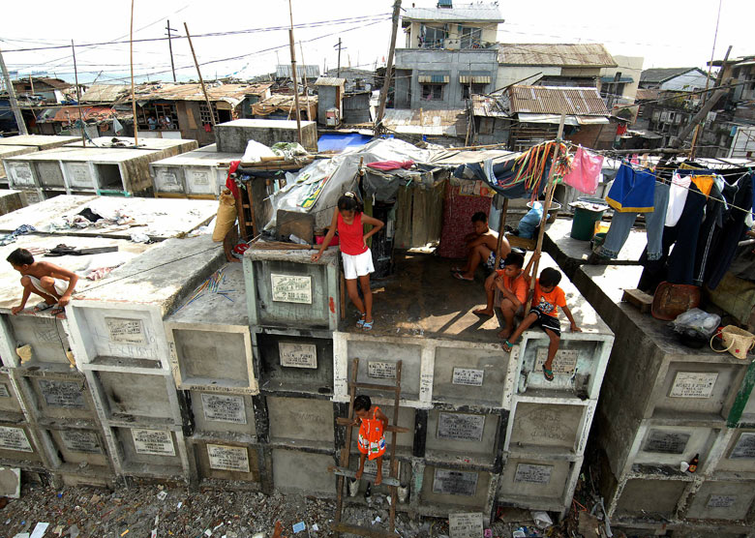
In A Cemetery
Cairo
ADVANTAGES:
Land available
Close to work
DISADVANTAGES:
No services
Difficult to dig in water, sewers, etc

Slide 13





What Would You Not
Want To Live Without?
Water Electricity Sewage Health Care
Why?
Fresh Fruit A lockable Police
and veg front door

Slide 14
Lagos, Nigeria
Describe and explain the consequences (positive as well as negative) of rapid urban growth in Lagos.
Standard of Living
Informal Employment
Crime (Area Boys)
Unequal wealth video
http://www.youtube.com/watch?v=LFgb1BdPBZo
Notes:
Watch the video and get students to note down the consequence of rapid urban growth.
Discuss after.

Slide 15
Lagos – assignment (use the information from the video and the CIA world fact book)
Introduction: You must describe what Lagos is like. Where is it? (Tip – think about the senses-sight, sound, smell etc)
Part one: Describe what life is like in Lagos – how do people live, what do they do, how do they dress? (standard of living)
Part two: What are the good things about life in Lagos? (employment)
Part three: What are the negative aspects of life in Lagos? (crime)
Conclusion: How could problems in Lagos be solved in your opinion?

