Slide 1
Settlements

Slide 2
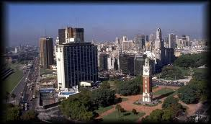
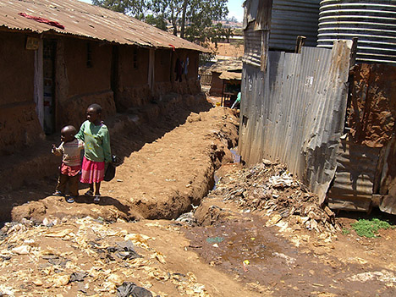
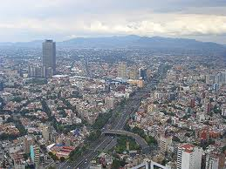
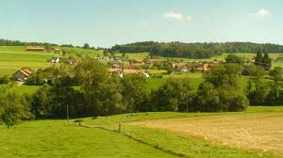
1
2
3
4

Slide 3
1
MEDC: More economically developed country (rich developed countries)
2
LEDC: Less Economically developed country (poor developing countries)

Slide 4
3
Urban area: a built up area such as a town or city
4
Rural area: is a area in the
countryside

Slide 5
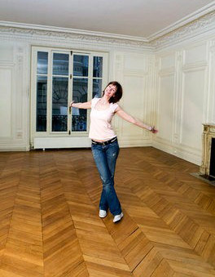
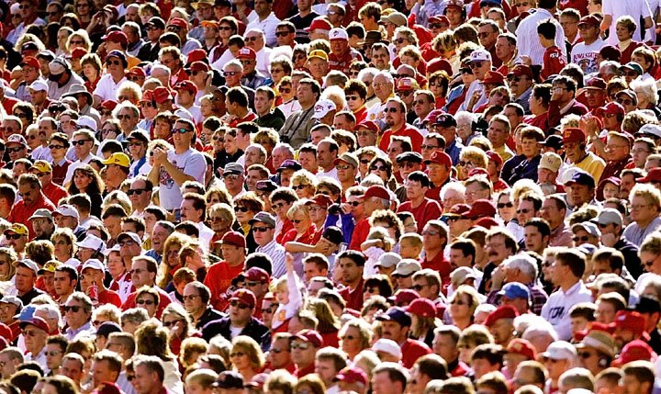


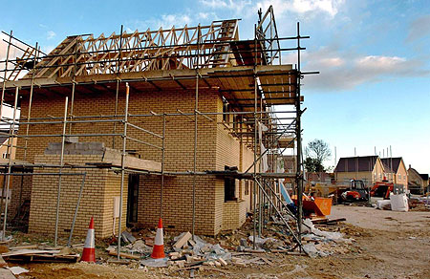
Population in the UK has increased by 7% since 1971
The number of households has risen by 30% since 1971. Most of this increase is because more people live alone (7 million of the Uk’s population)
New-single person households account for 70% of the increased demand for housing
This is due to people leaving home to rent or buy younger than previously, marrying later, getting divorced and living longer.
The government target is to build 240, 000 new houses every year by 2016

Slide 6
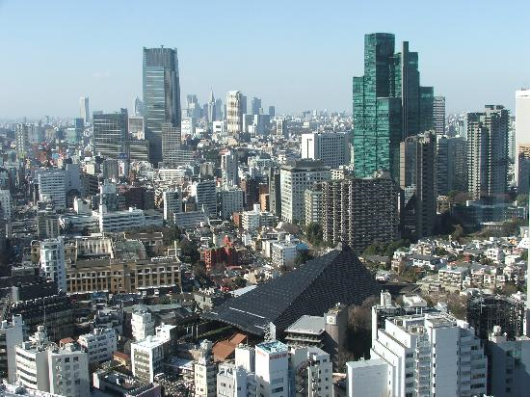
What causes urbanisation?
There are 2 main causes of urbanisation
  Rural-urban migration
  Natural increase

Slide 7
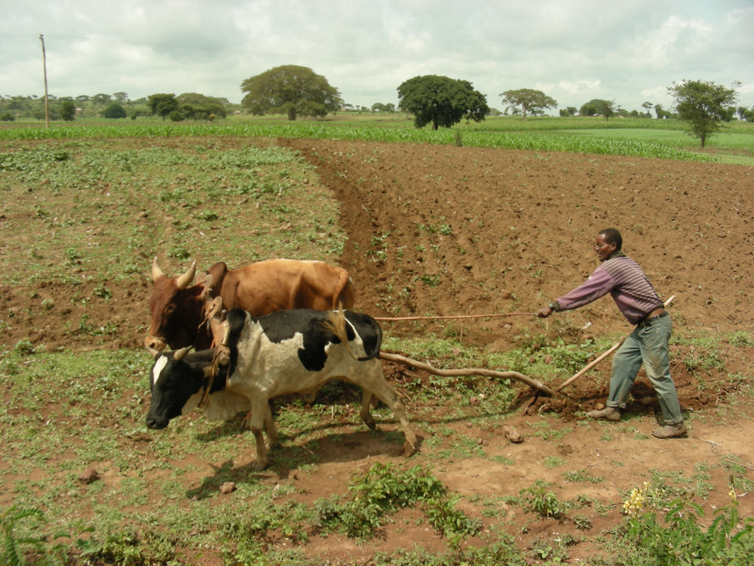
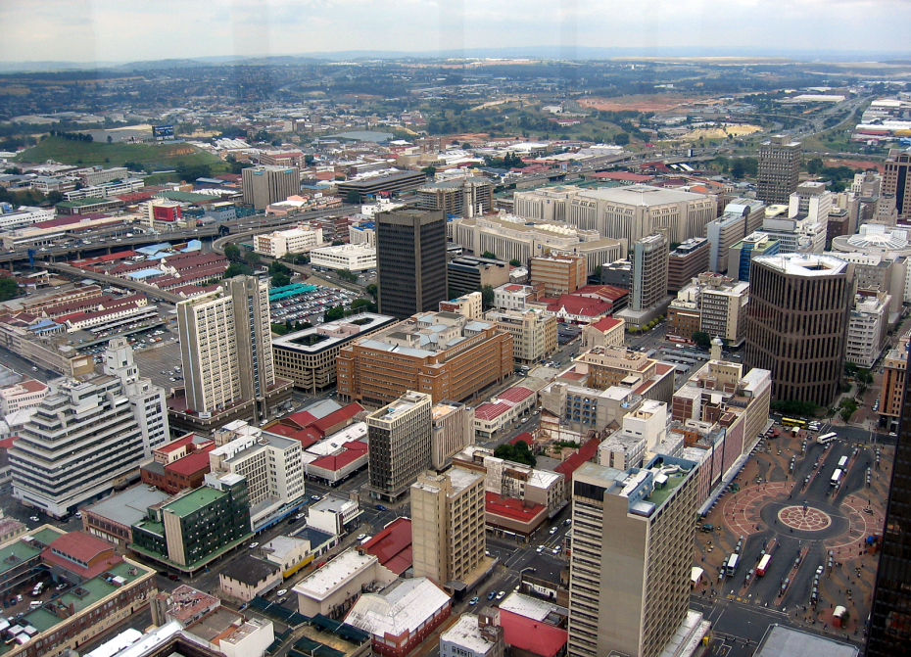
Rural to urban migration
From this to this

Slide 8
Rural – urban migration
The
The movement of people away from the countryside to the towns and cities.
It is the result of push and pull factors.
Push factors are things that push people out of the countryside
Pull factors are things that attract people to cities

Slide 9
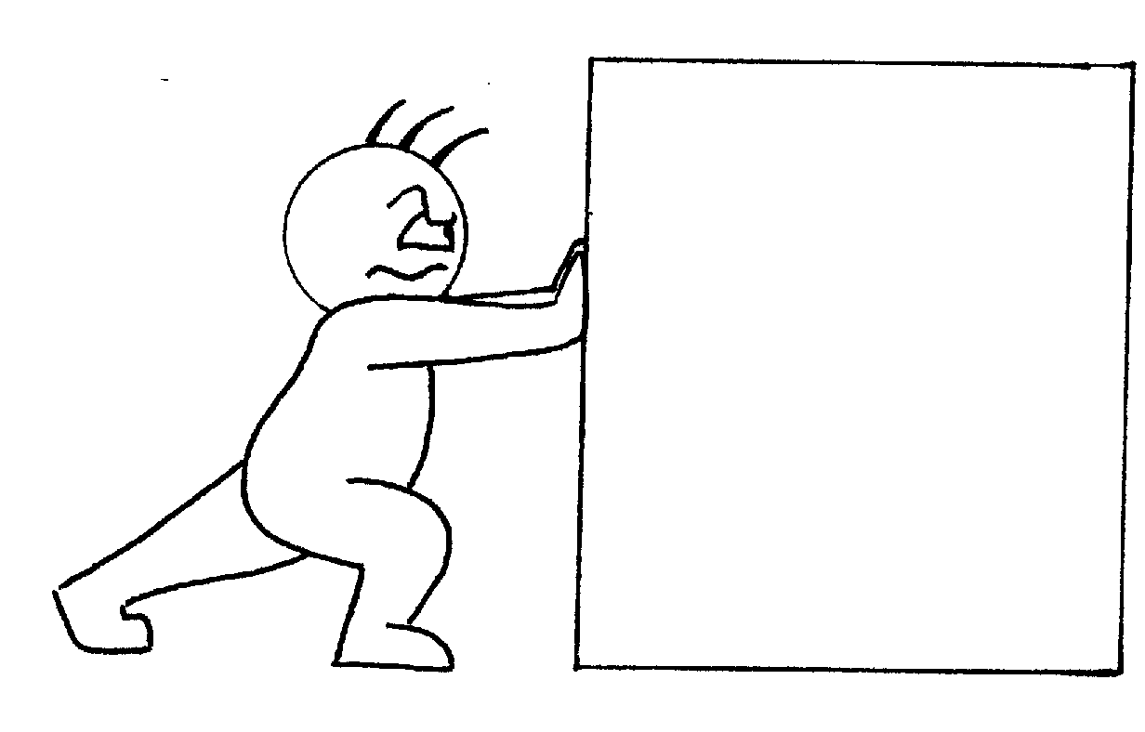
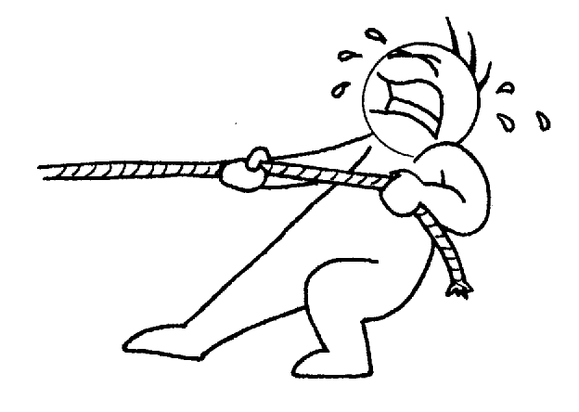
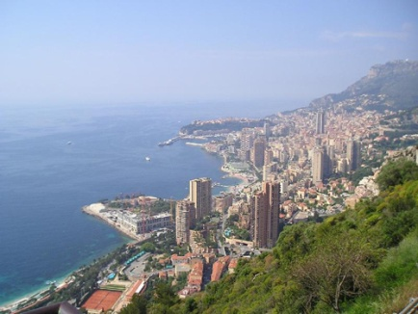
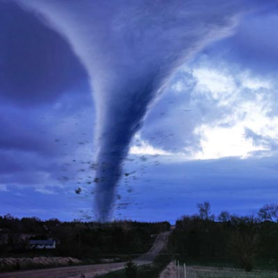
Reasons why people move from rural to urban areas in developing countries can be described as:
PUSH FACTORS:
Factors which push
People away from a place
PULL FACTORS:
Factors which pull
People to a place
Would these be push or pull factors: PUT THEM UNDER CORRECT HEADING
Uneconomic subdivsion of land
Poor education
Better Education
War
Poor healthcare
Poor housing
Drought
Flooding
Better Healthcare
Lack of jobs
Higher wages
Protection
Famine
Land degradation
Conflict
Good quality of life
More supply of food
Opportunities for jobs
Decline of traditional industries

Slide 10
Explain how push and pull factors encourage
Rural – urban migration.
Use examples from the push/pull factor table to help you.
Starter sentences:
Factors which encourage......
Urban to rural migration.......
There are several push factors which........

Slide 11
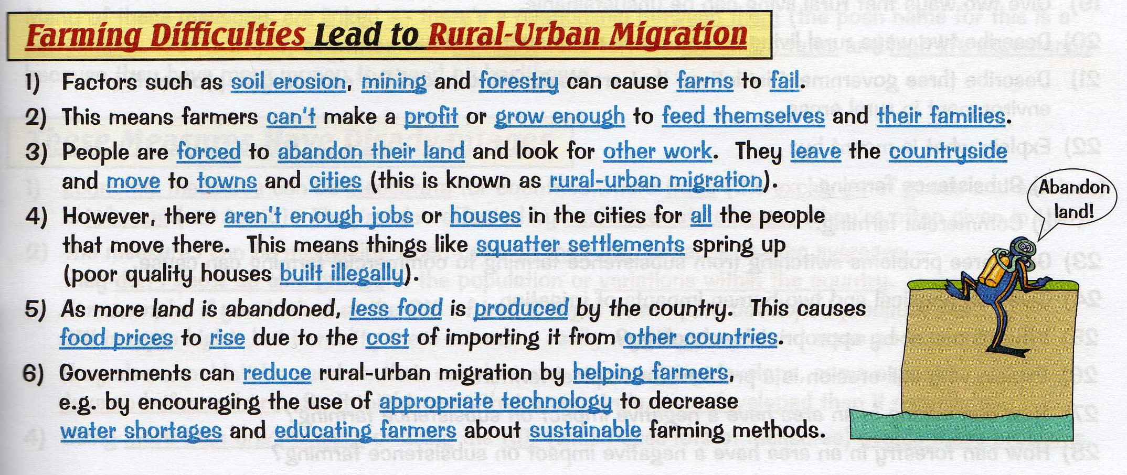

Slide 12
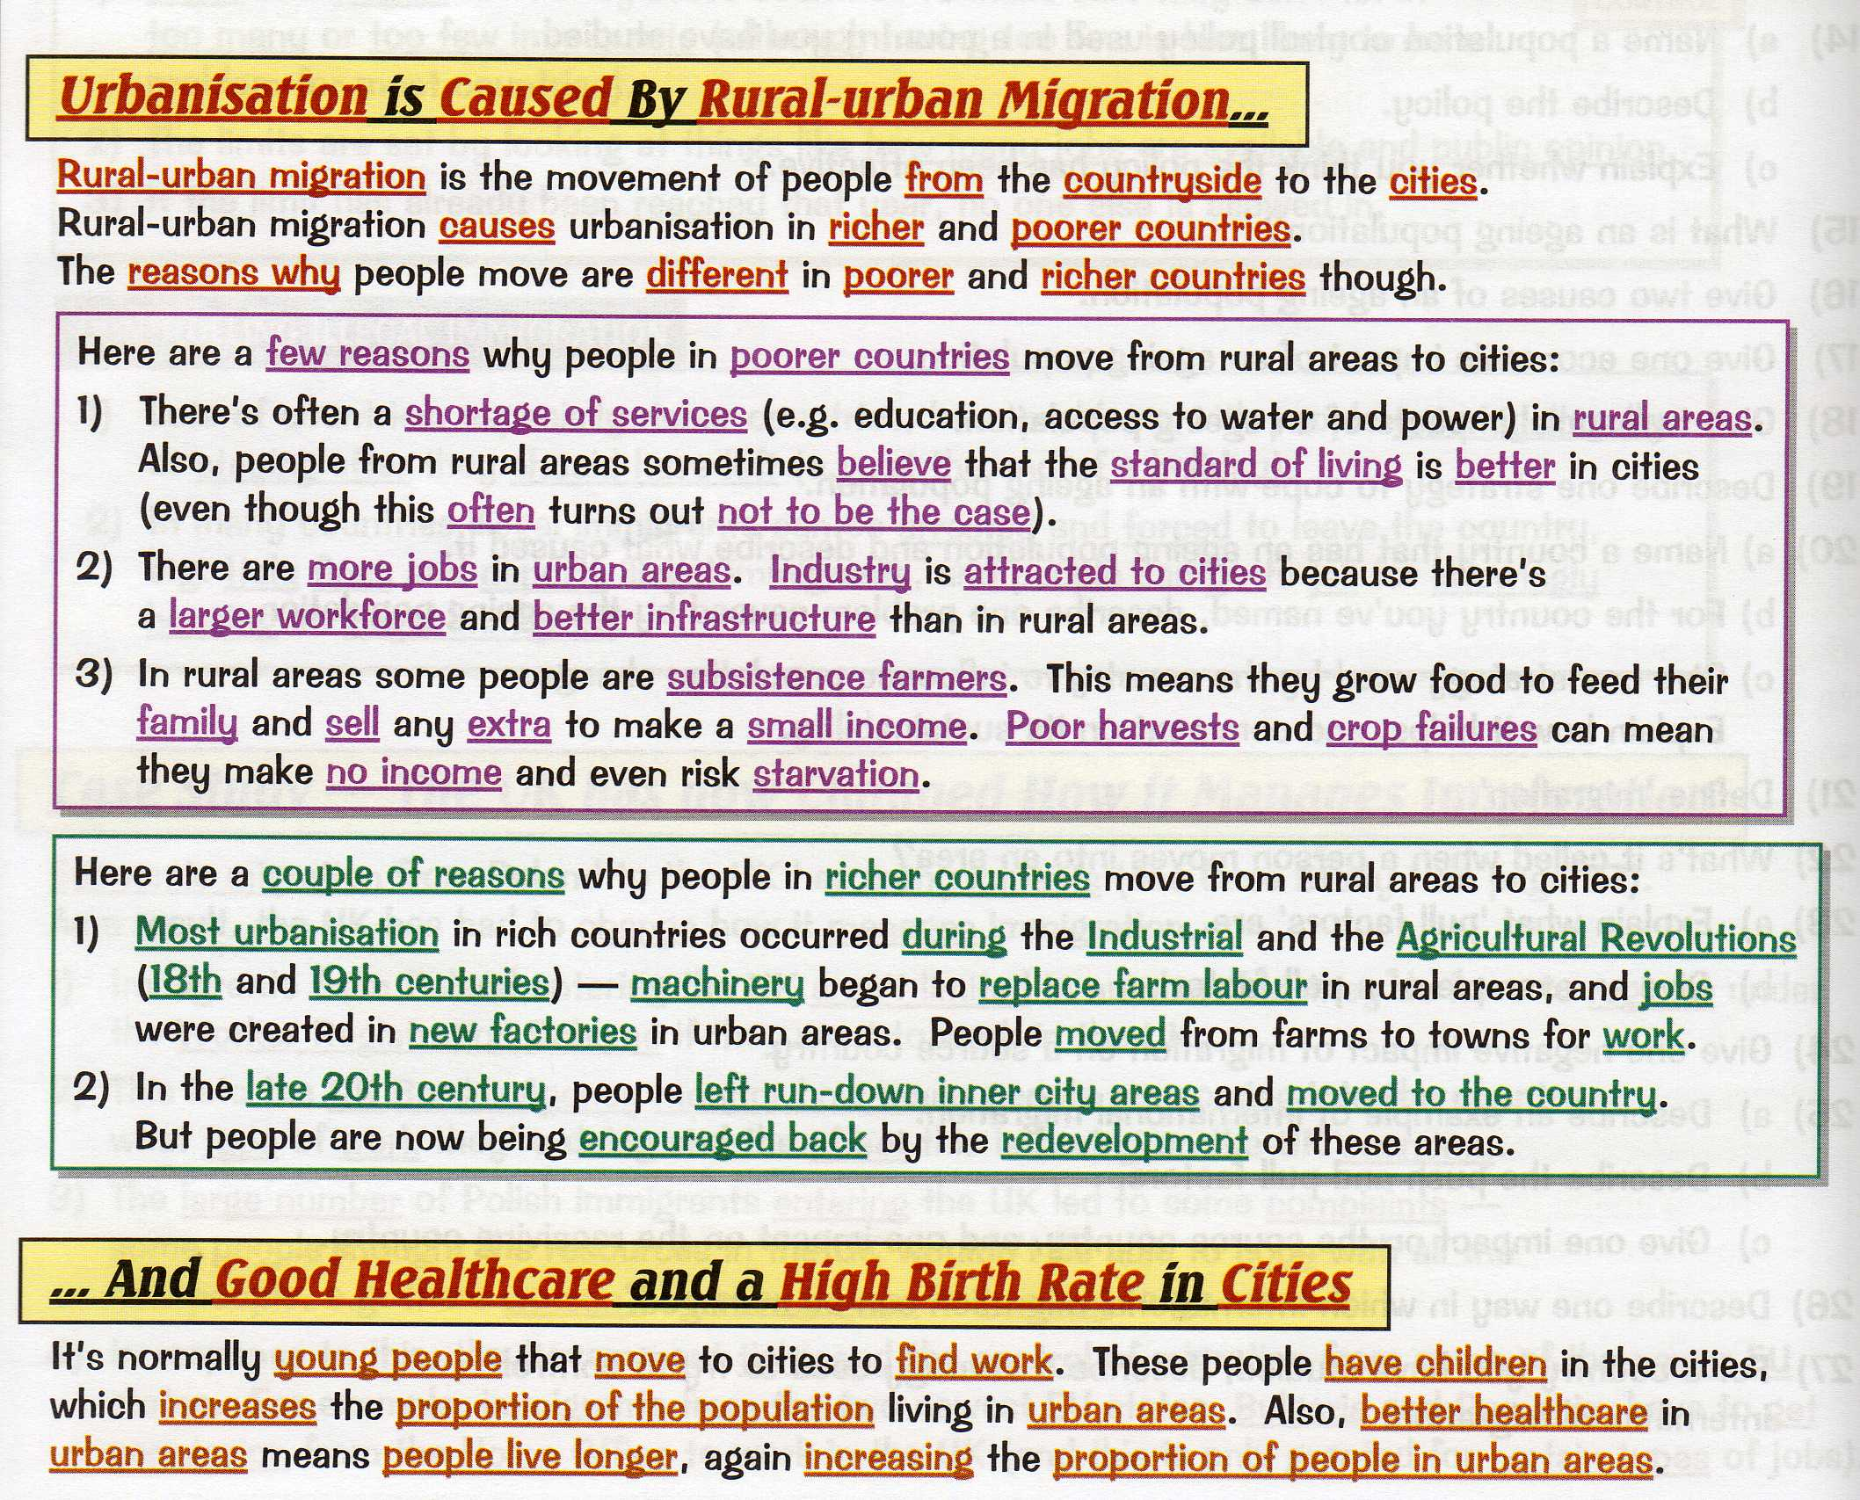

Slide 13
Natural Increase
The people that migrate into towns are generally young and this results in relatively high levels of natural increase.
The high proportion of young adults results in high levels of births.
There are falling death rates due to improved medical care, this means more babies are being born in cities than people dying leading to naturally increasing urban populations.

Slide 14
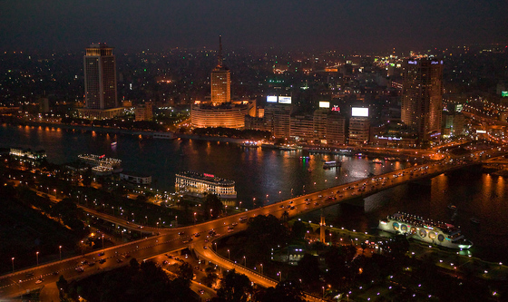
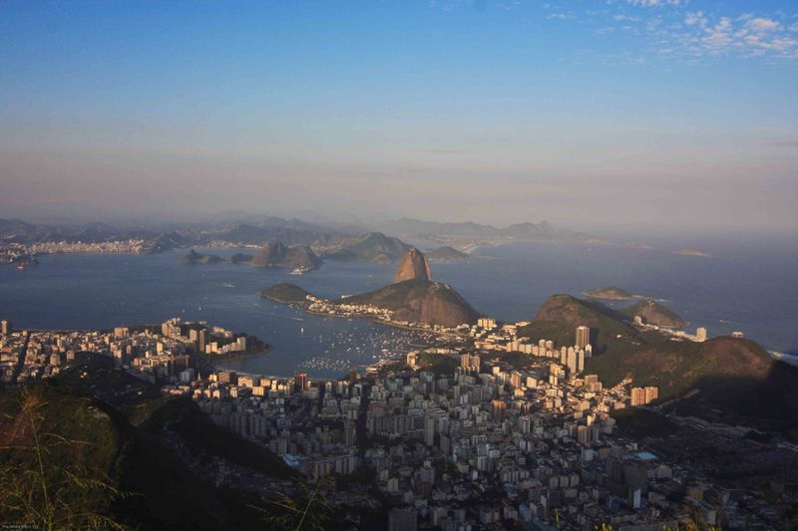
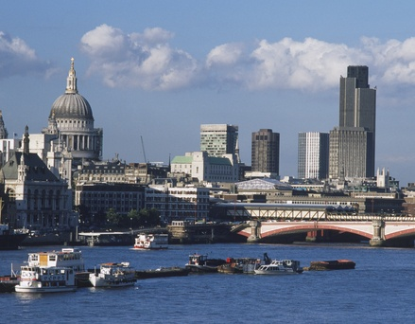
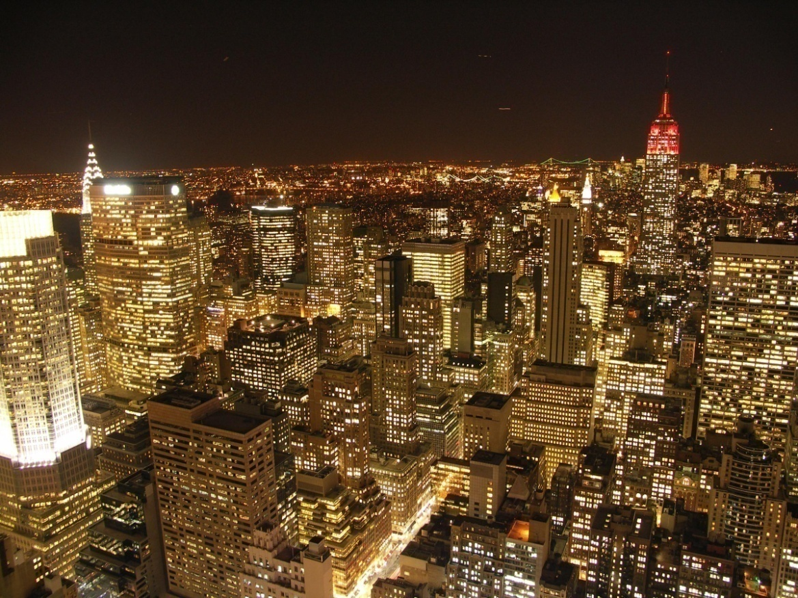
In 2008 for the first time in history over half of the world’s population lived in towns and cities.

Slide 15
Urbanisation is a global phenomenon.
L.O.
Be able to define urbanisation.
List different urban areas.
List three causes associated with urbanisation.
Describe different urban areas.
Describe the reasons for a growth in urbanisation.
Demonstrate how urbanisation can occur at different paces.
Explain how urbanisation can vary in a LEDC and MEDC.

Slide 16
Starter – match the city to the correct country.
Which cities have a population of over 1 million?
London
New York
Cairo
Paris
Antwerp
Tokyo
New Delhi
Canberra
Madrid
Accra
Spain
UK
Japan
India
Ghana
Belgium
Egypt
France
Australia
USA

Slide 17
Cities with over 1 million…
London
New York
Cairo
Paris
Antwerp
Tokyo
New Delhi
Canberra
Madrid
Accra
UK
USA
Egypt
France
Belgium
Japan
India
Australia
Spain
Ghana
7,640,000
8,391,881
2,138,551
472,071
28,025,000
11,680,000
3,312,010
1,963,264

Slide 18
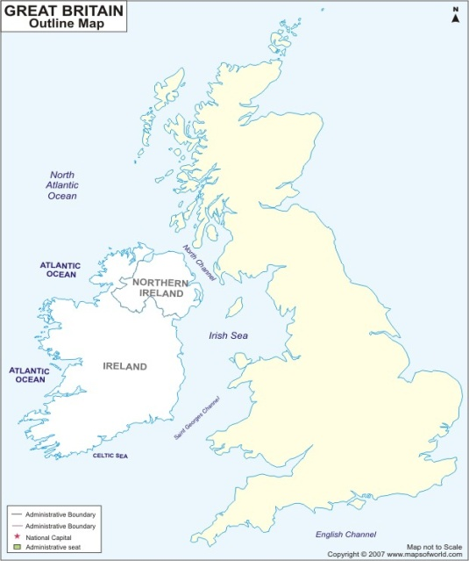
Urbanisation: why do people move to the city?
http://www.bbc.co.uk/learningzone/clips/7811.flv
A history of urbanisation in Britain
More than 80% of the British population now lives in urban areas. Urbanisation and rapid population growth at the time of the industrial revolution led to previously small towns such as Glasgow, Newcastle, Sheffield and Manchester becoming large cities. Within 150 years the UK was transformed from a nation of rural farmers to a nation of urban factory workers.
Watch the clip carefully.
Locate and label the cities mentioned onto the map.
For each city outline the causes and dates of urbanisation.

Slide 19
What are the characteristics and causes of urban environments?
Discussion points:
What are the motivating factors behind urbanisation?
Is all urbanisation a positive experience?
Are all countries experiencing urbanisation at the same rate?
Tasks:
Give details about the two causes of urbanisation in the speech bubble.
Study the photos and explain why you wanted to move.
For a city of your choice research and chart its growth. How has urbanisation changed its character? When did the main changes occur? Why did urbanisation occur?

Slide 20
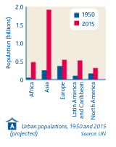
Plenary – Look at the Graph
What is going to happen to the worlds urban population by the year 2015?
Which continent will experience the biggest change?

Slide 21
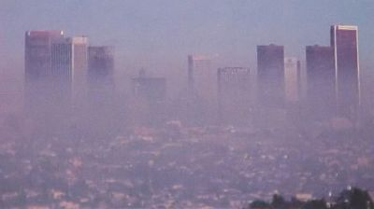
What impression do you get of this city?

Slide 22
Problems caused by urbanisation
L.O.
To list some of the problems caused by urbanisation.
To describe the problems caused by urbanisation linking in examples.
– Present work in an effective format.

Slide 23
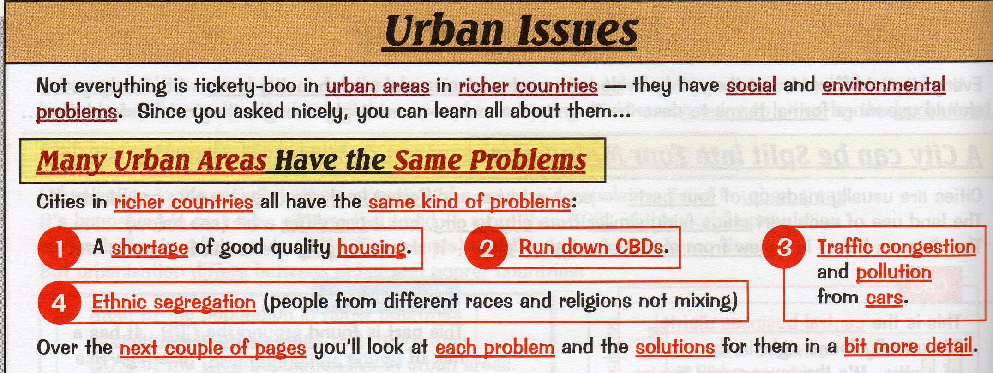

Slide 24
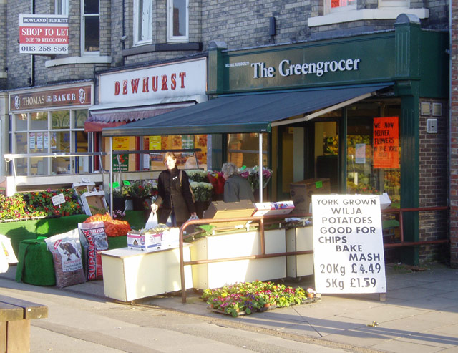
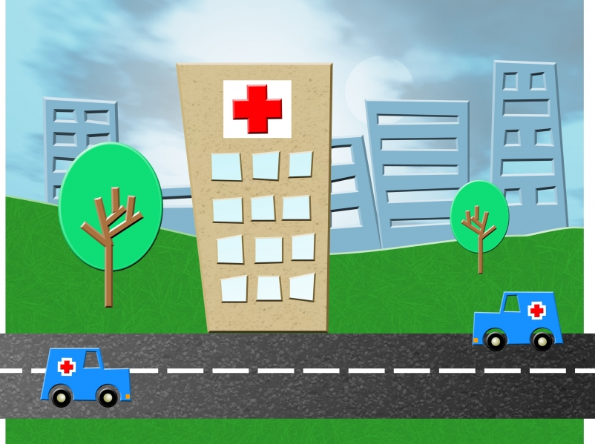

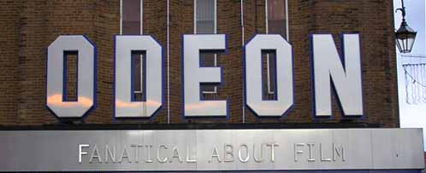
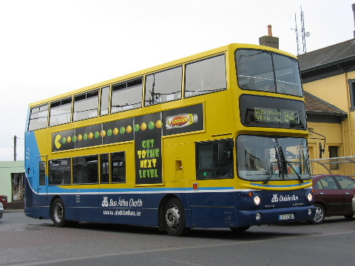
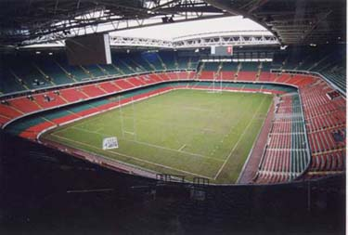
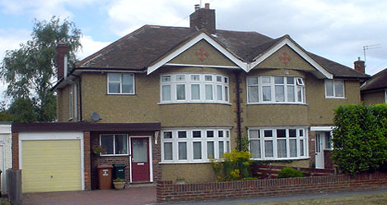
Benefits of
Settlement growth

Slide 25
There are more houses and flats to buy or rent
Food supplies are more reliable, with more shops giving greater choice
There are more and better services such as schools and hospitals
Benefits of Settlement growth
There is entertainment, in the form of concerts, museums, and sporting events
There are more jobs which are better paid
It takes less time and money to travel to work and shops.

Slide 26
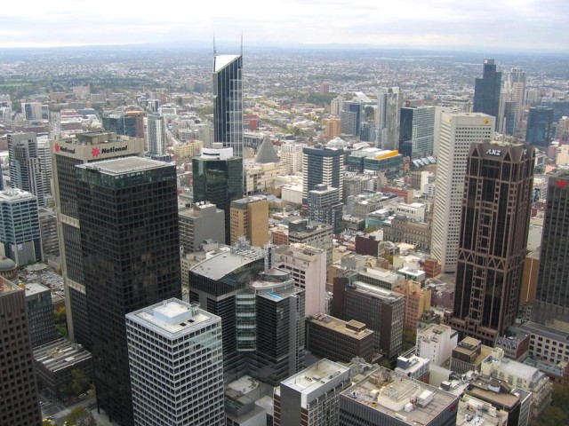
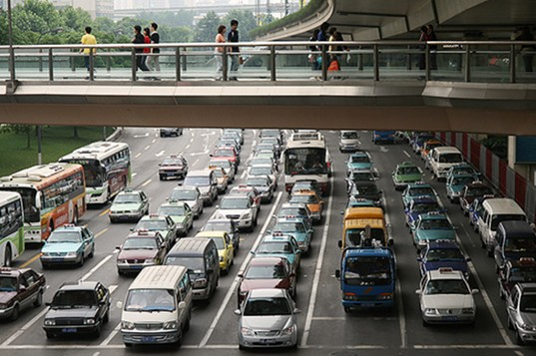

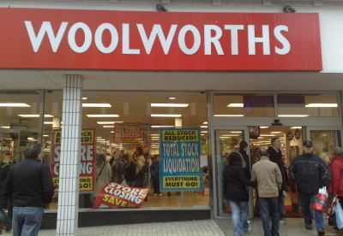
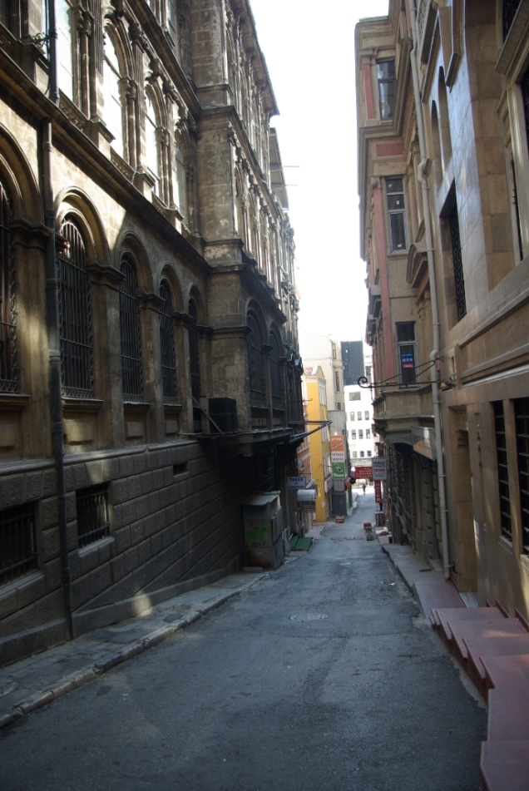
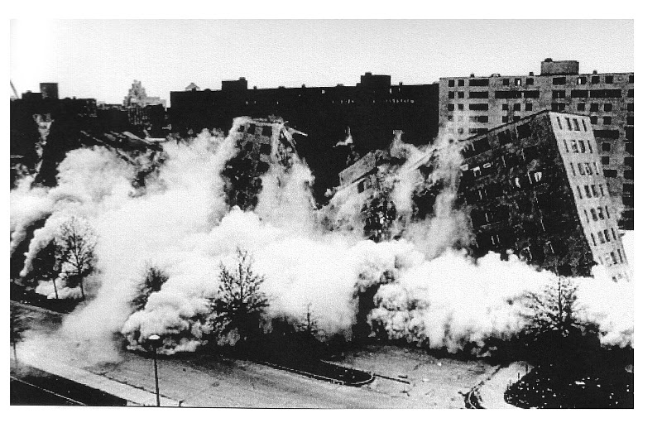

Problems of
Settlement growth

Slide 27
Waste land is created where buildings have been pulled down
Traffic causes congestion, accidents, noise and air pollution
Land is very expensive to buy in and near the city centre
Problems of Settlement growth
Crime, litter and vandalism make cities dangerous and unpleasant
Old roads are too narrow for lorries and buses, new roads take up too much land
Old houses and factories need urgent expensive repairs

Slide 28
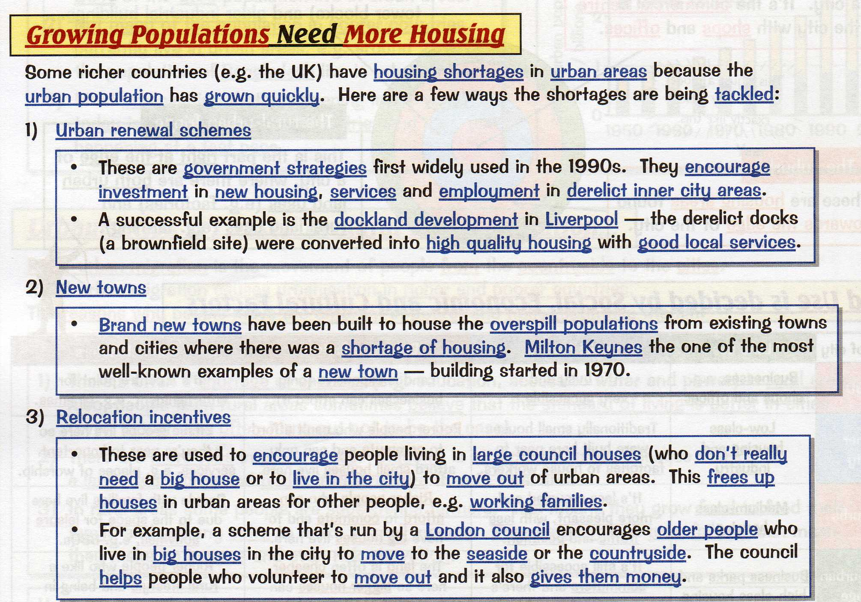

Slide 29
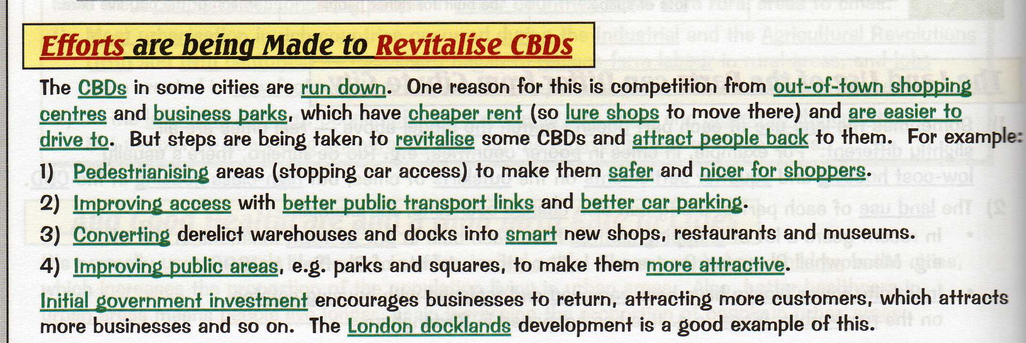

Slide 30
In a race across London, which method of transportation was the fastest?
Boat
Bike
Car
Public transport (bus and tube)
http://www.youtube.com/watch?feature=player_embedded&v=CkOzNK4l8KY

Slide 31
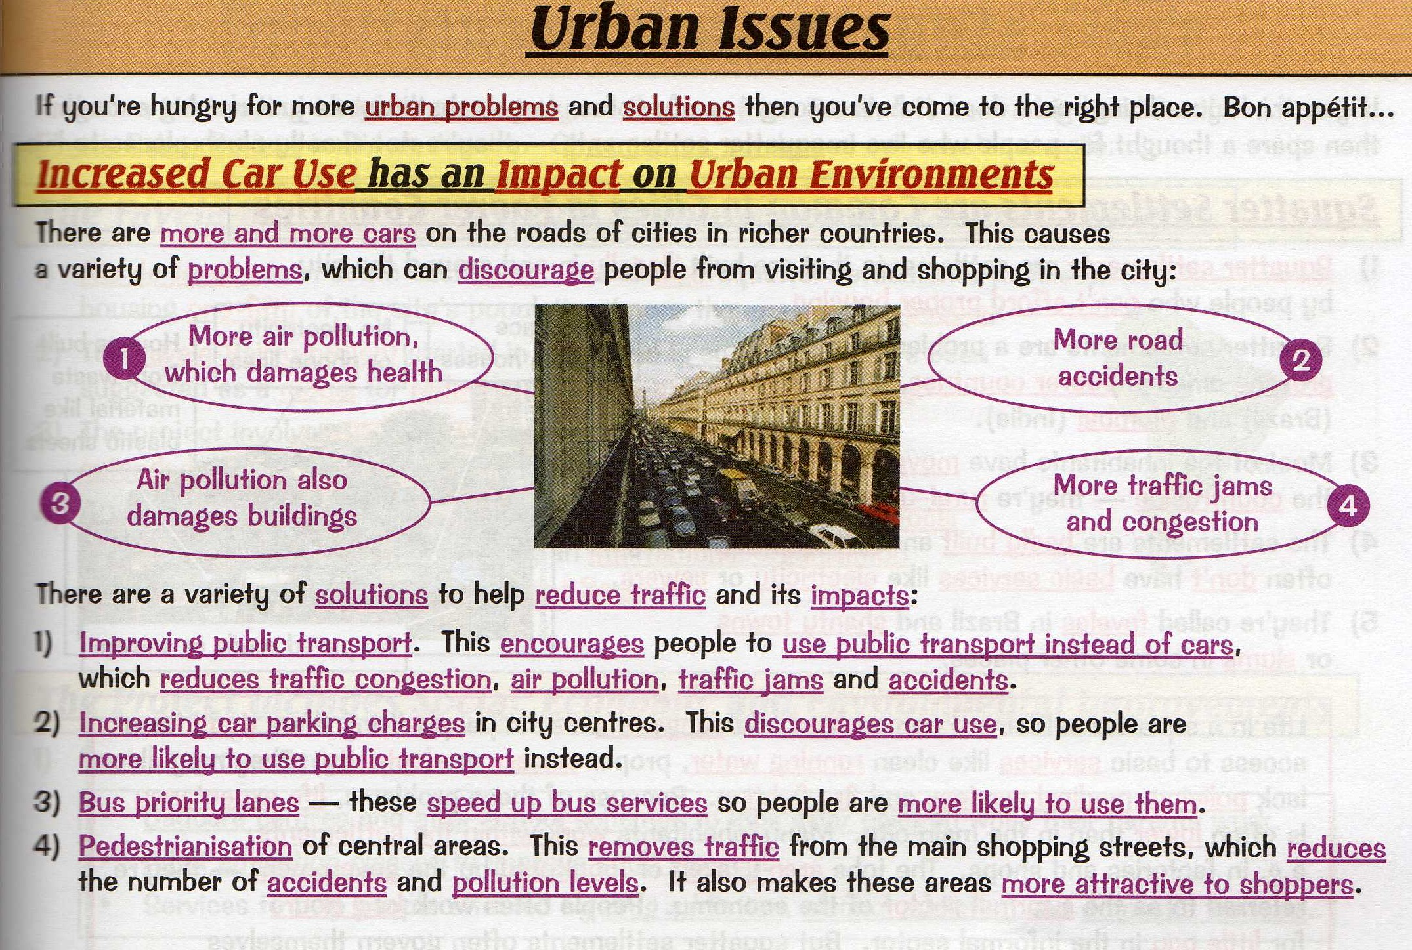

Slide 32
Copy and complete the following table:
Problem | Solution
Air pollution
Traffic congestion
The speed of travel
Accidents
Under use of public transport
Parking issues

Slide 33
A case study -
What are the solutions to reduce the impact of traffic on the environment?
What are the problems of increasing traffic?

Slide 34
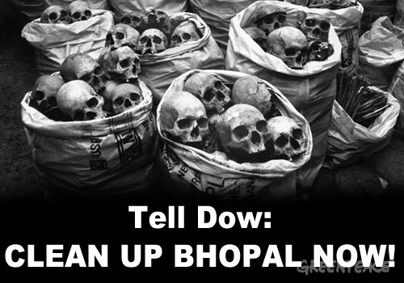

Slide 35
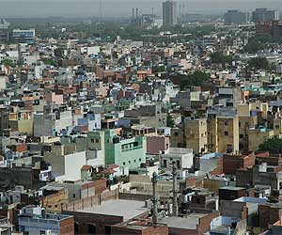

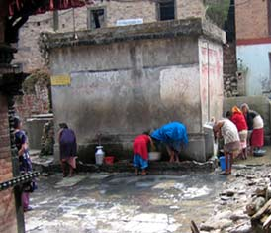
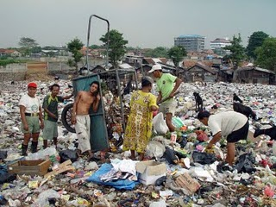
Environmental problems caused by rapid urbanisation in LEDCs
Define environmental problems and give examples.
Describe and explain the impact of urbanisation on the environment.
Evaluate the short and long term impact of the Union Carbide disaster at Bhopar.

Slide 36
Key terms – match the key terms with the correct definition
Industrialisation Disposal of waste material by burying it under layers of earth
Disposal of waste A company representing two or more nationalities
Landfill To treat or process used or waste materials so as to make suitable for reuse
Recycling The introduction of harmful substances or products into the environment
Air pollution The large-scale introduction of manufacturing, advanced technical enterprises, and other productive economic activity into an area, society, country
Transnational companies when plastic and heavy metals are disposed of in our rivers, lakes, and oceans.
Water pollution A means of destroying unwanted products

Slide 37
Flow diagram
Read page 52 Hodder.
Problem
Air pollution
Water Pollution
Waste disposal
Traffic related issues
Create four flow diagrams, one for each environmental problems caused by urbanisation in LEDCs.
Look to add examples and illustrations.
Causes
Solution

Slide 38
1984: Hundreds die in Bhopal chemical accident
http://news.bbc.co.uk/onthisday/hi/dates/stories/december/3/newsid_2698000/2698709.stm

Slide 39
Casestudy – Environmental problems caused by rapid urbanisation
World's worst During the early hours of 3 December 1984 the world's worst industrial accident unfolded in the Indian city of Bhopal.
Poisonous gas escaped from a chemical plant and killed 3,000 people, according to official estimates. Other estimates put the number at between 8,000 and 10,000.
Around 50,000 suffered permanent disabilities, and more died later.
Many people lived in shanty towns built alongside the factory and thousands more lived nearby in the old city.
There was no contingency plan for evacuation in the event of an emergency.
Poor sales had led the company to cut costs, scale back production and lay off around a third of the workforce.
Safety systems had also been cut.
Bhopal was asleep when the gas struck.
Simple advice to move upwind or stay indoors and seal doors and windows with damp cloths could have saved thousands but Union Carbide had not told people what to do if there was a leak.
Crowds of terrified people fled.
Bhopal's hospital was overwhelmed, lacking information about the gas or antidote.
Up to 500,000 survivors still suffer symptoms such as paralysis, partial blindness and impaired immune systems.
Union Carbide accepted "moral responsibility" for the disaster. It later blamed sabotage by a disgruntled worker.
After a legal agreement the firm provided victims with compensation averaging $500 (£300), far less than if they had been found guilty in a court of law.

Slide 40
Arrange the information you have been given Under the headings:
What happened?
Why did it happen?
What was the outcome?

Slide 41
Breaking down exam questions…..
Describe the environmental problems that can be caused by rapid urbanisation. (6 marks)
Give examples to show how environmental problems caused by rapid urbanisation might be solved. (6 marks)
Describe and explain how both people and the environment might suffer from environmental problems caused by rapid urbanisation. (8 marks)
Rapid urbanisation can cause many problems. Outline two problems and suggest how planning might overcome them. (4 marks)
Using examples describe how rapid urbanisation can impact on people and the environment. (8 marks)

Slide 42
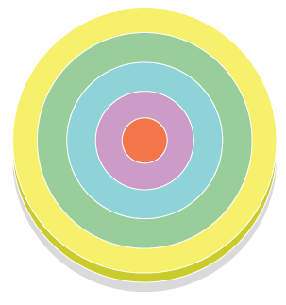
Urban Environments
BURGESS
Learning Objectives
To know the parts of a city
To know the uses of each part of the model
To know the differences between each part of the model

Slide 43
Take a tour through New York… http://video.nationalgeographic.com/video/player/places/cities-places/us_rhythmsofnyc.html
What do you see?
What do you hear?
What do you smell?
How does it change?
Why does it change?

Slide 44
Key Terms
Urban function is the job or role being performed by an area of land within a town or city e.g. central business district is the main hub of shopping and offices.
Land use – the type of building or other features that are found in the area e.g. terraced housing, banks, industrial estates, roads, parks.
Land use models are theories which attempt to explain the layout of urban areas.

Slide 45
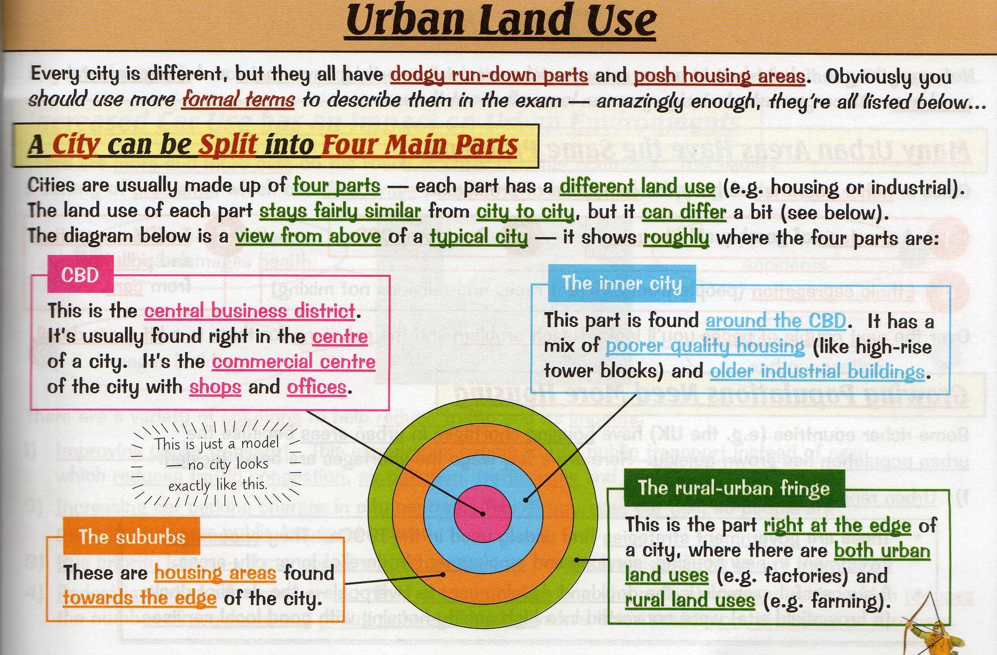

Slide 46
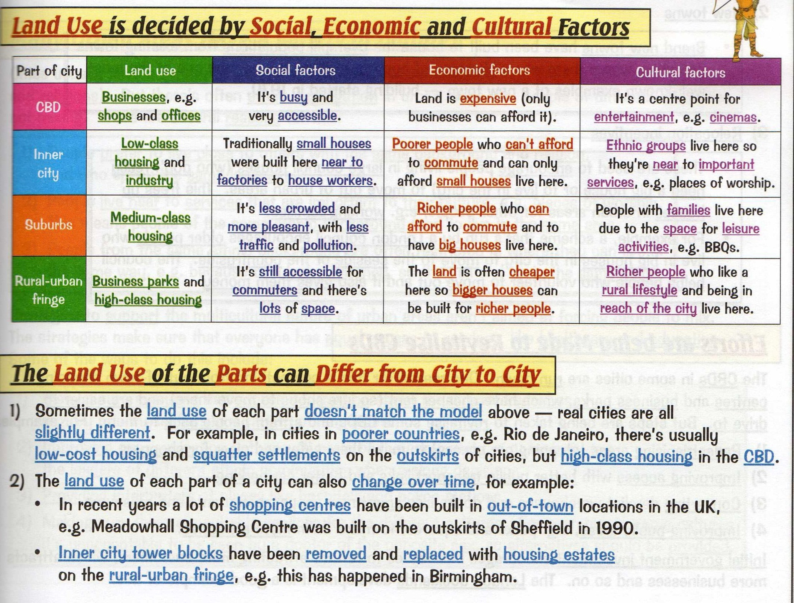

Slide 47
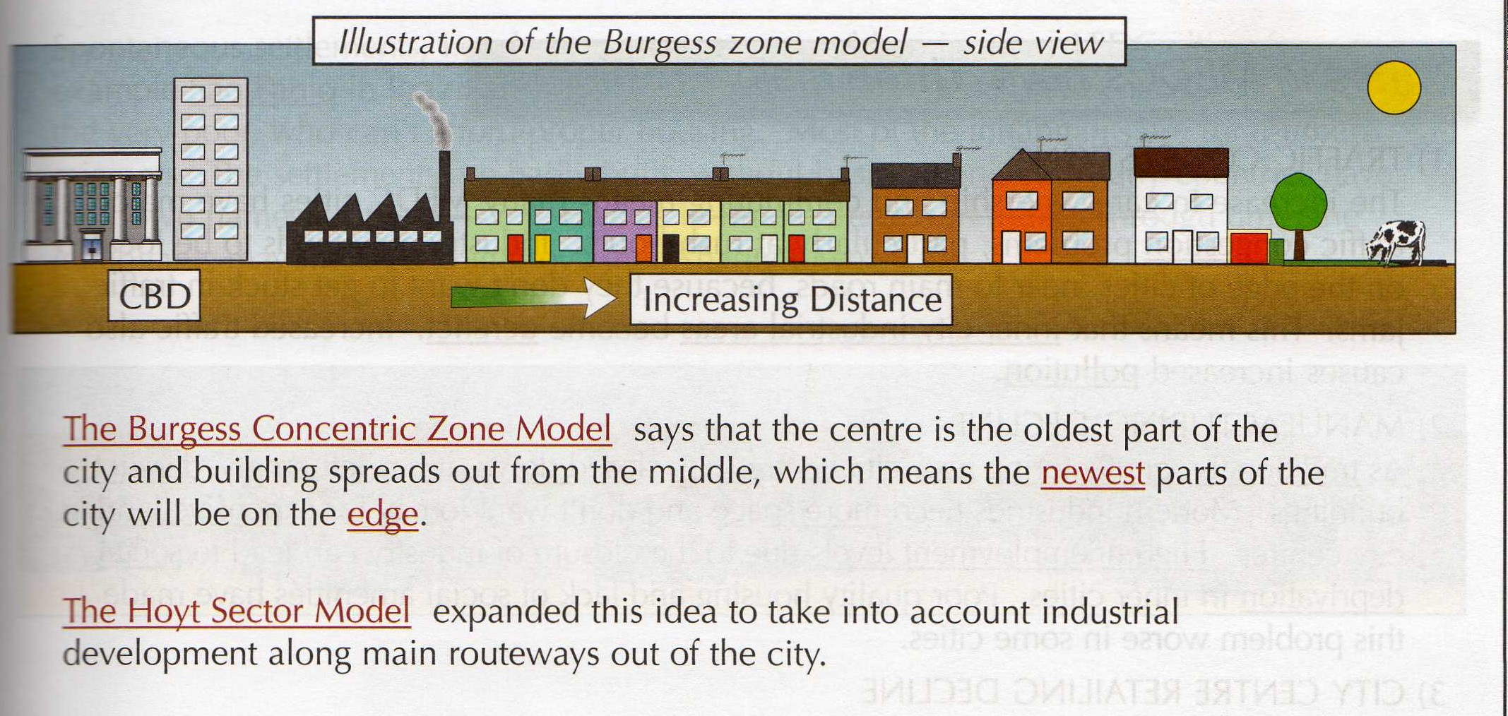

Slide 48
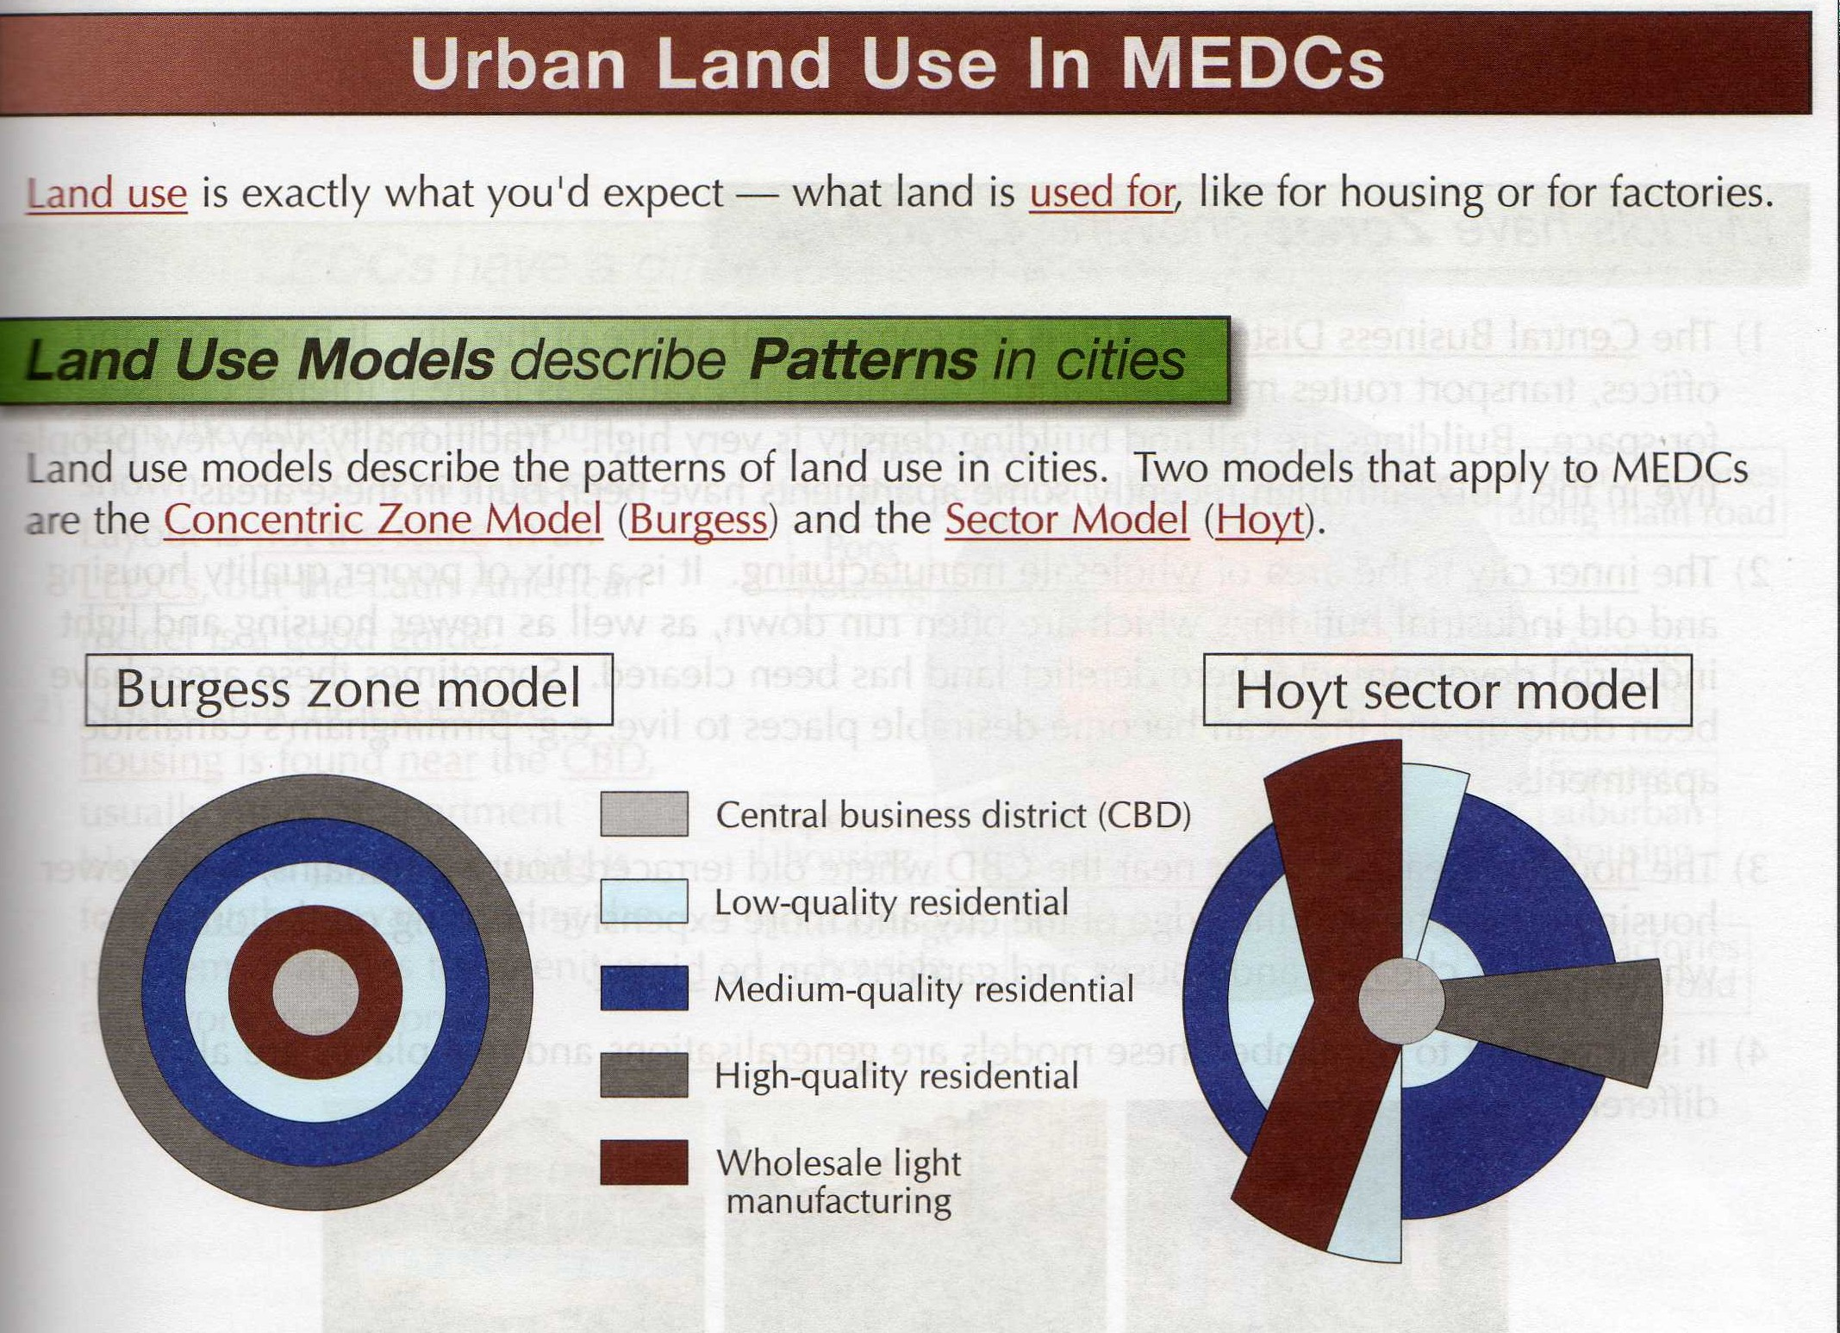

Slide 49
Changing Land Uses
Read through page 136/7 of the GCSE Geography text. Produce sketches to show the different types of housing that is found in each section of Burgess’ model. Draw your sketches around your model with an arrow labelling where that type of building would be found on Burgess’ model.
Draw in the buildings that you would expect to find in the CBD.

Slide 50
Patterns of Housing in the City
The Hoyt Model

Slide 51
Aims
To be able to explain the Hoyt Model of land use patterns in the city.
To compare Burgess’ and Hoyt’s model of the city.
To design and evaluate your own urban area.

Slide 52






Flags of the World
Who owns each of these flags?
A
B
C
D
E
F

Slide 53




Flags of the World cont.
G
H
I
J

Slide 54
Answers
A – New Zealand
B – Denmark
C – Japan
D – Britain
E – Italy
F – South Africa
G – India
H – Brazil
I – Portugal
J – China

Slide 55
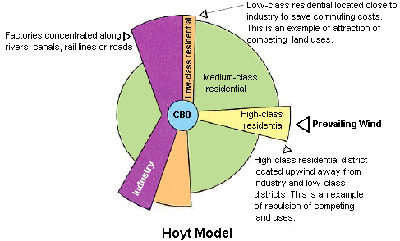
The Hoyt Model

Slide 56
Hoyt’s Model
Using Hoyt’s model of the city, answer the following questions in full sentences in your book.
Why would high class residential buildings be located upwind of the industrial section?
Why would low class residential buildings be located close to industry?
Why would factories be concentrated along rivers, rail lines or roads?
Write a paragraph explaining the similarities and differences between Hoyt’s model and Burgess’ model.

Slide 57
Changing Land Values and Population
Using page 60 from the text, sketch and label Figure C showing how land values and population change with distance from the city centre.
What happens to land values as you move outwards from the city centre?
What happens to population as you move outwards from the city centre? Why do you think this may be the case?

Slide 58
Urban Planners
You are bidding for a very lucrative contract to design a new city to be built in the United Kingdom. You are to work in pairs to design the city but the evaluation section needs to be completed individually in your exercise book. Will you use the Burgess Model? The Hoyt Model? Both? Neither? The choice is yours but if your city design is to win the contract, you must include all of the features listed and present a very well planned city.

Slide 59
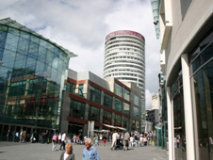
CBD
The Central Business District (CBD) in the city centre is where most business and commerce is located.
High/multi-storey buildings.
Expensive land values.
Department stores or specialist shops, like jewellers.
Shopping malls
Cultural/historical buildings, museums and castles.
Offices, finance, banks, administration, town hall (business sector).
Bus and railway stations (transport centres).
Multi-storey car parks.
The CBD is located in the centre because it is:
A central location for road/railways to converge.
The most accessible location for workers.
Accessible to most people for shops and businesses.

Slide 60
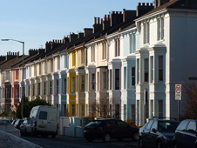
Inner city and terraced housing
The inner city is also known as the 'twilight zone'. It is typically found next to the CBD and has mainly terraced houses in a grid like pattern. These were originally built to house factory workers who worked in the inner city factories. Many of these factories have now closed down.
Many inner city areas declined in the late 20th century and have undergone a period of regeneration in recent years. Run down terraced housing is often bought by investors and improved to appeal to young professionals who need access to the CBD. This is called gentrification.

Slide 61

Suburbs
Suburban houses are usually larger than inner city terraces and most have a garden. Typically, they are detached or semi detached and the roads around them are arranged in cul de sacs and wide avenues. Land prices are generally cheaper than in the CBD and inner city, although the desirability of housing can make some areas expensive.
Many suburbs were built in the UK in the 1930s and have a distinctive style of housing, as shown in the picture to the right. More modern housing estates were built in the late 20th century as towns and cities have continued to grow.
Facilities such as schools, places of worship and parks are often present, and many are served by a local supermarket.
Suburban areas are often home to commuters who need access to the CBD along main roads and railways, and they are also within easy reach of the countryside.

Slide 62

RUF
This is found at the edge of a town or city and is where town meets country. It is common for this area to have a mixture of land uses such as some housing, golf courses, allotments, business parks and airports.
The mixture of land use often causes conflict as different groups have different need and interests. For example, building Terminal 5 at Heathrow on the outskirts of London was a source of controversy. The need for another runway continues to cause conflicts of interest

Slide 63

Burgess 3d Model
Step 1
As a class produce a large 3D version of the Burgess model
Step 2
Working in groups of 4-5, each group will get a different part of the city
Step 3
Your section of the model should illustrate – building type (land use), building height, environmental quality and anything else you think would enhance your section of the model.
Step 4
You may use drawings, writing or models to put together your part of the model.

Slide 64



Building Types
Shops, banks etc
Factories
Terraced housing
Semi detached housing
Detached housing

Slide 65

Building Height
Multi-storey
3-4 floors
2-3 floors
2 floors
1-2 floors

Slide 66
Land Prices
Very expensive
Cheap
Cheap
Average
Very expensive

Slide 67
Environmental Quality
Average
Poor
Poor
Good
Very good

Slide 68
Lesson objectives
To know how changes in the growth of settlements benefit some people more than others.
To recognise there are both good (positive) and bad (negative) points of settlement growth.

Slide 69

This is a small part of a large photograph of Lagos – use your geographical mind and sketch what you think might surround this area…
Notes:
Inform the students that this is a shanty settlement – common in LEDC cities that are rapidly urbanising.
They complete the task as above in their book.
Show the next slide after 5 mins – 10mins.

Slide 70
Notes:
Link back to the key question.
Rapid urbanisation of people from rural to urban areas cause large, informal settlements to grow as the governments cannot (or do not) keep pace with the movement of people in terms of providing facilities.
It also shows that there are huge inequalities in large cities. This can cause tension and ultimately conflict. It also causes crime rates to increase as poor dwellers see how some people live. Crime results from desperation.

Slide 71
Lagos, Nigeria
Describe and explain the consequences (positive as well as negative) of rapid urban growth in Lagos.
Standard of Living
Informal Employment
Crime (Area Boys)
Unequal wealth
video
Notes:
Watch the video and get students to note down the consequence of rapid urban growth.
Discuss after.

Slide 72
Lagos - assignment
You must describe what Lagos is like
tip – think about the senses (sight, sound, smell etc)
Describe what life is like in Lagos – how do people live, what do they do, how do they dress?
What are the good things about life in Lagos?
What are the negative aspects of life in Lagos?
How could problems in Lagos be solved in your opinion?

Slide 73
Recap
Urban population over time will increase/decrease?
Urban population projected for 2015 will be highest in Africa/Europe/Asia?
MEDCS have high/ low urban population?
MEDCS have higher/ lower urban growth?
LEDCS have high/ low urban population?
LEDCs have higher/ lower urban growth?
Worlds fastest growing cities are in LEDC/ MEDC?
DON’T COPY

Slide 74
Lesson objectives
To know how changes in the growth of settlements benefit some people more than others.
To recognise there are both good (positive) and bad (negative) points of settlement growth.

Slide 75

Make a list of 5 words that you would use to describe a squatter settlement from this image.

Slide 76


Slide 77


Slide 78


Slide 79


Slide 80
Urban growth in developing countries (LEDCs)
Match the words to their definitions.
Fill out the form on your hometown. Suggest what a slum dweller might write on their hometown form.
The class will form 3 groups. Each group will receive different texts:
A. General information about slums
B. A script of a radio programme about Kibera, a slum in Kenya
C. A script of a radio programme about slums in Mumbai (India)
Each group will include the key points in a poster that they will present to the class. Prepare a true or false statement to test the class at the end of your presentation.

Slide 81
Urban growth in developing countries (LEDCs)
Compare and contrast urban environments in an LEDC and an MEDC
Compare and contrast two different urban environments in an LEDC

Slide 82
Compare the Problems caused by urbanisation in an LEDC and an MEDC
L.O.
Compare the problems caused by urbanisation in poorer and richer parts of the world.

Slide 83

What do you see?
Are the world's cities in crisis? People migrate to cities for many reasons, including entertainment, excitement and employment opportunities. For the first time in history there are more people living in cities than in rural areas. But are cities too crowded to cope?
http://www.bbc.co.uk/learningzone/clips/511.bb.wmv

Slide 84
Comparing Cities
New York
Brainstorm your impressions of LA, USA and Hollywood.
Would you like to live in LA?
http://www.bbc.co.uk/learningzone/clips/512.bb.wmv
http://www.bbc.co.uk/learningzone/clips/513.bb.wmv
Seoul
Brainstorm your impressions of Seoul, Korea.
Would you like to live in Seoul?
http://www.bbc.co.uk/learningzone/clips/1482.bb.wmv
http://www.bbc.co.uk/learningzone/clips/520.nb.wmv
Stick case study sheet comparing New York and Seoul into your book. Highlight key words. EXT: Compare the issues both cities are facing due to urbanisation.

Slide 85
What problems have urbanisation caused in the city?
Colour code the mind map to highlight the differences between LEDCs and MEDCs.
Use a variety of images with colour to make your mind map stand out and be memorable.
Create a mind map to show the problems that urbanisation has caused in cities.
Highlight key words and change the font size to make them stand out.
Where possible give examples – it could be cities that you have visited seeing family or whilst on holiday.

Slide 86
Urban growth in developing countries (LEDCs)
Compare and contrast New York and Seoul

Slide 87
Plenary
Inconvenient for a few.
Major problem impacting on a large percentage of the population.
Rate your problem caused by urbanisation.

Slide 88

Urban Environments
Squatter settlements
Learning Objectives
ALL – to know ways to improve squatter settlements
MOST – to know a case study for each strategy
SOME – to reflect on the effectiveness of each strategy
Notes:
Arsenal logo hyperlinked to highbury square

Slide 89

What adjectives come to mind when you study this photo?
If you lived here

Slide 90

If you lived here what problems might you experience?
Health?
Education?
Living conditions?
Transport?
Water?
Employment?
Leisure?

Slide 91

Where do you think this is?
Why do you think people live here?
How might you improve it?

Slide 92

Where do you think this is?
Why?
How would you
prioritise what
needs to be done?

Slide 93

Location of squatter settlements
Based on this figure how would you describe the location of squatter settlements? Where would you expect to find them in cities of poor countries?

Slide 94


Slide 95


Slide 96


Slide 97


Slide 98
Casestudy: Rio De Janeiro
Watch the video about Rio De Janeiro. The video explores the key themes of urbanisation, counterurbanisation and quality of life through examining different areas of the city.
Take notes while you watch the video then answer the following questions.

Slide 99
Video questions
What is Rio De Janeiro like?
What is a favela like?
What are the difficulties facing Rio De Janeiro?
What is it like living in new towns on the outskirts? Why do people move there?
How is the city changing?
Write your own definitions for the following terms: urbanisation, counterurbanisation and shanty town (favela).

Slide 100
These are the answers…. what are the questions?
Favela
Rubbish
Outskirts
Urban model
Counter-urbanisation
New town
Migration

Slide 101
Urban growth in developing countries (LEDCs)
The major cause of urbanisation in developing countries is ______________
People move from rural to urban areas because of poor environmental, _______ and __________ conditions

Slide 102
Problems and solutions
Watch the videos and use the textbook to complete the worksheet on the problems in squatter settlements, the solutions to the problems and a case study of a real squatter settlement in Brazil.
Notes:
Watch the slum cities dvd, map hyperlinked to a video

Slide 103
Squatter settlements
Problems of squatter settlements
Case study – Favela-Bairro project
Local authority schemes
Self-help schemes
Site and Service schemes

Slide 104
The speed of the urbanisation process in many poorer areas of the world results in squatter
settlements being built. The pace of rural-urban migration is too fast to allow the time
needed to build proper houses and for the economy to grow to provide jobs. People find
unoccupied areas of land and materials and begin to build their own makeshift shelters. As
there are few official jobs available, people create their own employment e.g. selling items,
cleaners, repairing things – this is known as the informal sector.
The speed of the urbanisation process in many poorer areas of the world results in squatter
settlements being built. The pace of rural-urban migration is too fast to allow the time
needed to build proper houses and for the economy to grow to provide jobs. People find
unoccupied areas of land and materials and begin to build their own makeshift shelters. As
there are few official jobs available, people create their own employment e.g. selling items,
cleaners, repairing things – this is known as the informal sector.

Slide 105

Ghana: Life in a Shanty Town
Key Idea: When Grace and her family moved due to problems in the countryside, what did they find in the city of Kumasi, Ghana?
Review: what were the problems that pushed Grace out of their rural village?
Can you identify any improvements
for Grace and her family in this photo in the market place at Kumasi?

Slide 106


Slide 107

Living in the Shanty town of Ariba at the edge of Kumasi, Ghana.
Grace’s new home: these families pay no rent, they are squatters & have made their own houses
What are the huts made of?
5. What are the
problems living
here?
2. Suggest reasons why these materials are used.
3. Do these huts have electricity, and a clean water supply?
4. How do you think they light the area at night and deal with sewage?
Grace,
her husband and family
live here
The nearby
Stream is
very polluted

Slide 108
Prioritising the Improvements in the Shanty Town
Work in groups of 3 – each group is a group of residents who want to improve the quality of life in Ariba.
You are given a map, a list of problems and 200 shanty town points to spend in your first year and another 200 in your second year to solve the probems.
In groups complete the 2 year planning sheet (resource 8) deciding what your priorities are for improving Ariba, giving reasons, costs and future plans.

Slide 109
Debriefing: How did you decide your priorities?
Your discussion may include:
  The responsibilities and abilities of Ghana’s government
  Competing priorities: should local industry be helped to generate more wealth first to build housing for workers?
  Should money be spent on improving the countryside?
  Why does the government not make them all leave?

Slide 110

Geography Homework
Prioritising the Improvements in the Shanty Town
Write up your planning decisions for Ariba, giving reasons for having made them.
What help should be given to people in the villages ( use p17)? Would it be better to help villages rather than the shanty towns? Explain.

Slide 111
Lesson objectives
To know how changes in the growth of settlements benefit some people more than others.
To recognise there are both good (positive) and bad (negative) points of settlement growth.

Slide 112
Urban Sprawl: Urban sprawl is when urban areas grow in physical size
Urban growth: is the rate of growth of an urban population
Megacity: A city with 10 million people or more (give a example of a city)
Population distribution: refers to how the population is spread out
Population density: refers to the number of people living in a certain area, usually km2

Slide 113



QUESTION:
How is urbanisation linked to economic growth?
Country moving
away from
rural agricultural
economy
To more industrial,
commercial
economy
More people move in
towns and cities

Slide 114
Draw this diagram
Describe what this diagram is showing
Why do you think this is happening?
MEDCs (developed)
Urban population HIGH
Rate of growth is low
LEDCs (developing)
Urban population LOW
Rate of growth is higher

Slide 115
3. Developed (MEDCs) countries have
urban populations that are still quiet
high/low, the rate of growth is
higher/lower (ONLY write the correct
answer)
MEDCs (developed)
Urban population HIGH
Rate of growth is low
4. Developing (LEDCs) countries have urban
populations that are still quiet high/low,
the rate of growth is higher/lower (ONLY
write the correct answer)
LEDCs (developing)
Urban population LOW
Rate of growth is higher

Slide 116
Explain how urban growth benefits the local economy in a less developed country.
Clear link to economic development which is expressed beyond the idea of jobs and money.
cheap work force which encourages industry to set up.
There is a large market for goods and services.
LEDCs wouldn’t cope without large supply of cheap labour.
MULTIPLIER EFFECT: Increase spending can increase income for a area
E.G: building a factory – getting employers – people will build shops – restaurants – entertainment -

Slide 117

Urban Environments
MEDC Housing Issues
Learning Objectives
ALL – to know 3 housing solutions
MOST – to know a case study for each strategy
SOME – to reflect on the effectiveness of each strategy
Notes:
Arsenal logo hyperlinked to highbury square

Slide 118

Urban Development Corporations (UDCs)
Private and Public investment
In the 1980s in an effort to reverse the process of inner city decline the UK government set up Urban Development Corporations (known as UDCs). The aim of these UDCs was to regenerate inner city areas with large amounts of derelict and unused land by taking over planning responsibility from local councils.

Slide 119




London Docklands Development Corporation (UDC)
Annotate the map of the docklands with problems with docks and solutions to the problems.
Complete the timeline of key events through time
C19th
1950s
1981
1998

Slide 120



Slide 121


City Challenge
Solving the problems
Multi-storey tower blocks were built in the 1960’s and demolished in the 1990’s

Slide 122

Urban Environments
MEDC Sustainable cities
Learning Objectives
ALL – to know sustainable living solutions
MOST – to know a case study for each strategy
SOME – to reflect on the effectiveness of each strategy
Notes:
Arsenal logo hyperlinked to highbury square

Slide 123


Slide 124


Slide 125


City Challenge
Homes were designed to conserve water and be energy efficient
There was a return to a traditional street layout – cul-de-sacs
Local schools and a new park have been built
The views of local people were considered

Slide 126


Sustainable Communities
BedZed, London
A focus to bring community relationships back into areas as well as care for the environment

Slide 127

BedZed is a community of individuals and families trying to make their community sustainable…

Slide 128

The houses are spacious and modern but use eco-friendly materials

Slide 129

The buildings have cavity wall insulation to reduce their fuel bills and save valuable resources

Slide 130

BedZed was developed in partnership with international engineering firm, Arup.

Slide 131
The houses use the most sophisticated sustainable technology available in the present day

Slide 132

Their quirky architecture has won several awards

Slide 133

Open space has been set aside to help develop a community spirit

Slide 134

There is a car club taking 2/3 of the community’s cars off the road

Slide 135

Recycling bins enable easy and effective reuse of resources

Slide 136
Urban Environments
LEDC Sustainable cities
Learning Objectives
ALL – to know sustainable living solutions
MOST – to know a case study for each strategy
SOME – to reflect on the effectiveness of each strategy
Notes:
Arsenal logo hyperlinked to highbury square

Slide 137


Slide 138


Slide 139
Plenary
What are some of the potential solutions to these problems of urban areas?

Slide 140

The Rural Urban Fringe
Learning Objectives
ALL – to know the reasons for building at the RUF
MOST – to know a case study about life in the RUF
SOME – to reflect on the effectiveness of counter-urbanisation
Notes:
Arsenal logo hyperlinked to highbury square

Slide 141
What is the rural-urban fringe?
It is the area where the city meets the countryside.

Slide 142


Slide 143


Slide 144


Slide 145


Slide 146


Slide 147
To summarise
Recently there has been increasing demand for land here because:
Land is cheaper
There is less traffic congestion and pollution
There is easier access and a better road infrastructure
There is a more pleasant environment with more open space

Slide 148
What do developers want the land for?
Housing developments as urban sprawl continues
Science and business parks
Hyper-markets and superstores
Office developments
Hotels and conference centres

Slide 149


Slide 150
Housing
Why is housing built at the RUF?
Land is cheap
More housing is needed as more people are living alone and living longer.
Peace and quiet
Less crime
Easy access to motorways
Good access to countryside

Slide 151
Shopping Centres
Why do they want to locate at the RUF?
Cheap land
Room to expand
Close to motorways
Space for parking
Leisure facilities can also be provided
Local suburban work force

Slide 152


Slide 153


Slide 154


Slide 155


Slide 156


Slide 157


Slide 158


Slide 159
What are the problems caused by developing the RUF?
Large areas of countryside may be lost
Buildings may be out of character with existing rural buildings
Villages become suburbanised
Traffic is likely to increase ( both cars and lorries)
There may be some noise or pollution
NIMBYism

Slide 160
How can change at the RUF be managed?
Creating ‘Green Belts’ – a zone of countryside around a city where development is controlled. They aim to:
Prevent urban sprawl
Prevent towns merging
Preserve the special character of towns
NOT ALL CITIES HAVE GREEN BELTS.
Examples include London, Oxford and Bournemouth.
However, greenbelts are often leap-frogged and development happens just outside it.

Slide 161
How can development at the RUF be managed?
New Towns
e.g Stevenage
At the end of the second world war towns were created just outside London’s green belt to prevent London spreading and give people a better way of life.

Slide 162
Other Policies
In recent years the Government has tried to reduce pressure on the RUF by encouraging development of brownfield sites over greenfield sites, and stopping any more out of town shopping centres from being built.

Slide 163


Brownfield and Greenfield sites
Many new homes will be built throughout existing towns and cities on land that is known as brownfield land.
Brownfield | Greenfield
Land that has been built on before and is to be cleared and reused often in the inner city | Land that has not been built on before usually in the countryside or on the edge of a city

Slide 164
Using your information attempt to answer the following questions:
What are the housing problems in cities?
Compare brownfield sites with greenfield sites
What strategies could be used to reduce the problems with housing?
Key terms (try to use some of these words in your answer):
Household:
Brownfield site:
Greenfield site:
Regeneration:
Sustainable community:
Problem solving to learn

Slide 165

Urban Environments
Multicultural mix
Learning Objectives
ALL – to know the causes of ethnic segregation
MOST – to know strategies aimed at supporting cultural mixing
SOME – to know a case study of cultural mixing

Slide 166


Slide 167
Encouraging Cultural Mixing
There is an attempt to integrate different ethnic groups and reduce segregation.
LEEDS
Seeking to improve literacy in areas where English can be a second language
Increasing employment through initiatives to ensure basic skills and access to information and training
Increasing community involvement by ensuring that the needs of minority groups are understood and met.
Providing facilities that encourage meetings of all sections of a community rather than separate ethnic groups.

Slide 168

Segregation
Oldham riots 2001
Between 500 white and Asian youths
Despite the apparent racial mix in many cities, a significant number of immigrants choose to live with people from similar areas and away from others with different ethnicity and culture. This represents segregation.
Notes:
Image hyperlinked to youtube

Slide 169
Reasons for segregation
Support from others
People feel safe and secure when they can associate with other people from the same background. There is a sense of belonging and protection from racial abuse.
A familiar culture
In a strange country, there is comfort from being with people who have similar ideas and beliefs and speak the same language.
Specialist Facilities
In many areas, these are provided so that, for example, Sikhs can worship in a gurdwara. Familiar foodstuffs will be available in shops
Employment factors
Immigrant groups tend to do low-paid jobs or have a high rate of unemployment. They have limited money and so can only afford cheaper housing in certain parts of the city.

Slide 170

Urban Environments
Environmental Issues
Learning Objectives
ALL – to know the causes of environmental issues in urban areas
MOST – to know strategies aimed at the reducing the impact on the environment
SOME – to reflect on solutions for air and water pollution

Slide 171


Slide 172


Slide 173


Slide 174


Slide 175


Slide 176


Slide 177


