Slide 1
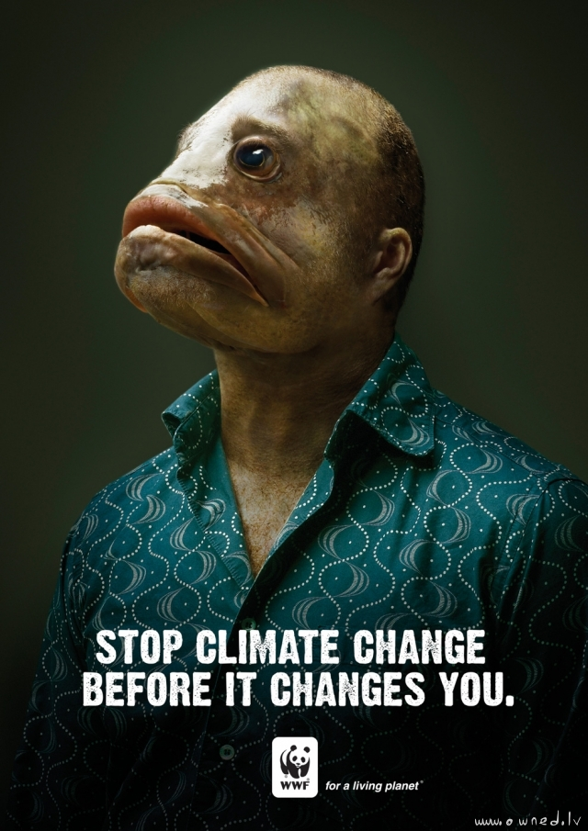
Can global climate change be stopped?
Change it before it changes you!

Slide 2
Aims
Understand the term carbon footprint.
Identify some strategies that can reduce the amount of carbon dioxide emissions (including carbon capture and storage).
Explain some of the problems with reducing carbon footprints.
Understand the problems environmental scientists face.

Slide 3
What is a carbon footprint?
A carbon footprint is the environmental impact of the total amount of carbon dioxide and other greenhouse gases emitted over the full life cycle of the use of a product, service or event by individuals, specific activities or areas.

Slide 4
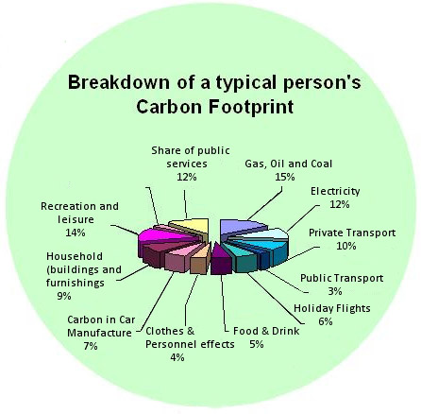

Slide 5
Cutting down on our footprint
Although there is still much debate on global climate change and the real cause, it is widely accepted that it would be wise to reduce the amount of carbon dioxide we emit.
How do we do it?

Slide 6
This is how!
Alternative energy supplies.
Energy conservation.
Carbon capture and storage.
Carbon taxes and licences.
Carbon off setting.
Carbon neutrality.

Slide 7
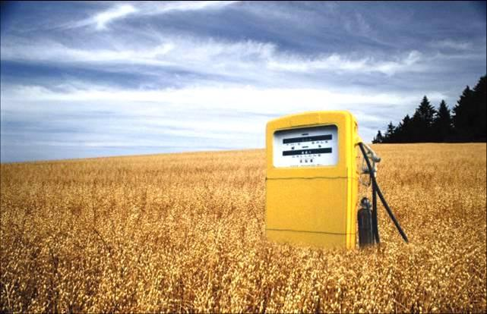
Alternative energies – (the most likely)
Bio fuels such as ethanol and biodiesel. They are renewable and almost carbon neutral e.g. They absorb as much carbon dioxide (via photosynthesis) as they release when combusted in engines.
However, they replace crops meaning food prices increase, habitats are lost and the transport and processing of the fuel mean they are not actually carbon neutral.

Slide 8
Wind, wave, solar – all renewable
Wind -
Wave
solar

Slide 9
Energy conservation
Increase in efficiency
Decrease consumption
Energy conservation

Slide 10
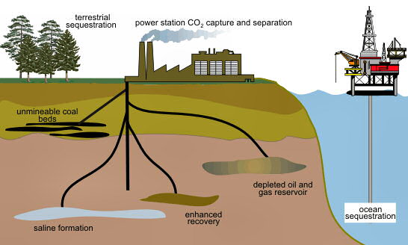
Carbon capture

Slide 11
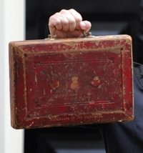
Carbon taxes
In the Uk It forces firms to measure and report their emissions - mostly the result of gas and electricity use - and then pay £12 per tonne of carbon dioxide they emit.
One problem however with this is that companies do not get any credit for sourcing some of their electricity from green sources.

Slide 12
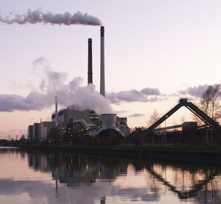
Carbon permits
Companies can buy the right to emit a certain amount of a pollutant.
This encourages the company to reduce their emissions (they have to buy less permits).
The government can then use the money for green projects.
The problem may be when enforcing where the money is spent – nurses are getting sacked after all!

Slide 13
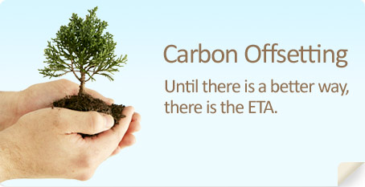
Carbon offsetting
Companies can offset the amount of carbon dioxide that they release by investing in green projects such as wind farms or planting trees.

Slide 14
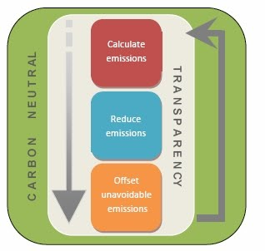
Carbon Neutral?
The idea is to become carbon neutral – the amount of carbon released is offset by the amount sequestered (offset).
However this is not always the case e.g. Biofuels.

Slide 15
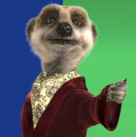
Simples? – The problems reducing the footprint
Scientific disagreement over climate change.
Lifestyle change.
Cost to industry.
Incomplete international co-operation.
Lack of education and public information.

Slide 16
Lifestyle change – can we live without this?
Food
Transport
Electricity

Slide 17
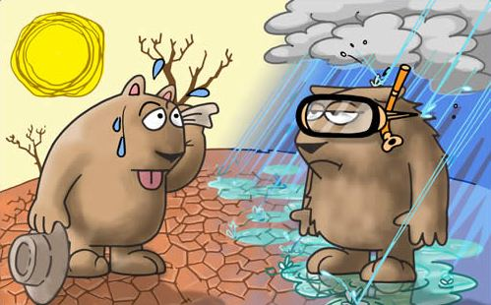
Confusing reports

Slide 18
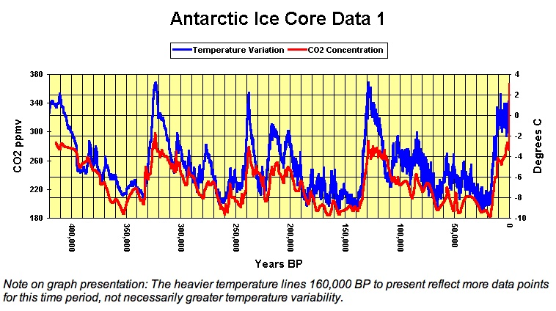
Al Gore said in an inconvenient truth that an increase in carbon dioxide has resulted in an increase in global temperatures. He used this graph Do you agree?

Slide 19
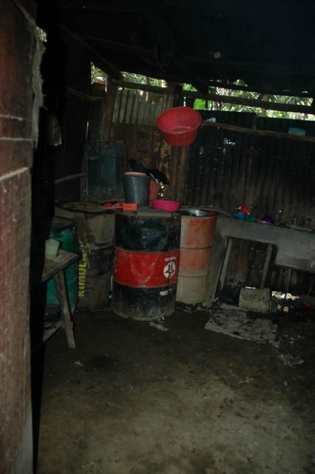
Which would you prefer?

Slide 20
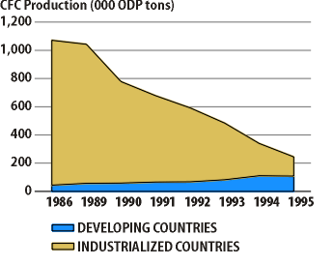
Montreal Project – A success?
In 1985 Scientists discovered an area of our ozone that was much thinner than expected (hole in the ozone layer).
This was then linked to CFC’s (Chloroflourocarbons).
In 1987 27 governments signed the Montreal Protocol on Substances that Deplete the Ozone Layer.

