Slide 1
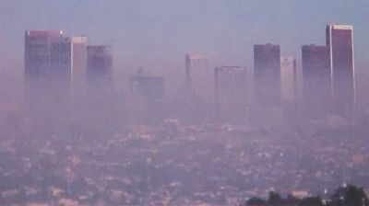
What impression do you get of this city?

Slide 2
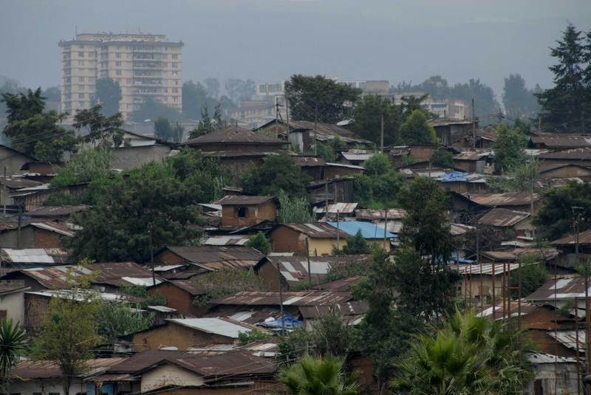
What do you see?
http://www.bbc.co.uk/learningzone/clips/511.bb.wmv
Are the world's cities in crisis? People migrate to cities for many reasons, including entertainment, excitement and employment opportunities. For the first time in history there are more people living in cities than in rural areas. But are cities too crowded to cope?

Slide 3
Problems caused by urbanisation
L.O.
To list some of the problems caused by urbanisation.
To describe the problems caused by urbanisation linking in examples.
Compare the problems caused by urbanisation in poorer and richer parts of the world.
C.0. – Present work in an effective format.

Slide 4
Comparing Cities
Los Angeles
Brainstorm your impressions of LA, USA and Hollywood.
Would you like to live in LA?
http://www.bbc.co.uk/learningzone/clips/512.bb.wmv
http://www.bbc.co.uk/learningzone/clips/513.bb.wmv
Cape Town
Brainstorm your impressions of Cape Town, South Africa.
Would you like to live in Cape Town?
http://www.bbc.co.uk/learningzone/clips/1482.bb.wmv
http://www.bbc.co.uk/learningzone/clips/520.nb.wmv
Stick casestudy sheet comparing Los Angeles and Cape Town into your book. Highlight key words. EXT: Compare the issues both cities are facing due to urbanisation.

Slide 5
What problems have urbanisation caused in the city?
Colour code the mind map to highlight the differences between LEDCs and MEDCs.
Use a variety of images with colour to make your mind map stand out and be memorable.
Create a mind map to show the problems that urbanisation has caused in cities.
Highlight key words and change the font size to make them stand out.
Where possible give examples – it could be cities that you have visited seeing family or whilst on holiday.

Slide 6
Plenary
Inconvenient for a few.
Major problem impacting on a large percentage of the population.
Rate your problem caused by urbanisation.

