Slide 1
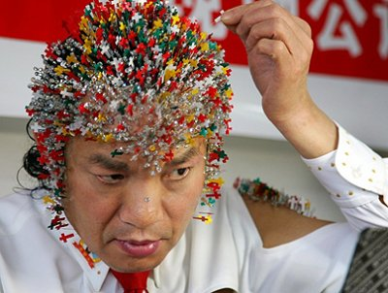
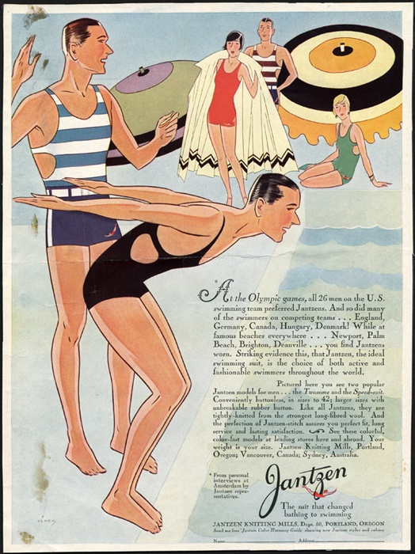
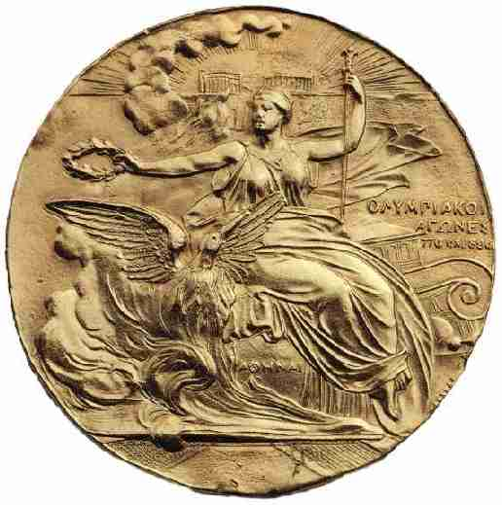
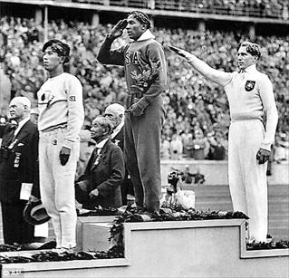
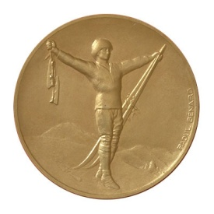
1972 Munich Olympics. Terrorists took an Olympic team hostage at the games.
Dr Wei Sheng from Nanning, S China, pierced his head, face, hands and chest with 2008 needles in the five colours of the Olympic rings.
USA advert to purchase your own Olympic swim wear.
1936 Berlin Olympics, in Nazi Germany. Jesse Owens winning the gold medal for the decathlon.

Slide 2
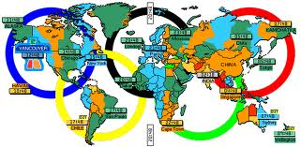
A Global Celebration of Sport?
Competences
R3 – take responsibility for completing tasks on time in groups.
M2 – to collect and record information interestingly.
Lesson Outcomes:
To have used an atlas to locate and describe the countries and cities that have held the Olympics.
To have reached a judgment as to whether the Olympics is a truly global event.

Slide 3
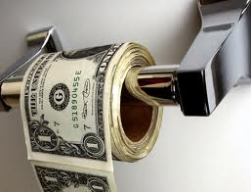
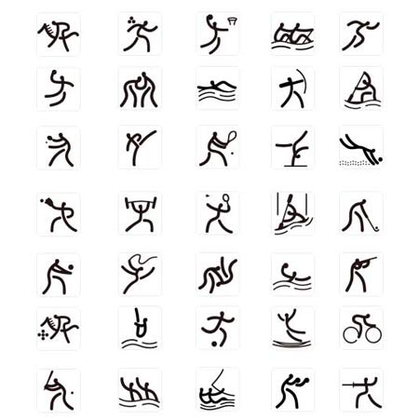
Today’s Keywords
Related to society itself – dealing with the individual. Connected directly with people and their experiences.
Social
Related to how a county is run and connected with the governing of a country or region.
Conservatives and Labour.
Political
Related to money. How to make a profit and how to spend money.
Economics

Slide 4
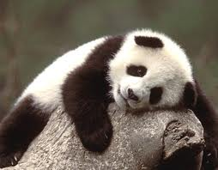
Main Activity
In groups you are to locate specific information on each country that has held, or is going to hold the Olympics.
You are then to present this information in an interesting manner.
Country and Capital City | Economic and Social Data | Symbols Images that represent the country
Beijing, China. 2008 | Life expectancy – 71 yrs. This suggest that they have a good health system. 38% live in towns.

Slide 5
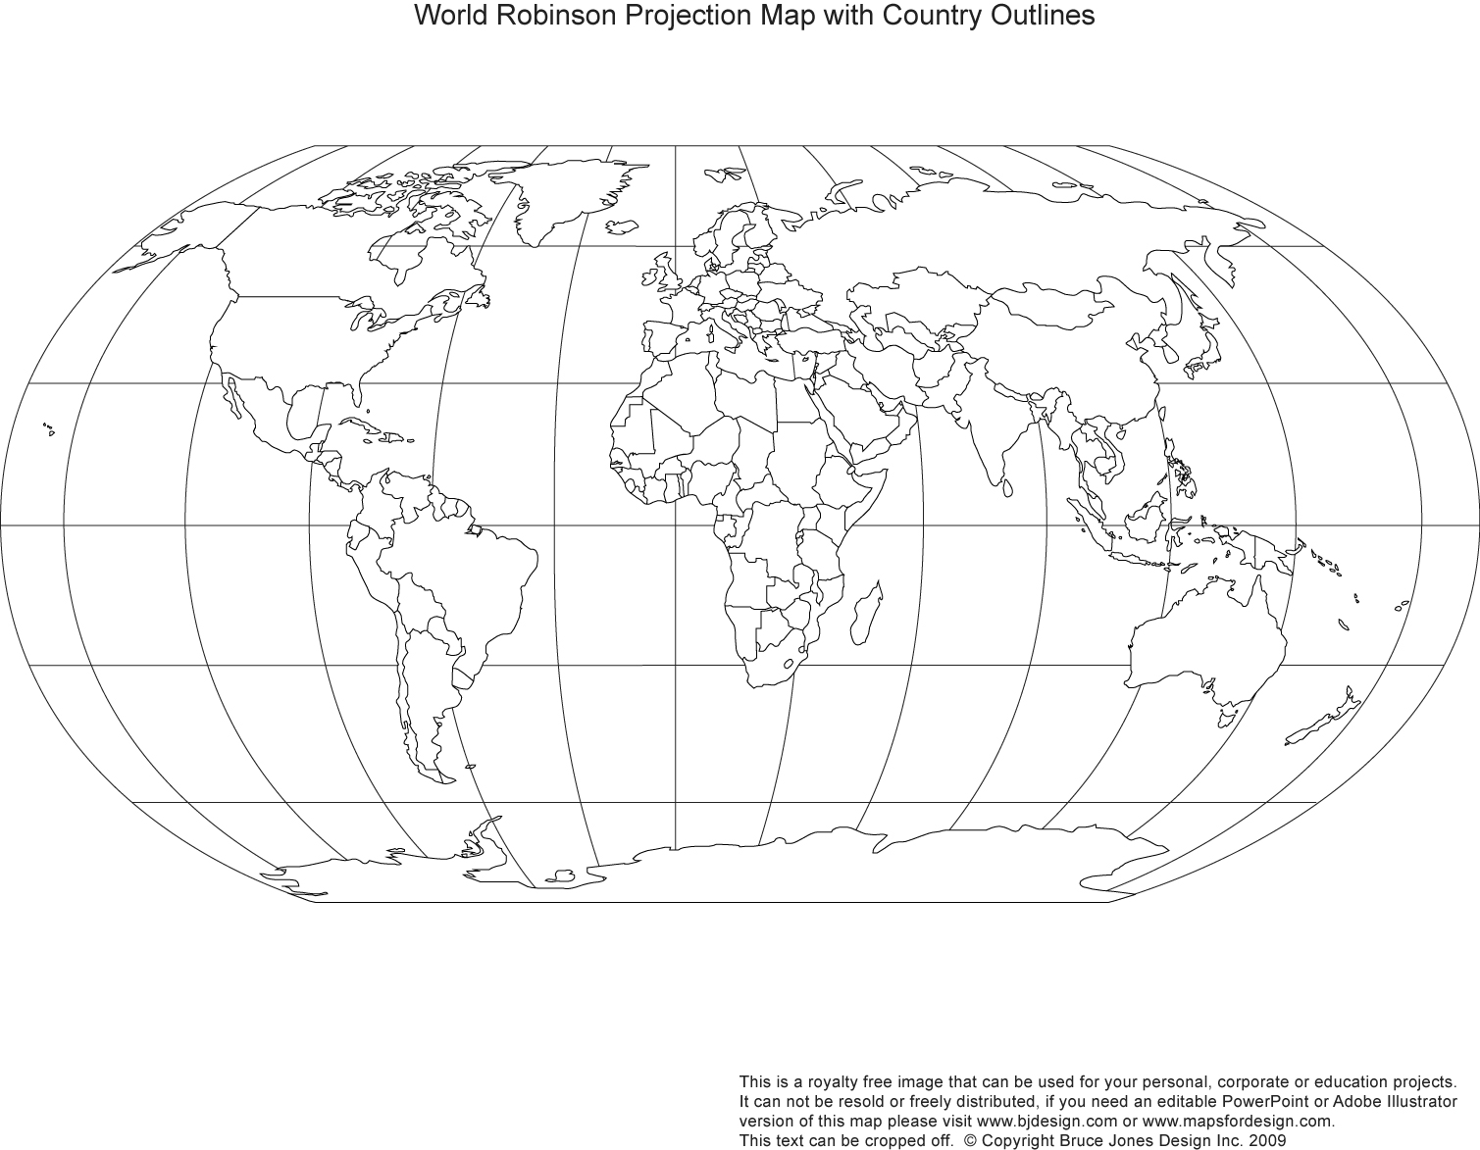
Host Cities of the Olympics

Slide 6
Groups
Sophie Ashton
Dominic Banks
Sam L
Jordan P
Beth
George
Josh M
Rupert W
Tasia H
Marissa C
Charles C
Christopher T
Lorna Cousins
Sam B
Robin N
Charles Cooper
Holly H
Peter B
Tom L
Frank P
Jason H
Izzy L
Jack T
Charlie R
Dylan K
Josie M

Slide 7
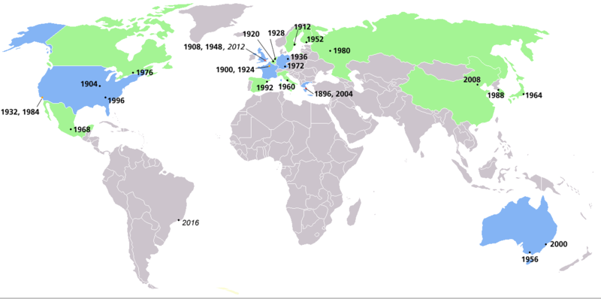
Host Cities of the Olympics
Have you spotted any trends as to where the Olympic games are held?
What trends have you noticed about the type of country that host the games? economically.
Is the Olympic games truly a global event?

Slide 8
Stop….. consider…..collaborate ……
Look at the location of past and future Olympic host cities. Are the Olympic Games a truly global event? Explain your answer:
Stop….. consider…..collaborate……
Look at the data you have collected on past and future Olympic host cities. Why do governments want to hold the Olympic Games? Explain your answer:
Homework Sheet
Level 3 –Offer some reasons and use some key terms.
Level 4 – Consider how it might affect the lives of people living there. Offer reasons for own ideas. Use appropriate vocabulary.
Level 5- . Recognise a range of views and how begin to explain how holding the Olympics will cause positive changes. Select information and suggest plausible reasons.
Level 6 – Describe and begin to analyse how different factors influence governments. Appreciate that people have different attitudes.
Level 3 –Offer some reasons and use some key terms.
Level 4 – Consider how it might affect the lives of people living there. Offer reasons for own ideas. Use appropriate vocabulary.
Level 5- . Recognise a range of views and how begin to explain how holding the Olympics will cause positive changes. Select information and suggest plausible reasons.
Level 6 – Describe and begin to analyse how different factors influence governments. Appreciate that people have different attitudes.

Slide 9
Success Criteria
Plenary
To guarantee that the Olympic games are in the future, truly global, you and your partner are to draw up a “Success Criteria” for the Global Olympic Games.
i.e. must be held in a different hemisphere every four years .

Slide 10
Stretching
your minds…
Why do you think it is only wealthy countries that hold the games?
Is it beneficial for a country to hold the Olympics? If so, in what ways?
Finally, should the UK have placed a bid for the Olympics taking into account everything you have discovered today?
Notes:
Students to draw parallels
Link to race and community
Searching questions – which link the olympics to the grander scheme.
What are nations?
What does it do for communities? What nation do people subscribe to?

