Slide 1
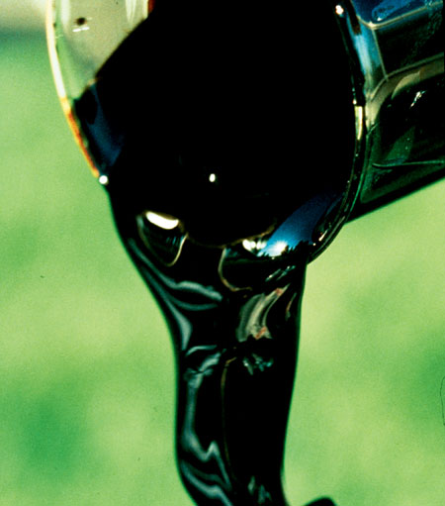
OIL A Natural Resource

Slide 2
Production
Why oil is so important to people today?
In 2003 global oil production was at 70 million barrels per day.
Saudi Arabia, the USA, Russia, Iran, China, Venezuela, Mexico and Norwa accounted for over 50% of total production.

Slide 3
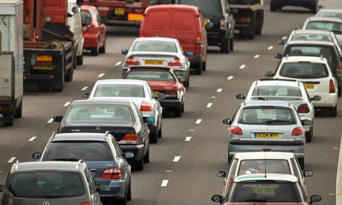

Slide 4
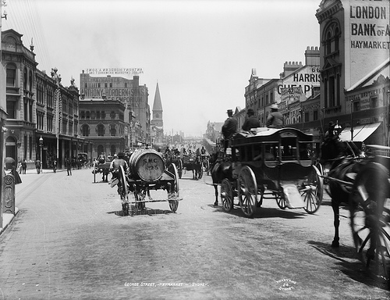
Energy
Why are we using more energy than we were 100 years ago?
Oil demand is a function of population and level of development

Slide 5
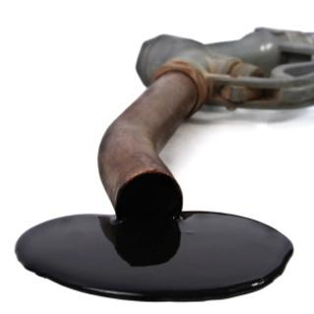
Oil is a fossil fuel
Oil reserves are generally found in geological structures such as anticlines, fault traps and salt domes.
Present rate of production and consumption means tat reserves could last for another 40 years.

Slide 6
3.

Slide 7
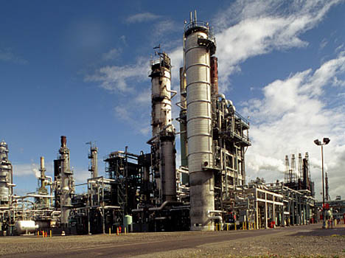
What happens when oil is extracted from the ground?
Crude oil is extracted from the ground and sent to an oil refinery by underground pipes or by ship. However, Pipes can leak and are targets for destruction.
At a refinery, different parts of the crude oil are separated into useable petroleum products:
E.g. Diesel, Petrol, Jet Fuel.

Slide 8
Oil Refining It is the world’s largest source of energy consumption
Over 80% of oil refining now takes place in Europe, North America and Japan.
The separation between production and refining causes problems. For example, oil used to be cheap so many countries became dependant on it.
What happened in 1973 and what are the consequences?

Slide 9
The implications of Middle East Oil
What happened in 1991?
Does this show the importance of the Middle East as a supplier of oil?
The Organization of Petroleum Exporting (OPEC) controls the price of crude oil making it a strong economical and political power and has increased dependency of regions on the Middle East.

Slide 10
The implications of Middle East Oil
Therefore, countries need to maintain good relations with the Middle East and strive for political stability in the region.
Or
Increase development in alternative forms of energy such as Coal or Nuclear power.

Slide 11
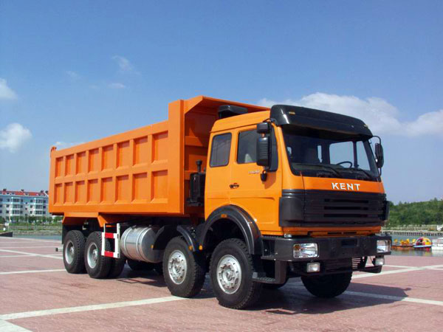
What is oil used for? (I know you know but these pictures really represent me – how?)
Oil powers cars and trucks.
Oil is used to generate electricity and heat homes.

Slide 12
Did you know that petroleum is an ingredient in the following items?

Slide 13
Key points – Oil as a Resource
Producing countries tend not to be consuming ones
Environmental impacts of oil slicks and leaks
1973 Oil Crisis
OPEC
1991 Gulf War
Implications of Middle East War
Closing question: Can we compare Nuclear energy to Oil in terms of popularity and environmental dangers?

