Slide 1
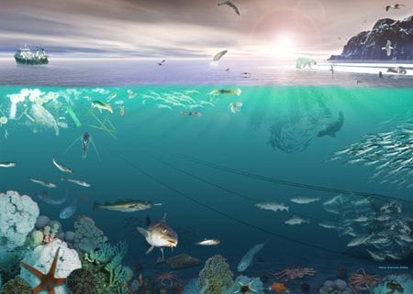
Oceans and Their Resources

Slide 2
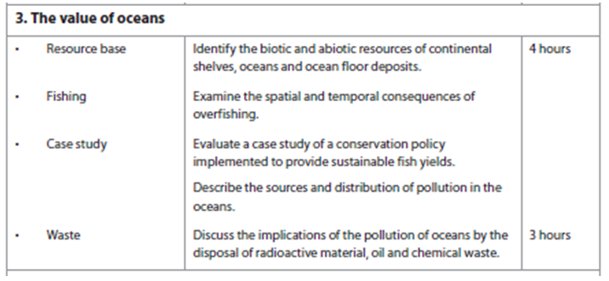

Slide 3
Resource Base - Starter – Brainstorm What resources are found in oceans?
Abiotic
Biotic

Slide 4
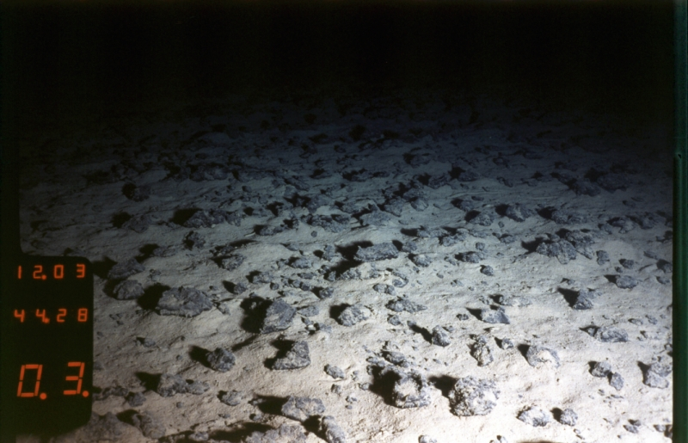
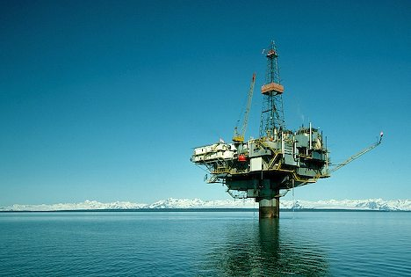
Abiotic Resources
Watch R. Ballard on Ted Talks

Slide 5
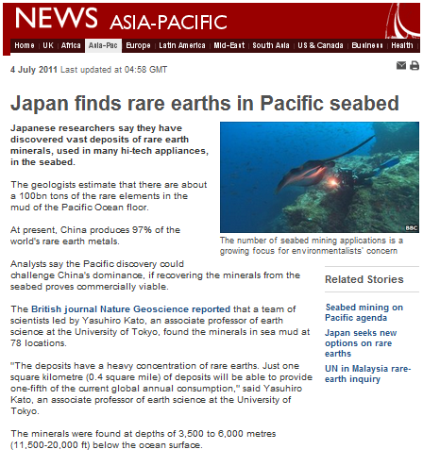
Discussion point – what are the benefits and the challenges that this discovery creates?

Slide 6
Oceans are a rich source of resources
Oil and gas found in continental shelf. Persian Gulf accounts for 66% oil 33% gas proven reserves.
Diamonds can be found on African and Indonesian continental shelf areas.
Near ocean ridges there are rich deposits of Sulphur and hydrothermal vents.
Gold and manganese are found on ocean floor.
Manganese nodules are found on the abyssal plain and contains manganese, iron, nickel, copper and other elements. A rare earth mineral worth a fortune as it can be used to form chemicals such as iron oxide. Mining technology undeveloped.
Deep ocean floors are covered with ooze – the skeletal remains of microscopic organisms.
The oceans provide fish. The gulf of Mexico has a large fishing industry. Shrimp and red snapper.
Oceans store and provide Carbon Dioxide playing a key role in carbon cycle over a long time-scale. Photosynthesis generates organic compounds of carbon – passes through the food chain – sinks to ocean floor – decomposed into sediments – destroyed at subduction zones – released to atmosphere through volcanic eruption.

Slide 7
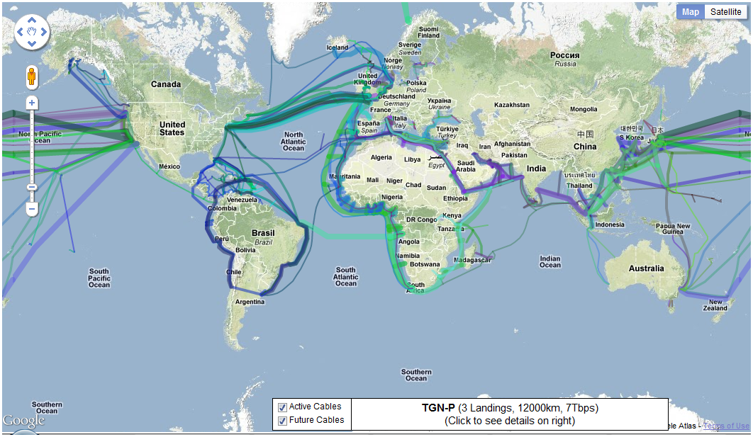
Use as a communication highway
Indirectly, the ocean is used by humans as a major form of highway.
Most international trade occurs on ocean shipping routes,
however recently, the ocean bed has been used more and more for laying communication cables for internet.

Slide 8
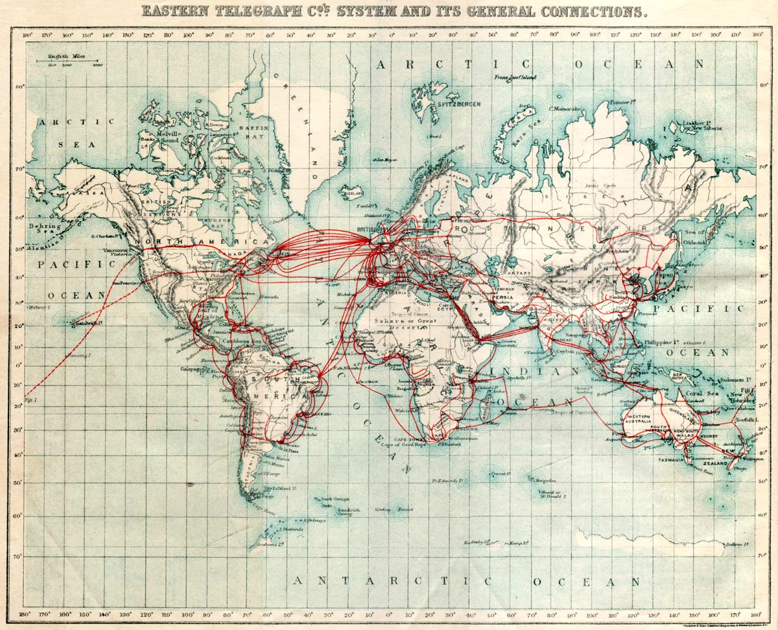
What do you think this map is of?
Compare it to the last one.
It was made in 1901

Slide 9
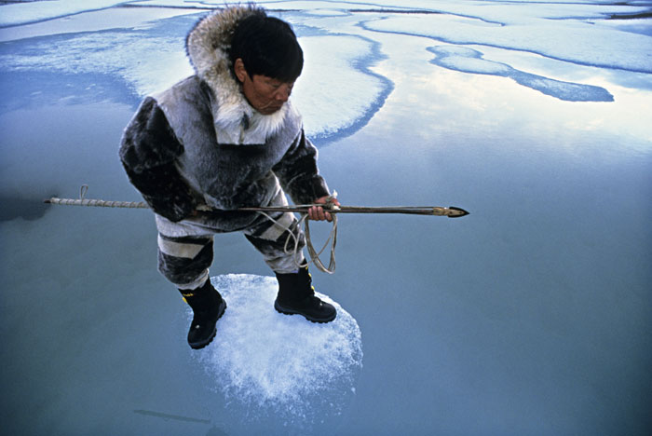
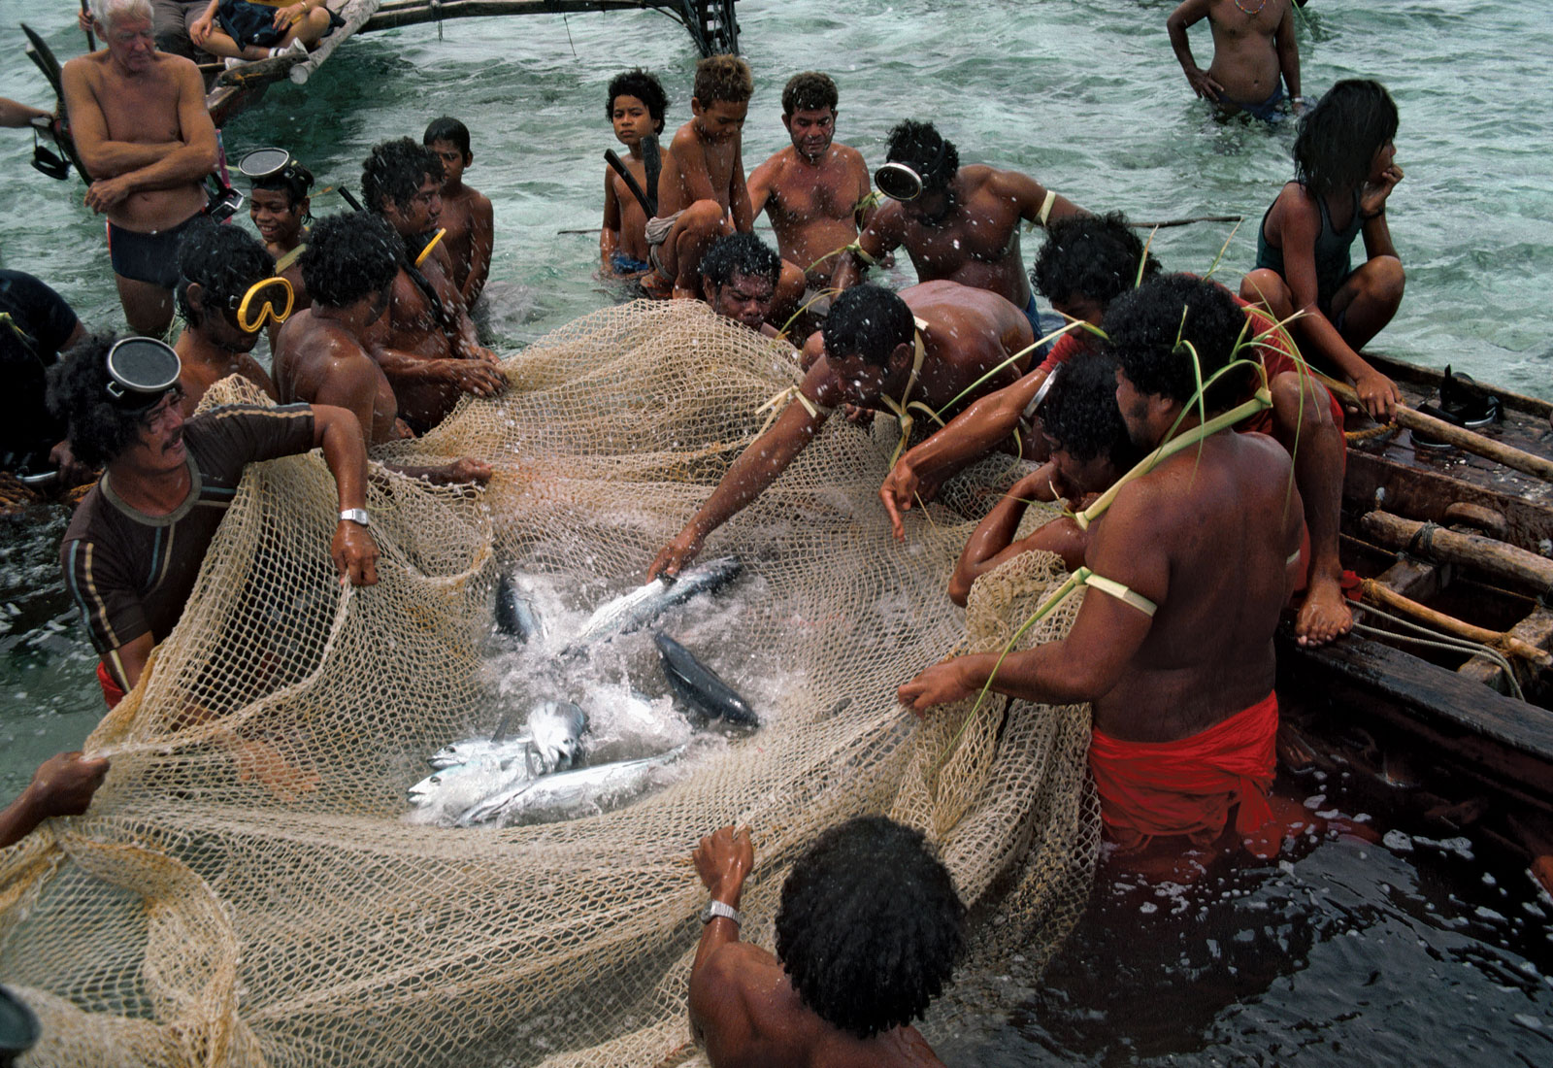
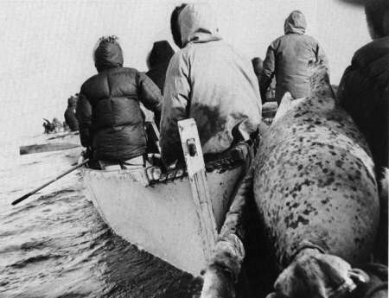
Some cultures reliance on biotic ocean resources are almost total. – e.g Alaskan Inuit and pacific islanders in Micronesia

Slide 10
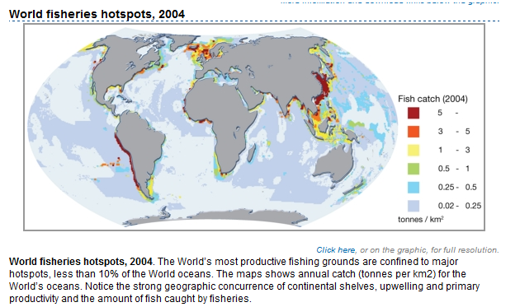
Biotic Resources – sustainably used?
Source - UNEP

Slide 11
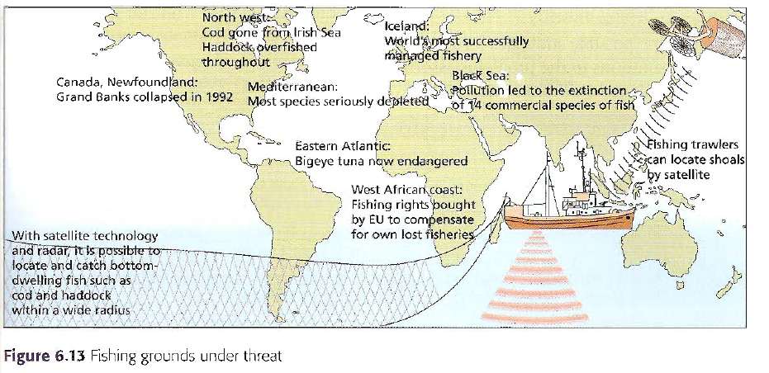
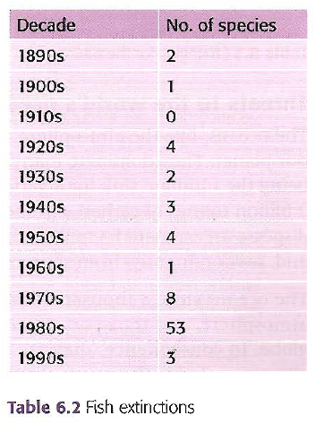
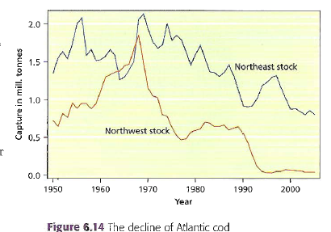
As large predator fish are being overfished to extinction the type of fish being caught are different. However How long can this last….

Slide 12
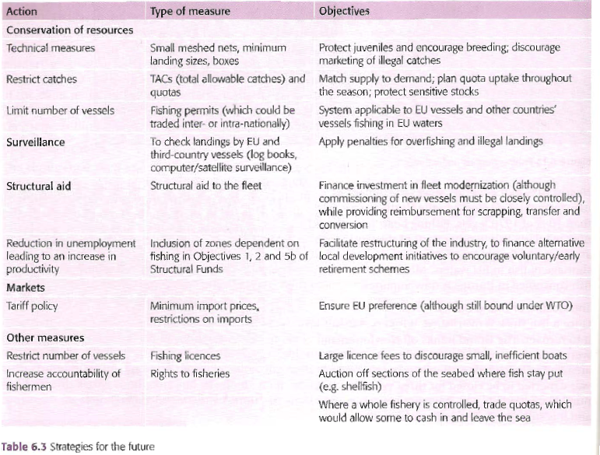
Some efforts are being made e.g. the EU common fisheries policy. However, these have been criticised. Below are some strategies for the future.

Slide 13
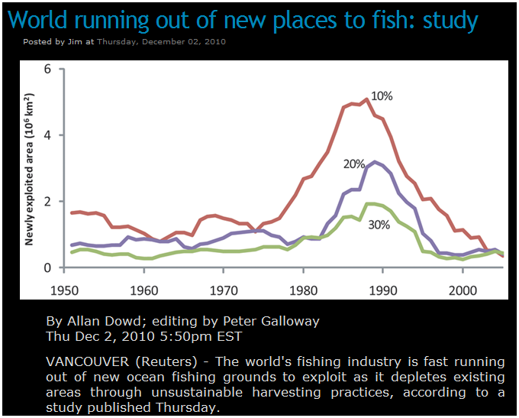
Exam Type Questions
Describe and explain the pattern that is being shown in the graph above.
Using Case studies, evaluate the attempts that are being made to reduce pressure on the worlds fish.

