Slide 1
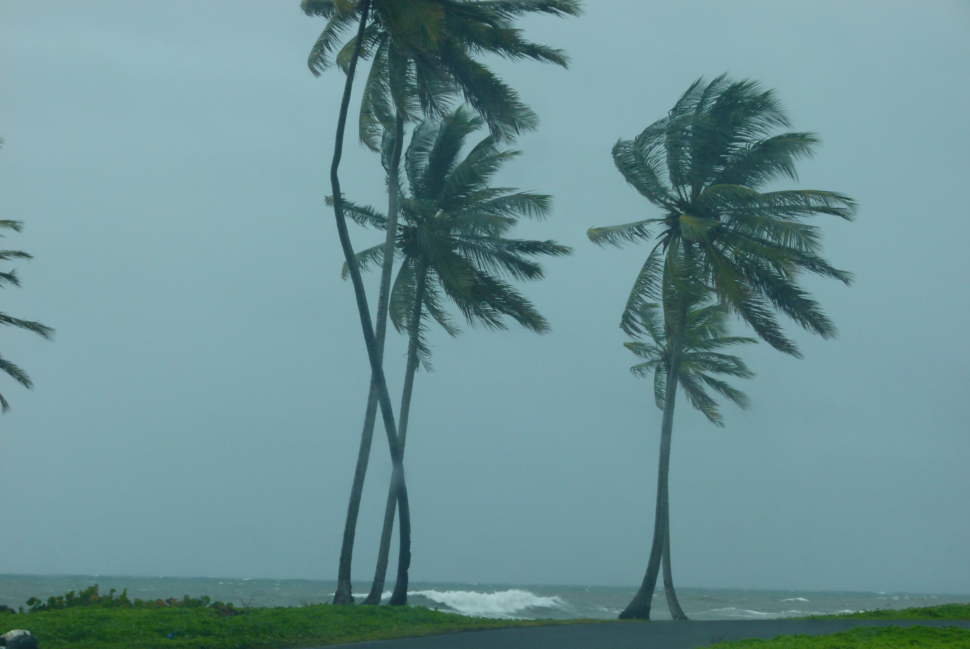
Oceans and Climate IB Geography

Slide 2
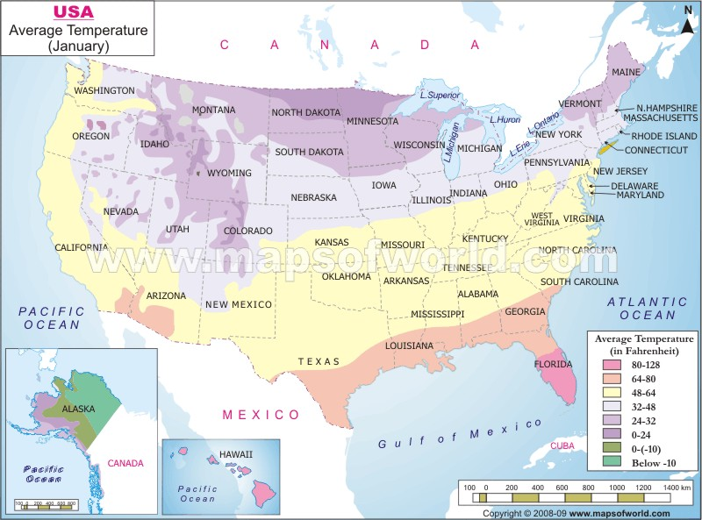
Distance from the sea and Weather
Due to the differing specific heat capacities of land and water, this can affect local variations in temperature.
Describe and explain any patterns of temperature that are caused by distance from the sea.
How might this pattern change in summer? Explain your answer.

Slide 3
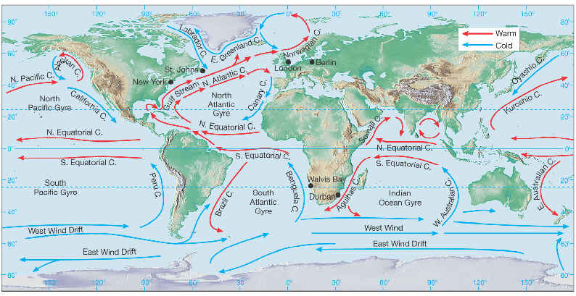
Ocean currents
Caused by prevailing winds
Ocean currents are also called GYRES
Pattern is generally clockwise in N. Hemisphere and anti-clockwise in South. Linked to coriolis effect.
Exception is current in Antarctic
Wind, currents and earths circulation force water westwards into wide domes up against east sides of continents.
Return in narrow fast currents in other direction e.g. gulf stream which carries heat northwards and then eastwards.
Main effect on climate relates to whether land is near a cold or warm current. (with the aid of prevailing westerly winds)
Ocean currents are very important in transferring excess energy from tropics to higher latitudes, thus regulating climate.

Slide 4
What is a temperature anomaly?
The term temperature anomaly means a departure from a reference value or long-term average. A positive anomaly indicates that the observed temperature was warmer than the reference value, while a negative anomaly indicates that the observed temperature was cooler than the reference value.

Slide 5
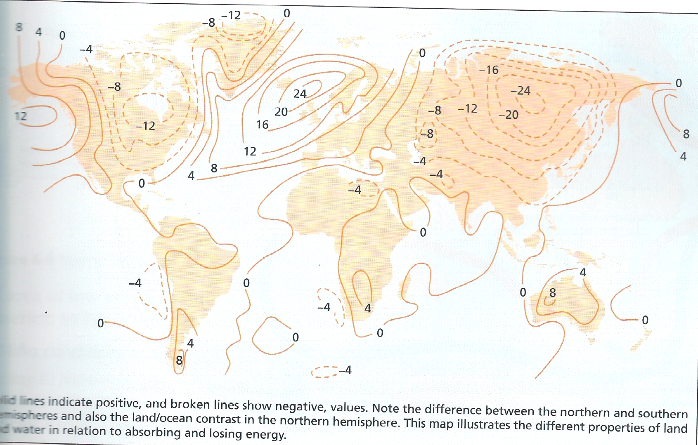
Temperature Anomalies linked to the Ocean
Source: nagle and Cooke
Describe and explain the pattern of climate anomalies and how they may relate to distance from sea and ocean currents.

Slide 6
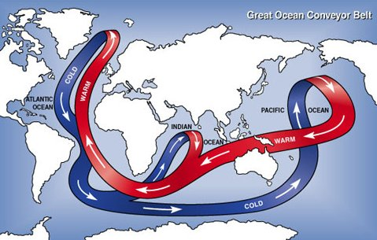
The Ocean Conveyor Belt – Thermohaline Circulation
http://www.windows2universe.org/earth/Water/circulation1.html
As water reaches higher latitudes it gets colder, denser and therefore more saline. This causes it to sink .
The sinking is one of the mechanisms for driving this global conveyor of water.
In lower latitudes as water gets warmer it gets less dense and rises.
The movement of water is slow – about 10cm /sec. water that sinks may take hundreds of years to resurface.
What is the link of this to one of the fears that climate change scientists believe may happen?

Slide 7
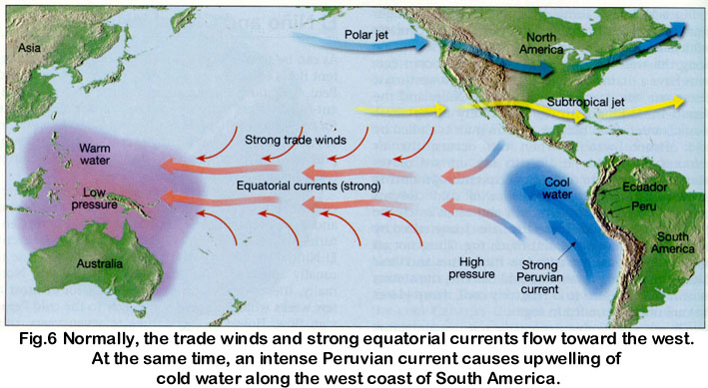
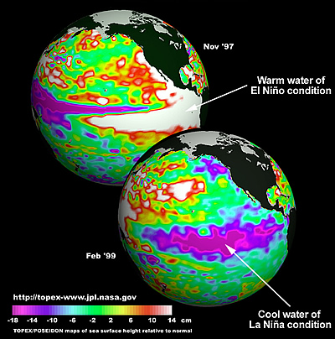
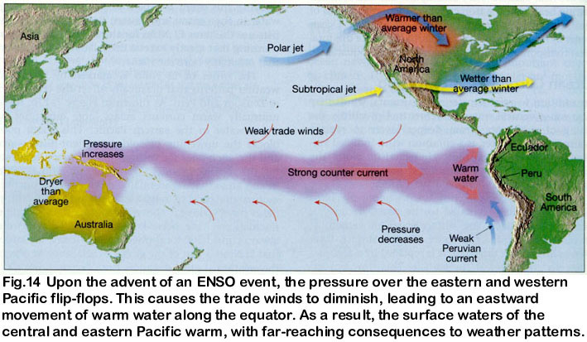
El Niño and La Niña
In El Nino years the reduced difference in air pressure between east and west pacific reduces wind speed. A reversal of normal conditions.
In La Nina years, increased differences cause greater wind speed and more upwelling of cold water off south America. An intensification of normal conditions. http://climate.nasa.gov/SeaLevelViewer/seaLevelViewer.cfm

Slide 8
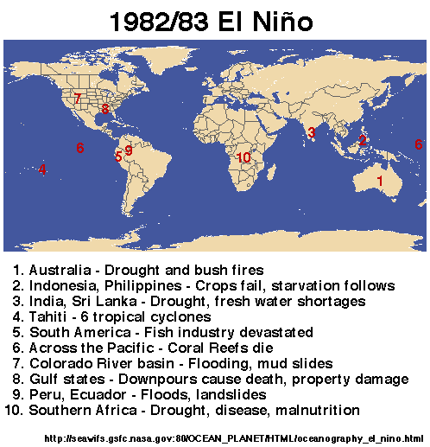
Impacts of El Nino and La Nina
The information on the right gives details of the impact of one el nino event.
Create an annotated map of impacts of the 97/98 el nino event.
Why is it important that sea water and air pressure is monitored to notify whether an el nino or la nina event will occur.
What difficulties are there in managing the impacts?

