Slide 1
Nuclear power stations
The benefits and disadvantages

Slide 2
Aims
Understand the positioning of nuclear power stations.
Know the advantages and disadvantages of nuclear power
Understand how the accident at Chernobyl happened.
Understand that nuclear power produces waste and the problems that that incurs.

Slide 3
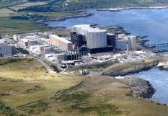
Where to put one.
They need large volumes of cooling water.
Often they are built at Sea. The large volumes of sea water mean that cooling towers are often not needed in comparison to rivers.
This nuclear power station in Anglesey is situated on the coast and has no cooling towers.

Slide 4
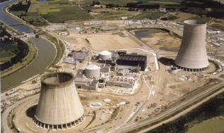
This nuclear powerstation like many in France is built on the banks of a river. A river does not have as much cooling power and as a result cooling towers are required to cool the water before the water is released back.

Slide 5
Other factors?
A nuclear power station requires a large expanse of flat land (however no more than a factory or a normal power station).
Proximity to populations – contrary to popular belief they do not need to be built very far away. Some nuclear powerstations are very close to local towns. If there was a major accident radioactive material would spread over hundreds of miles.

Slide 6
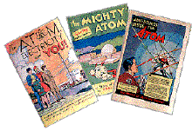
Pros and cons
In the 1950s comics like these helped to encourage the idea that nuclear power would produce electricity with no problems and so cheaply that it would hardly be worth charging for it.
During the 1960s and 70s many people became more suspicious about nuclear power and the "Nuclear Power? No Thanks" logo became a symbol of anti-nuclear protesters.

Slide 7
Advantages
Small amounts of fuel required
Large reserves of fuel
Low emissions of pollution
Large amounts of stored energy

Slide 8
Nuclear power stations only use small amounts of fuel meaning less impact from mining and transport of the fuel and there are large reserves of Uranium so it will last a long time:-
A 1,000 Megawatt coal fired power station consumes between 2 and 3 million tonnes of coal each year.
A nuclear power station consumes between 25,000 and 100,000 tonnes of typical uranium ore.

Slide 9
Pollution
Carbon dioxide:- The actual operation of a nuclear power station does not release carbon dioxide into the atmosphere*. This is important because carbon dioxide is an important greenhouse gas.
Sulphur dioxide and oxides of nitrogen:- These gases are not released by nuclear power stations, so nuclear power does not add to acid deposition

Slide 10
Disadvantages
Radioactive
Accidents
Weapons
Waste

Slide 11
Radiation
Radiation is dangerous because it can penetrate materials, including the human body, and can cause damage to living cells.
If people are exposed to very high levels of radiation many of their cells will be damaged and they will become extremely ill and may die.
Lower doses may damage some cells and trigger the development of cancer, which may not appear for many years. If reproductive cells are damaged then children may be born suffering from genetic abnormalities.

Slide 12
Reactor accidents
There have been several serious accidents at nuclear reactors which have led to the release of radioactive material into the environment. Two of these, the Three Mile Island incident and the incident at Chernobyl, were very important in leading large numbers of people to have a negative view of nuclear power.

Slide 13
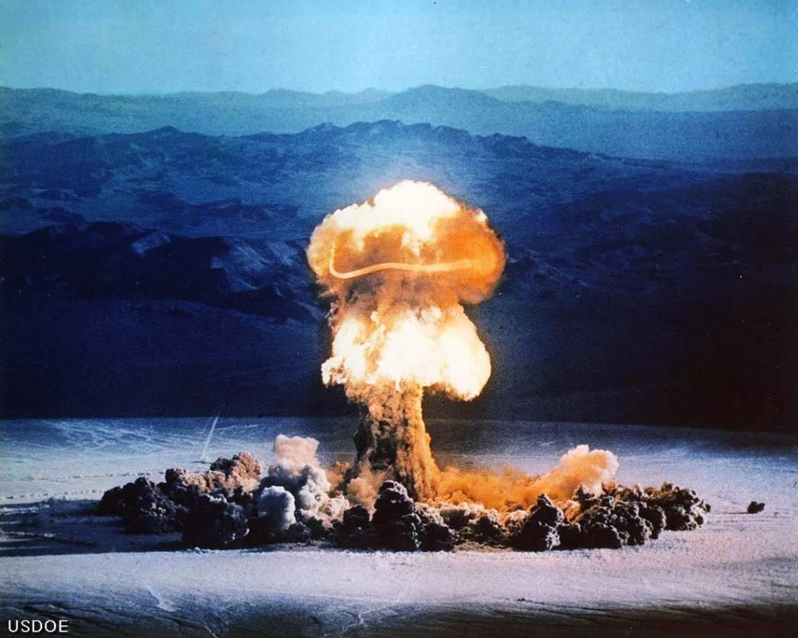
Nuclear weapons
When nuclear technology was first used it was in the form of nuclear weapons. The first nuclear reactors were not used to provide heat in power stations but to make plutonium to use in bombs.
This makes many people afraid of the use of nuclear power, although since the end of the Cold War between the USA and the former Soviet Union the risk of worldwide destruction by nuclear weapons seems to be much smaller.

Slide 14
Waste
LOW LEVEL WASTE
-Items such as used protective clothing from power stations and other nuclear works.
-Has very low levels of radioactivity and can be disposed of in special landfill sites.
INTERMEDIATE LEVEL WASTE
-Items such metal parts from reactors
-Has higher levels of radioactivity and must be stored in more secure locat-ions. Most countries plan to store this waste underground.
HIGH LEVEL WASTE
-Spent (used) nuclear fuel and the fission products left over after spent fuel has been reprocessed.
-Highly radioactive and very dangerous. Often this waster will be reclassified as intermediate after several years whereby its radioactivity has decreased.

Slide 15
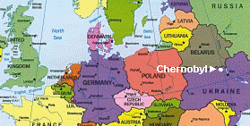
Chernobyl

Slide 16
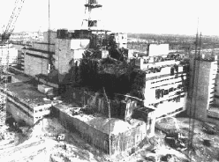
Late at night on 25th April 1986 engineers at the Chernobyl nuclear power station carried out unauthorised tests on one of the four reactors and set off an uncontrolled chain reaction.
Cooling water in the reactor began to react with hot metal, releasing hydrogen gas which exploded early the next morning, exposing the reactor core which then caught fire.
The explosion at Chernobyl was not a nuclear explosion : it was a chemical explosion which caused the release of radioactive material.

Slide 17
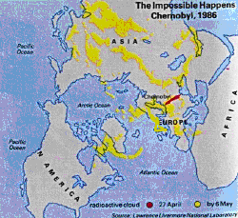
Fallout
Although reports seem to say only 31 died as a result of exposure during the incident it is hard to say how many more will die in the future.
135, 000 people had to be evacuated and there is a 30km radius exclusion zone.

