Slide 1
New unit
Criminality & Law

Slide 2
Crime & Community
Key Ideas:
Crime happens all over the world – in cities, in towns and in the countryside.
Some crimes affect people much more than others.
Views on the different types of crime vary from person to person.
‘Learn About’:
This unit looks at patterns of criminal activity within local areas all over the world.
What crime is and how it is caused
What people feel about crime
How crime varies locally, nationally and internationally
How the problem of crime might be solved.

Slide 3
By the end of this unit…
You Must- Be able to name different types of crime and understand the reason why not all crimes are recorded. Use a range of sources to communicate your findings in your writing.
You Should-Be able to identify locational patterns of crime and suggest ways to make environments safer. Use a range of primary and secondary sources to communicate your findings in your writing.
You could-Be able to understand the wider implications crime globally and critically evaluate a range of sources and present substantiated conclusions within well-argued reports.

Slide 4
Starter
What do you think when you first hear the word crime?
Think;
Type
Where
Who
When

Slide 5
What are your crime perceptions?
What crime do you think might happen here?
Evidence?
Why?
1.

Slide 6
Perceptions…
What crime do you think might happen here?
Evidence?
Why?
2.

Slide 7
Perceptions …
What crime do you think might happen here?
Evidence?
Why?
3

Slide 8
Perceptions…
What crime do you think might happen here?
Evidence?
Why?
4

Slide 9
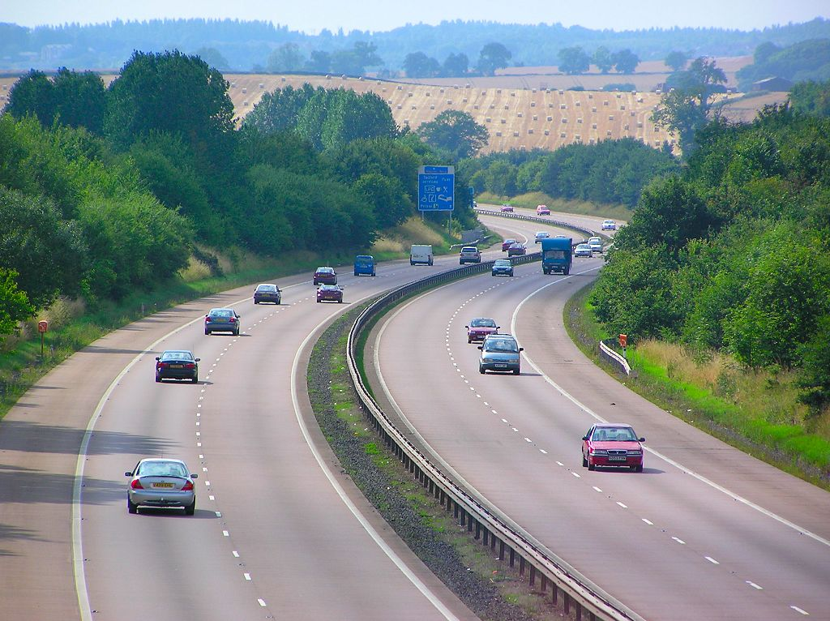
Perceptions…
What crime do you think might happen here?
Evidence?
Why?
5.

Slide 10
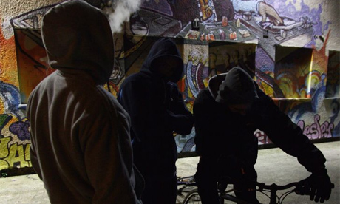
Perceptions…
What crime do you think might happen here?
Evidence?
6.
Why?

Slide 11
Crime and Demographics
Complete the table

Slide 12
What do we already know about crime?
You Must- Be able to name different types of crime.
You Should- Be able to identify different causes of crime.
You could- Be able to understand the wider implications of the way crime is portrayed on television

Slide 13
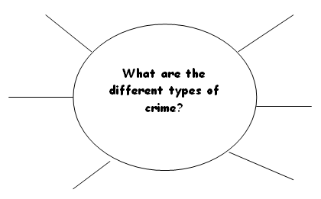
What is crime?
Key Idea:
A Crime is any action or offence that is punishable by law.

Slide 14
What do you think are the causes of crime?
In groups organise the statistics into the categories Economic, Political and Social onto your A3 sheet of paper.
Social
Economic
½ of all violence by strangers is committed by people who have been drinking
80% of criminals are male
Young people are most likely to be involved in crime (peer pressure)
Drug use
Frustrated aspirations
Boredom (lack of recreational facilities for young people)
Media? - TV, Films, Music
Fragmented community e.g. inner city rented accommodation / high-rise flats
Racial tension
‘Victimless’ crime e.g. fraud
Poverty (Gap increasing between rich & poor in UK)
Unemployment
MEDCs – more to steal (consumer durables)
Costs of buying illegal drugs
Shoplifting in the UK totalled £1.4 billion in 1996-1997
More than 1 in 20 British homes is burgled every year due to inadequate protection measures (affordability).
What are the causes of crime?
Political
Violence at anti-capitalism protests
Unpopular decisions made by government e.g. Poll tax / anti Gulf war protests

Slide 15
In pairs brainstorm...
Why might people not report crimes

Slide 16
Why might people not report crimes?
Only a ¼ of all crime is reported to the police
Some crimes are not reported because people think they are trivial. E.g. Speeding, even though it might lead to accidents & death.
The young & people from ethnic minorities may be unhappy with the service they get from the police.
Many violent assaults, sexual attacks & other crimes are not reported because the victim knows the attacker.
There may be fewer police officers nearby to help them.
Lack of community spirit

Slide 17
What is crime?
Task: in pairs discuss the following
Write a list of all the TV and computer entertainment programmes you can think of that involve crime.
Create an information fact file for your programme/game by answering the following questions:
What sort of crimes do they show?
Where do they show crimes taking place?
How realistic are they?
Do you think this has a positive or negative impact on society?

Slide 18
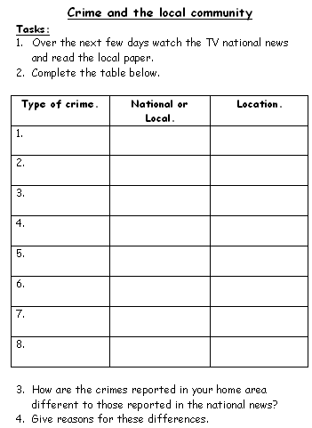
GP Homework
Complete Crime & the Local Community TV news survey

