Slide 1
Murder Mystery
LO: To develop analytical and problem solving skills

Slide 2
Do we all remember Enrique’s push and pull factors?

Slide 3
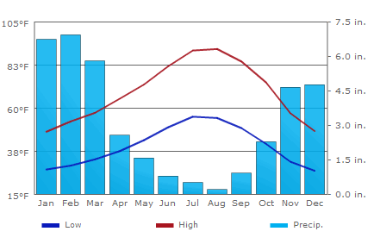
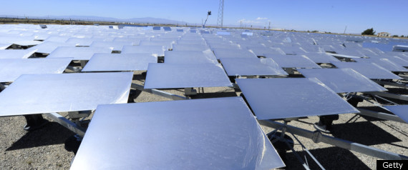
Enrique made it to California
What do we know about the state of California?

Slide 4
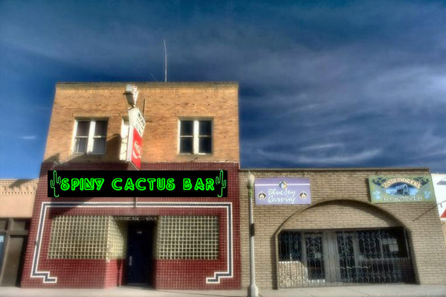
Enrique's local bar

Slide 5
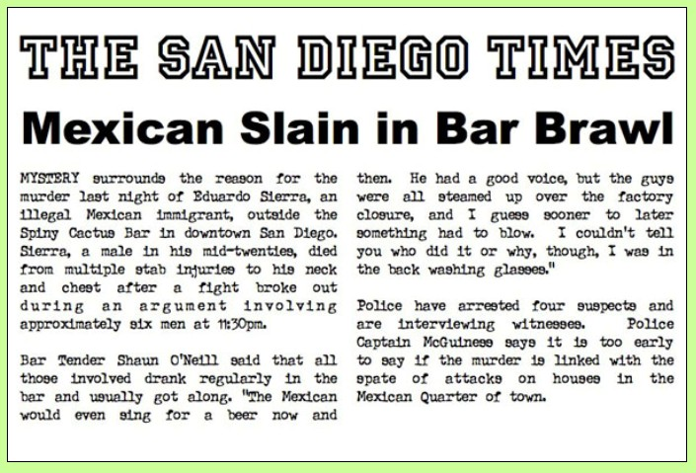
Enrique Sierra

Slide 6
After reading the article…
What do you think happened in that bar?

Slide 7
You are now a team of detectives…
In groups of no more than four you are going to find justice for Enrique and his family.
The following six suspects were all involved in the fight in the bar

Slide 8
Here are the suspects…

Slide 9
Suspect

Slide 10
Suspect

Slide 11
Suspect

Slide 12
Suspect

Slide 14
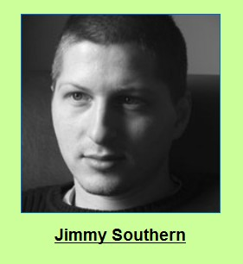
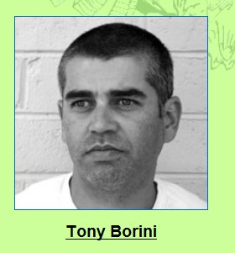
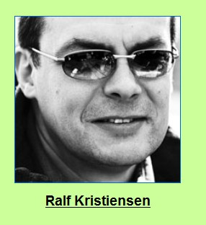
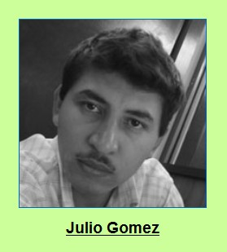

Slide 15
Evidence cards
You will now receive evidence cards you need to arrange them into thematic groups:
employment levels, income levels, industrial change, migration, quality of life and background information.
Then try to find out what happened in the bar, which resulted in the killing, by finding out:
a. who was most angry
b. What the arguments were about
c. which men were on each side of the argument and why?

Slide 16
Highlight the cards
Highlight the cards to show the push and pull factors of California.
Highlight the cards to show the push and pull factors of Mexico.

Slide 17
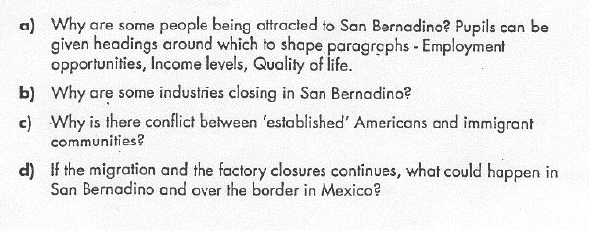
In your own words write detailed answers to the following questions using the information provided …

Slide 18
So who shall we arrest for the murder of Enrique Sierra?

