Slide 1
Please keep separate
Tongue roll
No tongue
roll

Slide 2
Our targets for today
To learn to count 1- 10 in Spanish in our own group, without communicating with people in the other group
To appreciate the skills of the long haired people and how they learn skills quickly.

Slide 3
Counting in Spanish
we are going to learn to count 1-10 in Spanish
To learn to count we are going to use the kinaesthetic ways of learning:-
Kinaesthetic- We will make an action to help us remember how to say the number

Slide 4
Lets get started!

Slide 5
This lesson is not what it not what it seems……
Although today you have learnt to count to ten in Spanish this lesson was actually about a new topic
The new topic is demonstrated by the picture on the next slide
It is one of the most important issues in today’s society
Look at the picture and decide what you think the new topic is…….

Slide 6
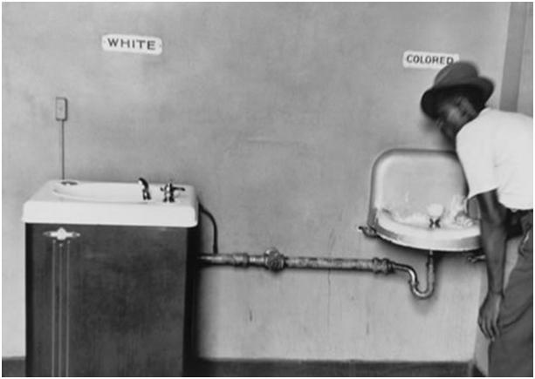

Slide 7
Prejudice and discrimination- The experiment
The experiment that you have been involved in today is an experiment that has been done since the 1960’s
In the 1960’s black people in America did not have the same rights as white people. A lot of white people thought black people were not as good as them and should be treated differently
A school teacher in the USA made this experiment to show her pupils what it felt like to be discriminated against. Here is a short clip showing this experiment Jane Elliot

Slide 8
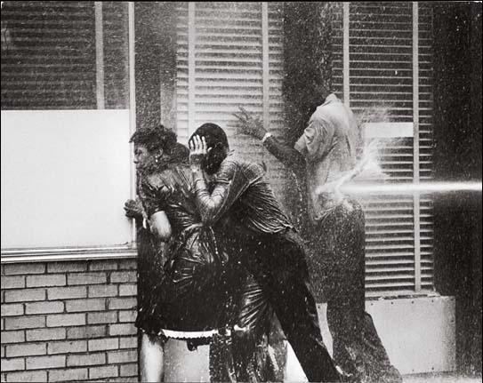
Prejudice in the 1960’s
In the USA in the 1960’s Black people did not have the same rights as white people- just because of the colour or their skin
Black people were seen as second class citizens

Slide 9
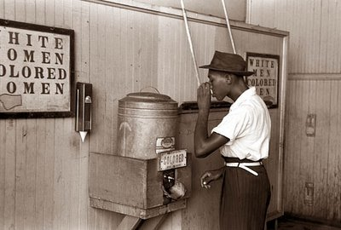
Black people were forced to use separate water fountains, cafés, restaurants, schools and were not allowed to sit with white people on public transport.
Violence against black people was very high and many were killed.

Slide 10
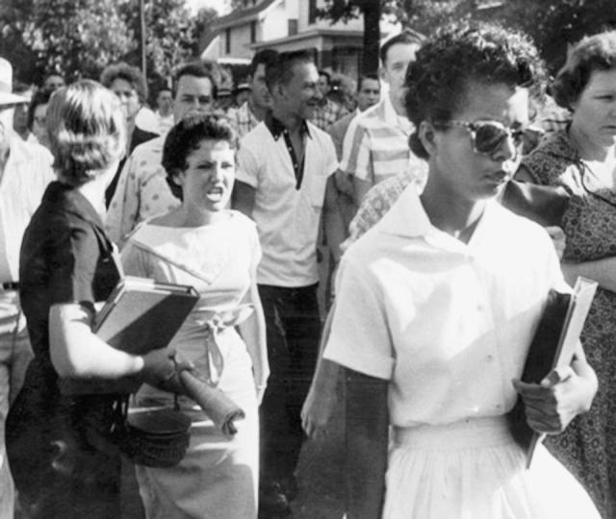
Prejudice and discrimination
If you could speak to a Black person from the 1960’s what would you say?
What would you tell them about today’s society?
What would you show them as evidence that we do not discriminate in today’s society? Why?

Slide 11
WRITE DOWN 5 WORDS TO DESCRIBE HOW THIS PICTURE MAKES YOU FEEL

Slide 12
Multicultural Society
To investigate what it means by living in a multi cultural society
To apply own views to living in a multicultural society

Slide 13
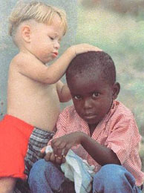
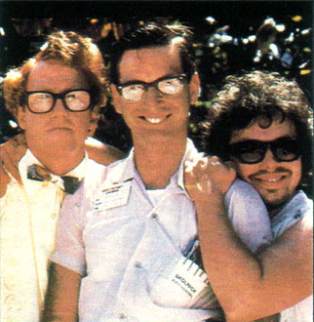
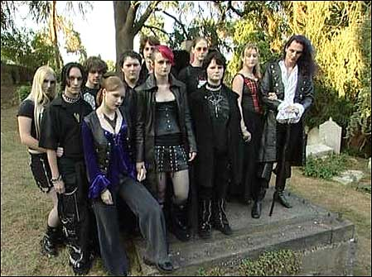
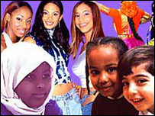
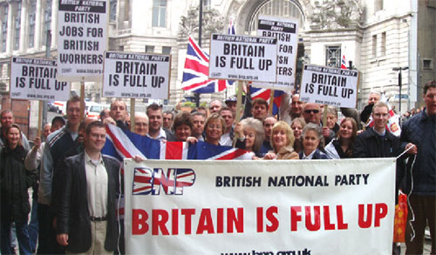
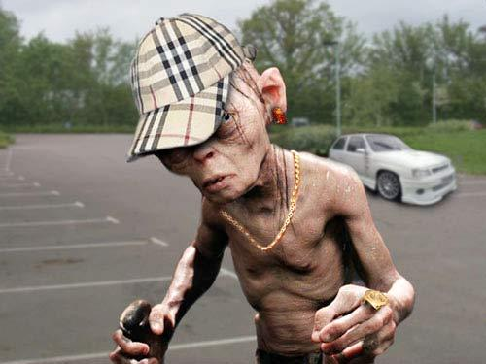

Slide 14
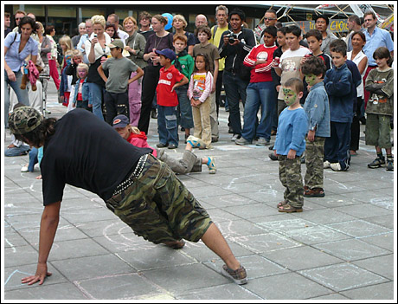
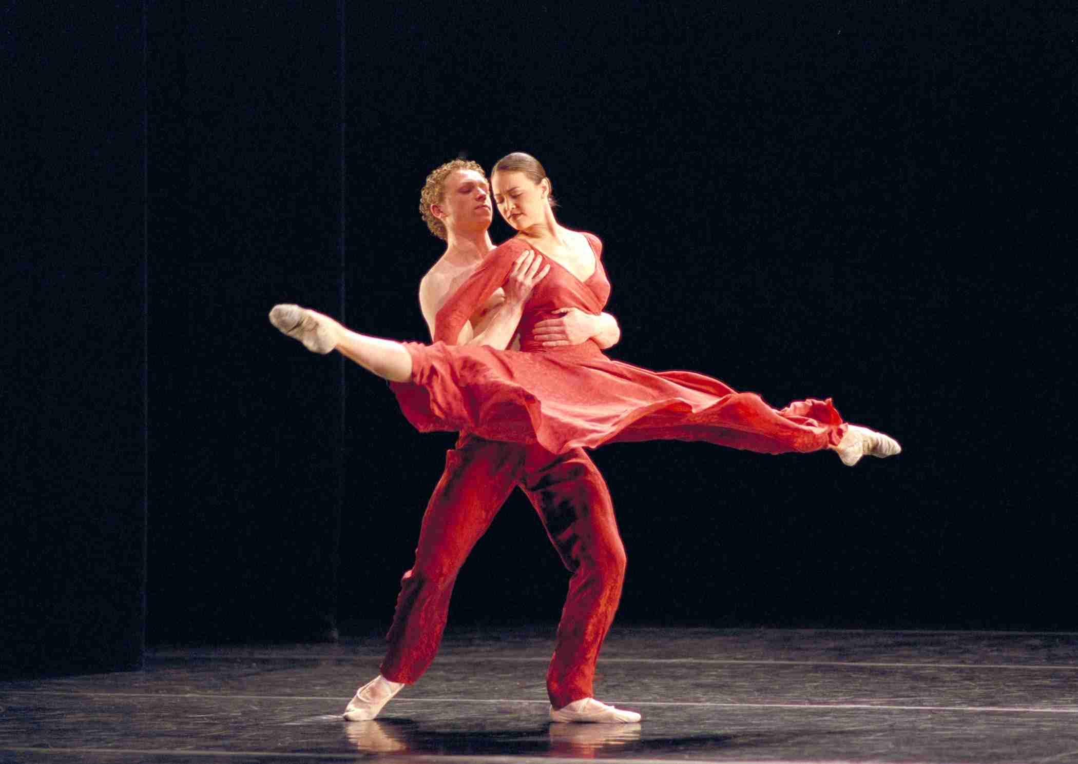
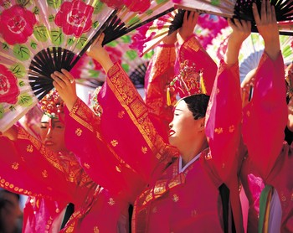
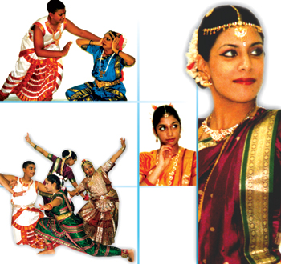
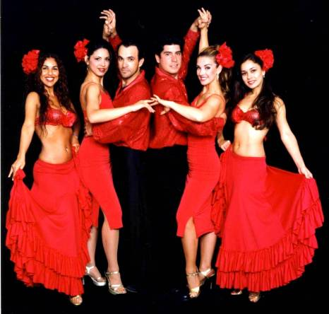

Slide 15
Prejudice
Treating people more favourably because they have been discriminated against in the past
Having an over simplified mental image of people and applying it to everyone in a group
Discrimination
Blaming certain groups for problems in society
Stereotype
Positive Discrimination
Actions as a result of prejudice
Scapegoat
Thinking badly of someone because of the group he/she belongs to

Slide 16
IN YOUR BOOKS CREATE TWO SPIDER DIAGRAMS/LISTS
ADVANTAGES OF LIVING IN A MULTICULTURAL SOCIETY
DISADVANTAGES OF LIVING IN A MULTICULTURAL SOCIETY
ORGANISE THE CARDS INTO ADVANTAGES AND DISADVANTAGES
What are your views on living in a multicultural society?
Do you think there are more advantages or disadvantages?

Slide 17
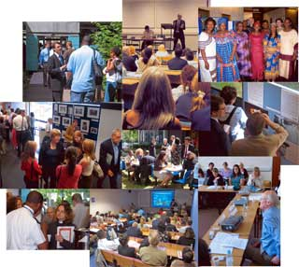
In order to answer the question you need to include...
Describe and explain what multiculturalism is
Multiculturalism is...e.g.
Explain at least two advantages
Some people would agree with the statement because...e.g.
Explain at least two disadvantages
Some people would disagree with the statement because...e.g.
Include your own opinion
I agree/disagree with the statement because...e.g.
‘Multiculturalism brings a variety of choices’
What do you think? Explain your opinion. (6 marks)

Slide 18
‘Multiculturalism brings a variety of choices’
What do you think? Explain your opinion. (6 marks)
Using the peer assessment hand out...
Swap with the person next to you and mark each others answers...
Give an overall mark and a comment based on their answer
Swap back – read their comments and set yourself a target on where you need to improve

Slide 19
Peer assessment: YES/NO
Has the definition of multiculturalism been identified?
Description of their own opinion clearly outlined
Has the potential choices been explained (reasons given?)
Has the assessment been separated into parts? Positives and negatives?
Spelling
Punctuation
Grammar
Presentation – is the work clearly set out
Target for improvement:

Slide 20
In order to answer the question you need to include...
Explain at least TWO arguments AGREE
Some people would agree with the statement because...e.g.
Explain at least TWO arguments DISAGREE
Some people would disagree with the statement because...e.g.
Include your own opinion
I agree/disagree with the statement because...e.g.
‘The biggest threat to multiculturalism being a success is prejudice’
What do you think? Explain your opinion. (6 marks)

Slide 21
‘Multiculturalism brings a variety of choices’
What do you think? Explain your opinion. (6 marks)
Using the peer assessment hand out...
Swap with the person next to you and mark each others answers...
Give an overall mark and a comment based on their answer
Swap back – read their comments and set yourself a target on where you need to improve

Slide 22
Peer assessment: YES/NO
Has the definition of multiculturalism been identified?
Description of their own opinion clearly outlined
Has the potential choices been explained (reasons given?)
Has the assessment been separated into parts? Positives and negatives?
Spelling
Punctuation
Grammar
Presentation – is the work clearly set out
Target for improvement:

Slide 23
Encouraging Cultural Mixing
There is an attempt to integrate different ethnic groups and reduce segregation.
LEEDS
Seeking to improve literacy in areas where English can be a second language
Increasing employment through initiatives to ensure basic skills and access to information and training
Increasing community involvement by ensuring that the needs of minority groups are understood and met.
Providing facilities that encourage meetings of all sections of a community rather than separate ethnic groups.

Slide 24
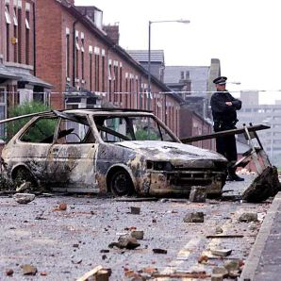
Segregation
Oldham riots 2001
Between 500 white and Asian youths
Despite the apparent racial mix in many cities, a significant number of immigrants choose to live with people from similar areas and away from others with different ethnicity and culture. This represents segregation.
Notes:
Image hyperlinked to youtube

Slide 25
Reasons for segregation
Support from others
People feel safe and secure when they can associate with other people from the same background. There is a sense of belonging and protection from racial abuse.
A familiar culture
In a strange country, there is comfort from being with people who have similar ideas and beliefs and speak the same language.
Specialist Facilities
In many areas, these are provided so that, for example, Sikhs can worship in a gurdwara. Familiar foodstuffs will be available in shops
Employment factors
Immigrant groups tend to do low-paid jobs or have a high rate of unemployment. They have limited money and so can only afford cheaper housing in certain parts of the city.

