Slide 1
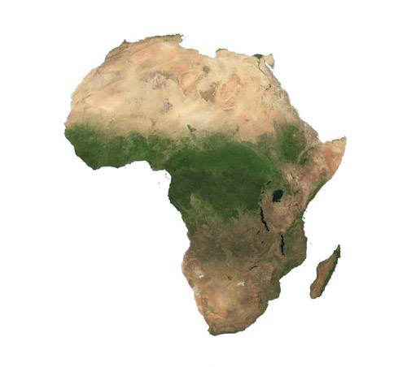
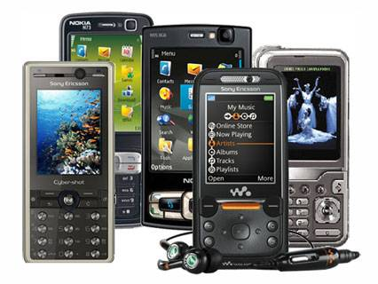
What does your mobile phone have to do with the lives of people and animals in Africa?

Slide 2
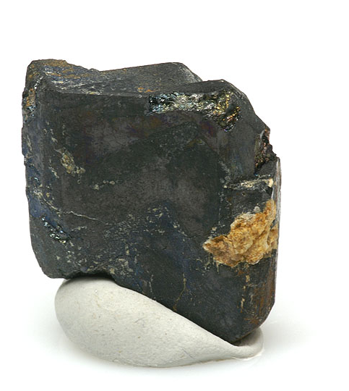
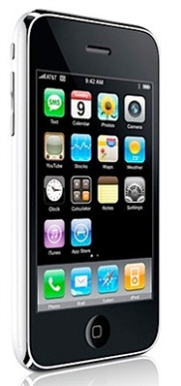
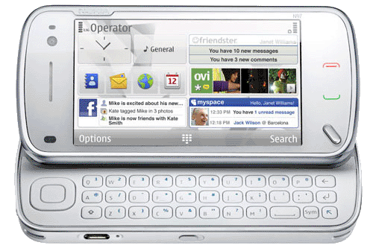
Columbite-Tantalite (CT)
Columbite-Tantalite (CT), is an important ore that contains the elements niobium and tantalum.
CT a vital element in creating components that store energy and are used in almost all of our small electronic devices, especially our mobile phones.

Slide 3
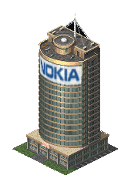
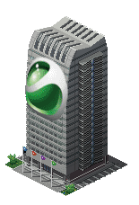
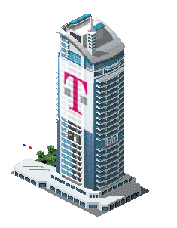
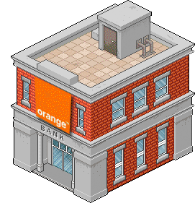
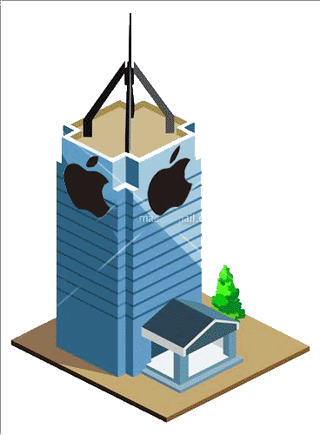
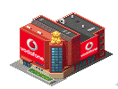
In Europe almost 200 million mobile phones are sold each year.
Worldwide, there are over 2 billion mobile phones connected.
England
Europe

Slide 4
The CT needed to make our phones is found in large quantities in the African country of
Democratic Republic of Congo.
(DOC is about 3400 miles across the planet from London, England).
DRC

Slide 5
England
DRC is striving to recover from civil war; millions have died, mostly through starvation and disease.
Fighting is fuelled by the country's vast CT wealth, and groups fight to control the CT supplies.
Land is cleared to make the mining of CT easier and DRC’s natural habitat is destroyed.
Because of the mining farmers can no longer grow food and are forced to look for other food supplies and jobs.
Gorillas are either killed for meat or leave because their habitat has disappeared.
DRC
Money made from CT is used to finance Militia.
Opportunities to make money decreases any chance of peace and increases conflict.

Slide 6
England
DRC is striving to recover from civil war; millions have died, mostly through starvation and disease.
Discuss...
Fighting is fuelled by the country's vast CT wealth, and groups fight to control the CT supplies.
Does CT Have a negative or positive impact on the lives of people.
Land is cleared to make the mining of CT easier and DRC’s natural habitat is destroyed.
Because of the mining farmers can no longer grow food and are forced to look for other food supplies and jobs.
How big an impact do each of these areas have on people..
Completely Negative
Mostly Negative
Neutral
Mostly Positive
Completely Positive
Gorillas are either killed for meat or leave because their habitat has disappeared.
DRC
Money made from CT is used to finance Militia.
Opportunities to make money decreases any chance of peace and increases conflict.

Slide 7
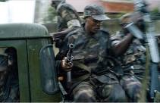
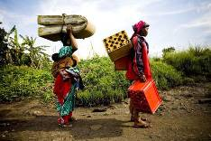
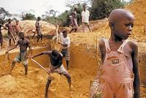
CT is a non-renewable resource. It is found n different parts of the world but there are large reserves in the Congo.
Militia
Groups of Militia from neighbouring countries control mining areas in DRC. They are well paid and can control the government.
DOC Facts
Women
Woman in the north-east can find work in mines, some carrying heavy loads, others as prostitutes. They are forced to leave their families and during the civil war many have been raped.
Miners
CT is dug by hand, this is a dirty and hard job. Some miners earn a good wage, but often have their money stolen by militia. Some miners are children. Miners do what they need to survive.
DRC

Slide 8
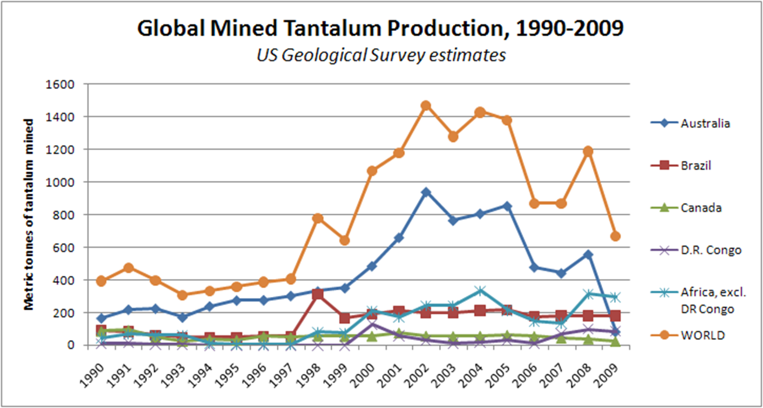

Slide 9
Considering the problems is DRC and the use of CT
Discuss...
Has your views on mobile phones changed?
What can we all do to address these issues? Think recycling, reusing, reducing and refusing...
Access to CT is causing conflict in DRC!
What are the social, economic and environmental impacts?
Should this influence the phone manufacture’s choice of material?

