Slide 1
Marxist Theory on Crime
LO: To understand the influence of social contexts on perspectives of crime.

Slide 2
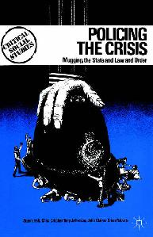
Marxist Theory on Media and Crime
Marxists would argue it is not surprising that moral panics centre around groups viewed as deviant or threatening to the rich and powerful in society
They highlight the way the media portrays criminals as working-class, ignoring white-collar or corporate crime.

Slide 3
Task:
Research an recent example of white collar or corporate crime and make a report on your findings for the class.
Who?
What?
Where?
When?
Why?
How?

Slide 4
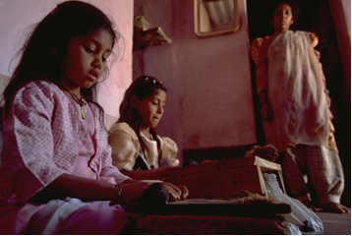
Think about ….

Slide 5
How many of you buy your clothes from here?
Why has Primark been in the News?

Slide 6
Or... Blood diamonds
What price for these diamonds?
The diamond business
The true cost of mining diamonds

Slide 7
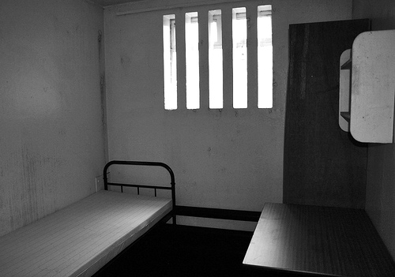
I am Nick Leeson. I was a top banker who defrauded so much money from my bank it collapsed.
Or… remember this guy??

Slide 8
Now lets …
Share your report with the class.
Read it out like you are a news reporter.
Discuss as a class.

Slide 9
Plenary:
“Corporate Crime should be reported more in the media.”
Do you agree or disagree with this statement?

