Slide 1
Oceans on the edge
Task 1: Watch the clip and use the information sheet to create a flash card for your first case study Mangrove Swamps
5 mins
http://www.youtube.com/watch?v=o_ggo6WNPZ4&list=PL88C86351609E3EA4

Slide 2
Exam Question
Study the distribution of mangrove swamp shown in Figure 2 (p.105). Identify the main populated areas where mangrove swamp grows.[3 marks]
(Excellent answers provide specific details of Asian locations (naming the West coast of India and Indonesia) or mentioning north-west and south-east Africa.)

Slide 3
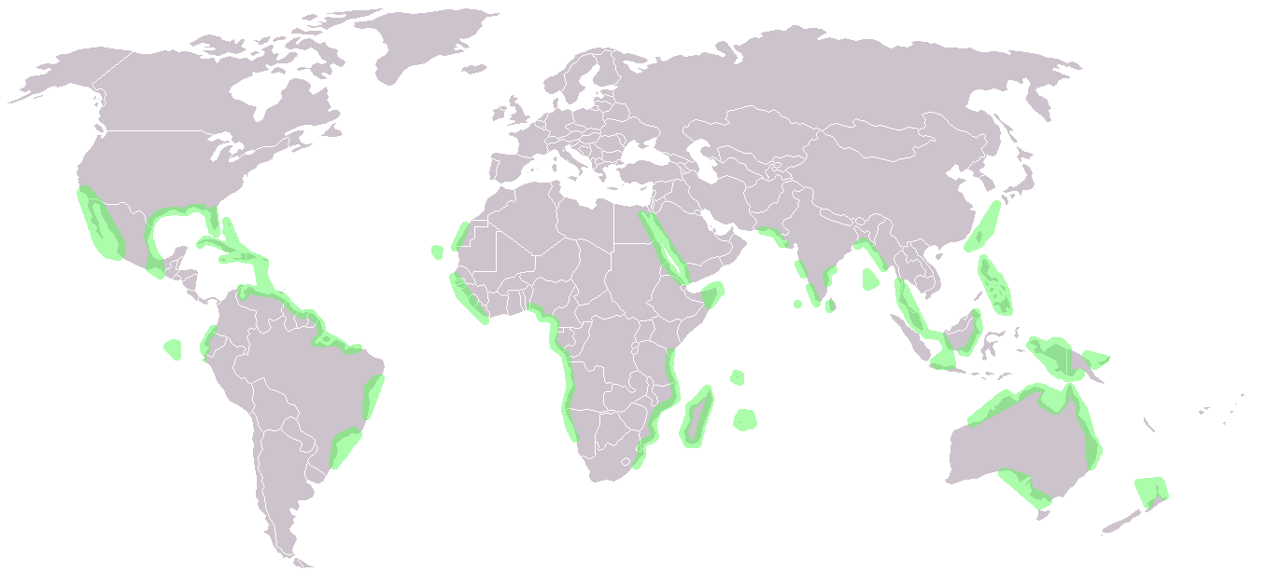
Mangrove distribution

