Slide 1
Fantastic Places: Machu Picchu
LO
To know and understand why Machu Picchu is a fantastic place

Slide 2
Google earth Starter
You will watch Machu Picchu from google earth
You will find out which continent it is in
You will find out which country it is in
Write down your thoughts to do with what you see i.e descriptive words and feelings

Slide 4
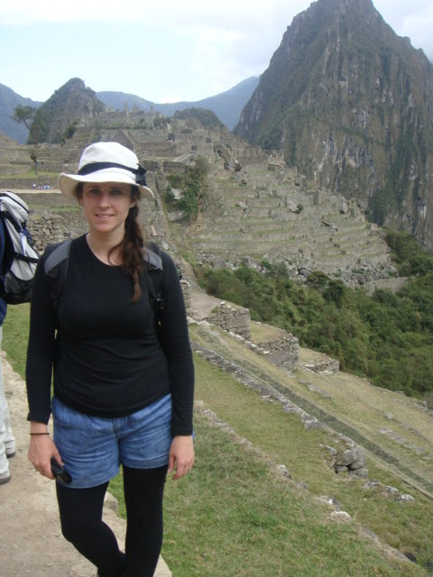
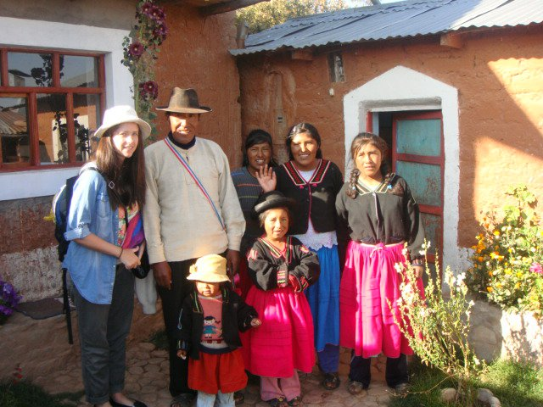
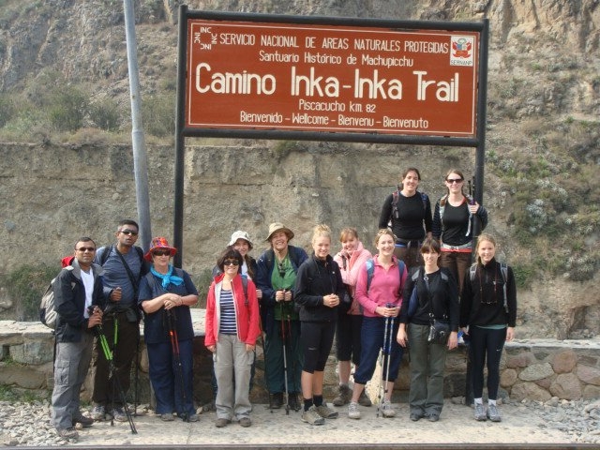
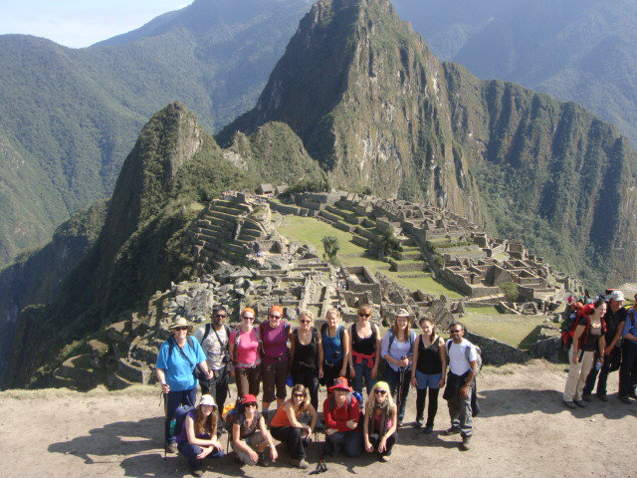
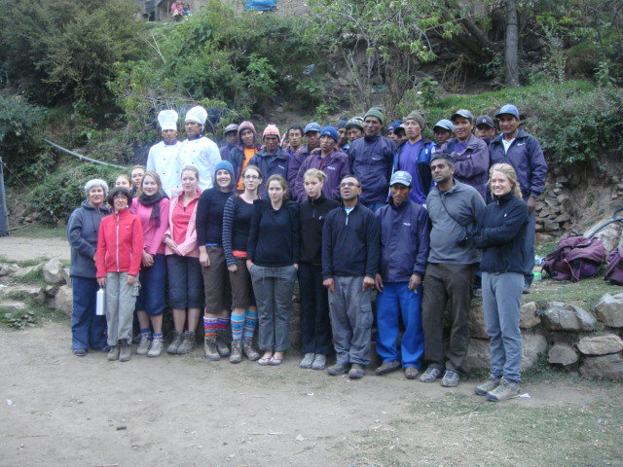
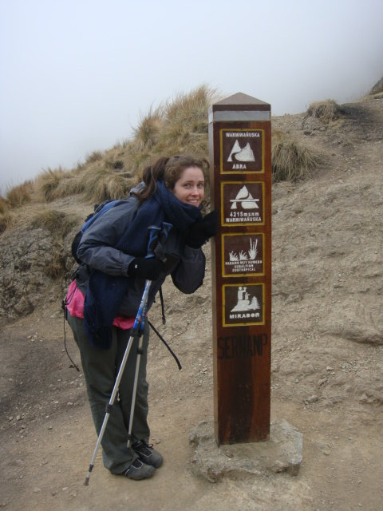

Slide 5
Why is it fantastic ? Back ground info
Task: You have information in the boxes
Background info
Human attractions
Physical attractions
the benefits of tourism for locals
How is it being preserved ?
Why was it a good settlement?
Put the information in chronological order in the background section(purple boxes)
It is believed to be abandoned because the Inca’s were afraid of Spanish invasion.
In 2007 voted as one of the New Seven Wonders of the world
2430 meters above sea level
Hiram Bingham an American found the ‘lost city’ in 1911
Inca ruler Pachacuti Inca Yupanqui built Machu Picchu in the mid-15th century
It is a no fly zone
UNESCO is considering putting Machu Picchu on its List of World Heritage in Danger.^{[38]}
It became a A UNESCO World Heritage Site in 1983
Most of the roughly 150 buildings in Machu Picchu were built of granite
It was built by the Inca people

Slide 6
Human and Physical attractions
Tourists come and complete the Inca Trail
There are approximately 200 buildings
Most spectacular place in Peru
Rafting trips can be taken down the Urubamba River
Over 400 different plant species
The Inca Trail has ten different climatic zones and sub-zones, from deserts to tropical Andean cloud forest
The trek is 32 kilometres long starting at the railway and ending at the Holy City.
The nearby town of Aguas Calientes has thermal (hot water) baths.

Slide 7
The benefits of tourism and why is it in danger?
Porters can carry too much and lead to health problems
Tourism is the only income local people get
Jobs are provided e.g tour guides
It encourages conservation
The local area is improved
Cultures can be exchanged
Tour guides leave their families for a while
A loss of culture
Landslides occur
The site is slowly eroding

Slide 8
Why was it a good settlement and how it is being conserved ?
Its remote and hidden by the Amazon rainforest
It is protected by the U.N
As its so high up the Incas were close to sky therefore the Gods.
The town of Agus Calientes will receive 10% of tickets to improve sewage
Less trains will visit the Inca trail
Less roads will be built around it
They are cutting tourists by 800.

Slide 9
Writing Task: Can your work make the newsletter?
You are going to inform people why Machu Picchu is a fantastic place.
Your writing has to be ‘magical’, ‘engaging’ and ‘interesting’
What to include
Location
Facts
Why its important to conserve it? (tourism and environmental reasons)
What fantastic words could you use?
Historical
Notes:
Get the class to give some words/ descriptive words.

