Slide 1
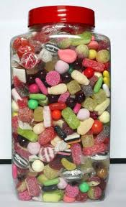
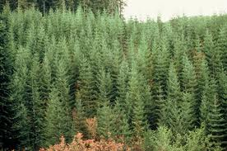
What do we mean by the term ‘density’?
1, 2, 3, 4, 5.......50, 51, 52.......oh no! I lost count!
Some pictures to help!

Slide 2
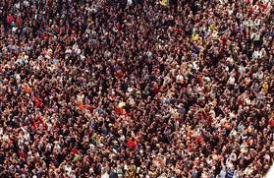
Population Density
Learning Objective:
To define the term population density and understand the key terms
To use key terms to explain the population density of a number of places around the world

Slide 3
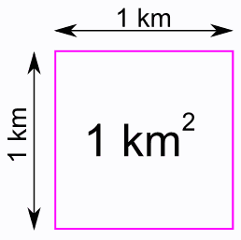
This is a square kilometre and is how population density is measures.

Slide 4
What is population density?
This is the number of people living in a square kilometre
Sparsely populated Densely populated
Least populated Most populated

Slide 5
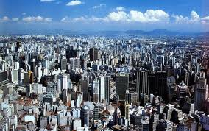
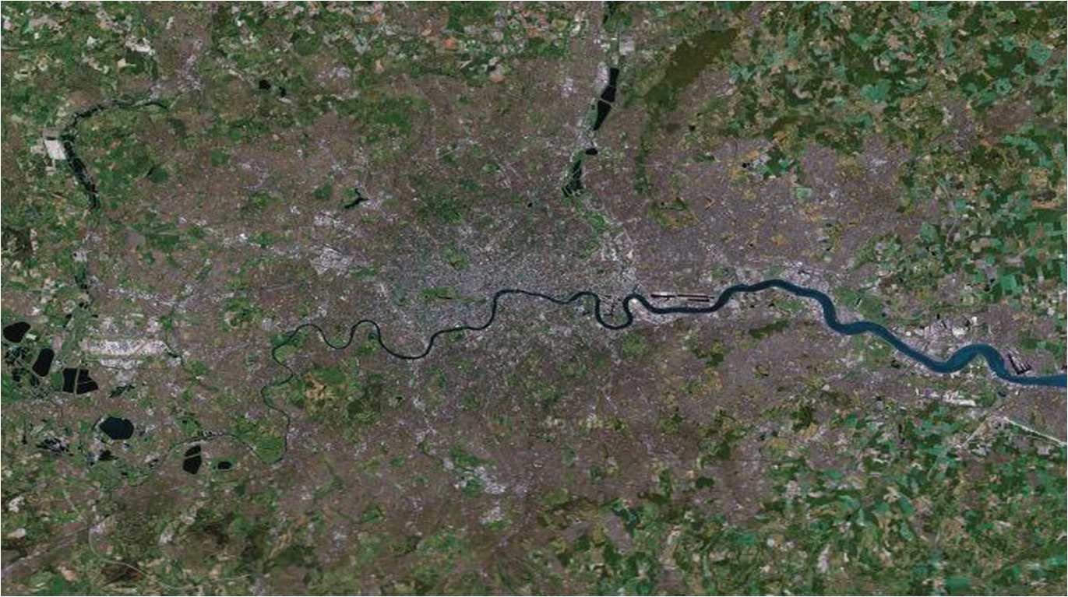
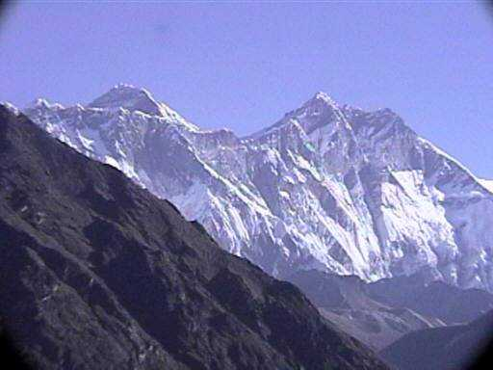
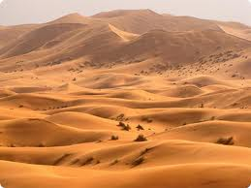

Slide 6
So what does population density look like on a map?

Slide 7
Access to services
Varied climate
Lack of services (expensive)
Fertile soil
Extreme environments
Few natural resources
High employment
Land relief
Unemployment
Poor soil
Accessible
Inaccessible
Many natural resources
Extreme climate
Pollution
Positive factors | Negative factors
Conflict

Slide 8
Your task:
In your books divide your page into three columns:
There are 10 images around the room. Fill in the table in your book to describe the picture as Sparse or Dense and suggest some positive and negative factors for each picture.
Population Density | Positive Factors | Negative Factors

Slide 9
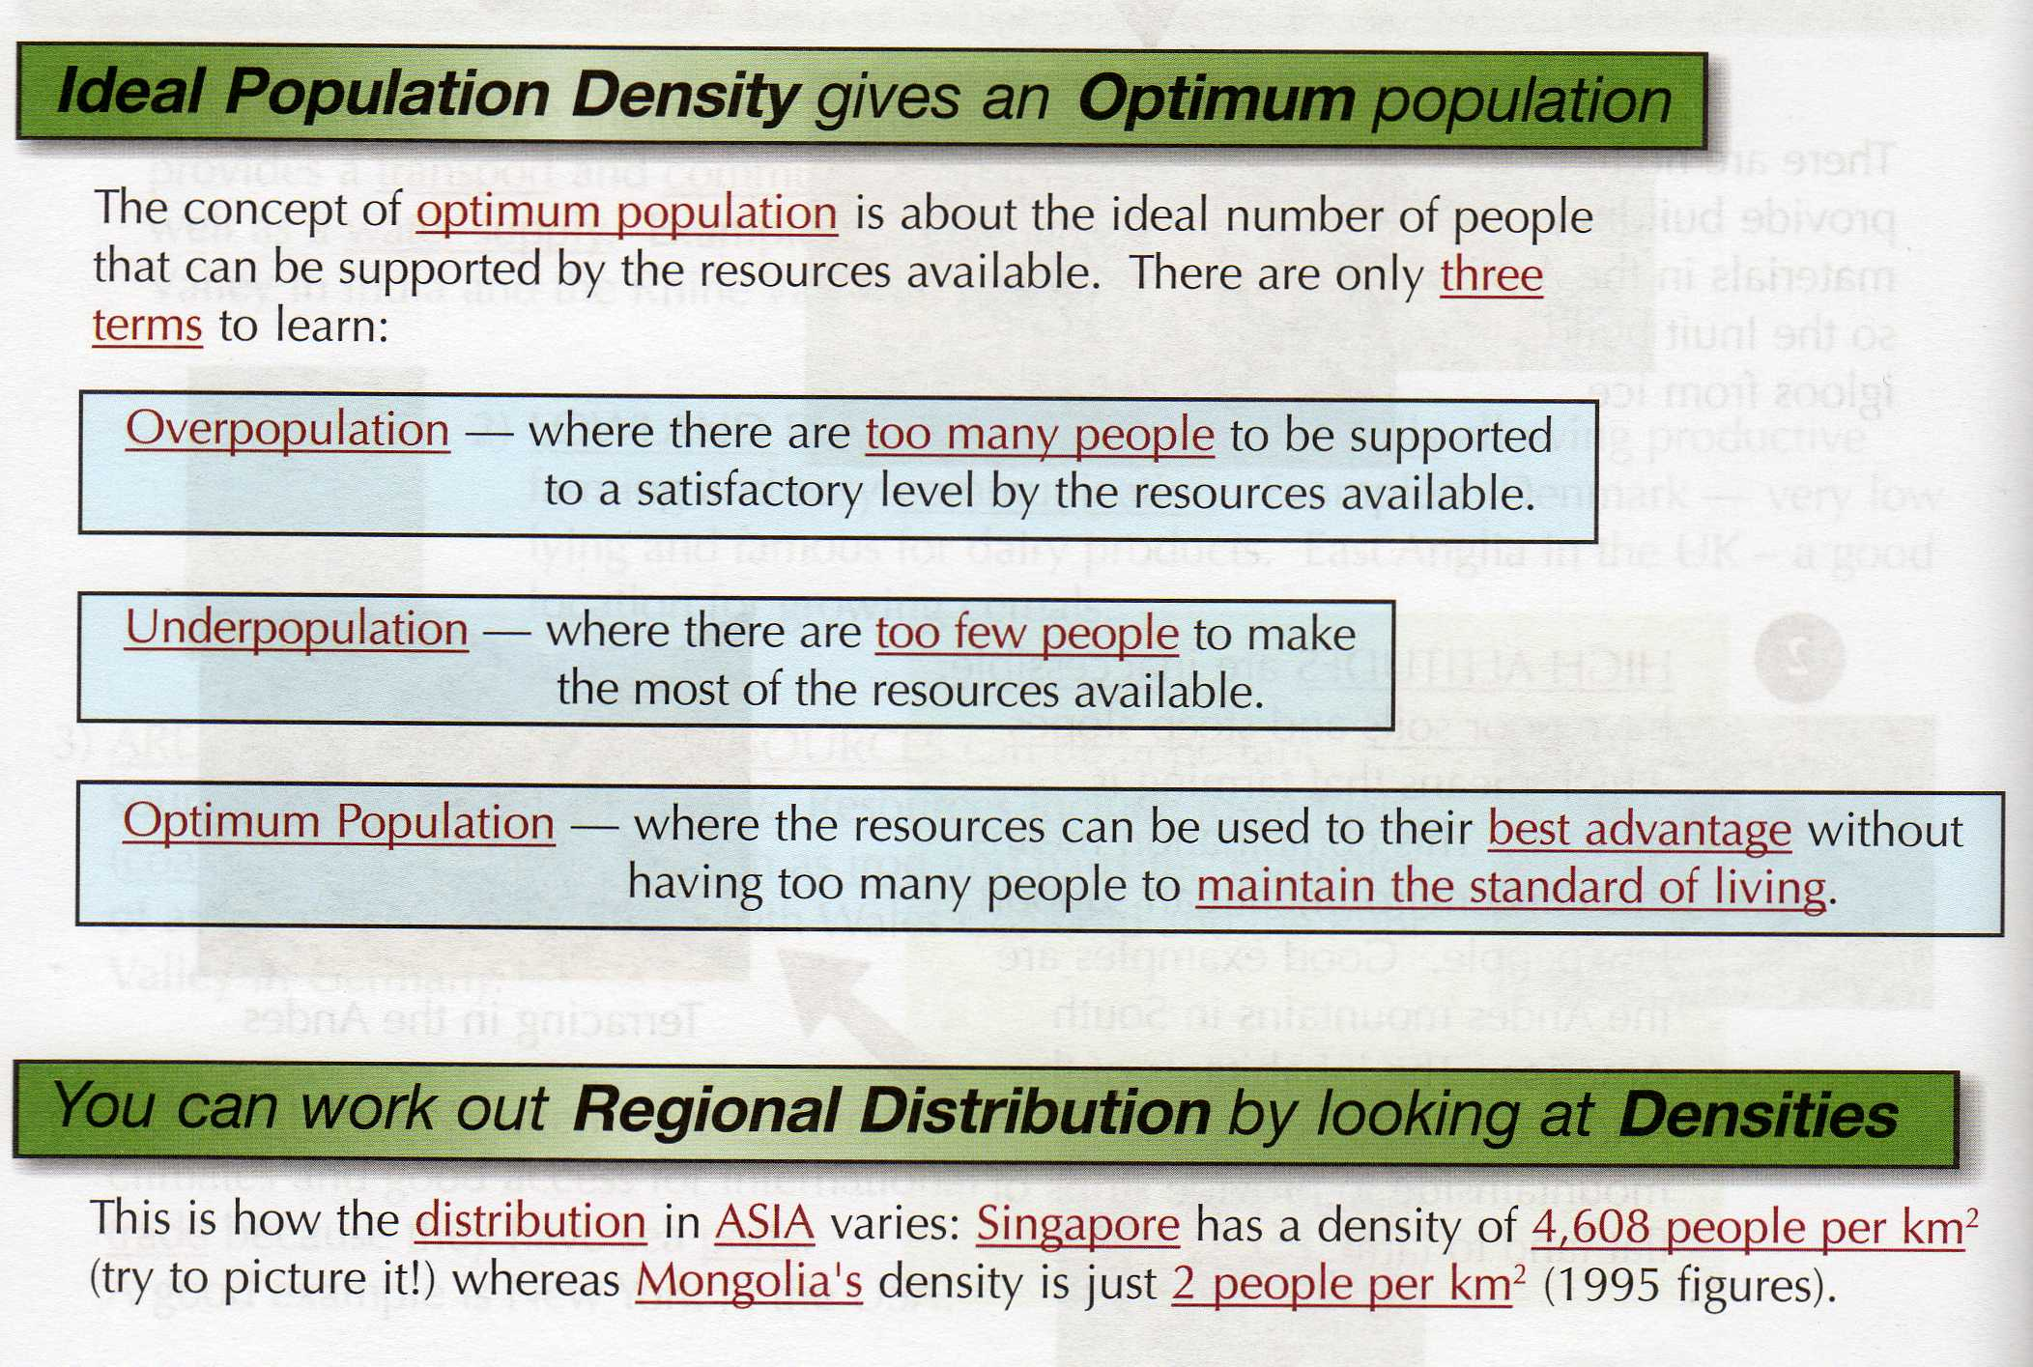

Slide 10
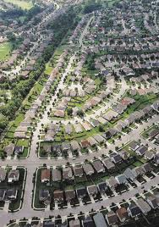
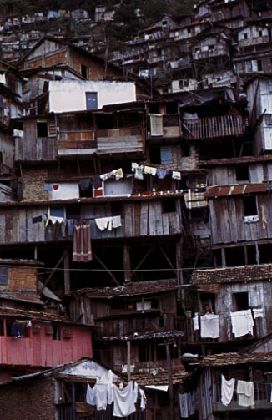
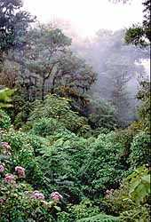
Over, under, optimum?
A
B
C
How can you tell? Positive or negative factors?

Slide 11
Population Density
Learning Objective:
To define the term population density and understand the key terms
To use key terms to explain the population density of a number of places around the world

Slide 12
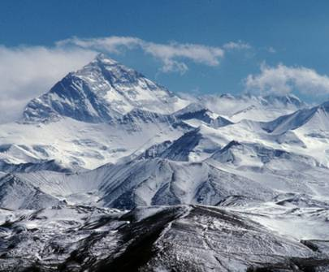
Densely or Sparsely Populated? Why?

Slide 13
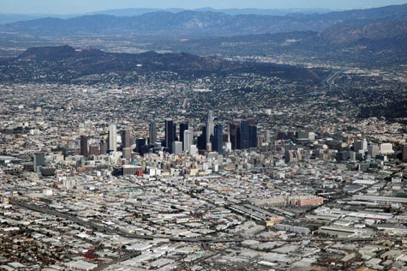
Densely or Sparsely Populated? Why?

Slide 14
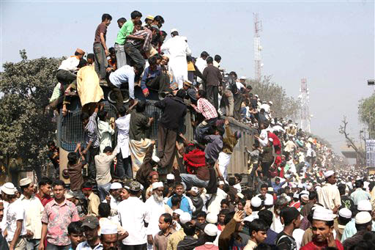
Densely or Sparsely Populated? Why?

Slide 15
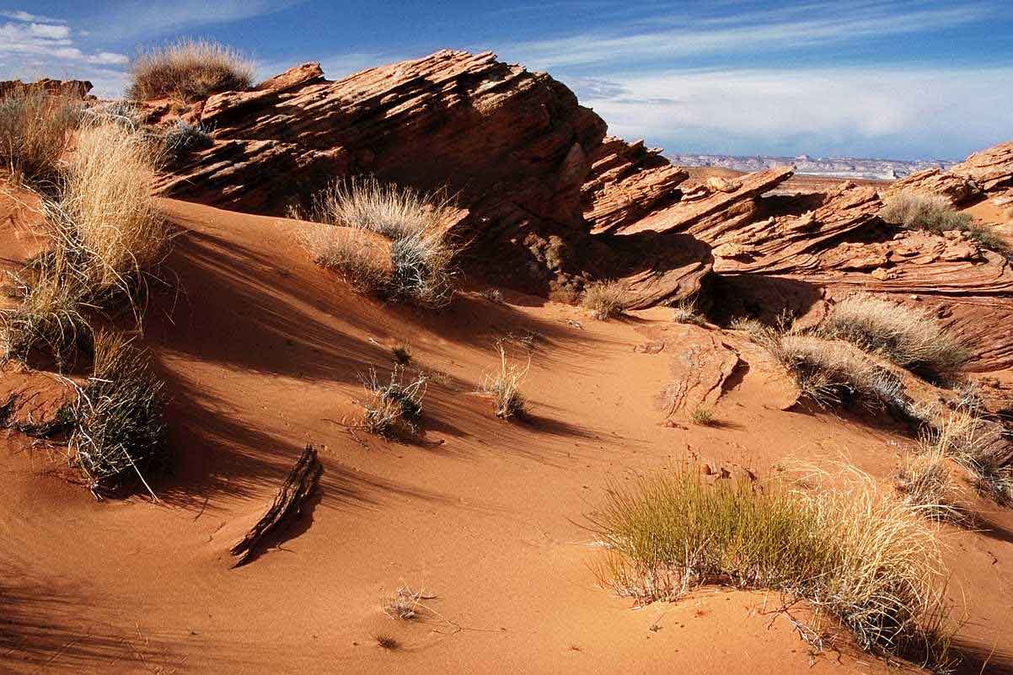
Densely or Sparsely Populated? Why?

Slide 16
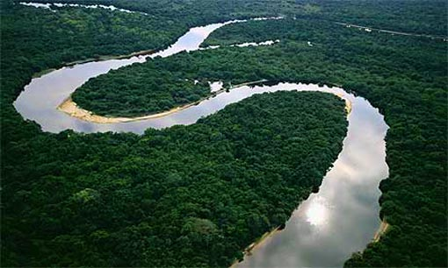
Densely or Sparsely Populated? Why?

Slide 17
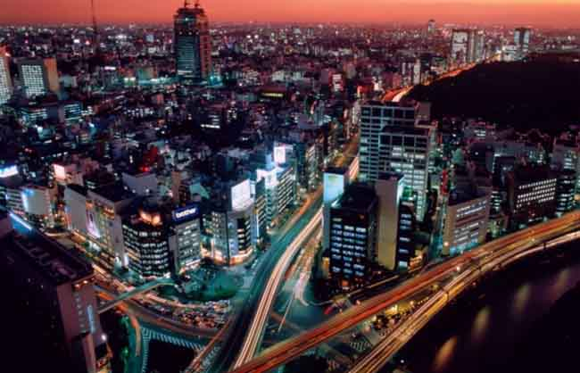
Densely or Sparsely Populated? Why?

