Slide 1
People everywhere
Are there too many?

Slide 2
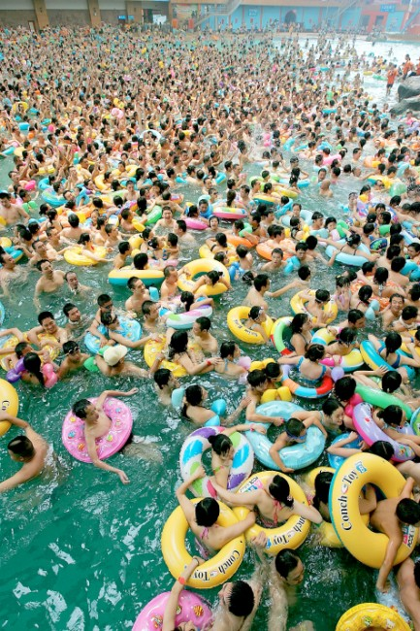
Look at the picture.
Discuss what the advantages are of living in a country with a large population. Make a mind map!
Make references
to the image- what do you notice?

Slide 3
Learning Objective
Describe and explain the concepts of population distribution

Slide 7
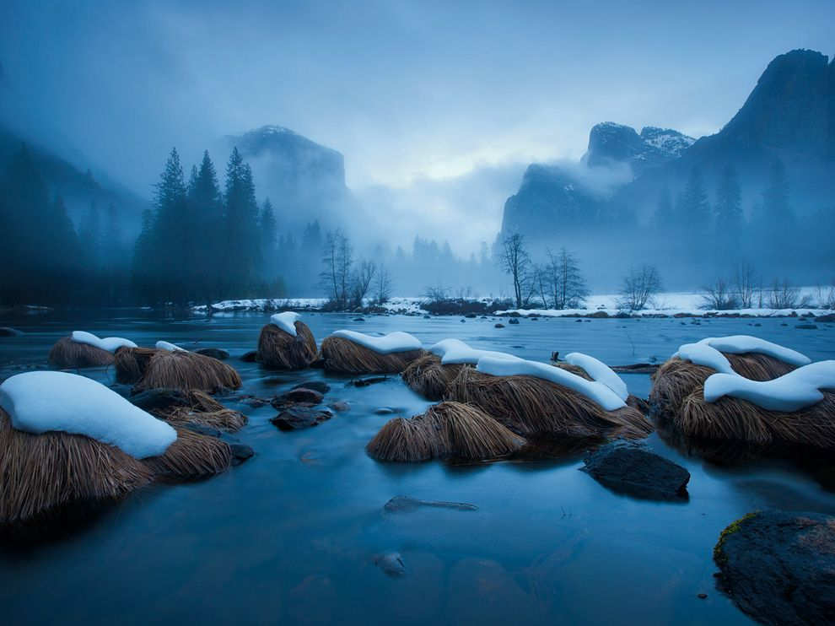
Sparsely/Densely populated…why?
Numbers!

Slide 8
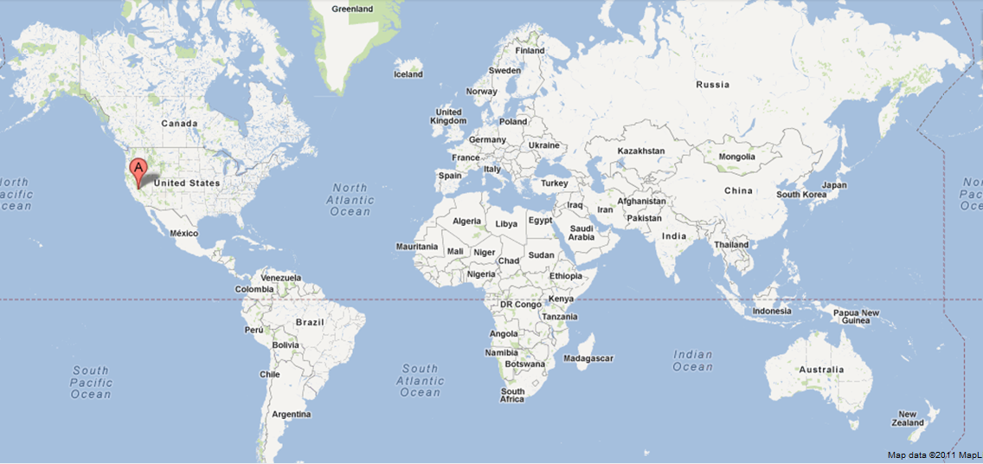
Merced River, Yosemite, California, USA

Slide 9
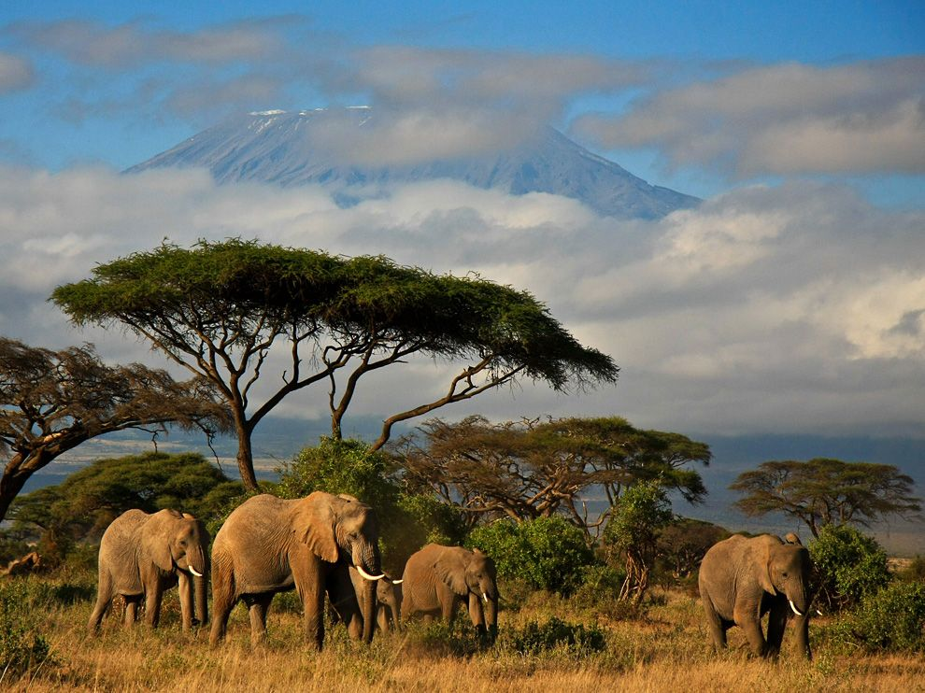
Sparsely/Densely populated…why?
Numbers!

Slide 10
Elephants in Kenya

Slide 11
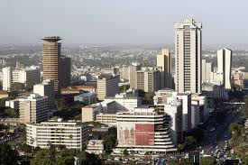
Sparsely/Densely populated…why?
Numbers!

Slide 12
Nairobi in Kenya

Slide 13
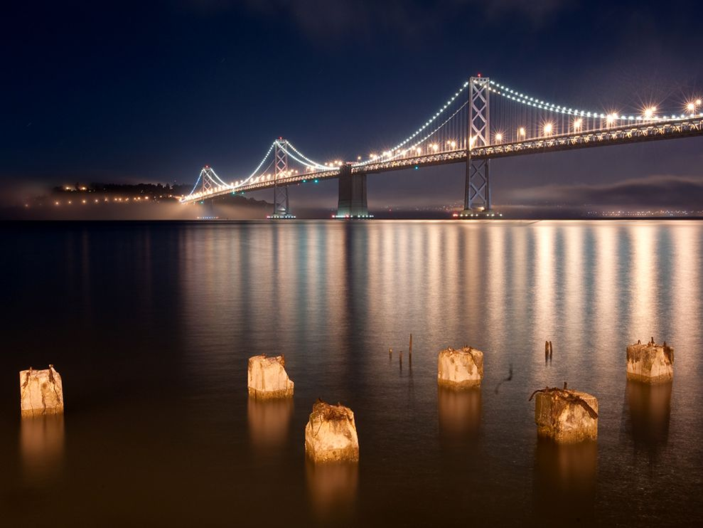
Sparsely/Densely populated…why?
Numbers!

Slide 14
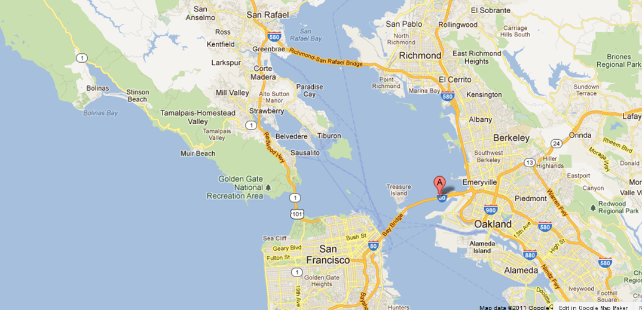
Bay Bridge, San Francisco, USA

Slide 15
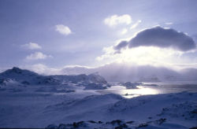
Sparsely/Densely populated…why?
Numbers!

Slide 16
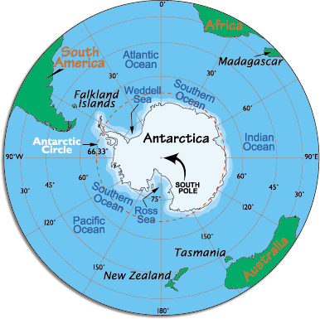
Antarctica

Slide 17
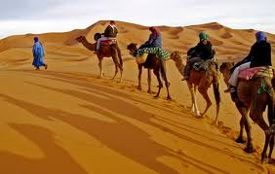
Sparsely/Densely populated…why?
Numbers!

Slide 18
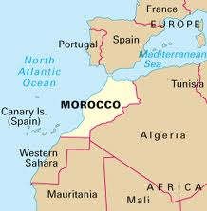
Morocco

Slide 19
What affects where we live?
Sparsely populated (negative factors) | Densely populated (positive factors)
Flat land
Mountains
Dense forest
Lowland
Open grassland
Good farming
Unreliable water supply
Deep, rich soils
Thin, poor soils
Job opportunities
Poor farming
Deserts
Extension: choose a location which you have visited. Was it densely or sparsely populated? What are the reasons for this? Write a paragraph to describe and explain your location.

Slide 20
Task: On your computer go to-
www.ifitweremyhome.com
Lottery of birth is responsible for much of who we are. If you were not born in the country you were, what would your life be like? Would you be the same person? Use the website to understand life outside your home. Pick a country you would move to and make a fact file to compare your life to someone else's.
Include:
An overview of the country, a map, a photo
List some positives of living in that country
List some positives of living in that country

Slide 21
http://www.youtube.com/watch?v=rj3HU7_Y8Io

