Slide 1
Population Distribution
Objectives:
1 To understand the key terms of population density and population distribution.
To examine the reasons for areas of low population density.

Slide 2
Starter : how many people?
Are there in the our School?
Are there in our city?
Are there in the Country?
Are there on this continent?
Are there in the world?
http://www.youtube.com/watch?v=sc4HxPxNrZ0

Slide 3
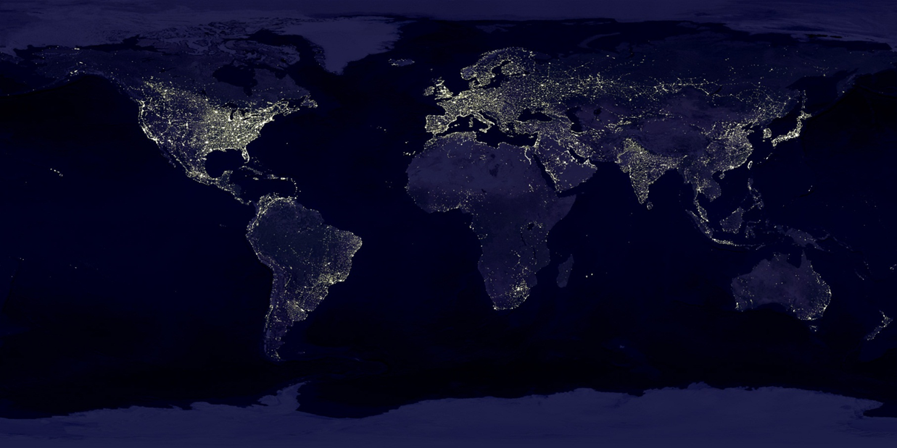

Slide 4
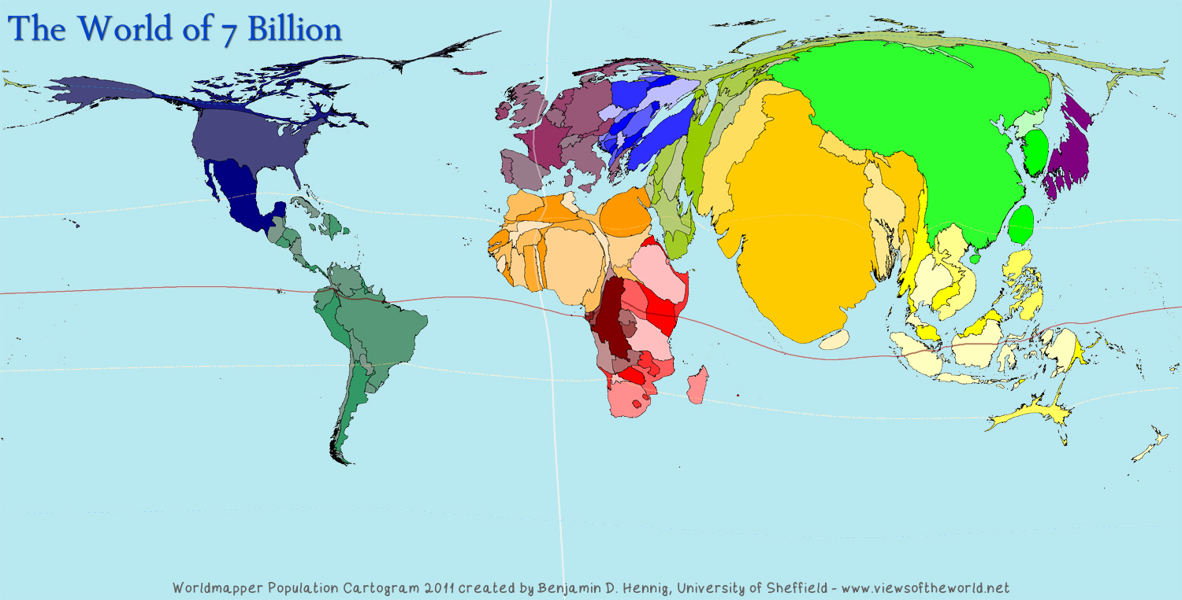

Slide 5
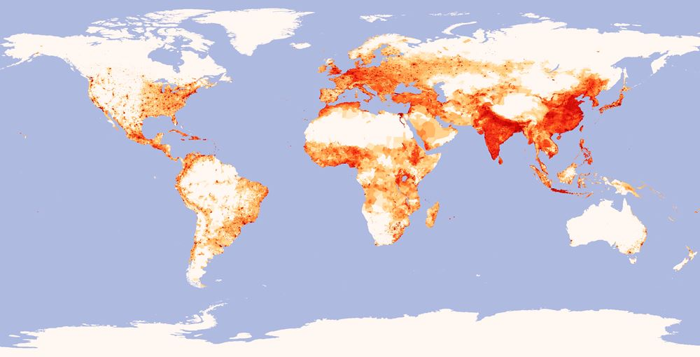

Slide 6
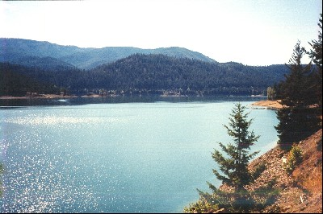

Few people
Look at the two pictures opposite. suggest reasons why few people live in either area.
Extension – Think of other places where few people live.

Slide 7
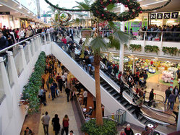
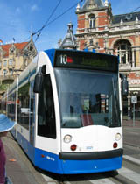
Lots of people
Look at the two pictures opposite. suggest reasons why lots people live in both areas.
Extension – Think of other places where lots of people live.

Slide 8
Key terms:
Population density is the number of people per square kilometre.
Population distribution is how people are spread out across an area.
Densely populated means that there are a lot of people within an area, it is crowded.
Sparsely populated means that there are few people within an area.

Slide 9
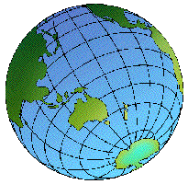
Do you think population distribution across the world is even?

Slide 10
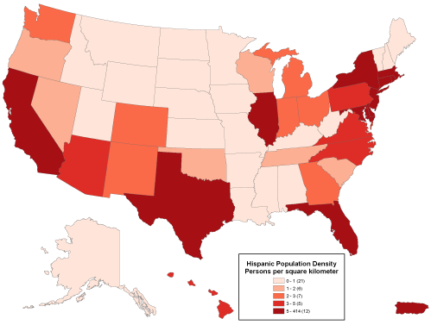
Geographical skills – choropleth shading.
Choropleth shading is where you use shades of a colour to indicate different groups on a map. It could be used to show number of schools in a county, number of mobile phones in a region or the income per country.

Slide 11
ACTIVITY!
Population Density = Pop. Of Country
Area of Country
This formula figures out population density!
Work through the table
Make a colour code on the World Map!

Slide 12

If you are done…
Choose 2 countries that have a high population density – why do you think it is high?
Choose 2 countries that have a low population density – why do you think it is low?

Slide 13
Plenary – Peer Assessment
Swap books with your partner.
Complete the peer assessment label and stick it under their work.
You have 5 mins to assess their work and add a target.

Slide 14
The population problem

Slide 15
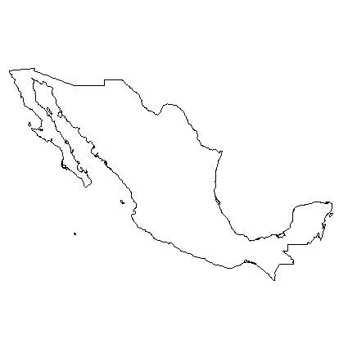
Plenary: Which country am I?
I am north of the equator.
I have a coast line on the Pacific Ocean.
Many of my people speak Spanish.
I am south of the USA.
I have mountains called the Sierra Madre Occidental.
My people wear ponchos and sombreros.
My capital is Mexico City.

