Slide 1
Learning Objective
Explain changes in the world's population using appropriate vocabulary

Slide 2
When discussing population change analogies can be a useful way of ‘getting your head around’ key concepts
How could bath tubs be used to describe population change?
Clue: think about all the functions, e.g. plug hole etc.
Birth Rate: the number of babies born per 1000 members of the population each year.
Natural Change: the difference between birth rate and death rate. If BR is higher than DR, population will increase, vice versa if DR is higher than BR.
Death Rate: the number of people who die per 1000 members of the population each year.

Slide 3
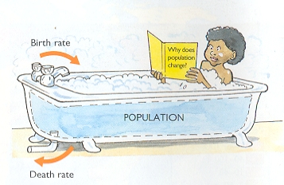

Slide 4
Population Change
Starter task:
Match the key term and definition and copy them down into your book.
Birth Rate
Death Rate
Natural Change
Population Explosion
The number of people dying each year per 1,000 of the population
Population change that is the difference between birth rate and death rate
The rapid increase in the worlds population over the last hundred years.
The number of people born each year per 1,000 of the population

Slide 5
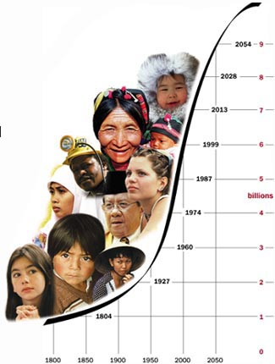
Current Human Population
Since the early 1800s, the human population on Earth has been growing exponentially.
Current world population estimate is: 6,404,307,344 people as of December 4, 2004

Slide 6
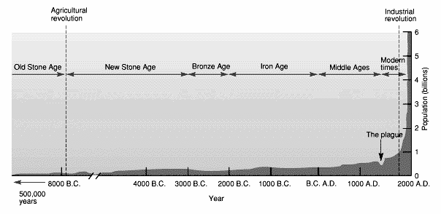
Human Population History

Slide 7
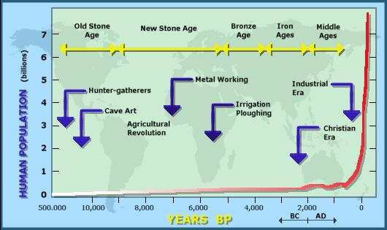
Measuring Population Change

Slide 8
Growth Rates
In 1850, the human population reached its first billion.
By 1930, it was 2 billion.
By 1960, the human population reached 3 billion.
Then in 1975, 4 billion, and so on…

Slide 9
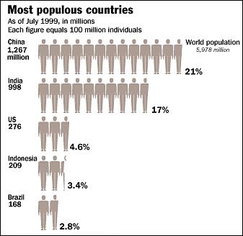
Current Rate of Growth
The human population is now growing at a rate of about 3 people/second or
260 thousand/day or
1.8 million per week or
93 million/year

Slide 10
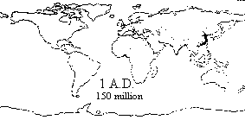
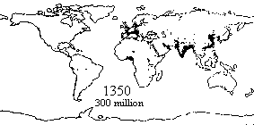
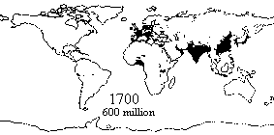
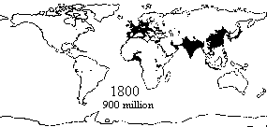
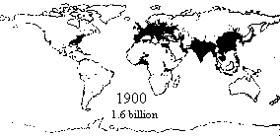
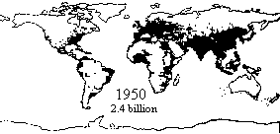
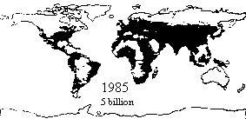
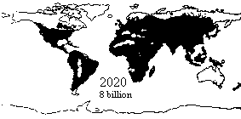
Each dot represents 1 million people

Slide 11
Task:
Put the statements into a logical order and stick them into your book.

Slide 12
Between 10,000BC and 1400AD the population stayed quite low at around 0.4million.
Then the population started to increase reaching 1 billion at about 1800.
At around 1900AD the population reached 2 billion.
Since then the population has been increasing at a very fast rate, reaching 6 billion in 2000.
The worlds population is now increasing by about two people every second, or 200,000 every day.
This fast increase in population is called a population explosion.

Slide 13
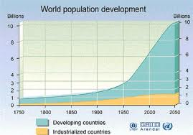
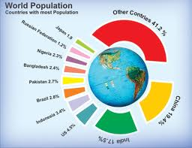
So where do you fit into the 7 billion ? Complete the four steps on: http://www.bbc.co.uk/news/world-15391515 Write down the information you collect about yourself and your country.
Population graph
Extension: Look at the links to population stories

Slide 14
Calculating Natural Change
Natural Change = Birth Rate – Death Rate
This will then give the natural change (usually a positive number but occasionally negative)
To convert this into a percentage move the decimal place one to the left. (e.g. 1.3 = 0.13%)
Country | Population | Birth Rate (per 1000) | Death Rate (per 1000) | Natural Change | % Natural Change
Bangladesh | 153 546 901 | 28.68 | 8
Burundi | 8 691 005 | 41.61 | 12.91
Denmark | 5 484 723 | 10.71 | 10.25
Germany | 82 369 548 | 8.18 | 10.80
Haiti | 8 924 553 | 35.69 | 10.15
Iraq | 28 221 181 | 30.77 | 5.14
Niger | 13 272 679 | 49.62 | 20.26
Turkey | 71 892 807 | 16.15 | 6.02
Uzbekistan | 28 268 440 | 26.45 | 7.62
Venezuela | 26 414 815 | 20.92 | 5.10
Which country has the highest natural change?
What will be the new total population of that country by the end of the year? (divide by 100 then x by (100 + % change))
Which country had the lowest natural change?
Are there any differences in levels of development between the countries with high levels of change compared to those with lower change rates? If so what?

Slide 15
Mapping Population Change
Key
Countries with change less than 1%
Countries with change between 1.01% and 2%
Countries with a change greater than 2.01%

Slide 16
TASK: Stick your country on the board as another example.

Slide 17
Children play an important role working with their family so people have more children to help them.
The majority of people are still farmers who live in rural areas away from the city.
Birth control isn’t always available so parents are unable to plan their families.
The reasons for
high population
growth in poor
countries
Some countries have no pensions for people in their old age so people will depend on their children to look after them.
Many children die young because of poor health care so people have more children to ensure they survive.
Outside the cities the tradition is to have many children because here there are fewer modern influences.

Slide 18
The majority of people live in urban areas…
Children have to be supported while they go to school….
In cities fewer people are attached to traditions…
The reasons for
low population
growth in rich countries
Birth control is easily available…
Few children die young because of good health care…
There are pensions for people in their old age…

Slide 19
Plenary:
Play Population dominoes.

