Slide 1
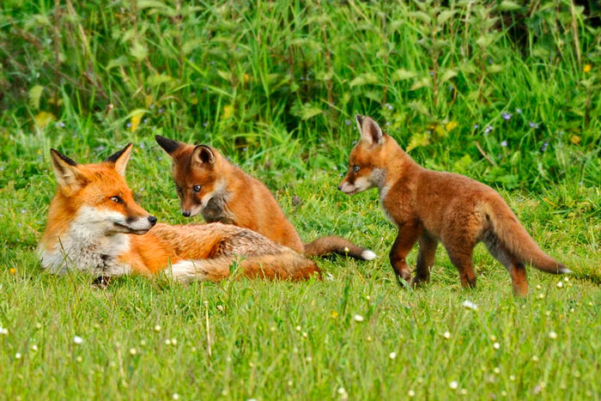
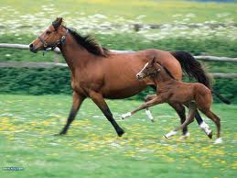
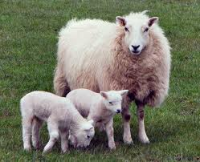
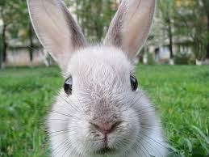
ODD ONE OUT
Can have ones like this where there are several answers.
PRESS SLIDE SHOW
Notes:
Odd one out, students on white boards can start by writing down which animal does not fit with the others. You are looking or the fox as it is a carnivore all other animals here eat grass and are therefore herbivores

Slide 2
Objectives
Realise in every food chain there is a producer and consumers (4b)
Draw food chains from list of animals given(4b)
Describe the feeding relationships shown by food chain (L4a)
Be able to place organisms into trophic levels (L5c)

Slide 3
Can you place me in a food chain?
Notes:
On white boards see if students can place this rabbit into a food chain

Slide 4
Can you place me in a food chain?
Notes:
On white boards see if students can place this rabbit into a food chain

Slide 5
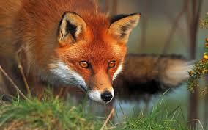
Can you place me in a food chain?
Notes:
On white boards see if students can place this rabbit into a food chain what are the arrows showing? At this stage looking for which animal eats which animal

Slide 6
Objectives
Realise in every food chain there is a producer and consumers (4b)
Draw food chains from list of animals given(4b)
Describe the feeding relationships shown by food chain (L4a)
Be able to place organisms into trophic levels (L5c)

Slide 7
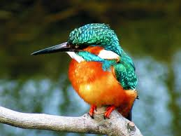
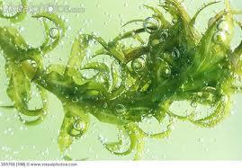
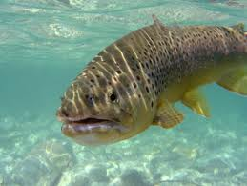
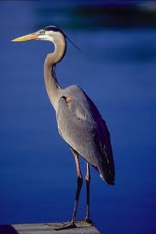
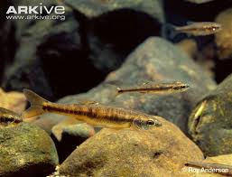
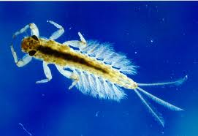
King fisher Pond weed Trout
Minnow (little fish) Mayfly larvae Heron
Notes:
In Pairs. Write the names of the animals above on A4 paper and make one food chain. Draw big black arrows on A4 to show who eats whom. Could discuss discuss the implausibility of a minnow eating a kingfisher.

Slide 8
One food chain
Notes:
In Pairs. Write the names of the animals above on A4 paper and make one food chain. Draw big black arrows on A4 to show who eats whom. Could discuss discuss the implausibility of a minnow eating a kingfisher.

Slide 9
Or
Another food chain
Notes:
In Pairs. Write the names of the animals above on A4 paper and make one food chain. Draw big black arrows on A4 to show who eats whom. Could discuss discuss the implausibility of a minnow eating a kingfisher.

Slide 10
Your turn
In pairs write down one food chains.
Perhaps one of the organisms in it could be you!
(Hopefully not being eaten by a wolf ☹)
Draw in arrows pointing from the thing being eaten to the thing eating it.
Insect
larvae
Minnow
(little fish)
Pondweed
Kingfisher

Slide 11
Objectives
Realise in every food chain there is a producer and consumers (4b)
Draw food chains from list of animals given(4b)
Describe the feeding relationships shown by food chain (L4a)
Be able to place organisms into trophic levels (L5c)

Slide 12
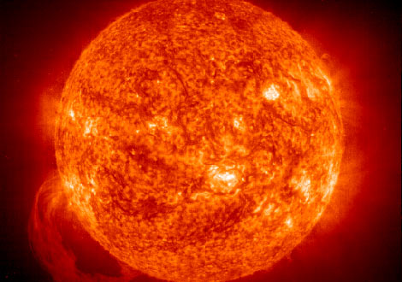
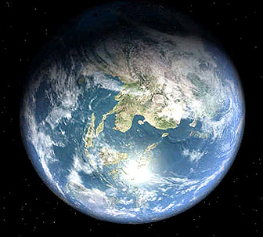
Energy Flow
Which way does the energy flow?
Which way do the sun’s rays go?
What is it used for?
Notes:
Sun: http://science.nationalgeographic.com/staticfiles/NGS/Shared/StaticFiles/Science/Images/Content/glowing-sun-sun-prominence-ga.jpg
Earth: http://rst.gsfc.nasa.gov/Sect19/earth-3d-space-tour-big.jpg

Slide 13
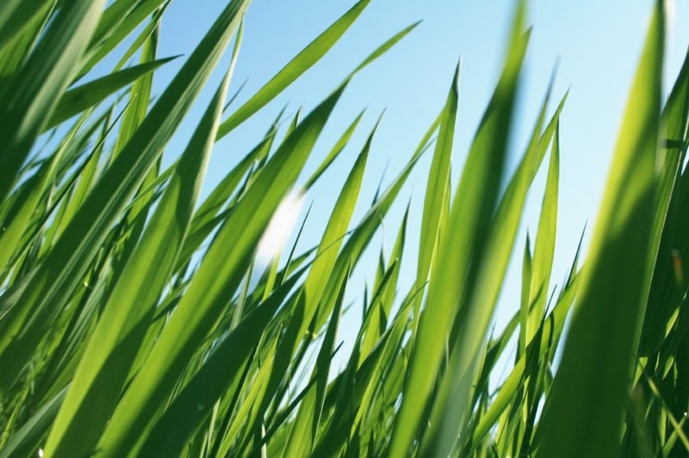
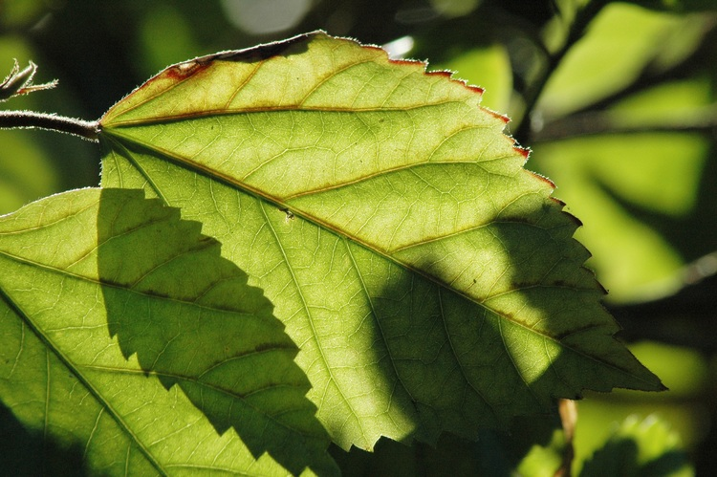
How is the sun’s energy used?
Notes:
Explain that the sun energy allows plants to grow through process of photosynthesis (suns energy converts(fixes) carbon dioxide and water into the sugar glucose, oxygen is a by product) this is then used by the plant for growth or if plant is eaten some of that energy will be transferred into the animal that ate it

Slide 14
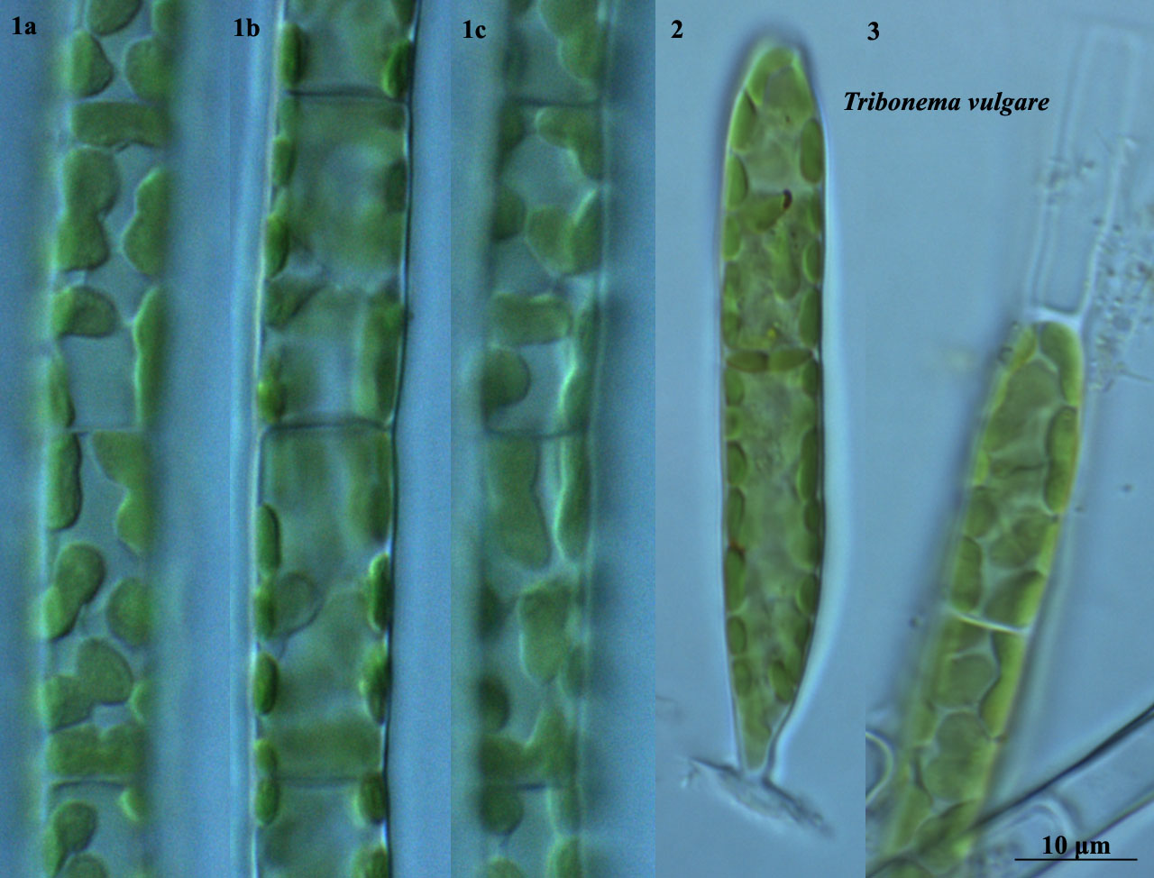
Plankton & Algae
Notes:
Photosynthetic too, just in water

Slide 15
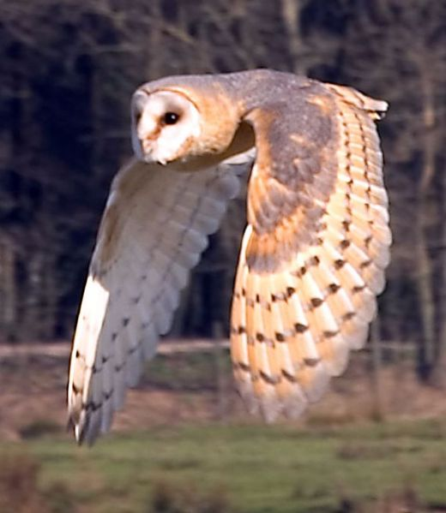
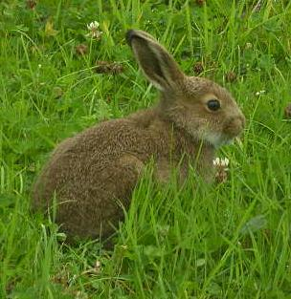
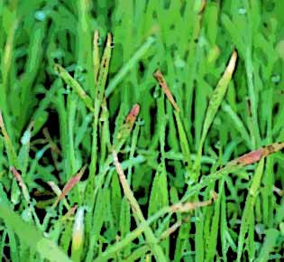
Food chain: a flow of energy in a habitat
Sun allows grass to grow
Grass is eaten by
Rabbits which are eaten by
Owls

Slide 16
Food chain: a flow of energy in a habitat
Grass is eaten by
Rabbits which are eaten by
Owls

Slide 17
Food chain: a flow of energy in a habitat
Grass is eaten by
Rabbits which are eaten by
Owls
Grass
Rabbit
Owl
The arrow means ‘is eaten by plus energy flow & always goes towards the consumer

Slide 18
Objectives
Realise in every food chain there is a producer and consumers (4b)
Draw food chains from list of animals given(4b)
Describe the feeding relationships shown by food chain (L4a)
Be able to place organisms into trophic levels (L5c)

Slide 19
Producers - organisms which can make their own energy from carbon dioxide and water using sunlight for energy (plants)
Primary consumer - organisms which eat producers (herbivores)
Secondary consumers - organisms which eat primary consumers (carnivores)
Tertiary consumers - organisms which eat secondary consumers (carnivores)

Slide 20
Each level of a food chain is known as a trophic level
Food chains always start with a producer. Producers are always on the first trophic level.

Slide 21
Food Chains
Each level of a food chain is known as a trophic level
Barn owl
Tertiary consumer
Fourth trophic level
Wood mouse
Secondary consumer
Third trophic level
Bark beetle
Primary consumer
Second trophic level
Oak Tree
Producer
First trophic level

Slide 22
Laminated card sort
Your turn in pairs
Or work sheet
Notes:
Students put into order food chain trophic levels and consumer

Slide 23
Objectives
Realise in every food chain there is a producer and consumers (4b)
Draw food chains from list of animals given(4b)
Describe the feeding relationships shown by food chain (L4a)
Be able to place organisms into trophic levels (L5c)

Slide 24
Examination question
Examination condition
Peer mark
Share grades

