Slide 1
Learning Objective
Explain and understand a population policy

Slide 2
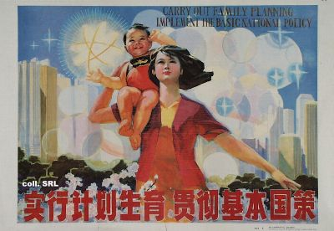
Making Population
Policies Work

Slide 3
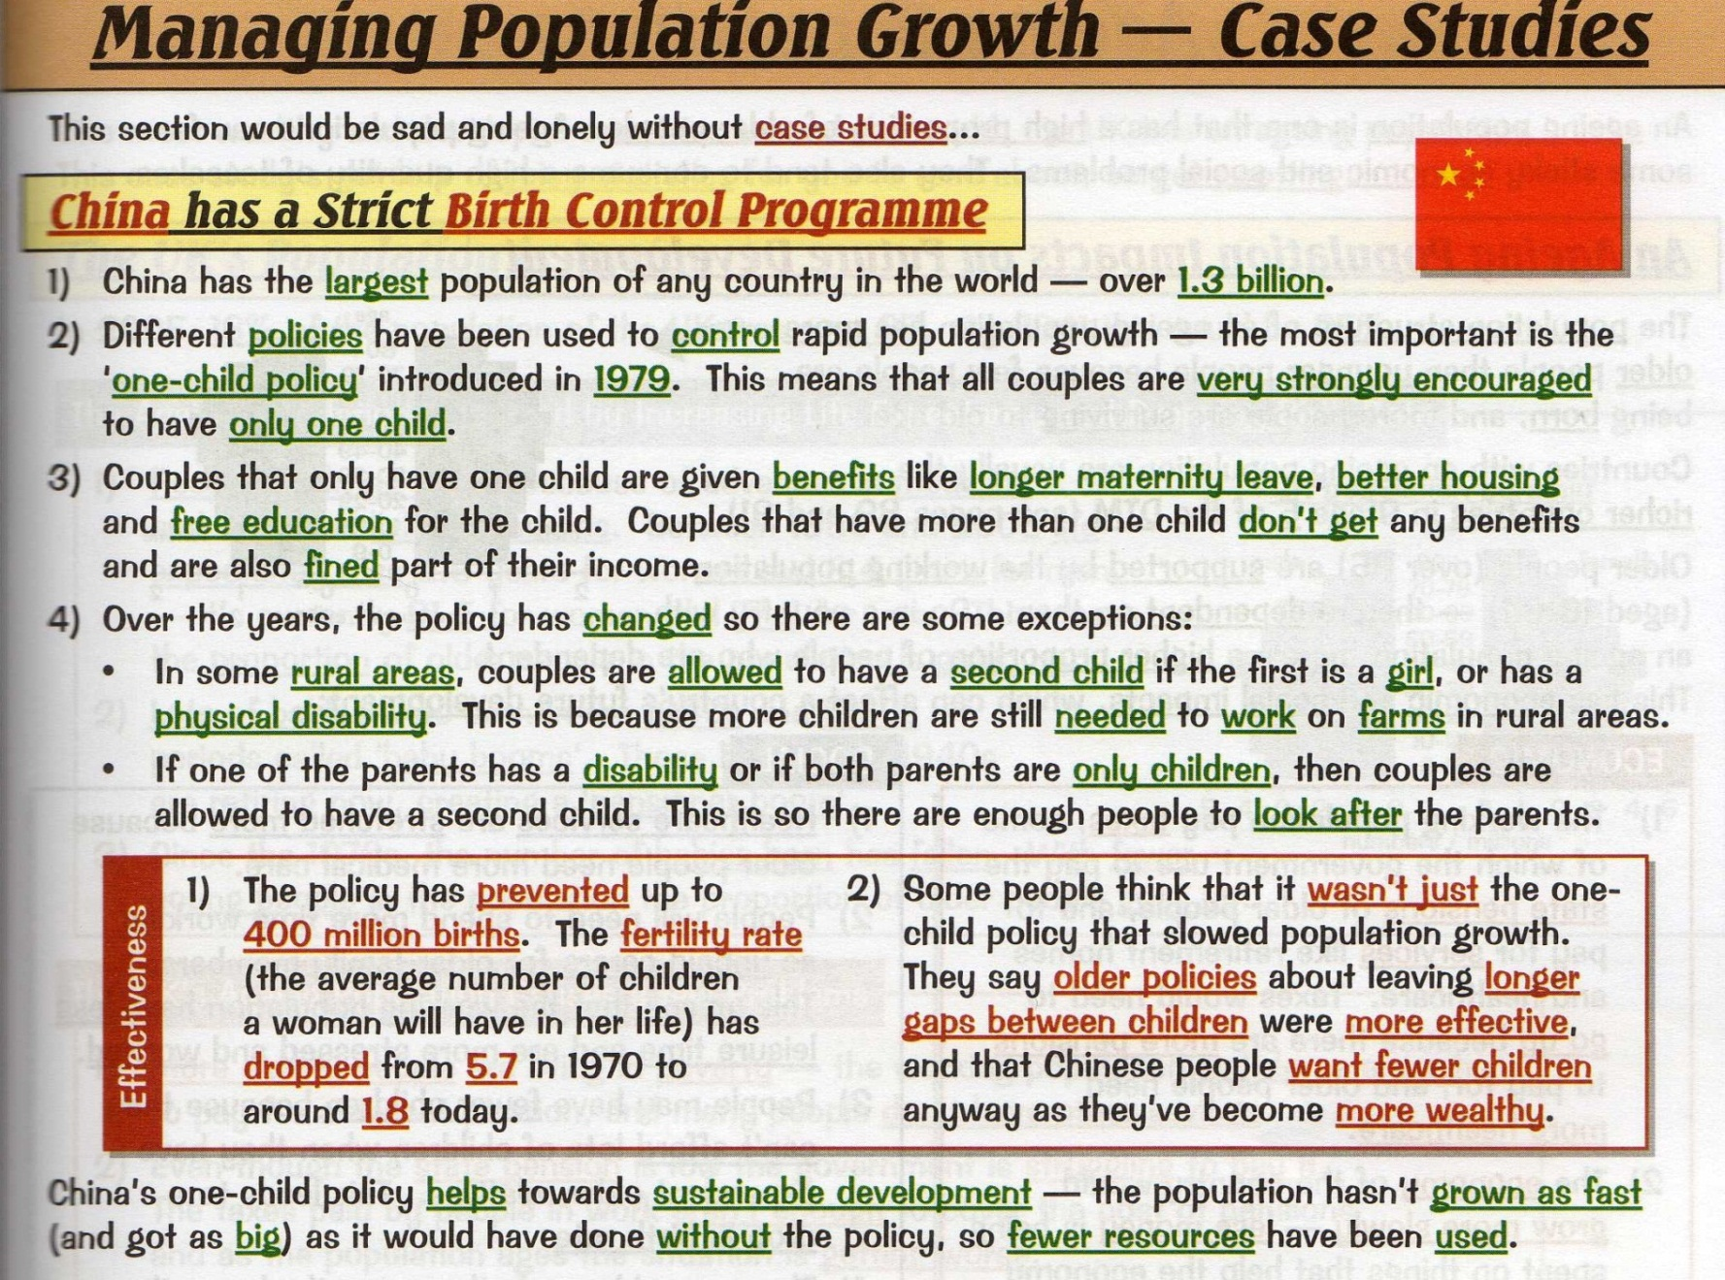

Slide 4
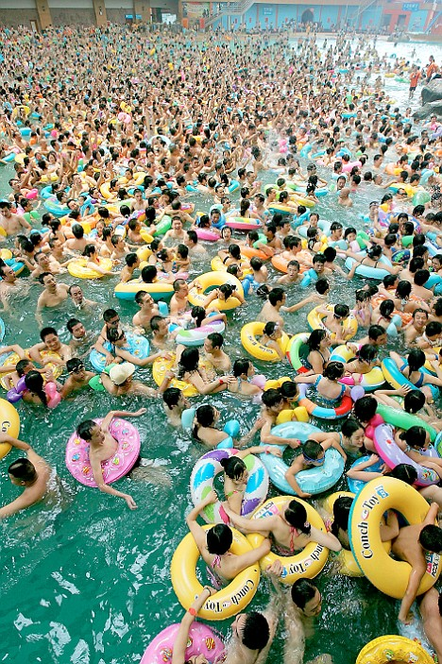
China and the One Child Policy
Learning Aim:
To be able to describe what the One Child Policy is and debate its cost and benefits .
Starter Task:
Are children a human right?
Discuss.

Slide 5

WHAT IS IT?
China’s One Child policy is a policy that the Chinese government introduced in 1979 to try and solve the problem of overpopulation.
It’s main purpose was to make sure that China could support its large population with facilities such as healthcare, education, housing, good jobs and most importantly, food.
The aim was to reduce poverty and to improve overall quality of life for the people.

Slide 6
TASK:
Draw the table below into your books. Cut out the cards and read each one carefully.
Sort through the cards and stick them under the correct heading:
FOR the one child policy | AGAINST the one child policy
Extension Task: You will need 3 different coloured pencils-
In one colour shade all the cards that are about ECONOMIC issues (money)
In a 2nd colour shade all the cards that show POLITICAL issues (government)
In a 3rd colour shade all the cards that show SOCIAL issues (people and society)
DON’T FORGET TO ADD A KEY.

Slide 7

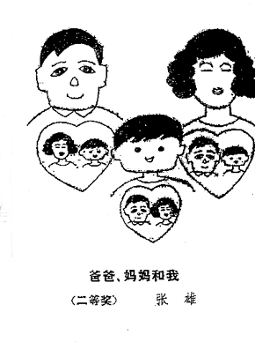
TASK: In your groups look at both of the posters. Work together to annotate both the images by answering the questions below. Write your ideas around each poster.
Describe what the poster shows
What is the message of the poster?
How does it promote the One Child Policy?
DISCUSS: Which poster is more effective and why?

Slide 8


Slide 9
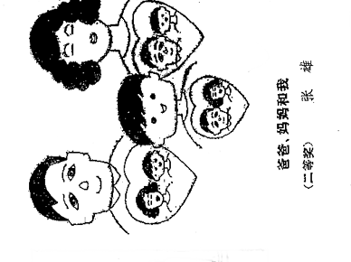

Slide 10
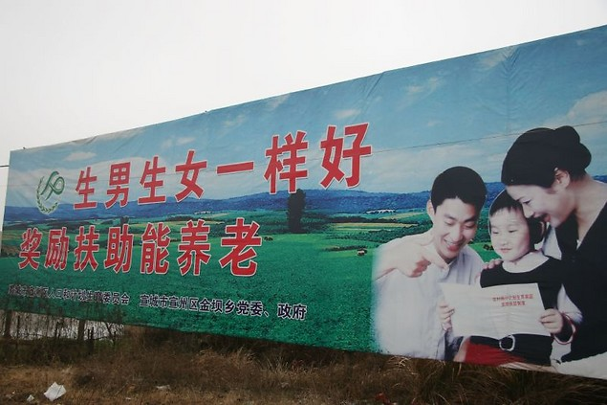

Slide 11


Slide 12
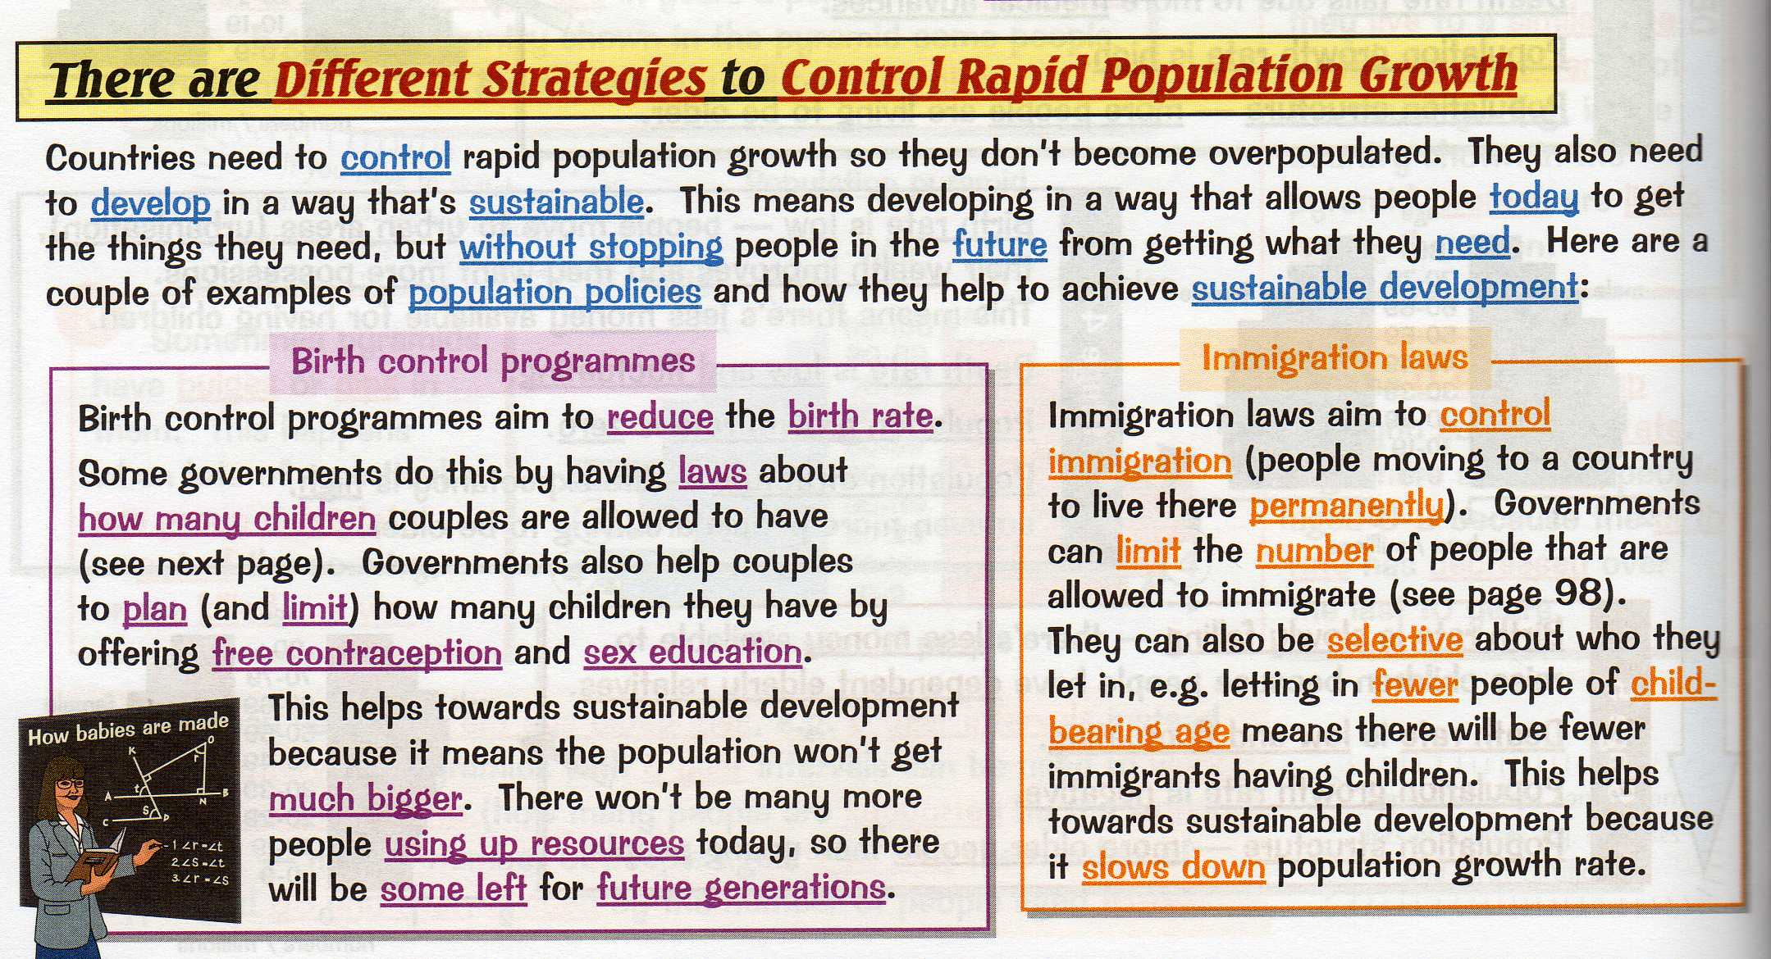

Slide 13



What Is Propaganda?
Propaganda is a form of communication that is aimed at influencing the attitude of a community toward some cause or position.
Source: wikipedia.org
Today’s Task
To create a fictitious piece of governmental propaganda promoting the population policy of a named country, it should be / include:
an A3 poster that could be put on display in a public place (bus/rail station)
information about the policy
benefits of the policy for both the individual and the country
the consequences of not complying with the policy
completed for display
don’t rush, this is a piece of art that can be very powerful

Slide 14


Guess The Flags?
Research about the different population policies of Estonia and Iran.
Choose one of the countries to create your piece of propaganda about.

