Slide 1
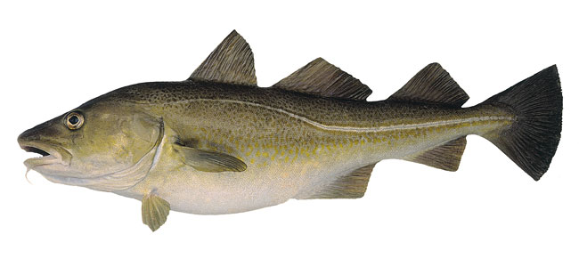
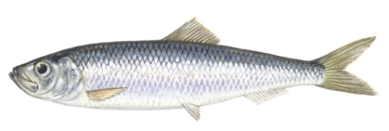
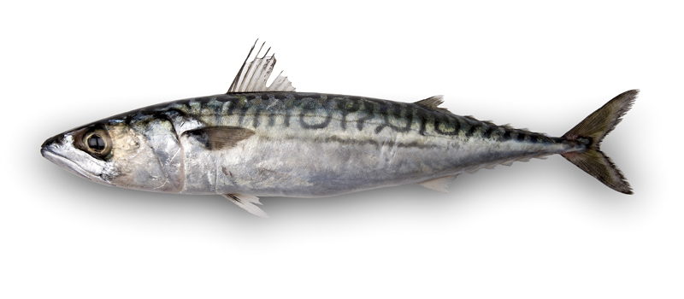
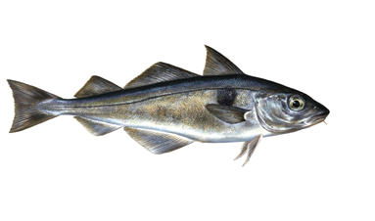
Can you name these fish?
Cod
Herring
Mackerel
Haddock

Slide 2
Fishing
All: Describe the general trend of fish stocks in the North Atlantic Ocean since 1963 (C grade)
Most: Suggest reasons for depleting fish stocks (B grade)
Some: Justify methods used to help fish stocks recover (A grade)

Slide 3
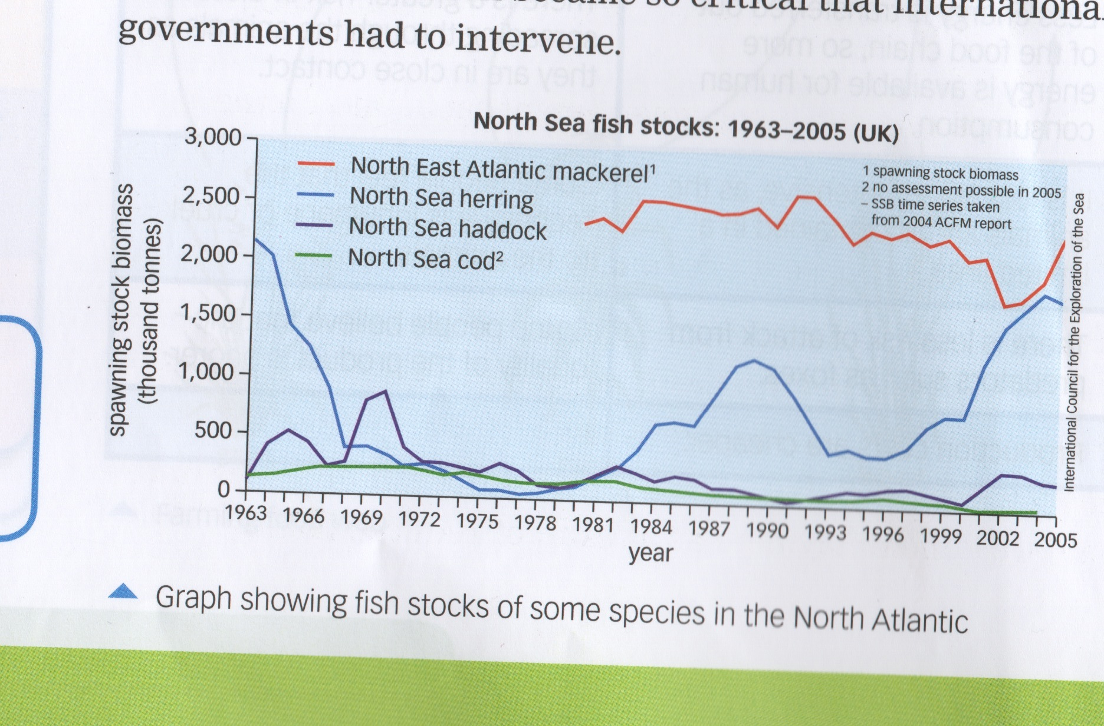
1. The graph shows the fish stocks of some species in the North Atlantic. Describe what happened to the herring population between 1963 and 2005
2. Which fish species is the most at risk from overfishing and why do you think this is?
All: Describe the general trend of fish stocks in the North Atlantic Ocean since 1963 (C grade)

Slide 4
Think, pair, share. Look and think about the following pictures and photos. Why do you think certain fish stocks in the ocean are decreasing?

Slide 5
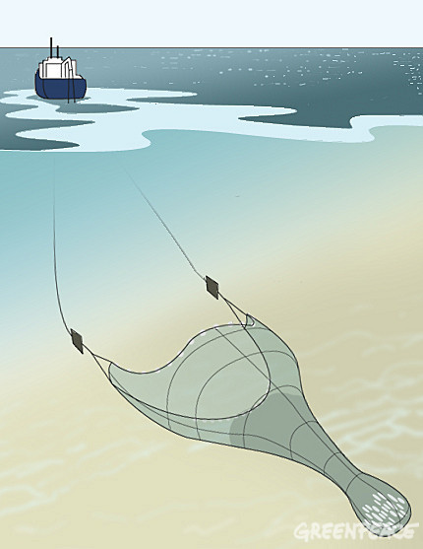
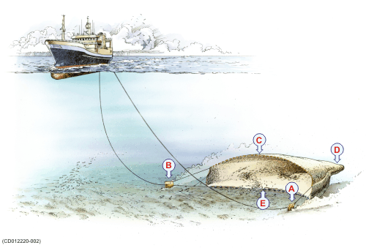
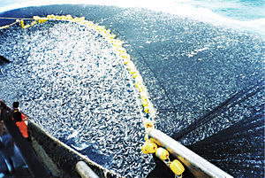
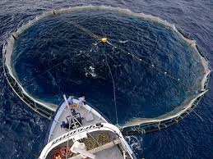
Why do you think certain fish stocks in the ocean are decreasing?
Reason 1

Slide 6
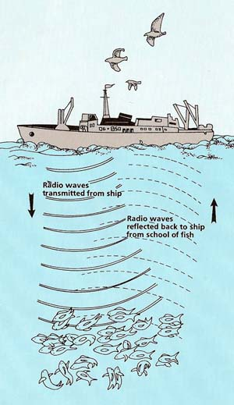
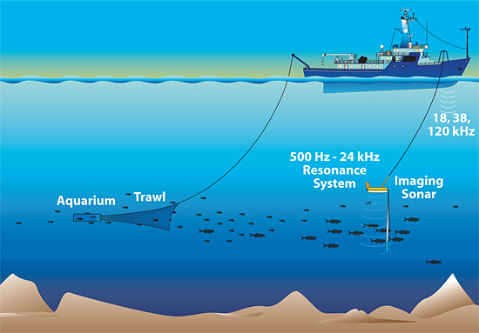
Why do you think certain fish stocks in the ocean are decreasing?
Reason 2

Slide 7
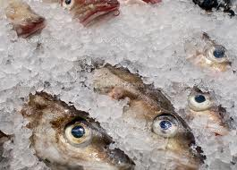
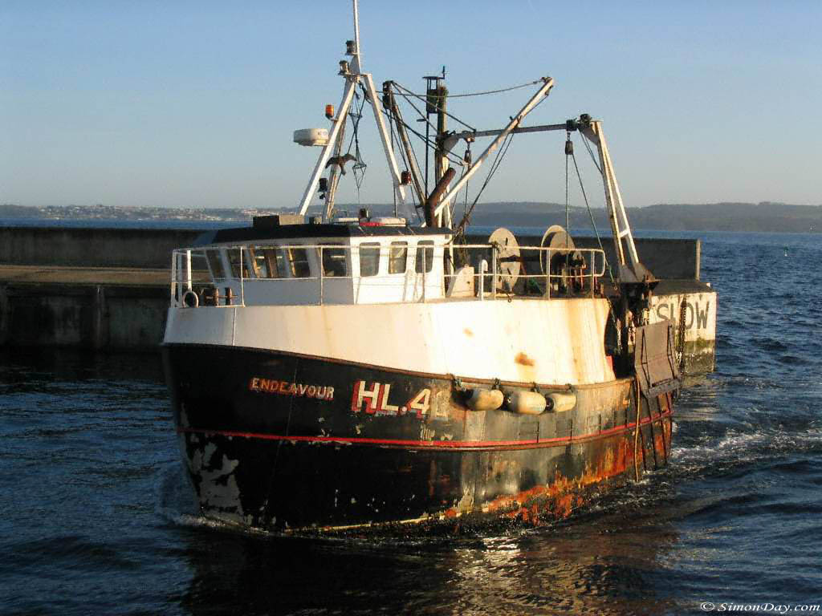
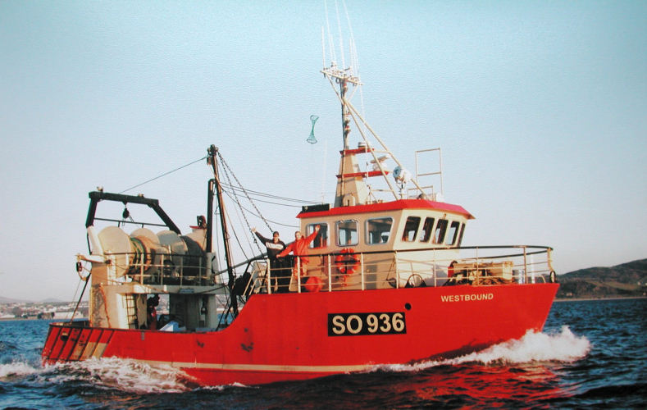
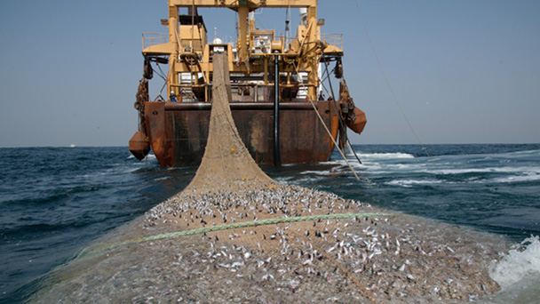
Why do you think certain fish stocks in the ocean are decreasing?
Reason 3

Slide 8
Why do you think certain fish stocks in the ocean are decreasing?
Reason 4

Slide 9
Think, pair, share. Look and think about the pictures and photos. Why do you think certain fish stocks in the ocean are decreasing?

Slide 10
Fish stocks in our oceans are decreasing / decreased due to:
Higher demand for seafood
Overfishing
Better technology - we became too efficient
sonar to locate fish
Sophisticated net designs to prevent fish escaping
Well-designed boats to travel long distances and store the fish
Most: Suggest reasons for depleting fish stocks (B grade)
Notes:
http://www.tes.co.uk/teaching-resource/Mauritania-s-Risky-Catch-6229515/ - overfishing in mauritannia
http://www.youtube.com/watch?v=XHMYT-bDqKQ – bit boring but UK trawler in 1960s
http://www.youtube.com/watch?v=u5uzbd05NzQ – big catch
http://www.bbc.co.uk/learningzone/clips/why-have-fish-stocks-decreased-in-the-north-sea-pt-2-2/4688.html – bbc clips overfishing video

Slide 11
Protecting fish stocks – Justify the effectiveness (give reasons for) each strategy
Net size – holes in the net were increased
………………………………………………………………………………………………………………………………………………………..
Fishing quotas – governments set limits on how much fish species can be caught
………………………………………………………………………………………………………………………………………………………..
Smaller, younger fish can escape, survive and breed – allowing population to recover
Less endangered fish are removed from the ocean – this allows population to recover
Some: Justify methods used to help fish stocks recover (A grade)
Notes:
http://www.tes.co.uk/teaching-resource/Mauritania-s-Risky-Catch-6229515/ - overfishing in mauritannia
http://www.youtube.com/watch?v=XHMYT-bDqKQ – bit boring but UK trawler in 1960s
http://www.youtube.com/watch?v=u5uzbd05NzQ – big catch
http://www.bbc.co.uk/learningzone/clips/why-have-fish-stocks-decreased-in-the-north-sea-pt-2-2/4688.html – bbc clips overfishing video

Slide 12
To finish off…
Some: Justify methods used to help fish stocks recover (A grade)
At the start of this lesson you described the general trend of North Atlantic herring.
This answer is now worth 6 marks
Suggest and explain reasons for the changes in the fish stock between 1963 - 2005
The herring stocks rapidly decreased from about 2,200 thousand tonnes to less than 500 thousand tonnes between 1963 and 1967.
The Herring were overfished nearly to the point of extinction but around 1978 the population steadily recovered to around 1200 thousand tonnes. There was another decrease in 1990 but this began to rise again in 1996 until 2005.

Slide 13
1. The graph shows the fish stocks of some species in the North Atlantic. Describe what happened to the herring population between 1963 and 2005
The herring stocks rapidly decreased from about 2,200 thousand tonnes to less than 500 thousand tonnes between 1963 and 1967.
This could be due to the increase in technology of fishing trawlers such as sonar to detect the fish, advanced nets with small holes so that smaller fish cannot escape, that could be dragged along the sea bottom catching huge quantities of fish. The boats became bigger, the crew could live for long periods of time at sea and they had freezers to store the fish for longer.
The Herring were overfished nearly to the point of extinction but around 1978 the population steadily recovered to around 1200 thousand tonnes. There was another decrease in 1990 but this began to rise again in 1996 until 2005.
The population recovery could be due to national governmental schemes to conserve the fish and make fishing more sustainable. For example, the holes in the net now have to be a certain size so that smaller, younger fish can escape and breed. There are also fishing quotas put in place which meant fewer herring were allowed to be caught allowing the population to recover.

