Slide 1
Skills

Slide 2
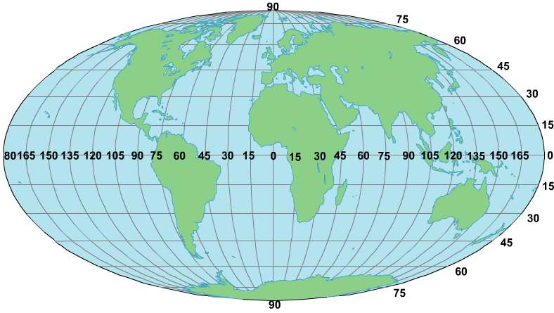
Latitude and longitude
A system of lines is used to find the location of any place on the surface of the Earth.
Lines of latitude run in an east-west direction. Lines of longitude run in a north-south direction.

Slide 3
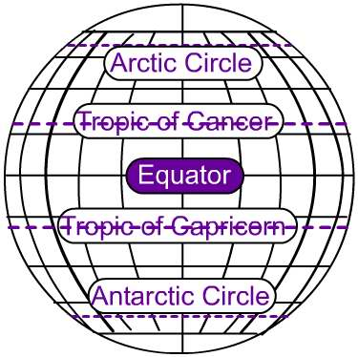
Latitude
Latitude (shown as a horizontal line) is measured in degrees north or degrees south of the equator, which is the line around the exact middle of the earth.
Lines of latitude are often referred to as parallels.
Tropic of Cancer (23° 30'' N)
Tropic of Capricorn (23° 30'' S)
Arctic Circle (66° 30'' N)
Antarctic Circle (66° 30'' S)
Notes:
You may want to discuss minutes and seconds.
Degrees of latitude and longitude can be divided into sixtieths, or minutes ('). Any location on Earth can be described as lying at a certain number of degrees and minutes of latitude either north or south of the equator and at a certain number of degrees and minutes of longitude either east or west of the prime meridian. For example, the United States Capitol in Washington D.C. is at 38 degrees 53 minutes north latitude (38° 53' N.) and 77 degrees 0 minutes west longitude (077° 00' W.). Minutes of latitude and longitude can be divided into sixtieths, or seconds ("), when more precise information on the location of a place is needed, for example, by navigators, surveyors, pilots, or map makers.

Slide 4
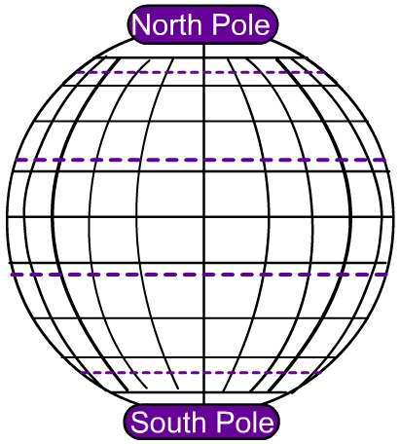
Latitude
There are 89 such equally spaced lines of latitude to the north of the equator and 89 to the south. Where the 90th east-west lines would be are two points – the North and South poles.
Each east-west line is a circle. The further it is from the equator the shorter its length. The 60th east-west line, for example, is only half as long as the equator!

Slide 5
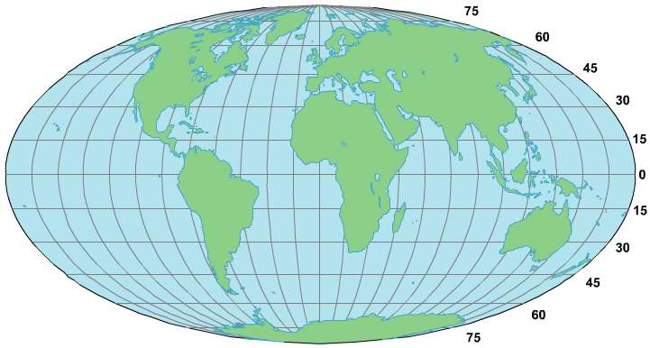
Latitude
North Pole
Equator
South Pole

Slide 6
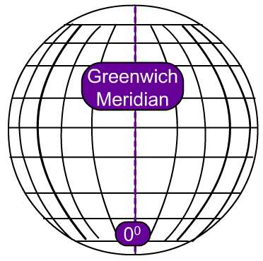
Longitude
Longitude (shown as a vertical line) is measured in degrees east or west of something called the Prime Meridian. This is the line going from the North Pole to the South Pole and running through the middle of the Greenwich Observatory in London.
Lines of longitude are often referred to as meridians.
Notes:
You may want to discuss how longitude came to be calculated.
The invention of clocks during the Renaissance was the first step toward the reliable calculation of longitude. The clocks of that era, however, were too inaccurate for use in navigation. In 1714 the British Board of Longitude offered a large cash prize to anyone who could build a clock that would meet certain standards of accuracy throughout long ocean voyages. By 1735 John Harrison, a British clockmaker, had submitted the first of several clocks, the last of which won the prize for him. They were called chronometers. In 1766 Pierre Le Roy, a Frenchman, built a chronometer more accurate than Harrison's. From that time on, sailors have been able to determine longitude accurately by comparing local time with Greenwich mean time (GMT). Shipboard chronometers are set to show GMT. Because of the speed and direction of the Earth's rotation, local time at a given place will be one hour behind GMT for every 15 degrees west of the prime meridian and one hour ahead of GMT for every 15 degrees east of the prime meridian. For example, if a ship's chronometer reads 0300 (3:00 AM) and the ship's local time is 0800 (8:00 AM), the ship is 75 degrees east of Greenwich, or at 75° E. Special radio time signals allow navigators to check the accuracy of their chronometers.

Slide 7
Why is the Prime Meridian in Greenwich?
Britain was a world leader in exploration and map making. Thus navigators of other nations often used British maps. As a result, in 1884 the meridian of Greenwich was adopted throughout most of the world as the prime meridian.

Slide 8
Why is the Prime Meridian in Greenwich?
There was still another reason for the selection of the Greenwich meridian as 0 longitude. Travelers must change time by an entire day when they cross the 180th meridian. If this meridian crossed a large country, timekeeping and the establishment of calendar dates would be difficult. But with the Greenwich meridian set at zero, the 180th meridian is near the middle of the Pacific Ocean. It crosses only a small land area in northeastern Asia and divides some island groups in the Pacific.
To avoid differing dates in those areas, the nations of the world established a special line across which dates change. It swerves from the 180th meridian whenever convenient. This line is called the International Date Line.

Slide 9
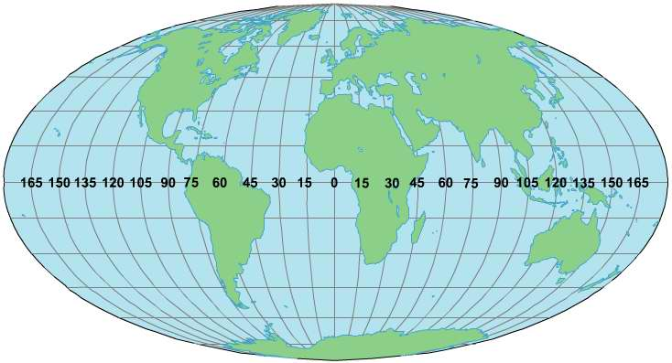
Longitude
Greenwich Meridian
International Date Line at 180º

Slide 10
Latitude and longitude

Slide 11
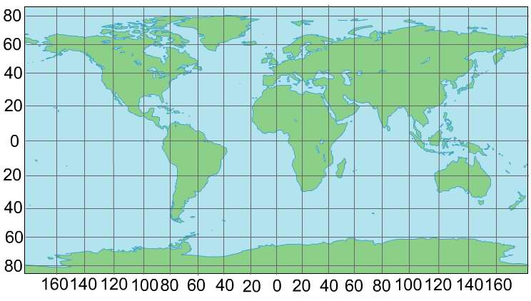
Latitude and longitude
N
These are lines of latitude
ALWAYS write these first
a
These are lines of longitude
The latitude of ‘a’ is 20ºS…’a’ is 20º south of the Equator.
The longitude of ‘a’ is 20ºW…’a’ is 20º west of the Greenwich Meridian.
Therefore we write the latitude and longitude of ‘a’ as 20ºS 20ºW.

Slide 12
Latitude and longitude
Mark these coordinates on your map
20ºS 140ºE
28ºS 20ºE
30ºN 90ºE
40ºN 120ºW
30ºS 80ºW

Slide 13
Latitude and longitude
Match the places with the correct latitude and longitude.
20ºS 140ºE
2
4
5
28ºS 20ºE
1
30ºN 90ºE
5
2
3
1
40ºN 120ºW
4
30ºS 80ºW
3
Notes:
Answers appear on mouse click.

Slide 15
Latitude and longitude
b
c
e
f
a
d
g
Write down the latitude and longitude of these places.

