Slide 1
http://www.youtube.com/watch?v=oNDjL_q7kHU&safe=active

Slide 2
LOA – What factors create water ‘pressure points’
LOB – Examples of future conflicts (international, regional and local)
LOC – To what extent is conflict likely?
LOA – 5-10mins
Discuss the factors that create pressure points and hot sports from using the Venn diagram on slide 4. Students to copy a rough version into their books and make notes
LOB 30mins – read through and discuss potential for water conflicts in the future and where they are likely to happen. Students should also read about the Nile as an example and Cochabamba to get a large and small scale conflict. Students then work in pairs to add on conflict information to their A3 map (slide 7). Students will need laptop access for this (if not, set for HWK and ask students to just label on the main hotspot areas). If there is time students should share information on conflict (if not, set for HWK)
LOC 10mins – discuss the likelihood of conflict in the future. Students to post it note their opinion onto the opinion line. Read through the rest of the information from slide 11 and look through the exam question that will be their HWK.
HWK – finish A3 conflict research poster and do exam practice question.

Slide 3
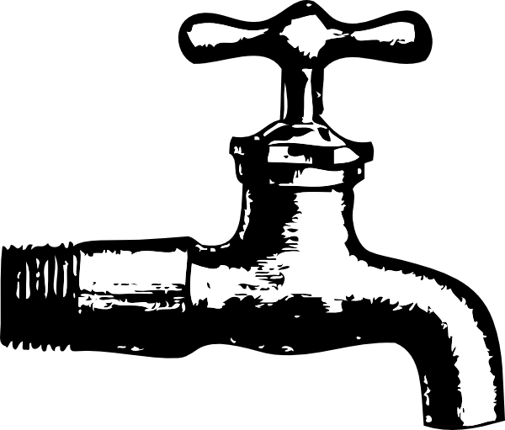
Water conflicts in the future?
Aims
LOA – What factors create water ‘pressure points’
LOB – Examples of future conflicts (international, regional and local)
LOC – To what extent is conflict likely?

Slide 4
Water Conflicts Impacts
Population growth
Consumer demand
Industrial growth
Agricultural demand
Reductions because of:
Users abstracting/polluting upstream
Deteriorating quality
Impact of climate change
DEMANDS?
Rising
SUPPLY?
Diminishing
PRESSURE POINT- i.e. need for management.
This is shown spatially as a ‘hotspot’ of conflict, see map on next slide.
Pressure and hence tension and conflict may be over surface flow and/or groundwater supplies
Dams and diversions and loss of wetlands are particularly contested.
DIFFERENT USERS ?
Conflicting demands
International conflicts i.e. basin crosses national boundaries
Internal conflicts i.e. within a country
Conservation versus exploitation

Slide 5
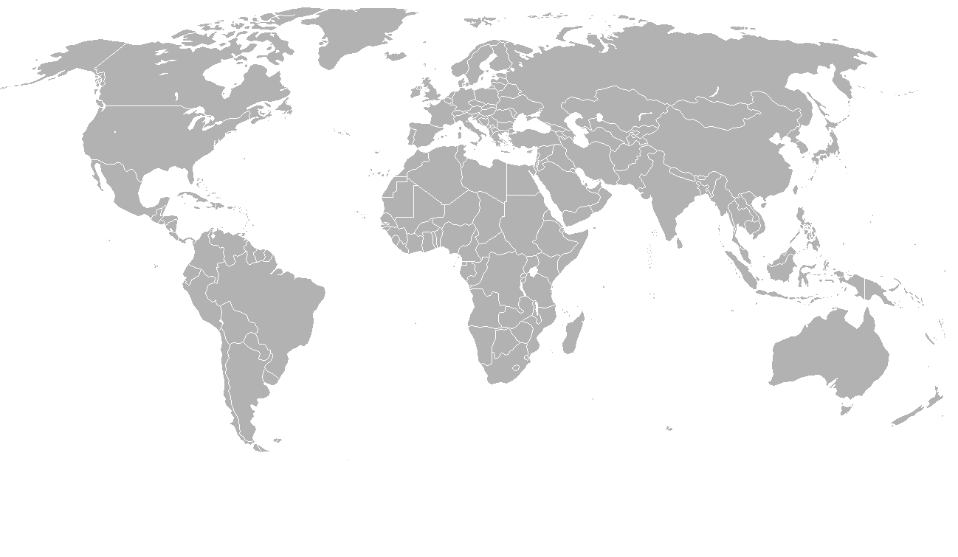
Present and potential water conflict hotspots
As water supply decreases, tensions will increase as different players try to access common water supplies
Many conflicts are transboundary in nature, either between states or countries
 | River basins currently in dispute
 | River basins at risk in the future
 | Large International drainage basins
Tigris-Euphrates
Iraq + Syria concerns that Turkey’s GAP project will divert their water
Colorado: disputes between the 7 US states and Mexico it flows through. The river is so overused, that it no longer reaches the sea!.
90% abstracted before reaches Mexico
Ob
The Aral Sea, an inland drainage basin, once the world’s 4th largest inland lake has shrunk since the 1950s after the 2 rivers feeding it: the Amu Dayra and Syr Darya were diverted for irrigation.
By 2007 the sea was 10% of original volume and split into 2 lakes. The ex soviet states are in conflict: Uzbekistan , Turkmenistan and Kazakstan.
Lake Chad
Mekong
Ganges
Insert Figure 2.11 page 47
Okavango
Zambezi
La Plata
Orange
Note: although there have been rising tensions globally, many areas demonstrate effective management to diffuse the situation and create more equitable and sustainable demand-supply balance, such as the Mekong River Committee,& the Nile River Initiative
Nile hotly disputed between Ethiopia and Sudan ,who control its headwaters, and Egypt .

Slide 6
Hydropolitics and Geopolitics
Political negotiations centred on conflicts over the shared use of water sources
History of hydropolitics in Nile Basin
tensions due to the dominance of Egypt
civil wars in Sudan Ethiopia
tensions from Egypt’s treaties dating back to the 1929 and 1959 Nile Water Agreements.
Upstream states increasingly challenging Egypt’s dominance.
Ethiopia wants to use the Nile River for HEP plants and industrial development.
The Nile is the world’s longest river , 6,500kms, 2.9km2 catchment,10% of Africa, running through 10 countries with 360 million people depending on it for survival.
Growing issues of desertification & salination and increased evaporation linked to climate change
About 85 % water originates from Eritrea and Ethiopia, but 94 % is used by Sudan and Egypt.
Evidence of more effective co-operation
The Nile Basin Initiative, system of cooperative management which started late 1990s
All countries except Eritrea working with The World Bank and bi-lateral aid donors .
Community level involvement .
Managers visited Colorado River recently to see how effectively the 1922 River Water Compact and its ‘law of the river’ works
Tech Fix ;
The megaprojects of dams like Aswan are famous.
Latest high tech is the 1990sproject called ‘Tecconile’ a joint GIS system to help monitor and plan the basin
1996 Helsinki Rules on the Uses of the Waters of International Rivers - regulating how transboundary rivers and groundwater are managed
The Nile Basin is an example that ‘Water Wars’ may be averted

Slide 7
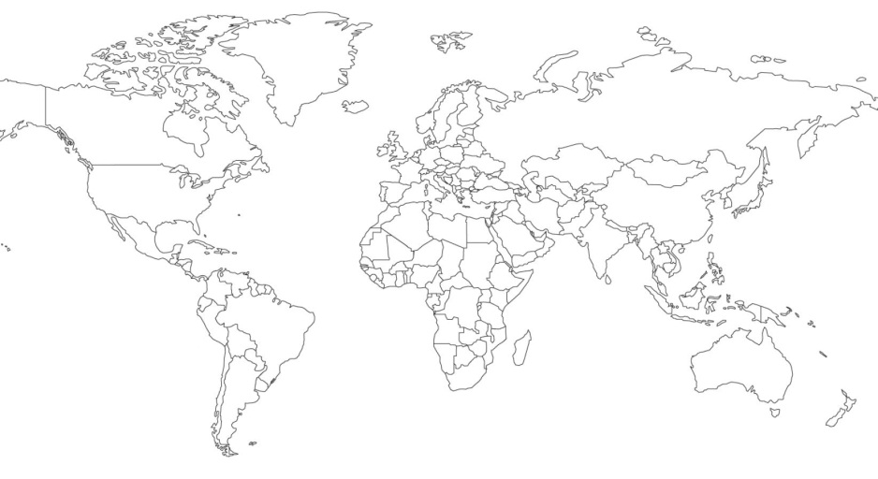
Water Hotspot
Task: Read through the information sheet on the water conflicts. You will then annotate the world map detailing the key causes and impacts of the water conflict in the ___ areas. Important things to note; causes, impacts (social, economic, environmental), players.
CHALLENGE: future (solutions)
Notes:
Create a hotspot map poster

Slide 8
Present and potential water conflict hotspots
As water supply decreases, tensions will increase as different players try to access common water supplies
Many conflicts are transboundary in nature, either between states or countries
 | River basins currently in dispute
 | River basins at risk in the future
 | Large International drainage basins
Tigris-Euphrates
Iraq + Syria concerns that Turkey’s GAP project will divert their water
Colorado: disputes between the 7 US states and Mexico it flows through. The river is so overused, that it no longer reaches the sea!.
90% abstracted before reaches Mexico
Ob
The Aral Sea, an inland drainage basin, once the world’s 4th largest inland lake has shrunk since the 1950s after the 2 rivers feeding it: the Amu Dayra and Syr Darya were diverted for irrigation.
By 2007 the sea was 10% of original volume and split into 2 lakes. The ex soviet states are in conflict: Uzbekistan , Turkmenistan and Kazakstan.
Lake Chad
Mekong
Ganges
Insert Figure 2.11 page 47
Okavango
Zambezi
La Plata
Orange
Note: although there have been rising tensions globally, many areas demonstrate effective management to diffuse the situation and create more equitable and sustainable demand-supply balance, such as the Mekong River Committee,& the Nile River Initiative
Nile hotly disputed between Ethiopia and Sudan ,who control its headwaters, and Egypt .
Which type of countries have the most water conflicts?

Slide 9
Notes:
June 2010

Slide 10
Using named examples, assess the potential for water supply to become a source of conflict. (15 Marks)
A range of examples for different reasons
No grammar or spelling errors. Fully geographic terminology
Clear and genuine assessment on severity and likelihood of conflict
A range of examples (3 or more)
Link made between water supply problems and conflict
Begins to assess how likely a conflict is or how severe it may be
Could they lead to water wars?
What could potentially reduce the risk of war?
Describes two examples , not fully focussed on the conflict
Clear explanations but a few mistakes
Large scale conflict and small scale conflicts
Conflict doesn’t only mean wars – it could be debate.
Two Named Examples
No paragraph or structure
Simple reasons why a conflict may happen

Slide 11
Privatisation of Water – Cochabamba (2000)
The Cochabamba protests of 2000, also known as the Cochabamba Water War, were a series of protests that took place in Cochabamba, Bolivia's third largest city, between December 1999 and April 2000 in response to the privatisation of the city's municipal water supply company Semapa. The new firm, Aguas del Tunari – a joint venture involving Bechtel and Suez Lyonaise – was required to invest in construction of long-envisioned dam (a priority of Mayor Manfred Reyes Villa) - so they dramatically raised water rates.
This move was supported by the IMF and World Bank as they considered it an option to promote economic growth which they considered impossible with services remaining in government control.
In February and March of 2000, protests broke out in Cochabamba, Bolivia, in response to the skyrocketing price of water. Many people saw their bills triple or even quadruple, just weeks after Aguas del Tunari, a private company owned by London-based multinational International Water Ltd., took over the city’s water system.
For thousands of families, the rate hike meant up to half of their monthly income went to paying for water. Unable to survive under these conditions, the citizens demanded that the water contract be terminated. After suffering civil rights abuses, injuries and even death at the hands of the police and military, the protesters were heard and their water rights were restored.
Water wars or cooperation?
In recent years there have been two common statements about the relationship between water and security. The first is that the wars of the future will be about water rather than, say, about oil. Contrariwise, the second is that so far there have been very few international conflicts over water and that shared water resources have more often led to cooperation than conflict.
If the optimism of the second insight vitiates the gloom-laden first, there is sadly some reason to temper that optimism. To begin with, some of the cooperation is between unequal powers and the resulting agreement has been one-sided. In such cases, cooperation masks conflict rather than resolves it.
More importantly, pressure on water resources is likely to grow over the next 40-50 years as the world population continues to grow, urbanisation proceeds apace and more countries, by dint of succeeding with a high growth economic strategy, enter the water-intensive phase of development that China and India are now in.
Water for Peace?
In what is probably the most ambitious survey of water crises and treaties around the world carried out so far, Aaron Wolf (1998) argued that water has brought about much more interstate cooperation than conflict. He analyzed 412 crises among riparian states between 1918 and 1994 and identified only seven cases where water issues contributed to the dispute (Wolf, 1999). Empirical evidence thus seems to corroborate Allan’s proposition.
Ideas to help you answer the exam question

Slide 12
Spare resources

Slide 13
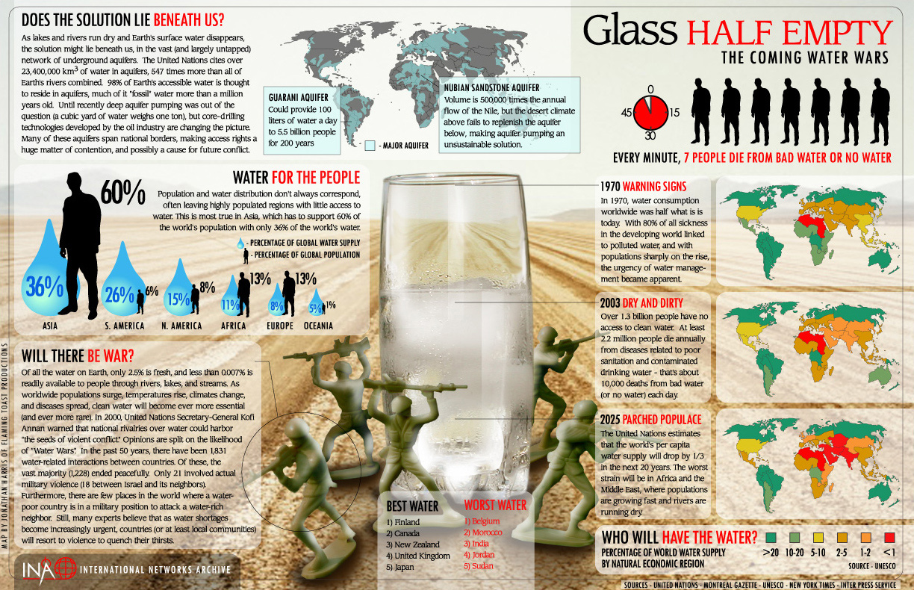

Slide 14
Questions- Answer in full sentences
How much water is fresh?
In the past 50 years how many water related alterations have there been?
How many of these alteration have resulted in violence?
Which countries have more percentage of world population than supply?
Look at the gap between supply and demand for Africa’s water supply and pop and Europe's water supply and pop. What do you notice?
How much water is stored up in aquifers according to the UN?
Name a ‘major’ aquifer other than the Nubian.
Why can the Nubian not be used sustainably?
Where will be the worst strain on water supply?
Which country would you not expect to be in the top 5 worst water countries?

